Slide 1
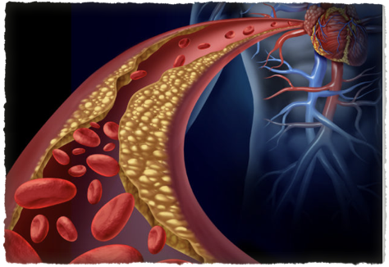
High Risk of Heart Disease
in
South Asians
Tanvir Ahmed MD
https://www.nytimes.com/2019/02/12/well/live/why-do-south-asians-have-such-high-rates-of-heart-disease.html

Slide 2
Are you at high risk?
South Asians (Pakistan India, Bangladesh and other countries in the region) are recently identified as uniquely high risk group for Heart Disease. Men appear to have a higher risk than women
South Asians have a four times greater risk of heart disease than the general population and have a much greater chance of having a heart attack before age 50.
Heart attacks strike south asian men and women at younger ages and the attacks are more deadly compared to any other ethnic group
Almost one in three in this group will die from heart disease before age 65.

Slide 3

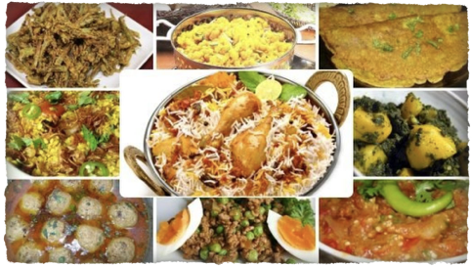
Why are we a High Risk Group
Smoking and Diet
South Asians tend to be smokers !!!
Typical South-Asian diet tends to be high in sugar, refined grains, and fatty foods

Slide 4
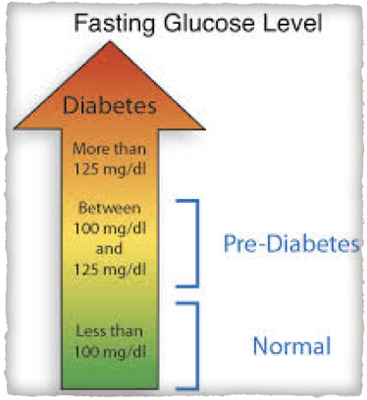
Why are we a High Risk Group
Pre-Diabetes
Pre-Diabetic. An alarming number of South Asians appear to be insulin resistant, a pre-diabetic condition in which the body does not process insulin efficiently
Insulin-resistant and diabetic patients are at EQUAL HIGH RISK for heart disease

Slide 5
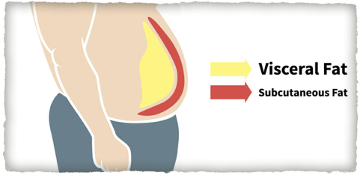
Why are we a High Risk Group
Thin Fat Syndrome
THIN FAT SYNDROME. Body mass index (BMI) in South Asians often falls into a Thin-fat syndrome
People may have an acceptable BMI (25 or less), but they also carry more of their weight in their abdomen and that visceral fat is more likely to lead to a cardiovascular event (Heart Attack etc.)

Slide 6
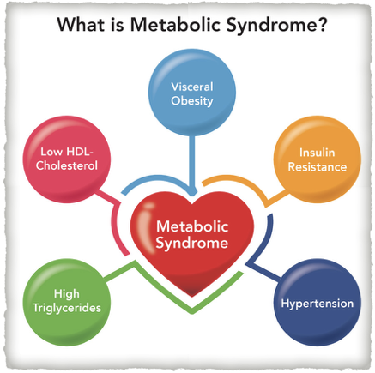
Why are we a High Risk Group
Metabolic Syndrome
More than 1/3rd of South Asian men and 17% of South Asian women have metabolic syndrome;
Metabolic syndrome is a cluster of conditions
High blood pressure
High blood sugar levels
Excess body fat around the waist
Abnormal cholesterol levels that increase the risk of heart disease, stroke and diabetes
If more than one of these conditions occur in combination, the risk is even greater

Slide 7
What can I do to Reduce My Risk
Knowledge is Power. Becoming aware of your risk at an early age is an important first step
Family history. The most important risk factor is often a family history of diabetes, high cholesterol, or heart disease, all of which are highly prevalent in South Asian families.
Regular Exercise and eating heart-healthy foods will also contribute to lowering your heart disease risk
No Smoking Vaping or any type of tobacco products

Slide 8
What Options do I have
Talking with a doctor knowledgeable about this type of heart disease will help.
It begins with education to help you and your family understand your personal risk of heart disease
Your Screening may be started earlier than in the traditional population
A dietitian can provide a detailed analysis of your dietary habits
You may be prescribed cholesterol- and blood pressure-lowering medications, as well as medications to control pre-diabetes
If active coronary disease is found, a cardiologist will need to be consulted
There are many specialized centers around the country to help

Slide 9
Symptoms of Heart Disease
You should be evaluated for cardiovascular risk and disease if you are having
Chest pain
Chest pressure
Shortness of breath when climbing stairs, walking uphill or on flat ground
Some patients have atypical symptoms
Seek care if you are concerned

Slide 10


