Slide 1

Majlis Ansarullah
Monthly Meeting
January 2019
This slide deck contains images licensed for the purpose of this presentation only.
No one is permitted to use the images for any other use, without prior permission.

Slide 2
AGENDA
Recitation of the Holy Qur'an (Verse 22:31)
Pledge
Did you know?
Sermon of the month: Attributes of True Ahmadi: Avoiding shirk (associating partners with Allah) both obvious and hidden (November 2, 2018)
Health Tip
Reminders/announcements
Du'a

Slide 3
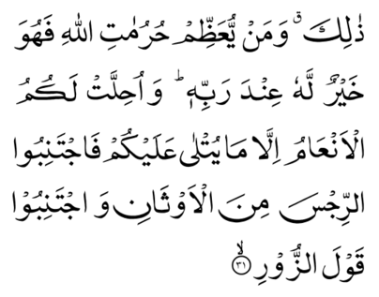
Recitation of Holy Qur'an
[22:31] That is God’s commandment. And whoso honors the sacred things of Allah, it will be good for him with his Lord. And cattle are made lawful to you but not that which has been announced to you. Shun therefore the abomination of idols, and shun all words of untruth.

Slide 4

Ansar Pledge
Say this part three times:
Ash-hadu • alla ilaha • illallahu • wahdahu • la sharika lahu • wa ash-hadu • anna Muhammadan • ‘abduhu • wa rasuluh
Say this part once:
I bear witness • that there is none worthy of worship • except Allah. • He is One • (and) has no partner, • and I bear witness • that Muhammad (peace be upon him) • is His servant • and messenger.
Say this part once:
I solemnly pledge • that I shall endeavor • throughout my life • for the propagation • and consolidation • of Ahmadiyyat in Islam, • and shall stand guard • in defense of • the institution of Khilafat. • I shall not hesitate • to offer any sacrifice • in this regard. • Moreover, • I shall exhort my children • to always remain dedicated • and devoted • to Khilafat. • Insha’allah.

Slide 5
Did you know?
In what year was the formation of Majlis Ansarullah was announced by Hazrat Khalifatul-Masih II (may Allah be pleased with him) during Friday sermon?
Who was the first Sadr Majlis of Majlis Ansarullah?
What is the official name of Majlis Ansarullah USA?
At what age does one become a member of Majlis Ansarullah?
What is the golden age that separates Saff Awwal and Saff Dom? (Awwal and Dom mean first and second respectively.)

Slide 6
Answers
The Friday sermon was given on July 20, 1940.
The first Sadr was Maulana Sher Ali Sahib. He was appointed by Hazrat Khalifatul-Masih II (may Allah be pleased with him).
The official name is “Majlis Ansarullah Silsila Aliya Ahmadiyya USA.”
Every male Ahmadi above 40 is a member of the Majlis.
Divided into Saff Awwal (over age 55) and Saff Dom (40-55).

Slide 7
Avoiding shirk (associating partners with Allah) both obvious and hidden
Friday Sermon, November 2, 2018
Friday Sermon

Slide 8
1. Being an Ahmadi by birth or accepting Ahmadiyyat by taking Bai’at does not suffice for one to become a true Ahmadi. Concerted effort is mandatory to follow all the practices expected of an Ahmadi.
2. For spiritual progress one has to forsake one’s ego and selfishness. A Bai’at, tainted with conceit, is of no use at all.
3. The companions of the Holy Prophet (peace and blessings of Allah be on him) overcame years of animosity for the sake of their faith. By doing that they forsake all forms of overt and covert Shirk.
4. Revering and worshipping worldly resources are a form of Shirk. The worldly benefit, for which a person neglects and discards the commandments of faith and God Almighty, becomes his worldly god.
5. By discarding a religious command to fulfil a worldly desire one becomes guilty of Shirk.
6. Falsehood is an idol and by adopting falsehood a person removes his faith in God. Hence, by telling lies, one also loses God.
Synopsis of the Sermon

Slide 9
Open Discussion Question
As a Nasir, which aspect of this Friday sermon, can I benefit the most from?
Share your thoughts!

Slide 10
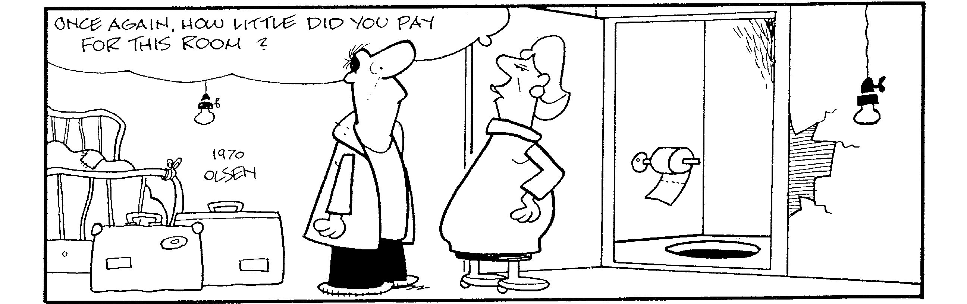
Discussion Scenario 1
You were finally able to make arrangements to go to UK for Jalsa with your wife and three children. You did not have any relatives in UK and were trying to make accommodation arrangements considering your tight budget. You found a great deal for a hotel room. Unfortunately, they only allowed 4 people in the room. For any more, you had to get another room.

Slide 11
How would you respond?
Book another room.
Look for another hotel.
Make sure they don’t find out and use the same room.
Any other response?

Slide 12
How would your response change if?
(Consider each separately.)
… You have really young children (can easily squeeze the kids in one bed).
… The hotel is full (no other rooms available).
… Other Jama’at members told you: “It’s okay– the hotel staff doesn’t care.”
… Other hotel options are much further away; would require rental car and other expenses.
Za'im Sahib, please email qaid.tarbiyat@ansarusa.org if you or any member has any question or concern.

Slide 13
Guidance from Friday Sermon
When taking Bai’at, a true Ahmadi pledges to avoid all forms of overt and covert Shirk. What is overt Shirk? Elaborating on this, the Promised Messiah (as) states, “… worshipping resources and revering worldly gods are also forms of Shirk. What is meant by worldly gods? These are worldly benefits, for which a person neglects and discards the commandments of faith and God Almighty. If a person discards a religious command to fulfill a worldly desire, he becomes guilty of Shirk…”
There are some who lie even in trivial matters. This does not behoove a believer. One should not come under the impression that small inaccurate statements are not lies. They most certainly are lies and take one far away from Tauhid [Unity of God].

Slide 14
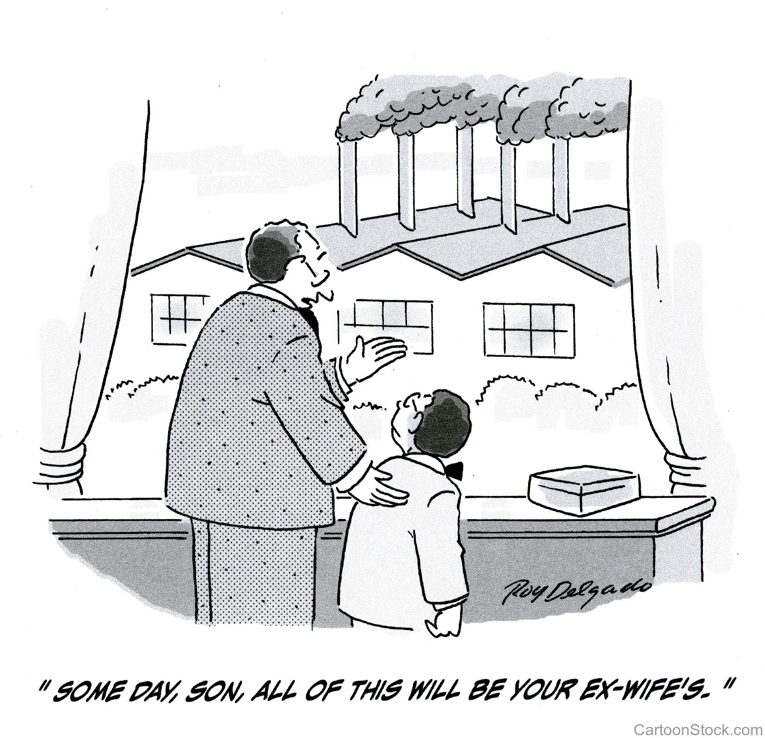
Discussion Scenario 2
A Nasir’s daughter was in a marital dispute. Despite attempts at reconciliation, nothing seemed to be working. Both he and his wife believed that their son in-law was at fault. The case went to the Jama’at Qadha system. The decision went in favor of the son in-law. The Nasir was extremely upset.

Slide 15
How would you respond?
Accept the decision as it is and pray to Allah for his daughter.
File an appeal to the Qadha system as he is convinced that the decision was incorrect.
Seek professional legal advice.
Any other response?

Slide 16
How would your response change if?
(Consider each separately.)
… One of the Qadha Board members is a cousin of his son in-law’s father.
… His daughter has two young children.
… His daughter was physically abused.
… The decision was upheld by both the appeals system and Hazrat Khalifatul-Masih.
Za'im Sahib, please email qaid.tarbiyat@ansarusa.org if you or any member has any question or concern.

Slide 17
Guidance from Friday Sermon
Thus, we will only fulfill the purpose of being an Ahmadi when we realize this truth and strive to attain it with all our faculties. The Promised Messiah (as) says: “Showing obedience is not a small matter or one that is easy to demonstrate. This requires a death on one’s part. Whosoever does not show complete obedience seeks to malign this community.” The Promised Messiah (as) further says: “I have advised my community on numerous occasions that one should not rely on the mere verbal proclamation of your pledge of allegiance. Until one understands the reality of the Bai’at, they cannot attain salvation.”

Slide 18
What to discuss with your family?
Pick one of the following topics from this Friday sermon to discuss with children/family during casual discussion:
  What are the various forms of hidden Shirk, how can we identify them and avoid to the best of our ability?
  How do we build trust in Allah the Almighty?
  How can we strengthen the Nizam-e-Jama’at (system of the Jama’at)?
Tips to engage youth in conversation: (1) Give them more talking time, and (2) use examples from Huzur’s (aba) sermon to make a point.

Slide 19
To-do list
Make a pledge to avoid any form of shirk in your life and avoid all types of falsehood, Insha’allah.
Take time with your wife to reflect on your habits. Ask: “Are we cutting corners where we shouldn’t be?”
Pair up with another Nasir to review your annual income and Chanda calculation.
Learn the basics of the system of Qadha in Jama’at (ahmadiyya.us/departments/qadha-a)
Email qaid.tarbiyyat@ansarusa.org if you have a different idea.

Slide 20
Walking with a Purpose
Health tip
Walking 30 minutes a day, 4-days a week cuts your risk of Diabetes by up to 60%.
Walking 30 minutes a day can reduce your risk of heart attack.
Walking 30 minutes a day reduces your blood pressure.
Walking improves Cancer Survival (Prostate & Breast Cancer).
Walking 20 minutes a day can burn 7 lbs of body fat in one year.
Walking is great exercise for bone health and reduces joint stress.
Walking has been shown to reduce stress and anxiety.
It is great tool that augments your creativity and improves sleep.

Slide 21
That’s all folks
Reminders/Announcements
Du'a
Jazakumullah for Participating!
If you enjoyed it, please convey to those brothers who are not here today!

