Slide 1
Majlis Ansarullah
Monthly Meeting
February 2019
This slide deck contains images licensed for the purpose of this presentation only.
No one is permitted to use the images for any other use, without prior permission.
Notes:
Changed date

Slide 2
AGENDA
Recitation of the Holy Qur'an (Verses 29:70, 51:56-57)
Pledge
Did you know?
Sermon of the month: Salat - The path to success and salvation (September 29, 2017)
Health Tip
Reminders/announcements
Du'a

Slide 3
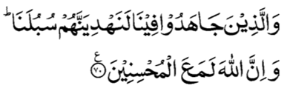

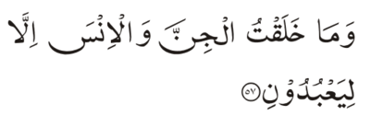
Recitation of the Holy Qur'an
[29:70] And as for those who strive in Our path — We will surely guide them in Our ways. And verily Allah is with those who do good.
[51:56] And keep on exhorting; for, verily, exhortation benefits those who would believe.
[51:57] And I have not created the jinn and the men but that they may worship Me.

Slide 4

Ansar Pledge
Say this part three times:
Ash-hadu • alla ilaha • illallahu • wahdahu • la sharika lahu • wa ash-hadu • anna Muhammadan • ‘abduhu • wa rasuluh
Say this part once:
I bear witness • that there is none worthy of worship • except Allah. • He is One • (and) has no partner, • and I bear witness • that Muhammad (peace be upon him) • is His servant • and messenger.
Say this part once:
I solemnly pledge • that I shall endeavor • throughout my life • for the propagation • and consolidation • of Ahmadiyyat in Islam, • and shall stand guard • in defense of • the institution of Khilafat. • I shall not hesitate • to offer any sacrifice • in this regard. • Moreover, • I shall exhort my children • to always remain dedicated • and devoted • to Khilafat. • Insha’allah.

Slide 5
Did you know?
When was the first time Ansar pledge was recited in Ansar, monthly?
When and were did first Ansar Ijtima take place?
What are the main branches of Majlis Ansarullah?

Slide 6
Answers
First time a pledge was recited in a monthly Ansarullah meeting on 11/30/44.
First Ansar Ijtima took place on 12/25/44 in Masjid Aqsa, Qadian, India.
Organization of Majlis Ansarullah has three bodies:
  Majlis Amma (general membership)
  Majalis Amila (executive bodies)
  Majlis Shura (consultative body)

Slide 7
Did you know?
What are the aims of Majlis Ansarullah?

Slide 8
Answers
  a) To organize all the male Ahmadis above the age of forty years in the Silsila Aliya Ahmadiyya (the Ahmadiyya Jama’at).
  b) To inculcate the following amongst its members:
  1. The love of Allah.
  2. The spirit to promote and propagate the teachings of Islam.
  3. The urge to preach Islam and serve mankind.
  4. The spiritual and moral training of children.
  5. Self-sacrifice.
  6. The spirit of protecting the institution of Khilafat.
  7. The spirit of placing collective interests above individual interests.
  c) It shall purely be a religious organization having no political interest whatsoever.

Slide 9
Salat - The path to success and salvation
Friday Sermon, September 29, 2017

Slide 10
1. Allah the Almighty has emphasized on regularity in Salat, timely observance of all the Prayers in congregation. Ansarullah should pay the most attention towards this.
2. The verse just recited [51:57] necessitates that the highest and utmost form of pleasure and enjoyment should be found in worship.
3. People are heedless and slack in Prayers as they are unaware of the delight and pleasure which Allah the Exalted has placed therein. One who finds no delight in Prayers is considered ill.
4. Pleasure from Salat is attained by being steadfast and regular in Prayers and continue to Pray until one experiences a delight.
5. Recitation of the Holy Qur'an in Salat must be done with utmost attention and ponder over its meaning carefully. And adhere to whatever it states.
6. Pleasure can be derived if Salat is observed with complete attentiveness and supplicated with concentration and repentance.
7. Supplicate to God in seclusion so that God Almighty protects our faith and becomes pleased with us.
Synopsis of the Sermon

Slide 11
Open Discussion Question
As a Nasir, which aspect of this Friday sermon, can I benefit the most from?
Share your thoughts!

Slide 12
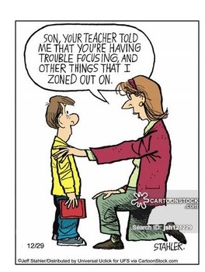
Scenario 1
A Nasir offers Salat on a regular basis; however, it feels like a mere routine. He feels that he can never maintain focus during Salat and has become very disappointed. One day he shared this with you.

Slide 13
How would you respond?
  This is very unusual and he should worry about his faith and say Istighfar.
  This is very common and there is no need to worry as long as he can complete the count.
  He should try to mix in yoga in his daily routine as it improves focus.
  This is not uncommon and he should try to improve focus in Salat by various ways.
  Any other response?

Slide 14
How would your response change if?
(Consider each separately.)
... This is a brother who has not been attending Jama’at activities.
… This brother and you are best friends.
… The standard of your own Salat is weak.
… This brother is a new convert.

Slide 15
Guidance from Friday Sermon
Furthermore, mentioning the reason and solution for why a person does not experience delight in Prayers, the Promised Messiah (peace be on him) says: “I observe that people are heedless and slack in Prayers as they are unaware of the delight and pleasure which Allah the Exalted has placed therein... Upon this, the question arises why they are unaware of this pleasure and have neither experienced it.”
Then with regards to one developing distracting thoughts in Prayers, as one occasionally develops other inclinations during Prayer, the Promised Messiah (peace be on him) states: “Those people who do not focus their attention completely on God Almighty in Prayers are the ones who develop many other thoughts. Observe how when criminal stands before a judge, does he develop any other thoughts in his mind?”

Slide 16
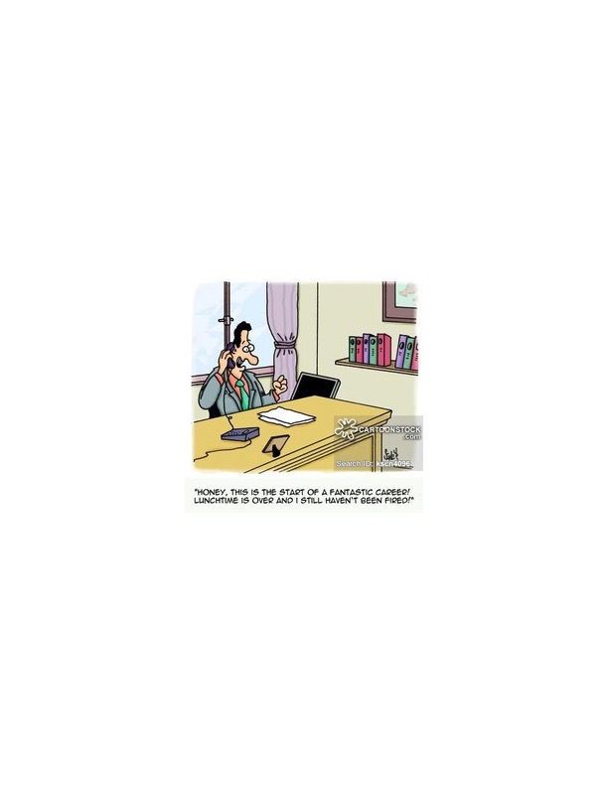
Scenario 2
A Nasir who was jobless for a while finally found a job. While discussing the schedule and pay, he thought about bringing the topic of Jumu’ah break.

Slide 17
How would you respond?
  The Nasir should wait a few months before bringing up this topic as by that time his position will be solidified.
  Say it upfront that unless he gets all Fridays off, he will quit.
  Bring up the topic and provide various options including offering at least two Jumu’ah Salats a month and making up the time.
  Any other response?

Slide 18
How would your advise change if?
(Consider each separately.)
… The nearest Jumu’ah center is an hour away.
… The Nasir regularly offers other Salat at the mosque.
… The brother can still listen to Huzoor’s (may Allah be his helper) sermon live on MTA.

Slide 19
Guidance from Friday Sermon
Then whilst elaborating on the point that a true dignified believer never prostrates to anyone but Allah the Almighty—as one should—and also refrains from making anyone other than Allah the focal point of our attention, the Promised Messiah (peace be on him) states: “Another aspect that I wish to elaborate is that Salat—the likes of which can be truly deemed to be Salat—can only be attained through prayer. To pray to anyone other than God is completely against the honor of a dignified believer because this honor of Prayer is only for God.

Slide 20

What to discuss with your family?
Pick one of the following topics from this Friday sermon to discuss with children/family during casual discussion:
Discuss with your family, the ways to improve Salat at home with emphasis on offering Salat in congregation at the mosque.
Discuss ways to derive pleasure in Salat and build a living connection with Allah the Almighty.
Discuss how Salat can protect from indecency.
Tips to engage youth in conversation: (1) Give them more talking time, and (2) use examples from Huzoor’s (aba) sermon to make a point.

Slide 21
To-do list
To-do list:
I will try to improve all aspects of my Salat and lead by example for my family, Insha'allah.
I will memorize the translation of the Arabic prayers and concentrate on them during Salat.
I will augment my obligatory Salat with Nawafil (supererogatory Prayers).

Slide 22
Health tip
BENEFITS OF CYCLING
Bike riding is easy on Joints compared to jogging. It is particularly beneficial for those with joint pain and stiffness of arthritis.
Great Aerobic Work out which is good for your heart, circulation and brain. Aerobic work out releases endorphins - Chemicals that make you feel good.
Builds Muscles - in your hips, thighs, legs, abdomen and muscles of breathing.
It helps with everyday activities. Improving balance, walking, standing, endurance, and stair climbing - improved strength and balance.
Pedaling builds bone. Pushing pedals, pull on the muscles, and then the muscles pull on the bone, which increases bone density - help prevent osteoporosis, falls, and fractures.

Slide 23
Health tip

Slide 24
That’s all folks
Reminders/Announcements
Du'a
Jazakumullah for Participating!
If you enjoyed it, please convey to those brothers who are not here today!

