Slide 1
Majlis Ansarullah
Monthly Meeting
July 2019
This slide deck contains images licensed for the purpose of this presentation only.
No one is permitted to use the images for any other use, without prior permission.
Notes:
Changed date

Slide 2
AGENDA
Recitation of the Holy Qur’an (Verse 9:18)
Pledge
Did you know?
Sermon of the month: Mosque a house of worship and a source of Tabligh (October 19, 2018)
Health Tip
Reminders/announcements
Du’a

Slide 3
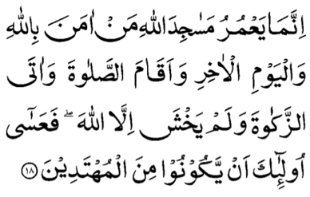
Recitation of the Holy Qur’an
[9:18] He alone can keep the mosques of Allah in a good and flourishing condition who believes in Allah, and the Last Day, and observes Prayer, and pays the Zakat, and fears none but Allah; so these it is who may be among those who reach the goal.

Slide 4

Ansar Pledge
Say this part three times:
Ash-hadu • alla ilaha • illallahu • wahdahu • la sharika lahu • wa ash-hadu • anna Muhammadan • ‘abduhu • wa rasuluh
Say this part once:
I bear witness • that there is none worthy of worship • except Allah. • He is One • (and) has no partner, • and I bear witness • that Muhammad (peace be upon him) • is His servant • and messenger.
Say this part once:
I solemnly pledge • that I shall endeavor • throughout my life • for the propagation • and consolidation • of Ahmadiyyat in Islam, • and shall stand guard • in defense of • the institution of Khilafat. • I shall not hesitate • to offer any sacrifice • in this regard. • Moreover, • I shall exhort my children • to always remain dedicated • and devoted • to Khilafat. • Insha’allah.

Slide 5
Did you know?
What are the various Chandas, that a member of Majlis Ansarullah has to pay?
What are the expected amounts for various Chandas?
Does a Nasir have to pay Ansarullah Chanda if he is regular in Jama’at Chanda?

Slide 6
Answers
Every Nasir has to pay 3 Chandas including membership, Ijtima and publications
Following amounts are expected for these Chandas
  Chanda membership: 1% of monthly take-home income to be paid every month
  Ansar Ijtima: 1/8th of Ansar Chanda
  Publications: $10 per year
Jama’at and Ansar Chandas are not interchangeable or in lieu of each other. A Nasir has to pay Jama’at Chandas per the prescribed rate as well as Ansar Chanda as mentioned above.

Slide 7
Mosque—a house of worship and a source of Tabligh
Friday Sermon, October 19, 2018

Slide 8
1. Building a mosque and keeping it in a good and flourishing condition requires that the worshiper should demonstrate their belief in “Allah” and “The Judgment Day” through practical examples.
2. The practical examples are: a. Observance of Prayer with its due requirements, b. Paying Zakat for the love of Allah and His creation and c. Fear none but Allah.
3. The real beauty of a mosque does not lie in its outward appearance, rather it lies in those worshipers who offer their Prayers with sincerity, otherwise all mosques are deserted.
4. The modest mosque of the Holy Prophet (peace and blessings of Allah be on him) was small and made of branches of date trees, but ponder over the magnificent works that took place in that mosque. The soul of a mosque is reliant upon its worshipers.
5. Through the righteous worshiper a mosque can be a means of spreading the true message of Islam. A worshiper through their righteous deed can paint the true picture of the beautiful and peaceful teachings of Islam.
Synopsis of the Sermon

Slide 9
Open Discussion Question
As a Nasir, which aspect of this Friday sermon, can I benefit the most from?
Share your thoughts!

Slide 10
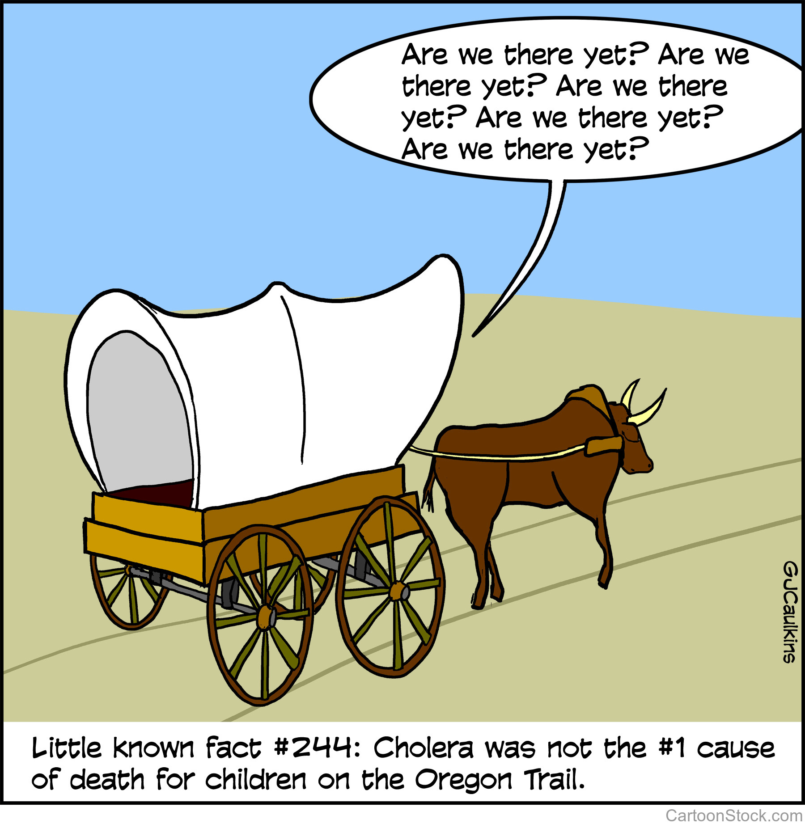
Scenario 1
For the past three days, you have been bringing your family with you to offer Isha Prayer at the mosque. It’s winter and cold outside. And your family has been the only family present at the mosque. On Day 4, your children ask if Salat can just be offered at home.

Slide 11
How would you respond?
Tell your family that you are disappointed as well and will talk to the officeholders about it.
Tell your family to give it one more chance and that if no one shows up, tomorrow, Isha will be offered at home.
Don’t succumb to family pressures. Continue to offer Salat at the mosque each evening.
Any other response?

Slide 12
How would your response change if?
(Consider each separately.)
… The mosque is a 10-minute drive from your home.
… The mosque is a 30-minute drive from your home.
… Your children complain they don’t have time to complete their homework due to the time it takes to offer Salat at the mosque.

Slide 13
Guidance from Friday Sermon
The Promised Messiah (peace be on him) elaborated on this fact in the following manner that in comparison to God Almighty, people have more trust and faith in other objects and means. They are more inclined towards their employments, their businesses and their worldly endeavors and undertakings.
We should not rejoice at the mere fact that we have constructed a very beautiful mosque in the city of Philadelphia. Rather, we should fulfill its rights and when we are presented before God Almighty, we should hear the words that these are the people who constructed a mosque for the sake of God Almighty and also tried to fulfill its rights. Hence, these people are counted among those guided ones and those people whom God Almighty is pleased and happy with. Thus, we should strive to develop this thought within us. Once we have developed this thought and we strive to act accordingly, we will experience the blessings and bounties of this mosque in this world. Our children and offspring will remain attached to their religion. We will be among those who are spreading the message of Allah the Exalted in this area and city. We will be among those who establish the unity of God in the world and the ones waving the flag of the Holy Prophet (peace and blessings of Allah be on him) throughout the world.

Slide 14
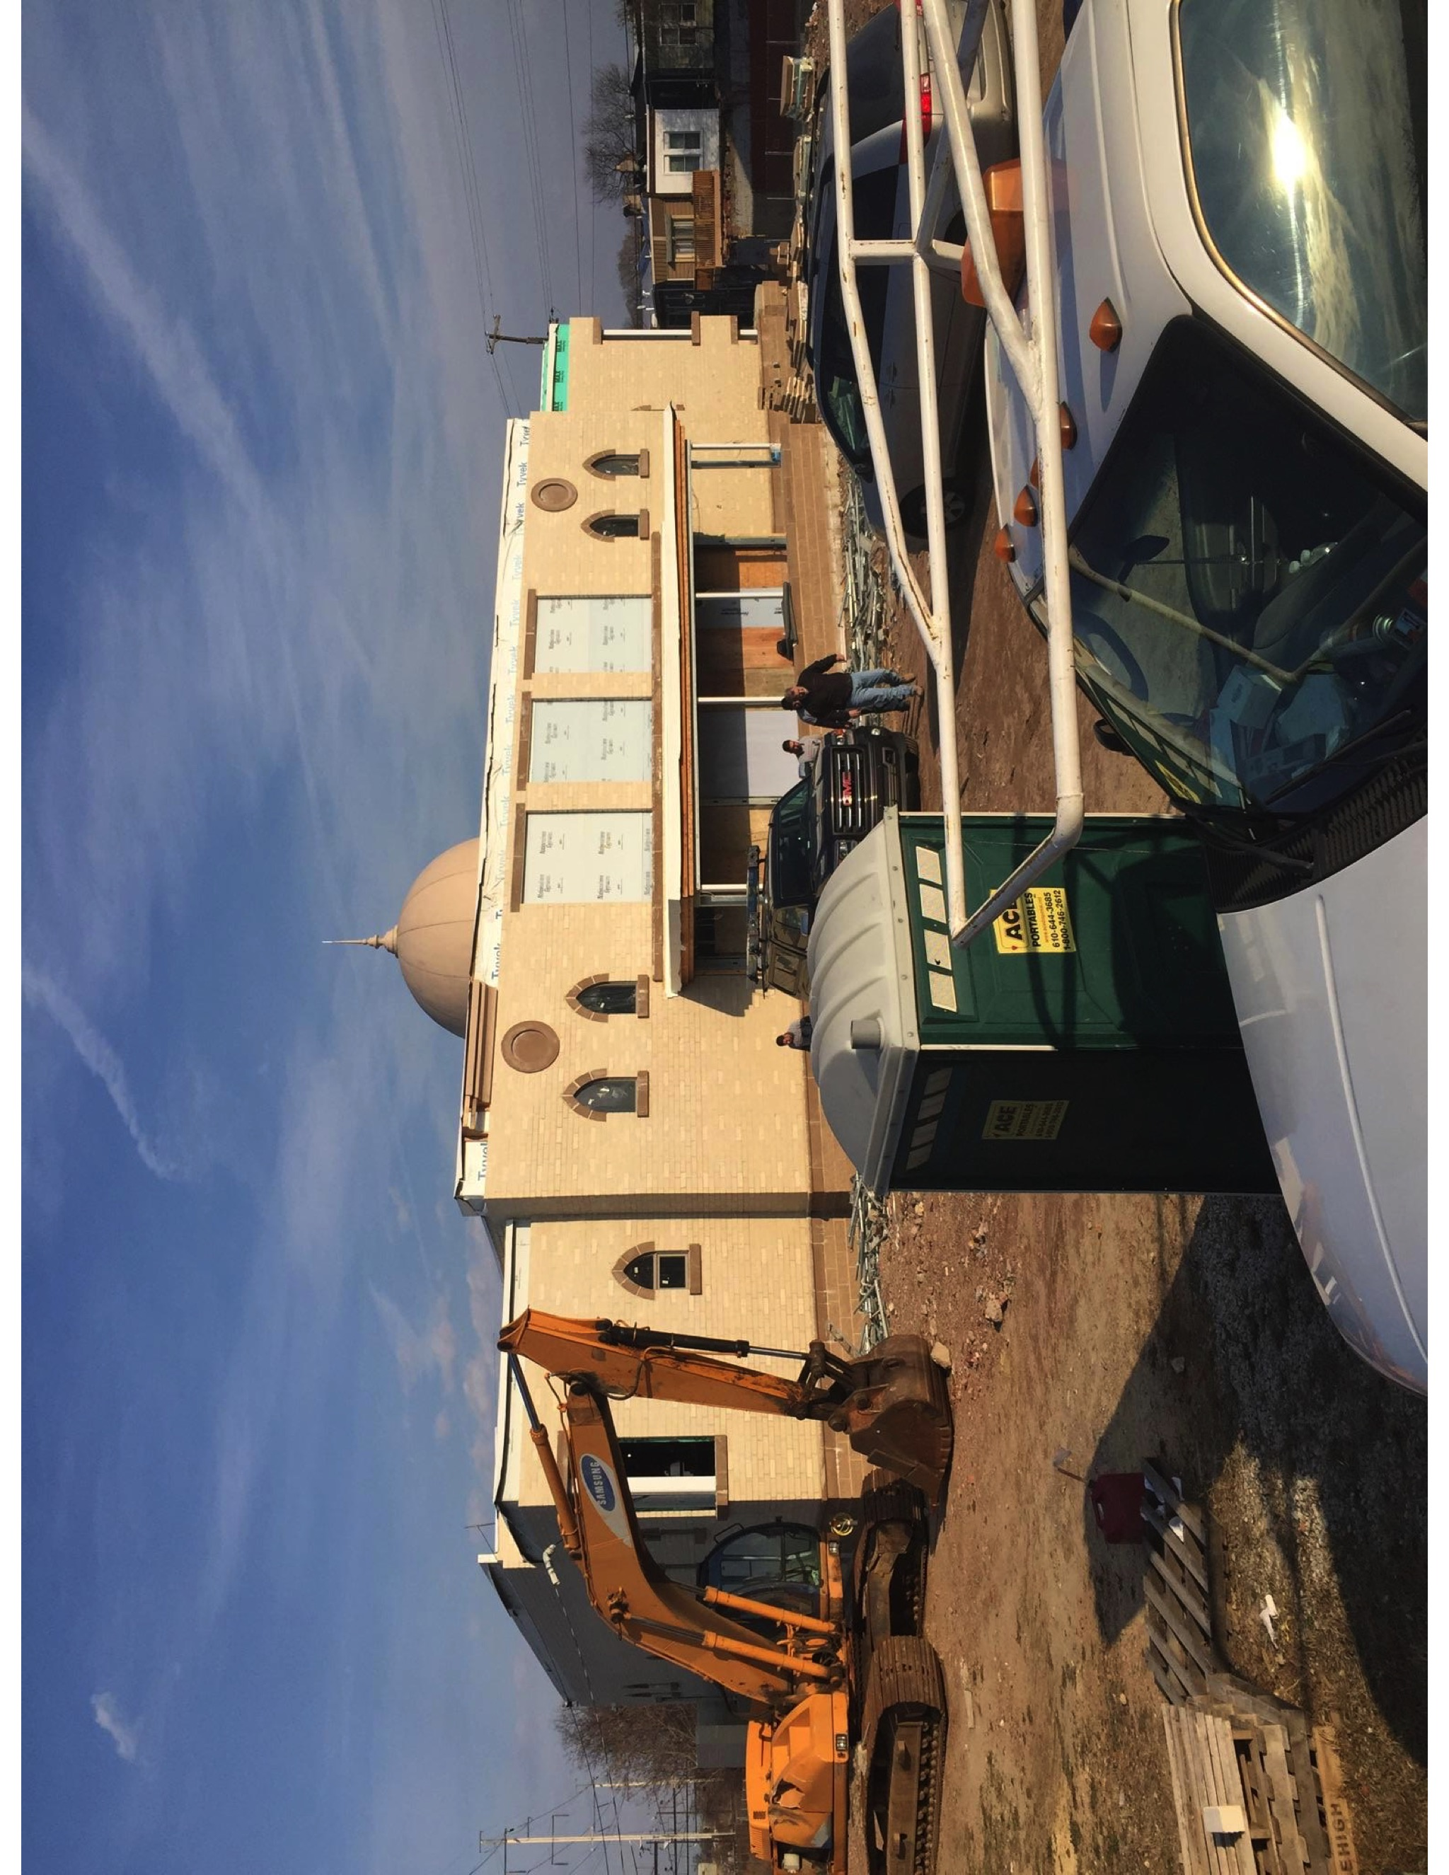
Scenario 2
A newly-formed Jama’at is eager to have their own mosque. There are many views on the table. What should be the priorities for choosing a site for a mosque?
Notes:
Members are split between the following ideas
1. A large purpose built Mosque which will be beautiful and attractive but far from where the members live. It will be very expensive.
2.The other idea is acquiring an older building in a busy area where most of the members live.

Slide 15
Prioritize the mosque criteria…
On a busy street with a lot of pedestrians and Tabligh opportunities
Number of members living within a 20-minute commute
Purpose-built mosque
Open space for sports
Ample parking
Classrooms for Tahir Academy
State of the art and beautiful facility
Visible from major highway
Proximity to good public schools
Proximity to public transportation
Properly zoned for place of worship

Slide 16
What if…
Would you sacrifice your Top Priority if a property becomes available that:
Would be the largest in the state?
Is in an unsafe neighborhood?
Is significantly cheaper?
Has adjacent living space for a missionary?

Slide 17
Guidance from Friday Sermon
The Promised Messiah (peace be on him) states, “At present, our Community is in great need of mosques. This is a House of God. In whichever village or city a mosque of ours is constructed, you may consider that the foundation of the progress of the Community has been laid. If you wish to spread Islam in a village or city where few Muslims can be found, or there are no Muslims at all, you should build a mosque, and God will draw Muslims there Himself. However, this cannot be achieved by merely constructing a mosque.”
The Promised Messiah (peace be on him) states, “The condition is that when constructing a mosque one’s intention should be sincere.” The mosque should be constructed with full sincerity and not for pretention. The Promised Messiah (peace be on him) further states, “It should merely be done for the sake of Allah.” In other words, the mosque should merely be constructed for the sake of Allah the Exalted. “Personal interests or vices should not have anything to do with it. Only then does God shower His blessings.” (Malfuzat, Vol.7, p. 119)

Slide 18
What to discuss with your family?
The benefits of staying connected with the mosque
The obstacles which may be keeping you and your family being regular in the mosque for offering Salat in congregation
Ways and means to use the mosque to propagate the message of Islam Ahmadiyyat
Tips to engage youth in conversation: (1) Give them more talking time, and (2) use examples from Huzoor’s (may Allah be his helper) sermon to make a point.

Slide 19
To-do list
Analyze your regularity in the mosque and try to improve upon it.
Think of ways to bring your family to the mosque on a more regular basis.
Participate in at least one unique activity to bring non-Ahmadis to the mosque which could help them come close to Islam Ahmadiyyat.

Slide 20
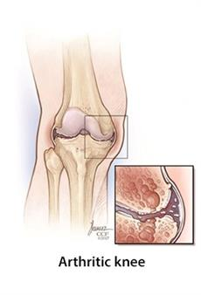
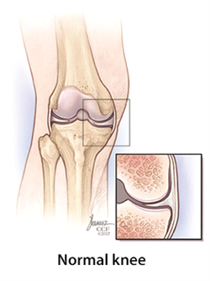
Health tip
Osteoarthritis
Cleveland Clinic Foundation

Slide 21
Health tip
Osteoarthritis
Osteoarthritis is a disease that damages the slippery tissue that covers the ends of bones in a joint. This allows bones to rub together, causing pain and stiffness.
Osteoarthritis occurs most often in older people. Younger people sometimes get the disease after joint injuries.
No single test can diagnose osteoarthritis. Doctors use several methods to diagnose the disease and rule out other problems.
Treatments for osteoarthritis include medicines, nondrug pain relief techniques, surgery, and alternative therapies.
Exercise, weight control, and other self-care activities can help you live with osteoarthritis.
National Institute of Health

Slide 22
That’s all folks
Reminders/Announcements
Du’a
Jazakumullah for Participating!
If you enjoyed it, please convey to those brothers who are not here today!

