Slide 1
Majlis Ansarullah
Monthly Meeting
December 2019
This slide deck contains images licensed for the purpose of this presentation only.
No one is permitted to use the images for any other use, without prior permission.
Notes:
Changed date

Slide 2
AGENDA
Recitation of the Holy Qur’an (Verse 2:287)
Pledge
Did you know?
Sermon of the month: New Year Resolutions for Ahmadis (January 2, 2015)
Health Tip
Reminders/announcements
Du’a

Slide 3
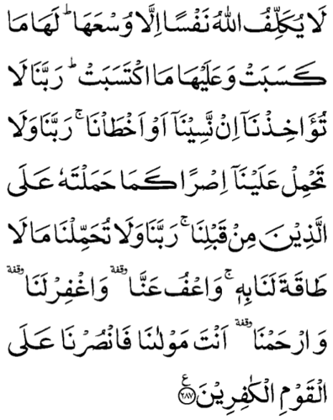
Recitation of the Holy Qur’an
[2:287] Allah burdens not any soul beyond its capacity. It shall have the reward it earns, and it shall get the punishment it incurs. Our Lord, do not punish us, if we forget or fall into error; and our Lord, lay not on us a responsibility as Thou didst lay upon those before us. Our Lord, burden us not with what we have not the strength to bear; and efface our sins, and grant us forgiveness and have mercy on us; Thou art our Master; so help us Thou against the disbelieving people.

Slide 4

Ansar Pledge
Say this part three times:
Ash-hadu • alla ilaha • illallahu • wahdahu • la sharika lahu • wa ash-hadu • anna Muhammadan • ‘abduhu • wa rasuluh
Say this part once:
I bear witness • that there is none worthy of worship • except Allah. • He is One • (and) has no partner, • and I bear witness • that Muhammad (peace be upon him) • is His servant • and messenger.
Say this part once:
I solemnly pledge • that I shall endeavor • throughout my life • for the propagation • and consolidation • of Ahmadiyyat in Islam, • and shall stand guard • in defense of • the institution of Khilafat. • I shall not hesitate • to offer any sacrifice • in this regard. • Moreover, • I shall exhort my children • to always remain dedicated • and devoted • to Khilafat. • Insha’allah.

Slide 5
Did you know?
When does Jama’at fiscal year end?
When does Tahrik Jadid year end?
When does Waqf Jadid year end?
When does Ansarullah year end?
When does Khuddamul-Ahmadiyya year end?
When does Lajna Imaillah year end?
When does Zakat year end?

Slide 6
Answers
Jama’at year ends on June 30.
Tahrik Jadid year ends on October 31.
Waqf Jadid year ends on December 31.
Ansarullah year ends on December 31.
Khuddamul-Ahmadiyya year ends on October 31.
Lajna Imaillah year ends on September 30.
Zakat can be paid once a year, up to the individual.

Slide 7
New Year Resolutions for Ahmadis
Friday Sermon, January 2, 2015

Slide 8
1. Mutual New Year greetings would only be beneficial when we reflect to see how much we fulfilled our obligations of being an Ahmadi last year and if there were any deficiencies, how can we make good this year.
2. The expected levels for Ahmadis have been explained in the conditions of Bai’at. If true happiness is to be celebrated at the start of a New Year, these responsibilities should be kept in view.
3. The Promised Messiah (peace be on him) said: “Stay alert and do not even take one step contrary to the teaching of God and the Holy Qur’an. I say to you most truthfully that a person who evades even one commandment from the seven hundred commandments of the Holy Qur’an closes the door to salvation with his own hands.”
4. The Promised Messiah (peace be on him) said: “Only that person joins our Jama’at who makes our teaching his modus operandi and puts it in practice according to his strength and endeavor.”
Synopsis of the Sermon

Slide 9
Open Discussion Question
As a Nasir, which aspect of this Friday sermon, can I benefit the most from?
Share your thoughts!

Slide 10
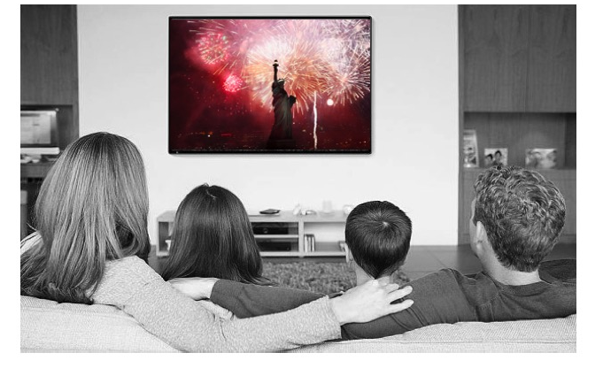
Scenario 1
As a Nasir and his wife sit down with a cup of coffee to watch the New Year’s celebrations on TV, they tell their children to sleep early so they can wake up for Tahajjud and Fajr. The New Year’s festivities on TV are not appropriate for younger audience anyway. The children leave reluctantly. The next morning their son asked “Why was it appropriate for you but not for me?”

Slide 11
How would you respond?
Don’t ask too many questions.
As the parents are more mature, the TV content is unlikely to cause any harm.
Apologize to the son and say that next time they would not watch anything that wouldn’t want their children to see.
Any other response?

Slide 12
How would your response change if?
(Consider each separately.)
… The Nasir and his wife routinely watch movies once the kids go to sleep.
… The kids watched the same New Year’s celebrations on their phones in their rooms.
… The parents offered Tahajjud and Fajr in the morning with their children.
… The parents decide to watch all of the festivities with their children.

Slide 13
Guidance from Friday Sermon
The Promised Messiah (peace be on him) also took pledge to keep away from fornication. He said do not go near fornication. That is, stay away from such functions which could even trigger the thought of it and do not adopt the ways which have risk factors as regards these sins. These days, lewd films are shown on television and the Internet or can be accessed on it. This is fornication of the eyes and thoughts and also a source of getting embroiled in bad practices...
Another pledge sought by the Promised Messiah (peace be on him) is to stay away from trespasses of the eye. The Holy Qur’an commands Ghadd al-Basar (lowering the gaze) and the Holy Prophet (peace and blessings of Allah be on him) said that Fire is forbidden to that eye which restrains from looking at what God has forbidden. The Promised Messiah (peace be on him) said: We have been positively commanded not to look at women outside the prohibited degrees (not a close relative) and their beauty. He said unrestrained looks end up in stumbling at times. God has sent this excellent teaching because God wills our eyes, hearts and intentions to remain pure. Islam has enjoined these boundaries on both men and women. Just as women are commanded to observe Purdah, men are commanded to observe Ghadd al-Basar. We should reflect as to how much we practice this!

Slide 14

Scenario 2
A Nasir sits down with his family on New Year’s Eve to come up with New Year’s resolution. Every family member came up with a suggestion. His teenage son suggested that they all start offering Tahajjud regularly. In the last Khuddam meeting they were encouraged to do so because the Promised Messiah (peace be on him) wanted Jama’at members to offer Tahajjud.

Slide 15
How would you respond?
It is a good idea son, but you need to be regular in daily Prayers before worrying about Tahajjud.
It is a good idea son, we will all make it a New Year’s resolution.
Son, I work hard all day and it is hard to wake up early in the morning.
Any other response.

Slide 16
How would your response change if?
(Consider each separately.)
… You have already been offering Tahajjud regularly.
… You are not regular in your five daily Prayers.
… You are not a morning person and find it hard to wake up early.
… Your parents were regular in offering Tahajjud.

Slide 17
Guidance from Friday Sermon
Pledge is also taken from us to organize offering Tahajjud Salat. Tahajjud should be organized because it was the way of the earlier righteous ones and it is a source of gaining closeness to God. This practice keeps one away from sin and removes bad habits and also keeps one away from physical ailments. The Promised Messiah (peace be on him) said our Jama’at should offer Tahajjud. Our Jama’at should be regular in Tahajjud. If not much they should offer two units of Prayer. Attention needs to be given to this matter!
We need to self-reflect how much we fulfilled our pledges last year and if there were any deficiencies how can we make good this year. The Promised Messiah (peace be on him) said: “Only that person joins our Jama’at who makes our teaching his modus operandi and puts it in practice according to his strength and endeavor.”
May God overlook our weaknesses of last year and enable us this year to make utmost efforts to mold our lives according to the expectations of the Promised Messiah (peace be on him).

Slide 18
What to discuss with your family?
Reflect in which ways the family is better than last year.
Reflect on ways to improve as a family.
Go over the conditions of Bai’at with them.
Tips to engage youth in conversation: (1) Give them more talking time, and (2) use examples from Huzoor’s (may Allah be his helper) sermon to make a point.

Slide 19
To-do list
Write a letter to Huzoor (may Allah be his helper) wishing him a Happy New Year and request prayers for you and your family.
Make a pledge and strive to offer Tahajjud on a regular basis.
Plan to exercise on a regular basis during the New Year.

Slide 20
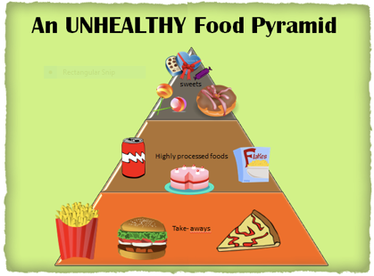
Health Tip
Eat smartly in the holidays

Slide 21
Health Tip
Eat smartly in the holidays
Harvard Nutritionist recommended to keep the following foods to a minimum to prevent many illnesses like diabetes, heart disease, high blood pressure and even some cancer.
Added Sugars in food and beverages are the worst offenders (Coke, juices, corn syrup, white or brown sugar).
Fats - eat low fat milk, cheese, yogurt.
Baked Sweets (doughnuts, cookies etc. should be reduced to a minimum.
White Carbohydrates such as pasta, bread be substituted with whole grain foods.
Processed Meats - choose fish, chicken instead of high fat, processed meats and in moderation.
Salt Restriction to 1500 -2300 milligrams a day.

Slide 22
That’s all folks
Reminders/Announcements
Dua
Jazakumullah for Participating!
If you enjoyed it, please convey to those brothers who are not here today!

