Slide 1

Majlis Ansarullah
Monthly Meeting
March 2020
This slide deck contains images licensed for the purpose of this presentation only.
No one is permitted to use the images for any other use, without prior permission.

Slide 2
Agenda
Recitation of the Holy Quran (62:10-12)
Pledge
Sermon of the month: The significance of Jum’ah prayers 5/31/19
  Verse from the sermon
  Advice from the sermon
Discussion scenario
Did you know?
Salat page
Health Tip
Free time slot for local topics
Reminders/announcements
Dua

Slide 3
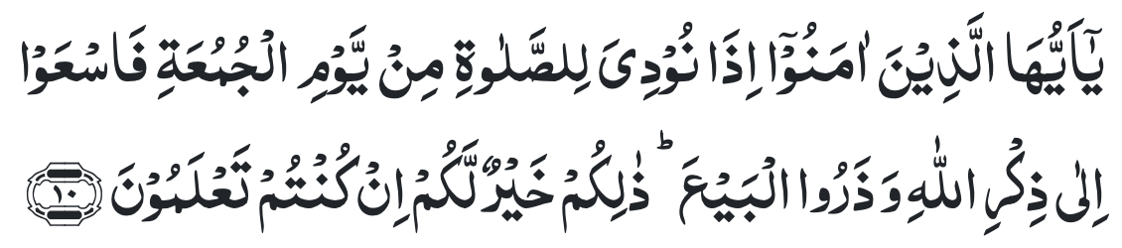
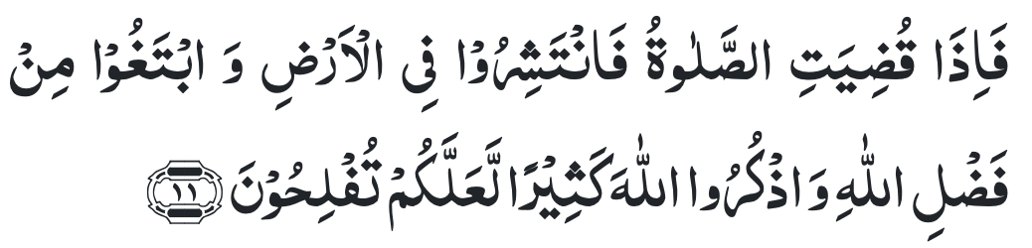
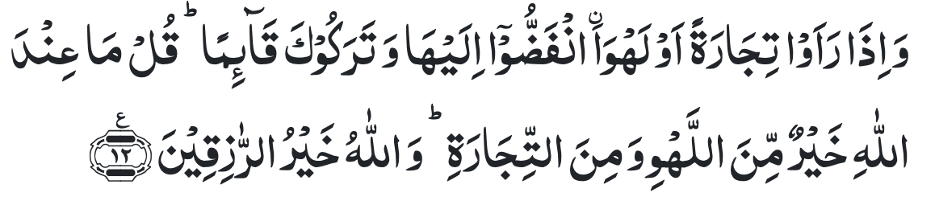
Recitation of the Holy Quran
O ye who believe! when the call is made for Prayer on Friday, hasten to the remembrance of Allah, and leave off all business. That is better for you, if you only knew.
And when the Prayer is finished, then disperse in the land and seek of Allah’s grace, and remember Allah much, that you may prosper.
But when they see some merchandise or some amusement, they break up for it, and leave thee standing. Say, ‘That which is with Allah is better than amusement and merchandise, and Allah is the Best Provider.’

Slide 4

Ansar Pledge
Say this part three times:
Ash-hadu • alla ilaha • illallahu • wahdahu • la sharika lahu • wa ash-hadu • anna Muhammadan • ‘abduhu • wa rasuluh
Say this part once:
I bear witness • that there is none worthy of worship • except Allah. • He is One • (and) has no partner, • and I bear witness • that Muhammad (peace be upon him) • is His servant • and messenger.
Say this part once:
I solemnly pledge • that I shall endeavor • throughout my life • for the propagation • and consolidation • of Ahmadiyyat in Islam, • and shall stand guard • in defense of • the institution of Khilafat. • I shall not hesitate • to offer any sacrifice • in this regard. • Moreover, • I shall exhort my children • to always remain dedicated • and devoted • to Khilafat. • Insha’allah.

Slide 5
The Significance of Jum'ah Prayers
Friday Sermon, May 31, 2019
Friday Sermon

Slide 6
Verse from the sermon
Based on these verses should Friday be a day of ease and holiday?
Why is Friday prayer so important for us?
What is the prophecy in this verse?

Slide 7
Commentary
Unlike the Jewish and Christians days of worship, Muslims are enjoined to be active and busy in their activities of daily living both before and after Friday prayers
These verses show that in Promised Messiah’s time people will be engrossed in trade, industry and entertainment which could keep them from worship of Allah
Muslims have been admonished in this verse not to ignore their spiritual well being in the pursuit of material gains and sensuous pleasures. (Five volume commentary)

Slide 8
1. In the Holy Quran, God Almighty has clearly stated that when one is called for the Friday prayer, one ought to pay heed immediately and attend the Friday prayer, regardless of how busy one may be.
2. The fact is that in reality many people do not pay attention towards this and they waste their Friday prayers for the sake of worldly affairs and pursuits.
3. It is the duty of a believer to always be mindful of the fact that any trade and business, or any of their affairs for that matter, can only be blessed through grace of God Almighty.
Synopsis of the Sermon

Slide 9
Open Discussion
As a Nasir, which aspect of this Friday Sermon, can I benefit the most from?
Share your thoughts!

Slide 10
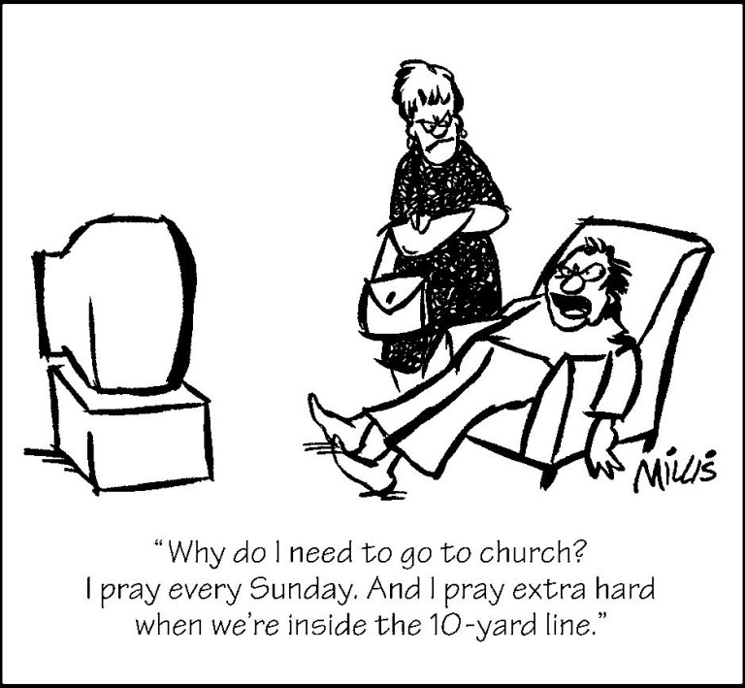
Discussion Scenario
Za’im Ansarullah was urging a Nasir to attend Friday prayers. The Nasir explained that if he takes time off for Friday, he will suffer significant financial loss and his Chanda will go down.
How can the Za’im approach this situation?

Slide 11
Discussion
Nasir has a point and a legitimate reason for missing Jum’ah prayers
Za’im should tell the Nasir that he has to come for Jum’ah and cover chanda short fall by working over time
Za’im should tell the Nasir, that Allah will put blessings in his income if he comes for Jum’ah and not to worry about any decrease in chanda as a result

Slide 12
Guidance from Friday Sermon
“Thus, it is the duty of a believer to always be mindful of the fact that any trade and business, or any of their affairs for that matter, can only be blessed through grace of God Almighty. Hence, if one can only attain these blessings through the grace of God Almighty, then they ought to strive to fulfill His rights first. Therefore, everyone must try and understand this principle. If this principle is understood, then for the five daily prayers and the Friday Prayers, our mosques will remain populated, in fact they will appear to become short of space, even after Ramadan.”
Bottom line is attending Friday prayer is an obligation. Allah will bless us and cover any potential losses.

Slide 13
1. We in particular, who believe in the Imam of the age, must pay special attention towards Friday Prayers. Ahmadis are in fact true believers, as Ahmadis have accepted the Imam of the age.
2. Worldly desires should not be our preferences, rather, the pleasure of God Almighty and acquiring His pleasure should be our preference.
Take Home Message

Slide 14
What to discuss with your family?
Pick one of the following topics from this Friday sermon to discuss with children/family during casual discussion:
  Importance of Friday prayers
  Make a definitive plan to make sure all male members attend Friday prayers regularly.
Tips to engage youth in conversation: (1) Give them more talking time, and (2) use examples from Huzur’s (may Allah be his helper) sermon to make a point.

Slide 15
Did you know?
When was the book Surmah Chasm-e-Aryah (Guidance for the Aryas) written?
What is the background of this book?
What comparative study has been mentioned at the end of the book?
What kind of invitation did the Promised Messiah (peace be on him) give to non-Ahmadi Muslims in this book?

Slide 16
Answers
The Promised Messiah (peace be on him) wrote this book in 1886
The Aryah Samajists attacked a number of miracles mentioned in the Holy Quran, and made fun of these miracles and denied belief therein. They also projected their decadent theories of soul's transmigration.
At the end of the book, he invited the whole of the Aryah Samaj to a comparative study of the Vedas and the Quran and then suggested another way of settling the dispute by engaging in a Mubahalah (Prayer Duel).
At the end of the book, he extended an invitation to non-Muslims to come to Qadian in order that he might show them heavenly signs in favor of Islam and he offered to bear all the expenses for any one who was prepared to come and stay with him for a period of at least 40 days.

Slide 17
Salat page
“Many people are occupied at work during the daytime; however Fajr, Maghrib and Isha prayers can be offered at Masjid. Many Ahmadis living in the Western countries live 15-20 miles from Masjid, but still make the effort to go to Masjid to offer Salat in congregation. If everyone who possesses a car utilizes it for worldly matters, uses it for gaining God’s pleasure, then the purpose of these vehicles will become the service of Islam and the individual will gain both worldly and religious rewards. Wherever it is not possible to go to Masjid, a few Ahmadis living close by should organize to get together in one home to offer prayers in congregation. And those Ahmadis living in isolated areas should make arrangements within the household to offer prayers in congregation with family members. ”.
(Friday Sermon June 22nd, 2012 delivered by Hazrat Mirza Masroor Ahmad (atba))

Slide 18

Health topic
Brain Health Supplements;
Do they really work

Slide 19
Brain Health Supplements
Do they really work

Slide 20
Diets Vs Supplements
Omega-3 Fatty Acids (Fish Oil) are found mostly in fish like salmon and mackerel. Leafy green vegetables (Brussels sprouts, spinach), vegetable oils (canola, soybean), and nuts and seeds (walnuts, flaxseeds) are other sources. Omega-3s in these foods may help protect brain cells
Vitamin E is the only proven supplement to have benefits in diseases like Dementia. It does not prevent the disease itself
B-Vitamins - B6, B9 (folate), and B12 are commonly linked with brain health. Most adults do not need it if they eat well
The Bottom Line - Focus on Aerobic Exercises (Nordic Walking, cycling), and diet rich in grains, vegetables and fruits and fish

Slide 21
Diets Vs Supplements
25% of adult Americans may be taking supplements that promise improved memory, attention and focus
These products are not regulated and there is not just enough evidence to back up their claim
More importantly people who take them are usually healthy, eat well and DO NOT NEED THEM
Many brain supplements focus on omega-3 fatty acids, vitamin E, various B vitamins, or various combinations
There's strong evidence that certain diets, like the Mediterranean diet, the DASH diet, and the MIND diet can help improve cognitive function

Slide 22
That’s all folks
Reminders/Announcements
Dua
Jazakumullah for Participating!
If you enjoyed it, please convey to those brothers who are not here today!

