Slide 1

Majlis Ansarullah
Monthly Meeting
April 2020
This slide deck contains images licensed for the purpose of this presentation only. No one is permitted to use the images for any other use, without prior permission.

Slide 2
Agenda
Recitation of the Holy Quran (2:184-185)
Pledge
Sermon of the month: Ramadhan and our responsibilities 5/10/19
  Verse from the sermon
  Advice from the sermon
Discussion scenario
Did you know?
Salat page
Health Tip
Free time slot for local topics
Reminders/announcements
Dua

Slide 3
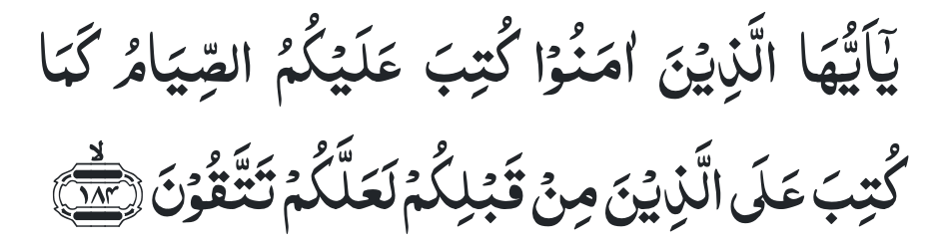
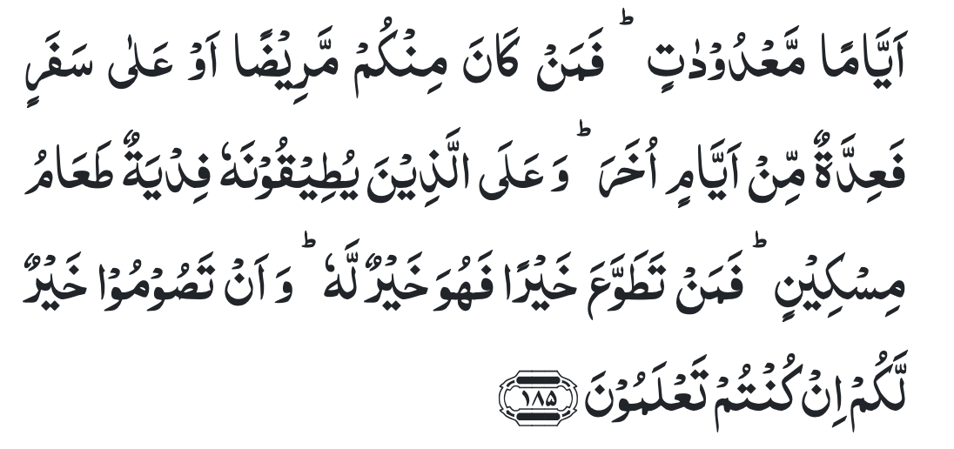
Recitation of the Holy Quran
O ye who believe! fasting is prescribed for you, as it was prescribed for those before you, so that you may become righteous.
The prescribed fasting is for a fixed number of days, but whoso among you is sick or is on a journey shall fast the same number of other days; and for those who are able to fast only with great difficulty is an expiation — the feeding of a poor man. And whoso performs a good work with willing obedience, it is better for him. And fasting is good for you, if you only knew.

Slide 4

Ansar Pledge
Say this part three times:
Ash-hadu • alla ilaha • illallahu • wahdahu • la sharika lahu • wa ash-hadu • anna Muhammadan • ‘abduhu • wa rasuluh
Say this part once:
I bear witness • that there is none worthy of worship • except Allah. • He is One • (and) has no partner, • and I bear witness • that Muhammad (peace be upon him) • is His servant • and messenger.
Say this part once:
I solemnly pledge • that I shall endeavor • throughout my life • for the propagation • and consolidation • of Ahmadiyyat in Islam, • and shall stand guard • in defense of • the institution of Khilafat. • I shall not hesitate • to offer any sacrifice • in this regard. • Moreover, • I shall exhort my children • to always remain dedicated • and devoted • to Khilafat. • Insha’allah.

Slide 5
Ramadhan and our Responsibilities
Friday Sermon, May 10, 2019
Friday Sermon

Slide 6
Verse from the sermon
Based on these verses, what is the main benefit of fasting and why?
Who are exempt from fasting?
Does paying “Fidya” makes you exempt you from fasting forever?

Slide 7
Commentary
The main purpose of fasting is achieving righteousness by first, being saved from harm and suffering, and secondly, to be saved from sin and evil.
Those who are sick, traveling, and whose physical condition or general health is such that they are unable to fast without running the risk of injuring their health.
Fidya is in expiation. However, if one regains capability should start fasting again.

Slide 8
1. God Almighty has prescribed fasting for our own benefit. We can derive spiritual as well as physical benefits from fasting.
2. Holy Prophet (peace be on him) stated that God Almighty says that “every deed of a person is for his own sake, except for observing fasts. In fact, the fast is observed for My sake.”
3. Those, who are excused from fasting because they are ill or traveling, need to observe the missed fasts and give the Fidya.
4. The Holy Quran and the month of Ramadan have a special connection. Therefore, alongside fasting one ought to ponder over the Quran and strive to act according to its teachings, so that one can derive true blessings from the fasts during Ramadan.
Synopsis of the Sermon

Slide 9
Open Discussion
As a Nasir, which aspect of this Friday Sermon, can I benefit the most from?
Share your thoughts!

Slide 10
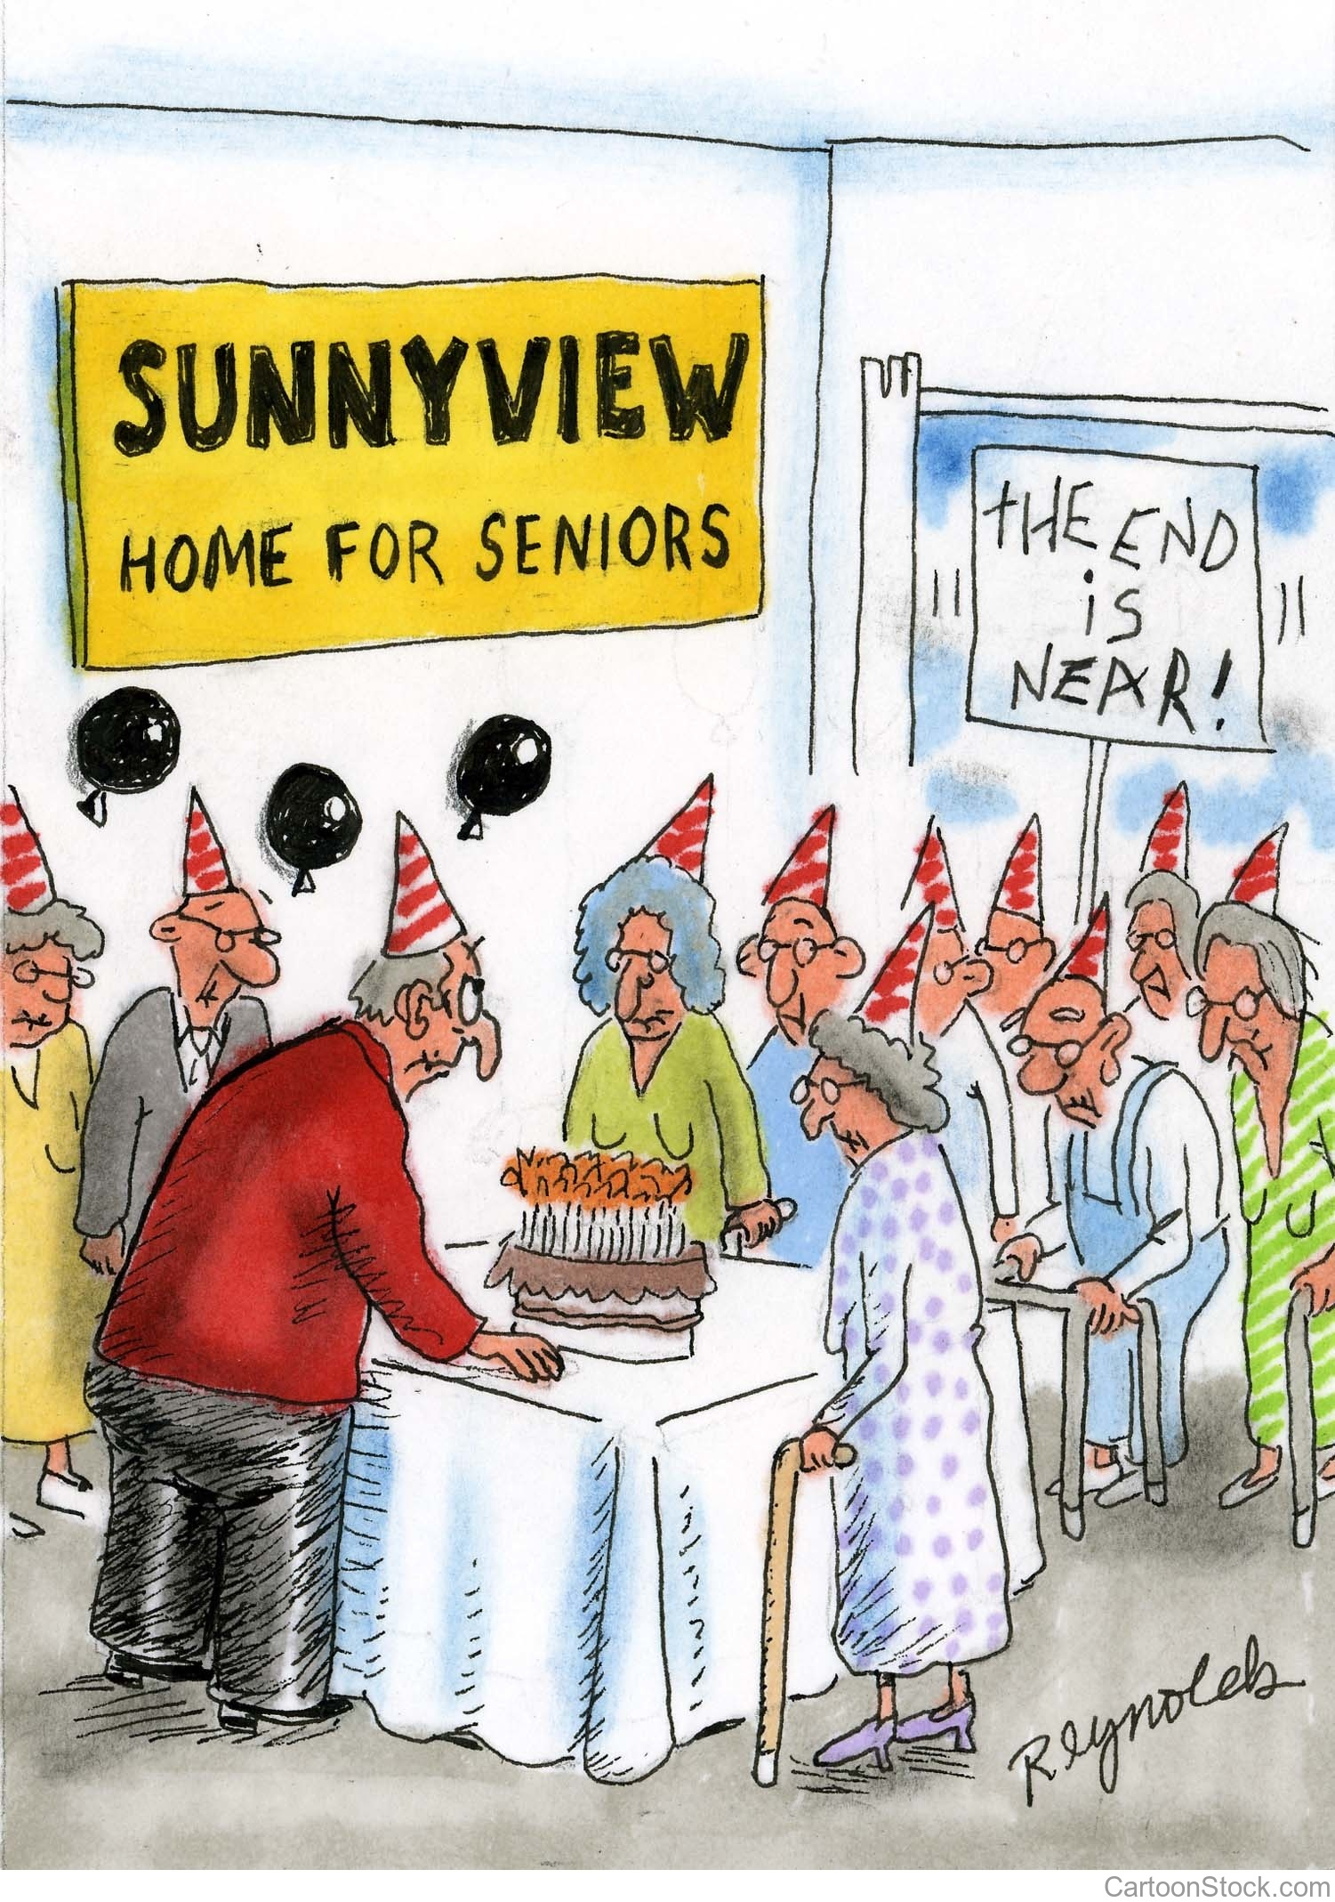
Discussion Scenario
The missionary asked a Nasir about missing a Dars and salat during the month of Ramadhan. The Nasir explained that he was invited to a restaurant for Iftar dinner party by his long time non-Ahmadi Muslim friends who he spends most of his weekends with. He admitted that he did offer both Salats when he got home around midnight. He felt that it was important to stay connected with non Ahmadi friends for the purpose of Tabligh.

Slide 11
Discussion
The Nasir was correct in his approach.
The Nasir should have declined the offer for the Iftar dinner party.
The Nasir should have only participated for a short period of time and offer his Salat before midnight
Any other suggestion?

Slide 12
Guidance from Friday Sermon
“The Holy Prophet(peace be on him) is addressing us; he is addressing those who call themselves Muslim; he is addressing those people to whom God Almighty has commanded that fasting has been made compulsory for them so that in these days of Ramadan they can exclusively remain preoccupied in the worship of God, and in striving to achieve moral and spiritual heights. However, if one fails to do this, then merely the arrival of Ramadan, Satan being shackled down, the doors of heaven being thrown open and the doors of hell being locked closed shall not benefit one at all.”
Bottom line is we need to stay away from routine worldly activities and avoid useless social gatherings in the month of Ramadan.

Slide 13
1. We should not simply become happy on account of Ramadhan’s arrival and become satisfied in merely congratulating each other for Ramadhan and the act of fasting.
2. We should seriously evaluate ourselves about whether we are striving to attain the true purpose of fasting as laid out by God Almighty.
3. Believing in Allah and by following His commandments one can achieve nearness of Allah during Ramadhan.
Take Home Message

Slide 14
What to discuss with your family?
Pick one of the following topics from this Friday sermon to discuss with children/family during casual discussion:
  Discuss ways of deriving the maximum benefit of this month with your family
  Review in what ways are we better today than last Ramadhan
Tips to engage youth in conversation: (1) Give them more talking time, and (2) use examples from Huzur’s (may Allah be his helper) sermon to make a point.

Slide 15
Did you know?
When was the book Fatha e Islam (Victory of Islam) written?
What is the background of this book?
What ways did Promised Messiah (peace be on him) use to fight false Christian doctrines?

Slide 16
Answers
The Promised Messiah (peace be on him) wrote this book in 1890
There was an all-out effort to convert the Indians, specially the Muslims to Christianity. It was against this background that the Promised Messiah (peace be on him) took up the task of frustrating the designs of Christian missionaries by demolishing the false beliefs of Christianity specially the belief that Jesus was the son of God and was sitting alive in heaven.
He disproved the false Christian doctrines by (1) publication of books, (2) the issuance of leaflets, (3) giving interviews, (4) correspondence, and (5) accepting bai‘at.

Slide 17
Salat page
“It is the responsibility of each Ahmadi to focus on observing Salat, to observe each Salat at its prescribed time. The five daily prayers are the milestone from where the spiritual journey begins; it is the seed that has the potential of spiritual growth. If one is negligent with Salat, virtues are suppressed in the manner that weeds suppress the growth of a field. It is our task to make the roots of this worship so strong that it safeguards us from all evil. Indeed it is for us to observe Salat and establish it first, it is as a consequence of observing it sincerely that Salat safeguards us in return”.
(Friday Sermon February 15, 2008 delivered by Hazrat Mirza Masroor Ahmad(atba))

Slide 18
Health Topic
Health Benefits of Fasting

Slide 19
Benefits of fasting
Intermittent Fasting decreases Insulin Resistance stabilizing blood Sugar
Intermittent Fasting helps lose weight
Diabetics can almost reverse their disease with weight loss achieving ideal body weight
Fasting increases your mental resilience to physical and mental stress
Fasting is also linked to improve Memory and Cognition
Intermittent Fasting also Helps reduce Blood Pressure
Some Studies have showed Improved Heart Health
Studies also show Fasting improves longevity
Above all - this is one act that is purely for Allah and the reward is Allah

Slide 20
That’s all folks
Reminders/Announcements
Dua
Jazakumullah for Participating!
If you enjoyed it, please convey to those brothers who are not here today!

