Slide 1

Majlis Ansarullah
Monthly Meeting
June 2020
This slide deck contains images licensed for the purpose of this presentation only. No one is permitted to use the images for any other use, without prior permission.

Slide 2
AGENDA
Recitation of the Holy Quran (10:10-11)
Pledge
Sermon of the month: Giving precedence to faith over worldly matters 10/17/14
  Verse from the Holy Quran
  Advice from the sermon
Discussion scenario
Did you know?
Salat page
Health Tip
Free time slot for local topics
Reminders/announcements
Dua

Slide 3
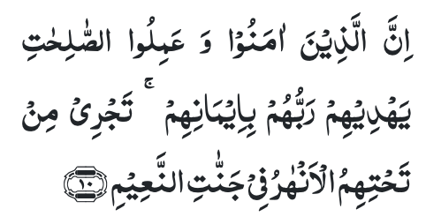
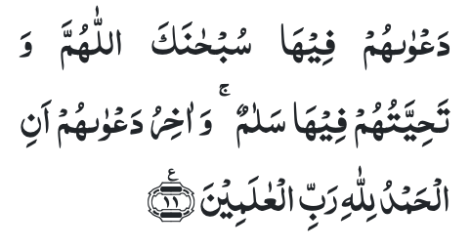
Recitation of the Holy Quran
But as for those who believe, and do good works — their Lord will guide them because of their faith. Rivers shall flow beneath them in the Gardens of Bliss.
Their prayer therein shall be, ‘Glory be to Thee, O Allah!’ and their greeting therein shall be, ‘Peace.’ And the conclusion of their prayer shall be, ‘All praise be to Allah, the Lord of the worlds.’ (10:10-11)

Slide 4
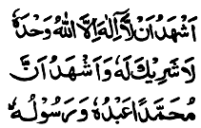
Ansar Pledge
Say this part three times:
Ash-hadu • alla ilaha • illallahu • wahdahu • la sharika lahu • wa ash-hadu • anna Muhammadan • ‘abduhu • wa rasuluh
Say this part once:
I bear witness • that there is none worthy of worship • except Allah. • He is One • (and) has no partner, • and I bear witness • that Muhammad (peace be upon him) • is His servant • and messenger.
Say this part once:
I solemnly pledge • that I shall endeavor • throughout my life • for the propagation • and consolidation • of Ahmadiyyat in Islam, • and shall stand guard • in defense of • the institution of Khilafat. • I shall not hesitate • to offer any sacrifice • in this regard. • Moreover, • I shall exhort my children • to always remain dedicated • and devoted • to Khilafat. • Insha’allah.

Slide 5
“Giving precedence to faith over worldly matters”
Friday Sermon, October 17, 2014
Friday Sermon

Slide 6
Discussion on verse
Can good actions lead to true guidance?
Can someone with good and pure heart do evil works?
Would every man’s actions rewarded equally?

Slide 7
Commentary
True guidance can only be achieved through true faith. Mere actions are of no value unless they are accompanied by purification of heart.
It is impossible for someone with good heart to fail to do good works.
A man’s actions will be rewarded according to degree of his faith. (Five volume commentary)

Slide 8
1. Every Ahmadi makes a pledge: ‘I will give precedence to faith over worldly matters’. It is, therefore, imperative for each and every Ahmadi including the office-bearers of the Jama’at to act upon their pledge.
2. Faith means to live in accordance with the commandments of the
Almighty God and seek to please Him by performing good actions and saying good words.
3. The Promised Messiah (peace be on him) said that those who become slaves of the world and devote themselves to the worldly pleasures alone, they are overcome by the Satan who vanquishes them.
4. God blesses the sincerity of and confers His nearness to those who serve faith while feeling its pain.
Synopsis of the Sermon

Slide 9
Open Discussion
As a Nasir, which aspect of this Friday Sermon, can I benefit the most from?
Share your thoughts!

Slide 10
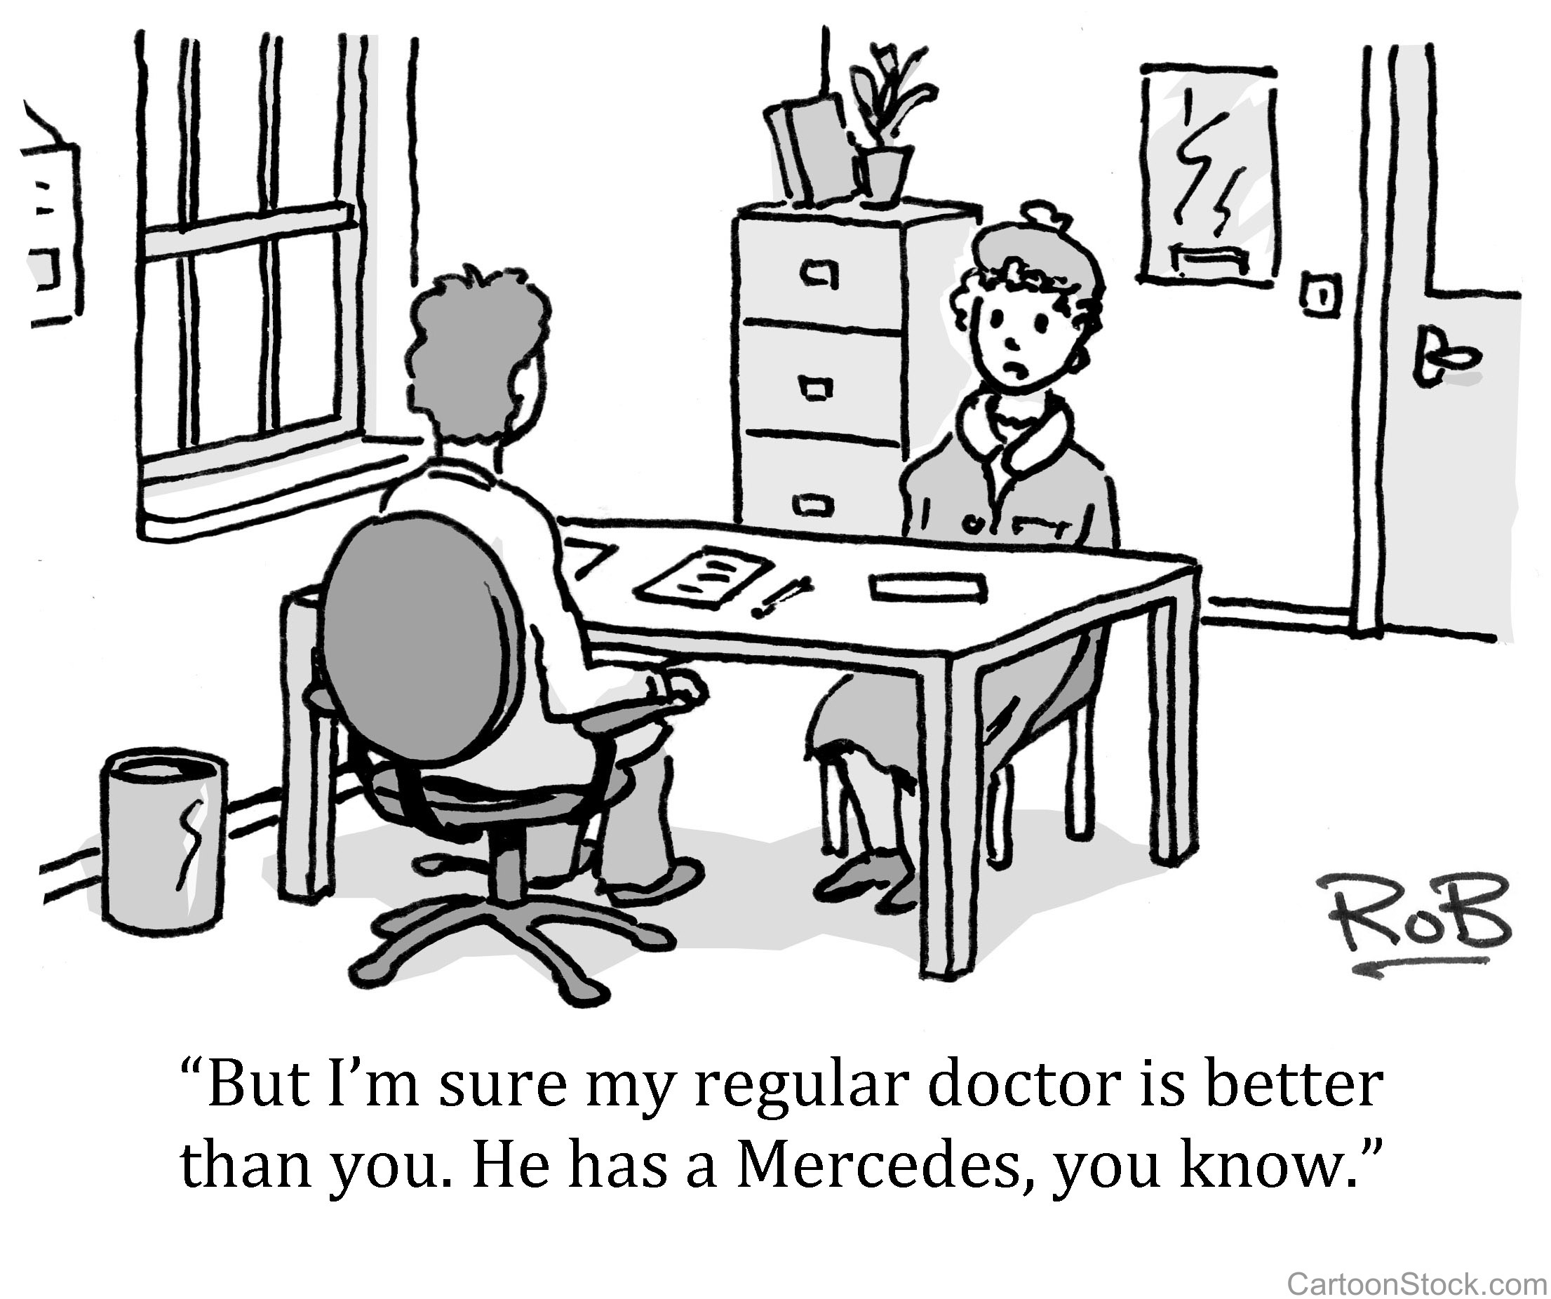
Discussion Scenario
A Nasir approached Za’im sahib about one of the members in his Amila. The Nasir was concerned that he is very extravagant and always wears expensive clothes and drives an expensive car. He felt that Islam recommends simplicity and the Nasir may not be setting a good example for others.
Upon questioning, the Nasir agreed that this member is very regular in salat and pays Chanda on a regular basis. He is also very available for any Majlis related activity.

Slide 11
Discussion
The Za’im should agree with the Nasir and ask the member to change his ways and try to lead a simple life.
The Za’im should tell the Nasir that he should mind his own business and not worry about other members.
The Za'im should agree with the Nasir but not talk to the member about it
It is ok for the member to be the way he is as long as he is fulfilling other religious obligations

Slide 12
Guidance from Friday Sermon
“God has not forbidden us to earn a living in the world and whatever is not forbidden is warrantable. It is indeed warrantable to wear elegant, valuable clothes, eat fine foods and live in splendid houses and have high grade ornaments.
However, all this would be unwarrantable if it became a hindrance in the advancement of Islam….Islam teaches not to be negligent about religious work and in this way one can pay the dues of giving precedence to faith over worldly matters. Religion does not stop one from eating fine foods, what is unwarrantable is when fine dining becomes a hindrance in matters of faith.
It should always be kept in view that whatever interferes in religious matters should be removed”.
Bottom line is that we should give precedence to faith over all worldly matters. It may not be advisable to directly critique someone about their lifestyle. We need to encourage everyone to do good.

Slide 13
1. We must draw our own attention, more than ever, to understand the concept of giving precedence to faith over worldly matters.
2. The best thing is to render sacrifices that are timely and in accordance with the needs of the time. It is warrantable to pursue our personal desires and goals, but it is unwarrantable to pursue them at the cost of Faith.
3. God is not in need of anything of ours. It is indeed His grace and favor that He has told us that if we give precedence to faith over worldly matters we will attain His pleasure.
Take Home Message

Slide 14
What to discuss with your family?
Pick one of the following topics from this Friday sermon to discuss with children/family during casual discussion:
  Discuss what is the meaning of giving precedence to faith over worldly matters.
  Discuss the daily routine of each family member and see where we give precedence to worldly matters over faith. Start with assessment of your own schedule.
Tips to engage youth in conversation: (1) Give them more talking time, and (2) use examples from Huzur’s sermon (may Allah be his helper) to make a point.

Slide 15
Did you know?
When was the book Taudih-e-Maram (Elucidation of Objectives) written by the Promised Messiah (peace be on him)?
What is the background of this book?
Which chapter of the Holy Quran has been described in this book?

Slide 16
Answers
The Promised Messiah (peace be on him) wrote this book in 1890
The Promised Messiah considered this book to be a continuation of his book Fath e Islam. He tackled various objections against his claim
He explained the functions of angels, in particular, that of angel Gabriel
He explained the vast possibilities of spiritual progress for man.
He made a forceful plea that unless the false beliefs like the one that Jesus Christ (peace be on him) was alive in the heaven are completely demolished, it would not be possible for the Muslims to enter into a debate or an argument with Christians
The Promised Messiah explained the chapter 91, Al-Shams in this book

Slide 17
Salat page
“Sometimes two Salats are combined, at times it is due to a valid reason but at other times people simply make it a norm. Huzur said Allah has indeed fixed a time for each Salat as verse 79 of Surah Bani Israel states:
“Observe Prayer at the declining and paling of the sun on to the darkness of the night, and the recitation of the Qur'an in Prayer at dawn. Verily, the recitation of the Qur'an at dawn is specially acceptable to God.” (17:79)
(Friday Sermon February 15, 2008 delivered by Hazrat Mirza Masroor Ahmad (may Allah be his helper))

Slide 18
That’s all folks
Reminders/Announcements
Dua
Jazakumullah for Participating!
If you enjoyed it, please convey to those brothers who are not here today!

