Slide 1

Majlis Ansarullah
Monthly Meeting
November, 2020
This slide deck contains images licensed for the purpose of this presentation only. No one is permitted to use the images for any other use, without prior permission.

Slide 2
AGENDA
Recitation of the Holy Quran (2:263)
Pledge
Sermon of the month: Blessings of Financial Sacrifice by Ahmadiyya Muslim Community. (November 4, 2011)
  Verse from the Holy Quran
  Advice from the sermon
Discussion scenario
Did you know?
Salat page
Health Tip
Free time slot for local topics
Reminders/announcements
Dua

Slide 3
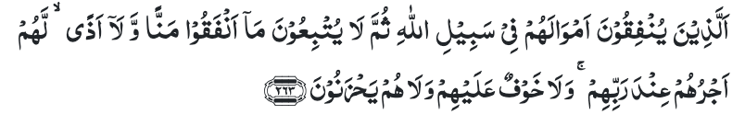
Recitation of the Holy Quran
They who spend their wealth for the cause of Allah, then follow not up what they have spent with taunt or injury, for them is their reward with their Lord, and they shall have no fear, nor shall they grieve. (2:263)

Slide 4

Ansar Pledge
Say this part three times:
Ash-hadu • alla ilaha • illallahu • wahdahu • la sharika lahu • wa ash-hadu • anna Muhammadan • ‘abduhu • wa rasuluh
Say this part once:
I bear witness • that there is none worthy of worship • except Allah. • He is One • (and) has no partner, • and I bear witness • that Muhammad (peace be upon him) • is His servant • and messenger.
Say this part once:
I solemnly pledge • that I shall endeavor • throughout my life • for the propagation • and consolidation • of Ahmadiyyat in Islam, • and shall stand guard • in defense of • the institution of Khilafat. • I shall not hesitate • to offer any sacrifice • in this regard. • Moreover, • I shall exhort my children • to always remain dedicated • and devoted • to Khilafat. • Insha’allah.

Slide 5
Blessings of Financial Sacrifice by
Ahmadiyya Muslim Community
Friday Sermon, November 4, 2011
Friday Sermon

Slide 6
Discussion on verse
What is meant by مَنًّا and اَذًی in this verse?
What is taunting and injury in relation to financial sacrifice?
How can one potentially ruin their sacrifices?

Slide 7
Commentary
The word مَنًّا would mean taunt and اَذًی would mean injury
Every good can be abused, and the abuse of spending in the cause of Allah is to follow it with boasting and injury
Making unnecessary mention, demanding anything in return for their contributions, and expecting worldly advantages etc.
Whether in the help of the community or of an individual, Islam condemns resort to “Mun” and “Aza”. It enjoins us to serve, but expects us to forget that we are rendering a service, for that would mar the good effect. (Five volume commentary)

Slide 8
1. Hadhrat Mirza Ghulam Ahmad (on whom be peace) said “Allah desires to draw towards Tauhid (unity of Allah) all righteous souls who dwell in the various parts of the world, and He wishes to bring all mankind into one faith. This is His purpose for which I have been sent. You must work towards this goal, with love and kindness.”
2. Whenever an appeal is made to the Ahmadiyya Community, with the grace of God, it has always responded eagerly and has excelled in prayers and sacrifice.
3. Tabligh requires Publication of books, Organization of missionaries, Building of mosques and Mission houses, Electronic means of communication, MTA etc. Financial giving is required for all these tasks and the contributions of the Community must be better than ever.
Synopsis of the Sermon

Slide 9
Open Discussion
As a Nasir, which aspect of this Friday Sermon, can I benefit the most from?
Share your thoughts!

Slide 10
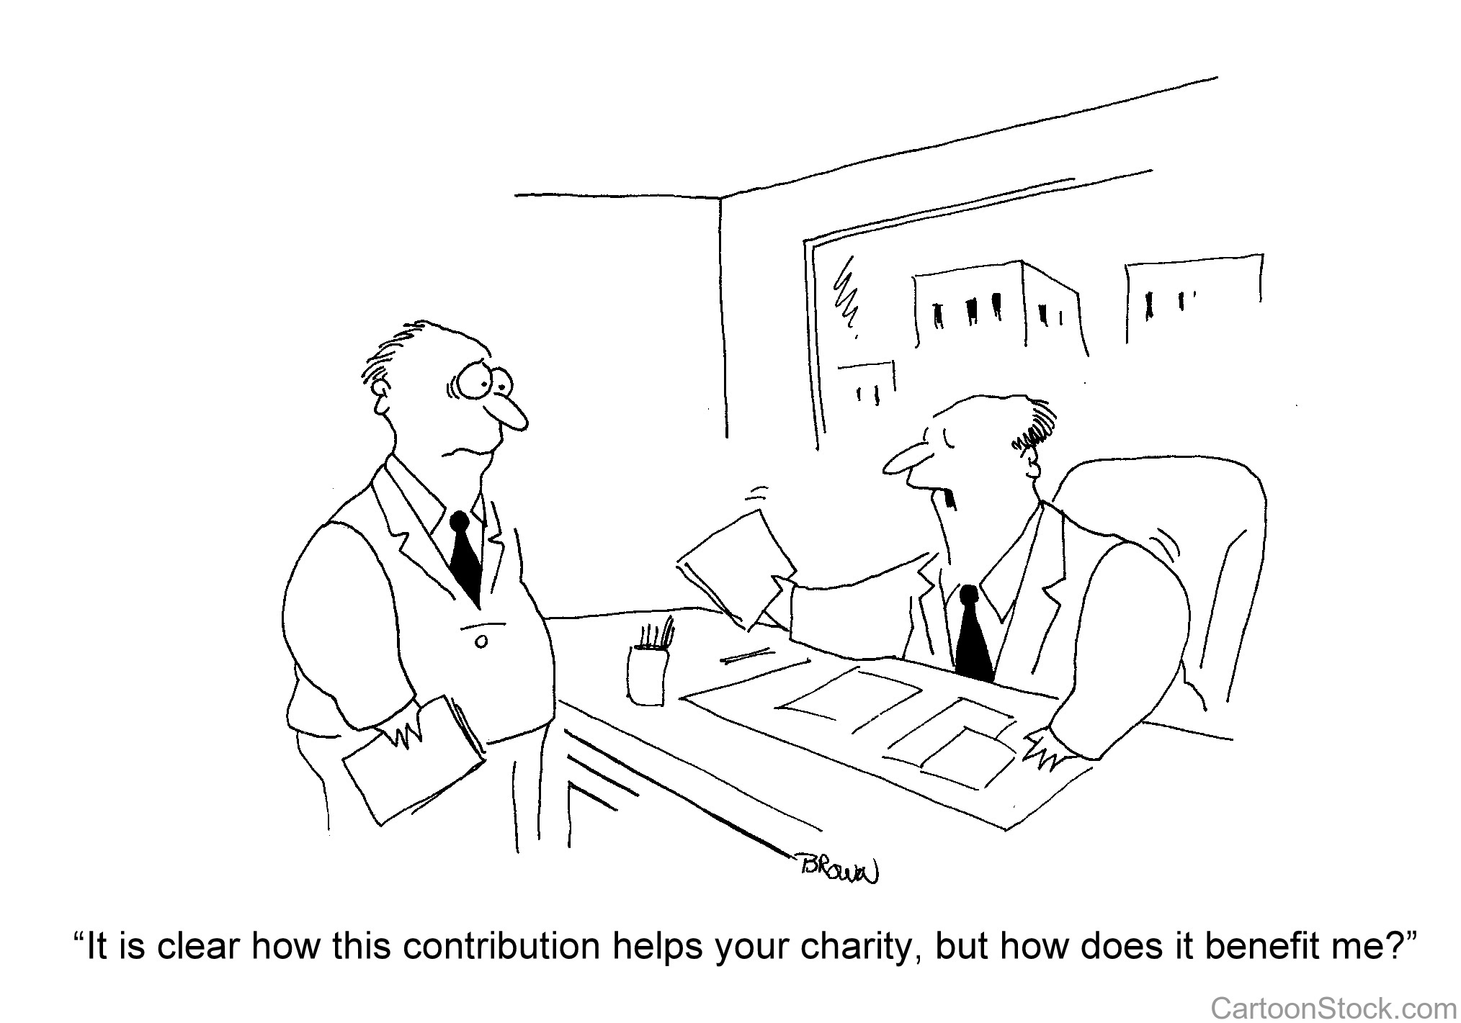
Discussion Scenario
Muntazim Ma’al was making a plea to members of a Majlis to increase the level of financial sacrifice and pay according to the income. One member jokingly said, our community has become like IRS and is always collecting money. He also felt that we are always asked to pay but never told where our contributions end up and we should have a say into how our money is spent. Some Ansar members became very uncomfortable with these comments and wanted to respond. Za’im stopped everyone and started to speak.

Slide 11
Discussion
Za’im should admonish this member and tell him that we should never question the financial system of the Jama’at?
Za’im should admonish the member but offer an explanation about the importance of financial sacrifice?
Za’im should close the discussion and ask to meet him after the meeting?
Za’im should explain the various ways Majlis/Jama’at funds are spent?
Any other suggestion?

Slide 12
Guidance from Friday Sermon
“The task to gather people on one religion and establish Oneness of God and establish the kingdom of the Holy Qur’an, bringing the pious-natured under the banner of the Holy Prophet (peace and blessings of Allah be on him) is the extensive and great mission which the Promised Messiah (on whom be peace) carried out and then entrusted it to his Community. This task cannot be carried out without bringing pious changes in oneself, sacrifice and prayers. These aspects alone will enable us to witness the progress that God has destined for this Community. Indeed, the Community is trying to follow these principles. InshaAllah we will always experience success if we are drawn to prayers”.
Bottom line is that we should trust the system of the Jama’at and be careful in the way we ask some questions. However, it is our duty to explain the structure of financial system and the use of Jama’at and Majlis funds.

Slide 13
1. Hadhrat Mirza Ghulam Ahmad (on whom be peace) was appointed by God in the current age to spread the teaching of the Qur’an. Through his spiritual writings and works demonstrate that he certainly fulfilled his obligation. This task is now on us and cannot be carried out without bringing pious changes in oneself, sacrifice and prayers.
2. As long as we continue to strive towards this goal, we will go on witnessing the progress of the Jama‘at which has been decreed by God, especially if our efforts are accompanied by prayers.
Take Home Message

Slide 14
What to discuss with your family?
Pick one of the following topics from this Friday sermon to discuss with children/family during casual discussion:
  What are various ways to offer financial sacrifice?
  What does it mean to pay according to prescribed rate?
Tips to engage youth in conversation: (1) Give them more talking time, and (2) use examples from Huzur’s (may Allah be his helper) sermon to make a point.

Slide 15
Did you know?
When did the Promised Messiah write the book Nishan-e-Asmani (The Heavenly sign)?
What is the background of writing this book?
What subject matters are discussed in this book?
What simple way has been explained by the Promised Messiah for seeker of truth?

Slide 16
Answers
Nishan-e-Asmani was written in 1892
Around this time many were attracted towards the Promised Messiah based on dreams and visions.
The Promised Messiah wrote this book to draw attention to heavenly testimony in support of his claim
He offered an easy way to test his claim. One could turn to God at night and offer two Rakat prayers, in the first of which Sarah Yasin should be recited, and in the second, Sarah Al-Ikhlas should be recited 21 times. After this, the seeker after the truth should repeat the Darud 300 times. And also Istighfar 300 times. Then he should pray that God might reveal to him the truth by means of a vision, dream or inspiration.

Slide 17
Salat page
“Who amongst us doesn't know that offering Salat is obligatory on Muslims. The Holy Quran has drawn our attention towards it by describing its importance at various places. According to Prophet Muhammad (peace be upon him), Salat is the essence of prayers. He even said that abandoning Salat makes a man closer to disbelief and idolatry. ”.
(Friday Sermon January 20, 2017 delivered by Hazrat Mirza Masroor Ahmad(at))

Slide 18
Health Topic
Screening Tests for Men Over 40

Slide 19
Did you know?
Blood pressure: Check at least every two years if it is in the healthy range (under 120/80) or once a year if it is above normal (between 120/80 and 139/89
Colon Cancer Screening: Recommended for men ages 50-75. Many different tests available, Colonoscopy, stool for blood, etc.
Diabetes Mellitus: If you have high BP or other risk factors for Diabetes, Talk to your Doctor
Cholesterol – Lipids: All men should have their cholesterol checked regularly starting at 35. Men at high risk for developing heart disease should start at age 20
Lung Cancer Screening: Annual CT (55 and 80) if you have smoked a pack a day for 30 years and currently smoke or have quit within the past 15 years
Abdominal Aortic Aneurysm: A one-time ultrasound imaging of your heart and aorta (between the ages of 65 and 75 if you have ever smoked

Slide 20
That’s all folks
Reminders/Announcements
Dua
Jazakumullah for Participating!
If you enjoyed it, please convey to those brothers who are not here today!

