Slide 1

Majlis Ansarullah
Monthly Meeting
December, 2020
This slide deck contains images licensed for the purpose of this presentation only. No one is permitted to use the images for any other use, without prior permission.

Slide 2
AGENDA
Recitation of the Holy Quran (29:46)
Pledge
Sermon of the month: Salat is the key to Personal assessment and improvement (3/30/2012)
  Verse from the Holy Quran
  Advice from the sermon
Discussion scenario
Did you know?
Salat page
Health Tip
Free time slot for local topics
Reminders/announcements
Dua

Slide 3
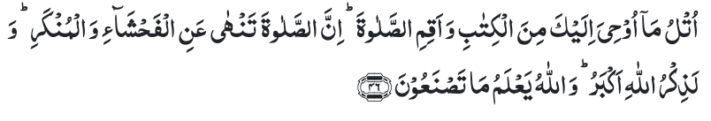
Recitation of the Holy Quran
Recite that which has been revealed to thee of the Book, and observe Prayer. Surely, Prayer restrains one from indecency and manifest evil, and remembrance of Allah indeed is the greatest virtue. And Allah knows what you do. (29:46)

Slide 4

Ansar Pledge
Say this part three times:
Ash-hadu • alla ilaha • illallahu • wahdahu • la sharika lahu • wa ash-hadu • anna Muhammadan • ‘abduhu • wa rasuluh
Say this part once:
I bear witness • that there is none worthy of worship • except Allah. • He is One • (and) has no partner, • and I bear witness • that Muhammad (peace be upon him) • is His servant • and messenger.
Say this part once:
I solemnly pledge • that I shall endeavor • throughout my life • for the propagation • and consolidation • of Ahmadiyyat in Islam, • and shall stand guard • in defense of • the institution of Khilafat. • I shall not hesitate • to offer any sacrifice • in this regard. • Moreover, • I shall exhort my children • to always remain dedicated • and devoted • to Khilafat. • Insha’allah.

Slide 5
Salat is the key to Personal assessment and improvement
Friday Sermon, March 30, 2012
Friday Sermon

Slide 6
Discussion on verse
What three things have been mentioned in this verse which will safeguard one from evil?
What are the benefits of Salat mentioned in this verse?
How can salat save one from evil?

Slide 7
Commentary
Preaching and reading of the Holy Quran, observance of Salat and the remembrance of Allah help free man from bondage of sin and help him to rise morally and spiritually
Salat restrains one from indecency and manifest evil.
Religions try to inculcate a living faith in a Supreme Being to Whom man has to render an account of all his actions. This faith can serve as a potent and effective check on man’s evil propensities. (Five volume commentary)

Slide 8
1. Promised Messiah (peace be on him) wished us to follow the true teachings of Islam and bring about a spiritual revolution by correcting our errors of creed and conduct. God has desired to give the world a model of a righteous and chaste life, and so He has created this Jama‘at. No honor or perfection can be attained without following in the footsteps of the Holy Prophet (peace and blessings of Allah be on him)
2. We have to be very careful because the evils prevalent in society can seep into our Jama‘at as well. TV channels have turned the whole concept of virtue and morality on its head, and the internet and other media are no different. If we do not come together to wage a Jihad against these evils, we will fall into the clutches of Satan.
3. Our only hope is to supplicate before God and establish a firm relationship with Him, which is best done through the daily prayers which safeguard us from everything vulgar and frivolous.
Synopsis of the Sermon

Slide 9
Open Discussion
As a Nasir, which aspect of this Friday Sermon, can I benefit the most from?
Share your thoughts!

Slide 10
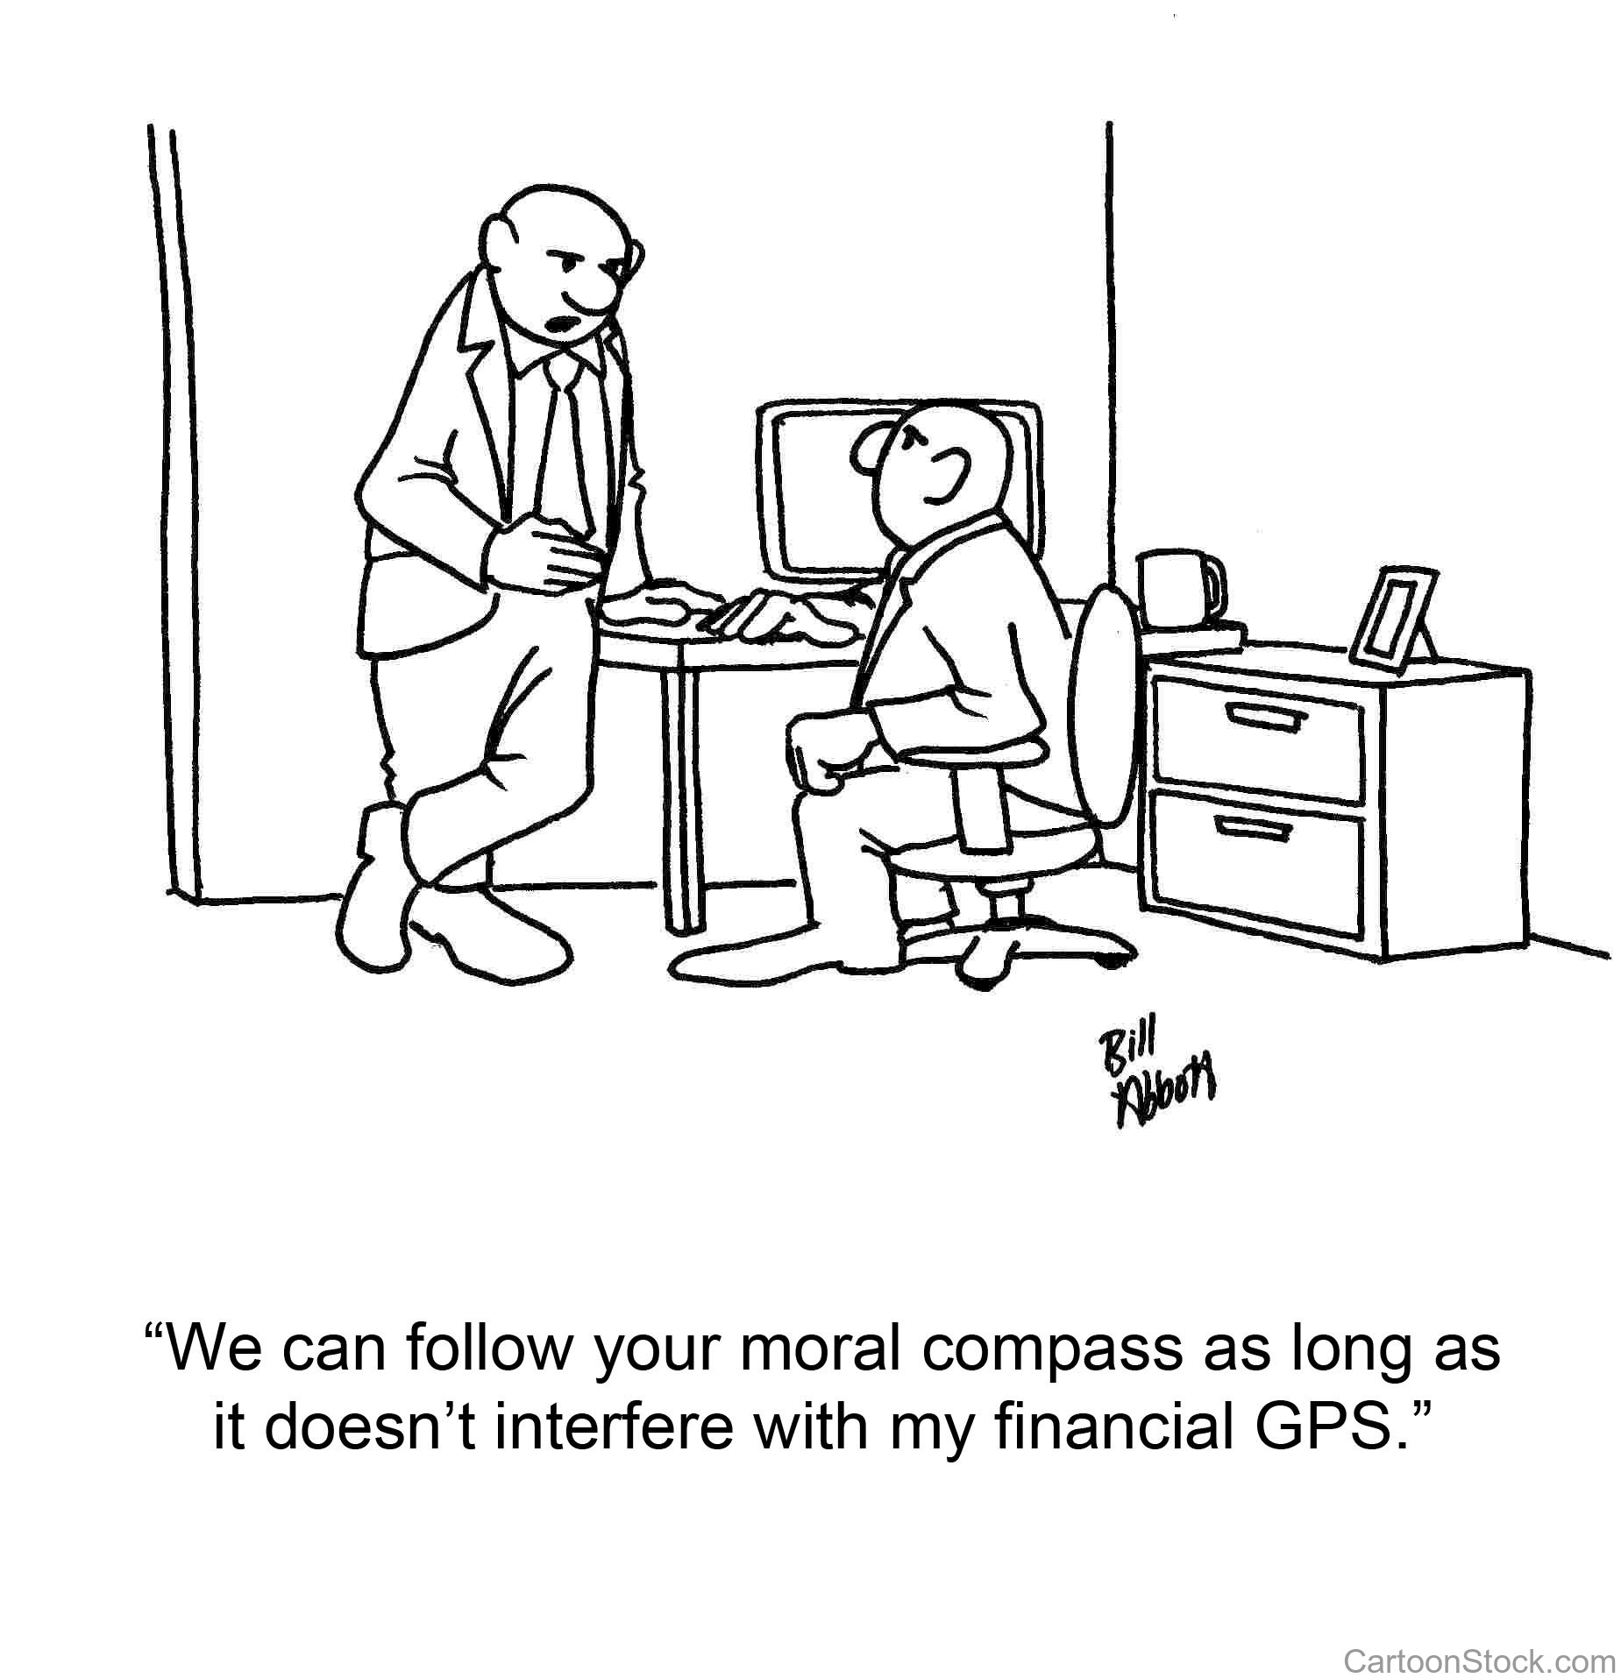
Discussion Scenario
Za’im of a Majlis and Muntazim Tarbiyat were reviewing the Tajneed list to call members about congregational Salat. Muntazim Tarbiyyat requested Zai’m sahib to call one Nasir who was not very regular in offering congregational salat. Za’im mentioned that this member is very regular in Chanda payment and in fact just paid a large check for Waqfe Jadid. He has been reminded about Salat several times before. He thought it may not be a good idea to bother him with another phone call. Muntazim Tarbiyat felt that we should not care about how much one has contributed when it comes to Salat.

Slide 11
Discussion
Do you agree with the approach of the Za’im as the member is at least fulfilling his other obligations and has been reminded about salat before?
Do you agree with Muntazim Tarbiyat, that we should not care about one’s financial contributions when it comes to other Tarbiyat matters?
Is there a hybrid approach available?

Slide 12
Guidance from Friday Sermon
“Huzoor said this was because according to the Holy Prophet (peace and blessings of Allah be on him) the greatest piety for an individual was what he or she lacked. For example a person who is not very good at caring for parents and family, serving faith is not a great virtue. It is possible his service is for simply for show. Therefore those who do not fulfill the dues of their families but are office-holders, need to take care of their families in order to be rewarded for their service to faith. There are some who are very good at financial giving but not so good at Salat, for them observance of Salat will be a great virtue. Salat is a great virtue but it is not accepted when offered for show, when a person who offers Salat usurps others his Salat cannot be a virtue. It would be better if he fulfilled the rights of others and then offered Salat for it to be rewarded”.
Bottom line is that the Nasir needs to achieve all virtues. Muntazim can remind him about Salat but in a compassionate and caring way.

Slide 13
1. Let us always remain vigilant over ourselves and remember that it is only through our Taqwa and righteousness that we can bring about a revolution in the world.
2. We will only be able to reform ourselves truly if we discard every evil and adorn every virtue and live up to the objectives of the Bai‘at.
3. One major duty of a believer is to acquire that virtue in which he is lacking, and this virtue can vary from person to person.
4. It is essential for us to reform ourselves and become a good example for the youth, our children, our wives and our colleagues.
Take Home Message

Slide 14
What to discuss with your family?
Pick one of the following topics from this Friday sermon to discuss with children/family during casual discussion:
  How can we improve the level of Salat in our households?
  Discuss the meaning of “Vying one another in goodness”?
Tips to engage youth in conversation: (1) Give them more talking time, and (2) use examples from Huzur’s (may Allah be his helper) sermon to make a point.

Slide 15
Did you know?
When the Promised Messiah (peace be on him) write the book Eik Isai Kei Tin Sawal Our Unkay Jawabat (Three questions by a Christian and their Answers)
What is the background of this book?
What is the main subject matter of this book?

Slide 16
Answers
This book was written in 1892
Abdullah James, a Christian posed three questions about the Holy Prophet and invited Anjuman Himayat-e-Islam to answer. They submitted these questions to the Promised Messiah (peace be on him).
Three questions were
  a. The Holy Prophet (peace and blessings of Allah be on him) was doubtful about his own Prophethood and divinity of the Holy Quran.
  b. The Holy Prophet (peace and blessings of Allah be on him) did not show any miracles and
  c. Had the Holy Prophet (peace and blessings of Allah be on him) been alive today, he would be helpless and would not have been able to answer about the number of Ashabe Kahaf and whether the sun is setting in slush?

Slide 17
Salat page
The Promised Messiah (peace be on him) says: Some unwise say that why would Allah need our worship. O heedless people, Allah does not have any need, you are the ones who need to worship so that you get Allah’s favor. With Allah’s favor, crooked things straighten out. Salat removes thousands of shortcomings and becomes a reason for attaining nearness to Allah.
(Lecture UK Ansar Ijtima 2018, delivered by Hazrat Mirza Masroor Ahmad (may Allah be his helper))

Slide 18
Health Topic
Walking Trends; Nordic Walking

Slide 19
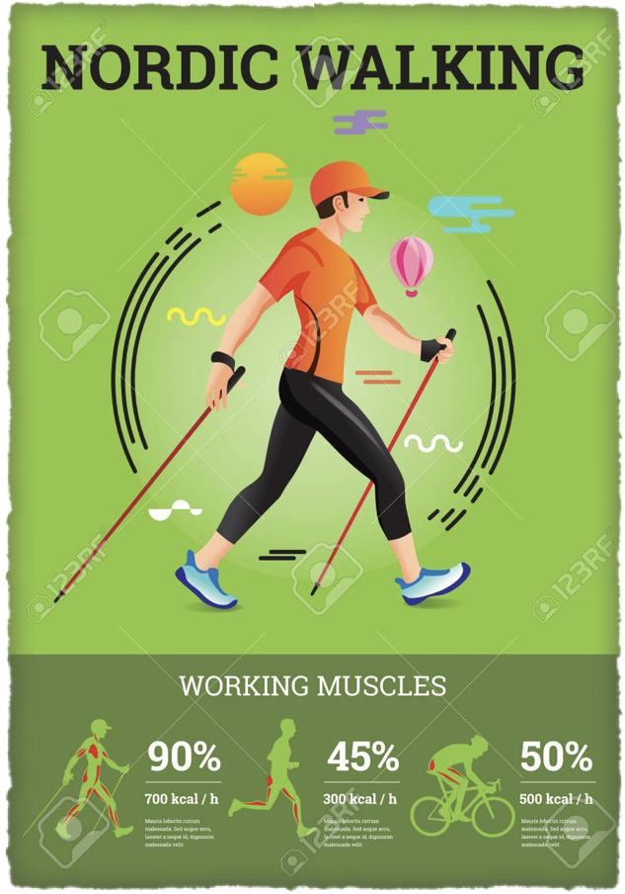
Nordic Walking
Nordic Walking or walking with Nordic Poles is one the best form of exercise
It involves Walking with the help of two special poles using single or double hand techniques
It is especially beneficial for those who have issues with balance, arthritis as it adds stability
Nordic Walking can be done on flat surface, uphill terrains or any surface

Slide 20
Nordic Walking
Dress comfortably - Wear clothing that allows lots of arm swinging
Stay hydrated - Drink water in advance or along your route
Do a 10-minute warm-up and cool-down
It increases endurance, muscle strength and flexibility, walking distance, cardiovascular fitness, and quality of life
Nordic walking reduces fat mass, "bad" (LD) cholesterol and triglycerides. It decreases waist circumference, and increases "good" HDL cholesterols
Helps fight Depression, anxiety, chronic pain
It is great social outdoor club activity

Slide 21
That’s all folks
Reminders/Announcements
Dua
Jazakumullah for Participating!
If you enjoyed it, please convey to those brothers who are not here today!

