Slide 1
Majlis Ansārullāh
Monthly Meeting
March 2021
This slide deck contains images licensed for the purpose of this presentation only.
No one is permitted to use the images for any other use, without prior permission.

Slide 2

Agenda
Recitation of the Holy Quran
Pledge
Salat page
The Holy Quran segment (10 min)
      - Selected verses
      - Questions and commentary
Friday Sermon segment (20 min)
-Sermon synopsis
-Discussion scenario and guidance from sermon
-Take home message
Mental and physical health segment (15 min)
Open slot for local topics
Reminders/announcements
Dua

Slide 3
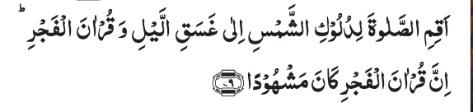
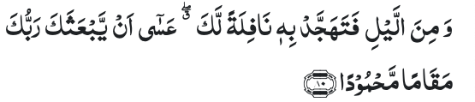
Recitation of the Holy Quran
Observe Prayer at the declining and paling of the sun on to the darkness of the night, and the recitation of the Qur’an in Prayer at dawn. Verily, the recitation of the Qur’an at dawn is specially acceptable to God (17:79)
And wake up for it (the Qur’an) in the latter part of the night as a supererogatory service for thee. It may be that thy Lord will raise thee to an exalted station. (17:80)

Slide 4
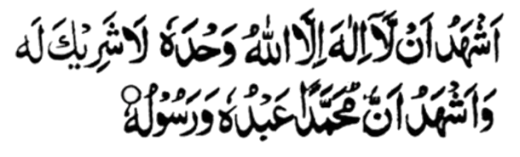
Ansar Pledge
Say this part three times:
Ash-hadu • alla ilaha • illallahu • wahdahu • la sharika lahu • wa ash-hadu • anna Muhammadan • ‘abduhu • wa rasuluh
Say this part once:
I bear witness • that there is none worthy of worship • except Allah. • He is One • (and) has no partner, • and I bear witness • that Muhammad (peace be upon him) • is His servant • and messenger.
Say this part once:
I solemnly pledge • that I shall endeavor • throughout my life • for the propagation • and consolidation • of Ahmadiyyat in Islam, • and shall stand guard • in defense of • the institution of Khilafat. • I shall not hesitate • to offer any sacrifice • in this regard. • Moreover, • I shall exhort my children • to always remain dedicated • and devoted • to Khilafat. • Insha’allah.

Slide 5
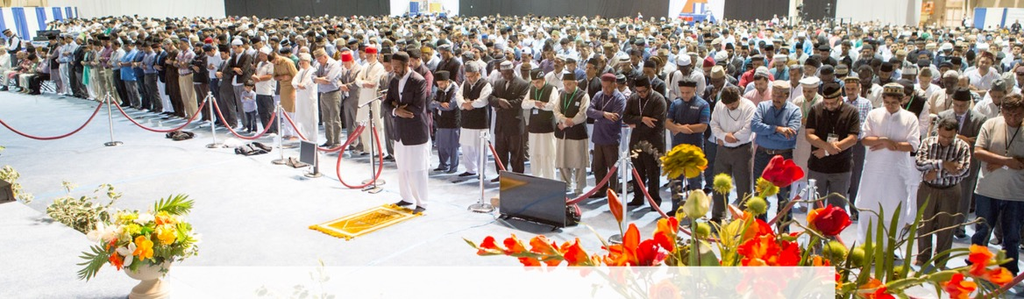
Salat Page
“Salat definitely and surely dispels evils. Salat is not just going through certain postures. The essence of Salat is the supplication that has pleasure and bliss in it.
(Malfuzat Vol. 1 page 103)

Slide 6
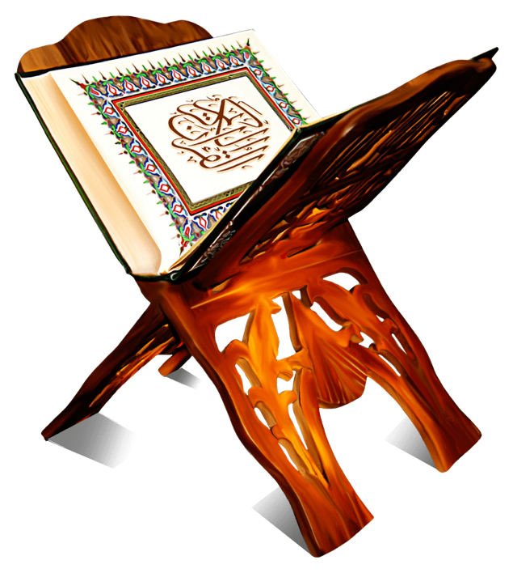
The Holy Quran Segment
Suggested Time = 10 mins
It contains verses, questions
about the verses followed
by commentary

Slide 7
Recitation of the Holy Quran
Observe Prayer at the declining and paling of the sun on to the darkness of the night, and the recitation of the Qur’an in Prayer at dawn. Verily, the recitation of the Qur’an at dawn is specially acceptable to God (17:79)
And wake up for it (the Qur’an) in the latter part of the night as a supererogatory service for thee. It may be that thy Lord will raise thee to an exalted station. (17:80)

Slide 8
Questions
How many salat times are mentioned in this verse?
What is meant by raising to Muqame Mahmood (exalted station) for the Holy Prophet (pbuh)?

Slide 9
Commentary
The word “Dalak Al Shams” implies three phases of the sun: declined from the meridian, or it became yellow or it set. This coincides with three prayers, Zuhr, Asar and Maghrib. Ghasaqillail (Isha’) and Fajar. Thus all five prayer times are mentioned in this verse.
“It may be that thy Lord will raise thee to an exalted station” is a prophecy. The Holy Prophet (pbuh) will be mocked and abused by his opponents. However, the righteous as well as God himself will sing his praises and exalt his status (Five volume commentary)

Slide 10
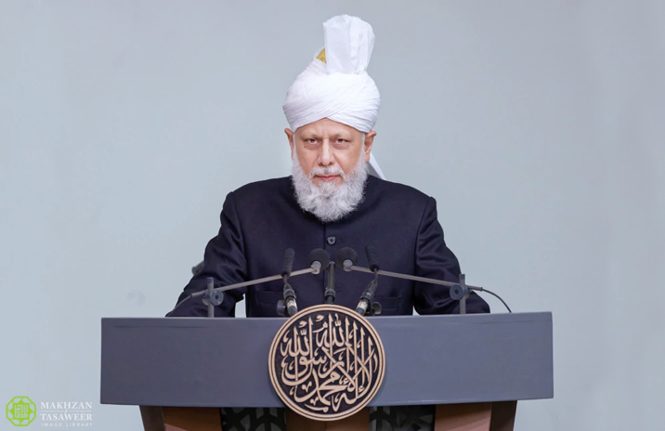
Friday Sermon Segment
Suggested Time = 20 mins
It contains the following items:
Synopsis of Friday Sermon (2 slides)
Scenario discussion and discussion questions (2 slides)
Guidance from Sermon to close the discussion (1 slide)
Take home message from the Sermon (1 slide)

Slide 11
Be regular in Tahajjud
Address Jalsa Salana UK: July 27, 2003
Friday Sermon

Slide 12
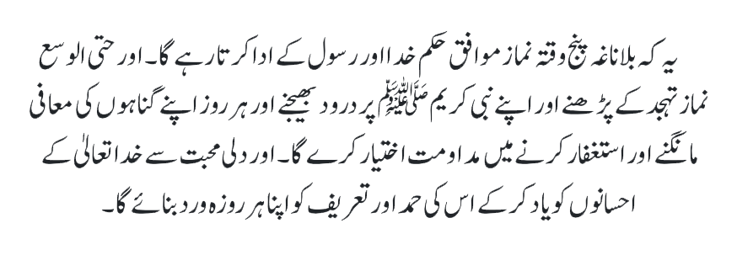
That he/she shall regularly offer the five daily Prayers in accordance with the commandments of God and the Holy Prophet Muhammad^{sa} and shall try his/her best to be regular in offering the tahajjud and invoking durud on the Holy Prophet Muhammad^{sa}. That he/she shall make it his/her daily routine to ask forgiveness for his/her sins, to remember the bounties of God and to praise and glorify Him.
Third condition of Bai’at

Slide 13
Synopsis of the Sermon
Hadrat Abu Hurairah^{ra} narrates that the Holy Prophet^{sa} said, ‘The first thing for which a person would be called to account is the Prayer. If he succeeds in this account, he would be successful and will attain salvation. If that account is deficient, he will be ruined and will be a loser. If there is a shortfall in the obligatory Prayers, Allah will make it up from his nawafil. Similarly, all his other deeds will be accounted for.’ (Sunan-ut- Tirmadhi)
The Holy Prophet^{sa} said, ‘Take heed, if there is no Prayer, there is nothing. Faith without worship is no faith at all.’
Hadrat Abu Hurairah^{ra} has related that the Holy Prophet^{sa} said, ‘Our Lord descends every night to the lowest heaven. When one-third of the night remains, Allah says, “Who will call upon Me, so I should respond to him? Who will beg of Me, so I should grant him? And Who will ask my forgiveness, so I should forgive him?” Allah the Almighty keeps saying so until dawn breaks.’ (Musnad Ahmad bin Hanbal)
Many members of the Community write letters for prayers. If they practice this method of prayer themselves, they will see the blessings of Allah pouring upon them.
Everyone should keep in mind that in order to win the pleasure of Allah, to attain His love, and to have our prayers find acceptance with Allah, we need the intermediation of the Holy Prophet ^{sa} . The best way to do that—as we are told in the hadith—is to invoke Allah’s blessings upon him. The Promised Messiah^{as} has also admonished that durud should be recited abundantly.

Slide 14
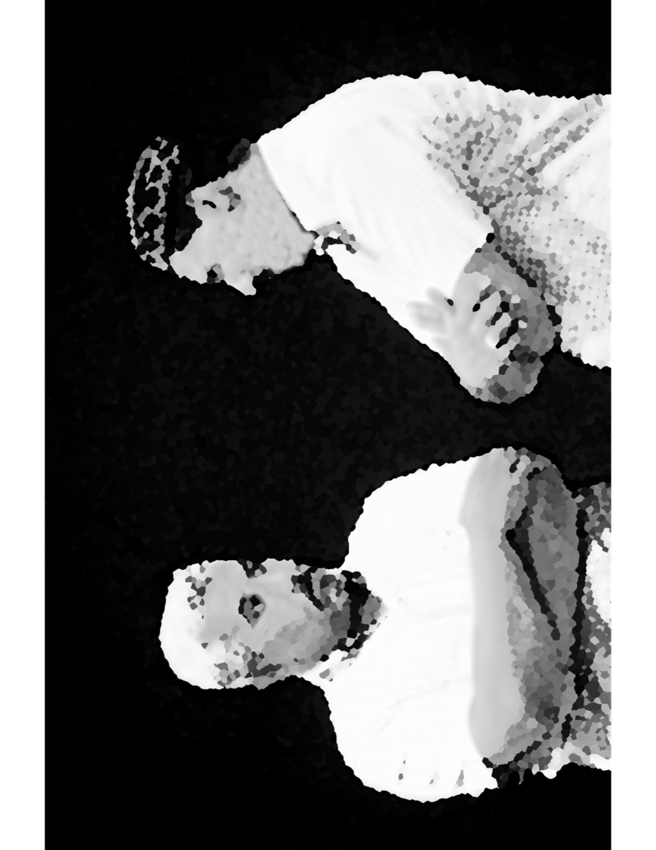
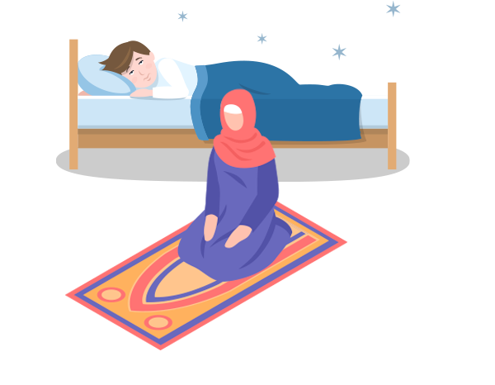
Discussion Scenario
A Nasir works two jobs and comes home late. He has the habit of “catching up” on his sleep on the weekend. His wife was worried that he is not offering any Tahajjud prayers. She had tried to talk to him a few times, but there was no response.
One morning at Tahajjud time, she woke him up. He got very upset at her that she should be mindful of his sleep and rest as it is important for his health. He told her not to wake him up again.

Slide 15
Discussion
Was Nasir’s wife justified in waking him up?
Is Nasir’s response justified?
How would you suggest the Nasir change his habit?

Slide 16
Guidance from Sermon
Hadrat Abu Hurairah^{ra} has related that the Holy Prophet^{sa} said, ‘Allah will have mercy on a man who gets up at night for his [voluntary] Prayer and awakens his wife for the same purpose, and if she hesitates, he sprinkles water over her face to wake her up. And, Allah will have mercy on a woman who gets up at night to offer [voluntary] Prayer and awakens her husband for the same purpose, and if he hesitates, she sprinkles water over his face to wake him up.’
(Sunan Abi Dawud, Kitab-us-Salat)
In our opinion, we have to follow the teachings of Islam regardless of circumstances. In this case the wife was justified in her concerns and would be advisable to continue to encourage him to offer Salat including Tahajjud. The Nasir should not get upset at her encouragement to do so.

Slide 17
Take "home" message
Pick one of the following topics from this Friday sermon to discuss with children/family during casual discussion:
  Discuss the status of congregational Salat in your family
  Discuss the benefits of Salat with your family
  Lead by example and offer Tahajjud prayers and encourage your family to do so?
Tips to engage youth in conversation: (1) Give them more talking time, and (2) use examples from Huzur’s (may Allah be his helper) sermon to make a point.

Slide 18

Mental and Physical health Segment
Suggested Time = 15 mins
It contains questions of
general knowledge and/or
religious knowledge
followed by their answers.
A thought-provoking video and a physical health segment

Slide 19

Mental Health

Slide 20

Quiz
Does water expand, shrink or remains of same size when it freezes?
How much snow would one inch of rain equal to?
What is the total height of Minara-tul-Masih?

Slide 21
1.Most liquids shrink when they freeze. Water also shrinks up to 4ºC. After that it expands with freezing. It expands about 9% (sciencefacts.net)
2. When the temperature drops to 30 F, one inch of liquid precipitation would fall as 10 inches of snow. However, it can vary from 5 inches to 20 inches (nsidc.org)
3. The height of Minara-tul-Masih is 105 feet.
Answers

Slide 22

Entangle
Sometimes, you may need the power of brain rather than that of tools.
Stuck cord: From Science is amazing

Slide 23

Physical Health Segment

Slide 24
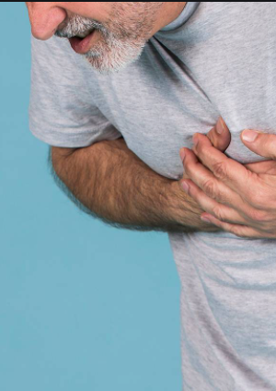
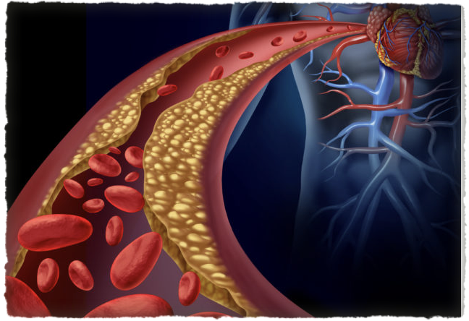
High Risk of Heart Disease in South Asians
Tanvir Ahmed MD
https://stanfordhealthcare.org/stanford-health-now/2015/south-asians-heart-disease-qa.html

Slide 25
High Risk of Heart Disease in South Asians
South Asians (Pakistan India, Bangladesh and other countries in the region) are recently identified as uniquely high-risk group for Heart Disease. Men appear to have a higher risk than women
South Asians have a four times greater risk of heart disease than the general population and have a much greater chance of having a heart attack before age 50.
Heart attacks strike south Asian men and women at younger ages and the attacks are more deadly compared to any other ethnic group
Almost one in three in this group will die from heart disease before age 65.

Slide 26
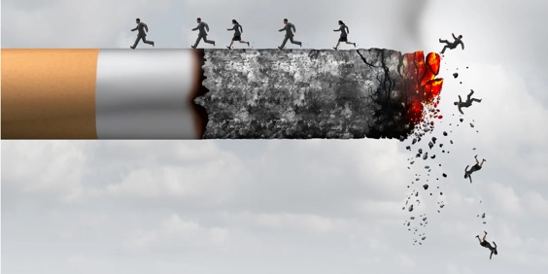
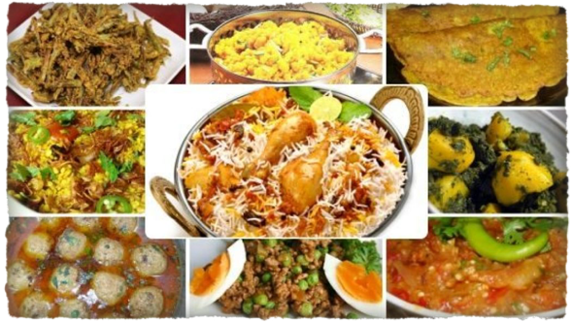
Why are we a High-Risk Group: Smoking and Diet
South Asians tend to be smokers !!!
Typical South-Asian diet tends to be high in sugar, refined grains, and fatty foods

Slide 27
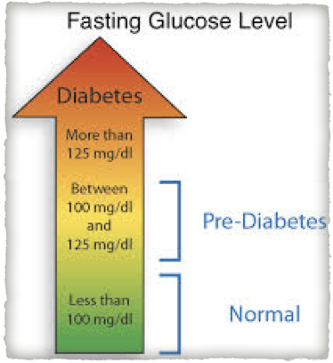
Why are we a High-Risk Group: Pre-Diabetes
Pre-Diabetic. An alarming number of South Asians appear to be insulin resistant, a pre-diabetic condition in which the body does not process insulin efficiently
Insulin-resistant and diabetic patients are at EQUAL HIGH RISK for heart disease

Slide 28
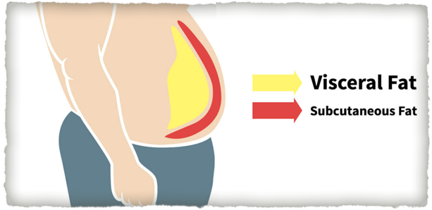
Why are we a High-Risk Group: Thin Fat Syndrome
THIN FAT SYNDROME. Body mass index (BMI) in South Asians often falls into a Thin-fat syndrome
People may have an acceptable BMI (25 or less), but they also carry more of their weight in their abdomen and that visceral fat is more likely to lead to a cardiovascular event (Heart Attack etc.)

Slide 29
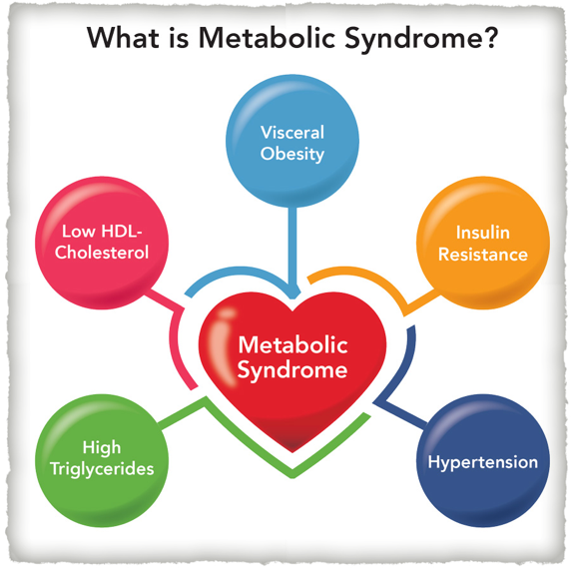
Why are we a High-Risk Group: Metabolic Syndrome
More than 1/3rd of South Asian men and 17% of South Asian women have metabolic syndrome;
Metabolic syndrome is a cluster of conditions
High blood pressure
High blood sugar levels
Excess body fat around the waist
Abnormal cholesterol levels that increase the risk of heart disease, stroke and diabetes
If more than one of these conditions occur in combination, the risk is even greater

Slide 30
What can I do to Reduce My Risk
Knowledge is Power. Becoming aware of your risk at an early age is an important first step
Family history. The most important risk factor is often a family history of diabetes, high cholesterol, or heart disease, all of which are highly prevalent in South Asian families.
Regular Exercise and eating heart-healthy foods will also contribute to lowering your heart disease risk
No Smoking Vaping or any type of tobacco products
Talk to your doctor and get a check up. Call the Helpline or Qa'id Health if you need any assistance

Slide 31
Open Segment
Suggested Time = Zaim’s discretion
Zaim can include any other segment of local interest in this segment

Slide 32
That’s all folks
Reminders/Announcements
Dua
Jazakumullah for Participating!
If you enjoyed it, please convey to those brothers who are not here today!

