Slide 1
Majlis Ansārullāh
Monthly Meeting
June 2021
This slide deck contains images licensed for the purpose of this presentation only.
No one is permitted to use the images for any other use, without prior permission.

Slide 2
Agenda
Recitation of the Holy Quran
Pledge
Salat page
The Holy Quran segment (10 min)
      - Selected verses
      - Questions and commentary
Friday Sermon segment (20 min)
-Sermon synopsis
-Discussion scenario and guidance from sermon
-Take home message
Mental and physical health segment (15 min)
Open slot for local topics
Reminders/announcements
Dua

Slide 3
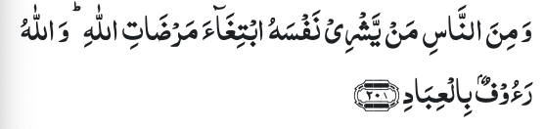




Recitation of the Holy Quran
And of men there is he who would sell himself to seek the pleasure of Allah; and Allah is Compassionate to His servants (2:208)
And thou, O soul at peace! Return to thy Lord well pleased with Him and He well pleased with thee. So enter thou among My chosen servants And enter thou My Garden. (89:28-31)

Slide 4
Ansar Pledge
Say this part three times:
Ash-hadu • alla ilaha • illallahu • wahdahu • la sharika lahu • wa ash-hadu • anna Muhammadan • ‘abduhu • wa rasuluh
Say this part once:
I bear witness • that there is none worthy of worship • except Allah. • He is One • (and) has no partner, • and I bear witness • that Muhammad (peace be upon him) • is His servant • and messenger.
Say this part once:
I solemnly pledge • that I shall endeavor • throughout my life • for the propagation • and consolidation • of Ahmadiyyat in Islam, • and shall stand guard • in defense of • the institution of Khilafat. • I shall not hesitate • to offer any sacrifice • in this regard. • Moreover, • I shall exhort my children • to always remain dedicated • and devoted • to Khilafat. • Insha’allah.

Slide 5
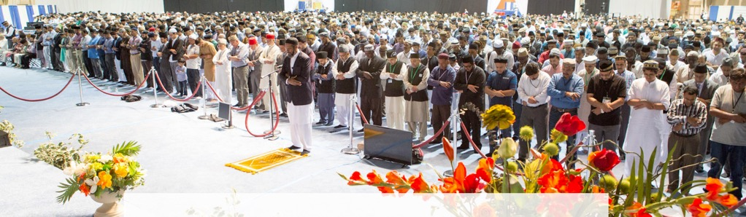
Salat Page
“My experience is that nothing takes one so near to God as Salat. The various postures of the Salat demonstrate respect, humility and meekness. In Qiyam (standing posture) the worshipper stands with his arms folded as a slave stands respectfully before his master and king. In Ruku’ (bowing) the worshipper bends down in humility. The climax of humility is reached in Sajda (prostration) which indicates extreme helplessness
(The Promised Messiah as. Speech at the Jalsa Salana Qadian, 1906)

Slide 6
The Holy Quran Segment
Suggested Time = 10 mins
It contains verses, questions
about the verses followed
by commentary

Slide 7
Recitation of the Holy Quran
And of men there is he who would sell himself to seek the pleasure of Allah; and Allah is Compassionate to His servants (2:208)
And thou, O soul at peace! Return to thy Lord well pleased with Him and He well pleased with thee. So enter thou among My chosen servants And enter thou My Garden. (89:28-31)

Slide 8
Questions
What does it mean to sell one’s self to seek the pleasure of Allah?
What is “soul at peace” and when is this condition achieved?

Slide 9
Commentary
The main concern of such people is to win the pleasure of Allah as if they have given away their souls for this purpose.
“Soul at peace” also called a heavenly stage, man is freed from all weakness and frailty and is braced with a peculiar spiritual strength. He becomes united with God and can’t exist without Him. It is in this life and not after death that this great transformation takes place in him and it is in this world and not elsewhere that access to Paradise is granted to him (Five volume commentary)

Slide 10
Friday Sermon Segment
Suggested Time = 20 mins
It contains the following items:
Synopsis of Friday Sermon (2 slides)
Scenario discussion and discussion questions (2 slides)
Guidance from Sermon to close the discussion (1 slide)
Take home message from the Sermon (1 slide)

Slide 11
Remain faithful to God in all circumstances of life
Address Jalsa Salana Germany: August 24, 2003
Friday Sermon

Slide 12
That he/she shall remain faithful to God in all circumstances of life, in sorrow and in happiness, in adversity and in prosperity, in felicity and in trial; and that he/she shall in all conditions remain resigned to the decree of God and keep himself/herself ready to face all kinds of indignities and sufferings in His way and shall never turn away from Him at the onslaught of any misfortune; on the contrary, he/she shall march forward.
Fifth condition of Bai’at

Slide 13
Synopsis of the Sermon
Hadrat Abu Hurairah ra narrates that the Holy Prophet (pbuh) said, ‘No Muslim suffers any calamity, suffering, pain, discomfort, or anxiety, even as small as the prick of a thorn, but Allah wipes out instead some of his defaults and his sins.’ (Sahih Muslim)
People who are reconciled to the will of Allah, and suffer all hardships and tribulations for His sake, are never left unrewarded by Allah the Almighty.
Hadrat Ibn-e-‘Abbas ra has related that: I was once riding with the Holy Prophet (pbuh). He said, ‘My dear child, I am going to teach you a few things: Keep Allah in mind, He will safe-guard you; keep Allah in mind, you will find Him nearby. When in need, ask only of Allah; if you need help, ask Him alone for help. Remember, if the whole world joins together to benefit you, it can do nothing to benefit you, except if Allah wishes and decrees it for you. And if they all join to hurt you, they can do nothing to hurt you, except if Allah decrees the harm for you. The pens have been stored away and the ink has dried.” (Sunan-ut-Tirmadhi)
When the time of ease comes, do not forget this pledge of bai‘at nor let your future generations forget it. Always remain faithful to the dear Allah, so that His blessings may continue to pour on your future generations; transfer this relationship of fidelity to the coming generations.

Slide 14
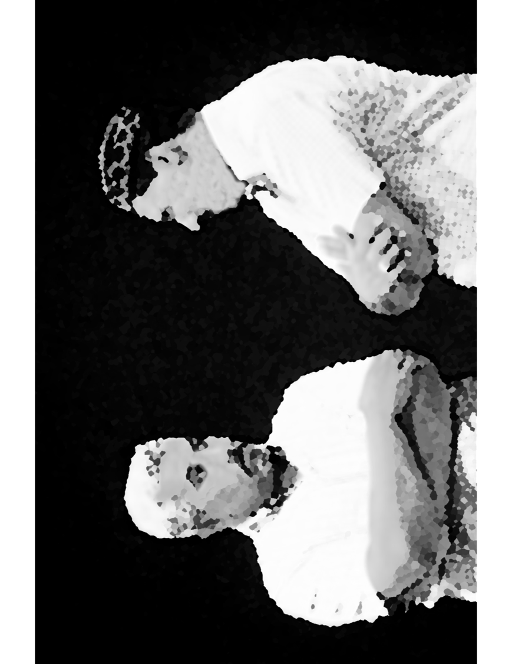
Discussion Scenario
A Nasir’s son was removed from the system of the Jama’at due to a disciplinary action from Huzoor (atba). Nasir was extremely devastated. He joined Ansar meeting after a long absence. He made some comments against the system of the Jama’at. Za’im sahib talked to him after the meeting and advised him to show patience and pray for forgiveness of his son. The Nasir said that he really loves his son and believes that he has done nothing wrong and he disagrees with the judgement. Such punishments could take members away from the Jama’at

Slide 15
Discussion
Please share your thoughts,
Why do you think the Nasir is responding in this way?
What would be an appropriate reaction in this situation?
How should the Za’im handle the situation?

Slide 16
Guidance from Sermon
The Promised Messiah (peace be on him) writes:
It is inevitable that you should be tried with diverse types of pain and misfortune as the faithful before you were tried. Be mindful, lest you should stumble. So long as you have a firm relationship with heaven, the earth can do you no harm. Whenever harm befalls you, it will be through yourself and not through your enemy. Even if you lose all honor on earth, Allah will bestow eternal honor upon you from heaven. So do not let go of Him. It is inevitable that you be persecuted and suffer many disappointments, but do not lose heart, for it is Allah Who tests you whether you are steadfast in His cause or not. If you desire that angels should praise you in heaven, then endure beating and be joyful, hear abuse and be grateful, experience failure and do not cut your relationship with Allah. You are the last Jama‘at of Allah, so practice virtue at its highest level.
The bottom line is, we should have trust in Allah the Almighty and our faith should not waiver no matter what the challenge may be. The Nasir should not jeopardize his faith and trust in the system of the Jama’at by talking negatively in public. He could follow Jama’at guidelines and request Khalifatul Masih (atba) for forgiveness.

Slide 17
Take "home" message
Pick one of the following topics from this Friday sermon to discuss with children/family during casual discussion:
  How can one develop personal relationship with Almighty God?
  Share examples where you had to sacrifice worldly desires to please Almighty God
Tips to engage youth in conversation: (1) Give them more talking time, and (2) use examples from Huzur’s (may Allah be his helper) sermon to make a point.

Slide 18
Mental and Physical health Segment
Suggested Time = 15 mins
It contains questions of
general knowledge and/or
religious knowledge
followed by their answers.
A thought-provoking video and a physical health segment

Slide 19
Mental Health

Slide 20
Quiz
Why do the sun and moon appear around the same size in the sky?
Who is the fastest land animal?
When was the foundation stone of Rabwah (Pakistan) laid?

Slide 21
1. Sun is 400 times larger than the moon, but it is 400 times farther from the earth. That is why they appear to be about the same size in the sky (earthsky.org)
2. Cheetah. Can go as fast as 70 mph (awf.org)
3. September 20, 1948
Answers

Slide 22

Balloon Pop
Why doesn’t the white balloon pop? Simple concept but really effective science demo by Steve Spangler. The white balloon doesn’t absorb as much light (heat) as the other ones (even if it will eventually pop)
Balloon bursting: From Massimo

Slide 23
Physical Health

Slide 24

S H I N G L E S
PREVENTION & TREATMENT
TANVIR AHMED
QAID HEALTH

Slide 25
The Disease
Shingles is a Viral Infection, that causes a painful rash, usually on one side of the body
It is caused by the chicken-pox virus
After chicken pox, the virus never leaves the human body and remains dormant. It reactivates later in life as shingles
You are at risk if you are over 50, have reduced immunity, undergoing cancer treatment etc.

Slide 26

Signs & Symptoms

Slide 27
PREVENTION & TREATMENT
There are two vaccines available for Shingles, Shingrix and Zostavax
Shingrix is preferable, can protect for more than five years. It is recommended for those over 50 yrs. and even if you received Zostavax
Zostavax affords protection for 5yrs. It is recommended for those over 60
There is NO CURE but prompt treatment can speed healing and reduce complications

Slide 28
Open Segment
Suggested Time = Zaim’s discretion
Zaim can include any other segment of local interest in this segment

Slide 29
That’s all folks
Reminders/Announcements
Dua
Jazakumullah for Participating!
If you enjoyed it, please convey to those brothers who are not here today!

