Slide 1
Majlis Ansārullāh
Monthly Meeting
November 2021
This slide deck contains images licensed for the purpose of this presentation only.
No one is permitted to use the images for any other use, without prior permission.

Slide 2
Agenda
Recitation of the Holy Quran
Pledge
Salat page
The Holy Quran segment (10 min)
      - Selected verses
      - Questions and comments
Friday Sermon segment (20 min)
-Sermon synopsis
-Discussion scenario and guidance from sermon
-Take home message
Mental and physical health segment (15 min)
Open slot for local topics
Reminders/announcements
Dua

Slide 3
Recitation of the Holy Quran
And worship Allah and associate naught with Him, and show kindness to parents, and to kindred, and orphans, and the needy, and to the neighbor that is a kinsman and the neighbor that is a stranger, and the companion by your side, and the wayfarer, and those whom your right hands possess. Surely, Allah loves not the proud and the boastful (4:37)

Slide 4
Ansar Pledge
Say this part three times:
Ash-hadu • alla ilaha • illallahu • wahdahu • la sharika lahu • wa ash-hadu • anna Muhammadan • ‘abduhu • wa rasuluh
Say this part once:
I bear witness • that there is none worthy of worship • except Allah. • He is One • (and) has no partner, • and I bear witness • that Muhammad (peace be upon him) • is His servant • and messenger.
Say this part once:
I solemnly pledge • that I shall endeavor • throughout my life • for the propagation • and consolidation • of Ahmadiyyat in Islam, • and shall stand guard • in defense of • the institution of Khilafat. • I shall not hesitate • to offer any sacrifice • in this regard. • Moreover, • I shall exhort my children • to always remain dedicated • and devoted • to Khilafat. • Insha’allah.

Slide 5
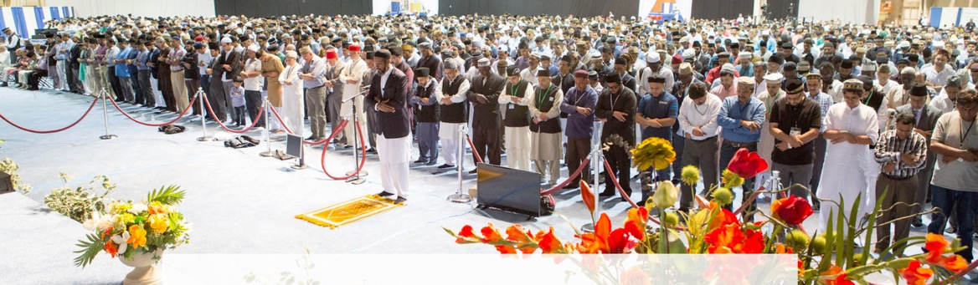
Salat Page
All physical postures during the Salat should represent the condition of the heart also. When the worshipper stands in the Salat his heart should also be standing erect for God's obedience; when he bows down the heart should also bow down; and when he goes into prostration the heart should also prostrate itself, which means that the heart should not let go of God at any time. When he reaches that condition, he will begin to get rid of sins
(Malfuzat, Vol. VI, pp. 367-368).

Slide 6
The Holy Quran Segment
Suggested Time = 10 mins
It contains verses, questions
about the verses followed
by commentary

Slide 7
Recitation of Holy Quran
And worship Allah and associate naught with Him, and show kindness to parents, and to kindred, and orphans, and the needy, and to the neighbor that is a kinsman and the neighbor that is a stranger, and the companion by your side, and the wayfarer, and those whom your right hands possess. Surely, Allah loves not the proud and the boastful (4:37)

Slide 8
Questions
Muslims are encouraged to be kind to which segments of the society in this verse?
How does Allah the Almighty characterize people who do not show kindness to fellow human beings?

Slide 9
Commentary
In this verse the Holy Quran enjoins a Muslim to make his kindness so comprehensive as to include in his scope the whole of mankind, from parents who are the nearest, to strangers who are the farthest removed.
In addition to looking down and behaving arrogantly, the very act of abstaining from being kind to one’s fellow beings, whether relations or neighbors or strangers, is an act of pride condemned by Islam (Five volume commentary)

Slide 10
Friday Sermon Segment
Suggested Time = 20 mins
It contains the following items:
Synopsis of Friday Sermon (2 slides)
Scenario discussion and discussion questions (2 slides)
Guidance from Sermon to close the discussion (1 slide)
Take home message from the Sermon (1 slide)

Slide 11
Endeavor towards beneficence of mankind
Friday Sermon Fazal Mosque, London: September 12, 2003
Friday Sermon

Slide 12
That he/she shall keep himself/herself occupied in the service of God’s creatures for His sake only and shall endeavor towards the beneficence of mankind to the best of his/her God given abilities and powers.
Ninth condition of Bai’at

Slide 13
Synopsis of the Sermon
Develop compassion for God’s creatures, with the understanding that it is something more than a good deed, it falls into the category of benevolence.
The kindness you show towards others should be motivated by heartfelt love and not to seek acknowledgement from people for the favor.
One interpretation of this is that despite their own needs, those who love Allah take care of the needs of others in order to attain the love of Allah the Almighty. They themselves stay hungry, yet they feed others.
Hadrat ‘Abdullah Bin Mas‘ud (ra) states that the Messenger of Allah (pbuh)said, ‘All creatures are God’s family. So, Allah likes the person, from among all humans, who treats His family (creatures) well and looks after their needs.’ (Mishkat-ul-Masabih)
Thus, if you had overlooked the faults of your brethren, if you had tried to counsel them with sympathy instead of making their weaknesses public, Allah will overlook your faults as well.
I appeal to every Ahmadi doctor, every Ahmadi teacher, every Ahmadi lawyer, and every Ahmadi who by virtue of his profession can serve humanity in any way, to try to help the poor and the needy. As a reward, Allah the Almighty will increase your wealth and your lives even more.

Slide 14
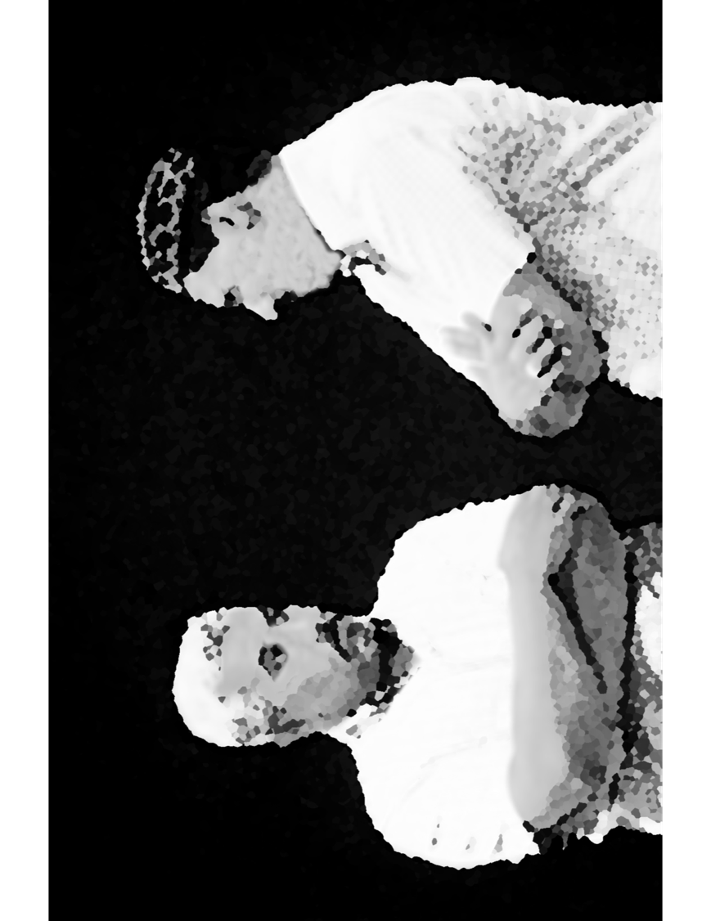
Discussion Scenario
Za’im of a Majlis launched a program to send clothing to the needy members in Pakistan, India and Africa. A collection drive was initiated. After a week, he was pleased to see a large stack of clothing. He noticed that along with nice, and clean clothes there were many used, worn out and even smelly clothes.
In the next Ansar monthly meeting he expressed his disappointment and wanted to cancel the initiative. He asked the members to take their clothing back.

Slide 15
Discussion
In your opinion,
The Za’im sahib was justified in his response. He wanted to teach the members a lesson.
The Za’im should have taken the good clothes and discarded the rest and not say anything to the membership. Afterall, the members donated items.
Why did the members send old and worn-out clothing?
Any other suggestions?

Slide 16
Guidance from the Sermon
Some people write to me saying that they want to give— for the weddings of poor girls—good clothes that have only been worn for a day or two and were not used again because they were too small or for some other reason. In this regard, it must be clear that even if these items are being given through the auxiliary organizations of Ahmadiyya Muslim Jama‘at, like Lajnah Ima’illah or Khuddam-ul-Ahmadiyyah, or even if they are being given individually, they should respect the dignity of the poor. They should give away items in a condition that they are still worth giving. The items should not be completely worn out with stains, stench of sweat, etc. If such clothes are given, they should be washed, cleaned, and mended first. As I have said, our auxiliary organizations like Lajnah Ima’illah also distribute such clothes. They should make it clear to the recipients that these clothes are used and that they should only accept them if they choose to. Everyone has a sense of honor, and as I have said earlier, this sense of honor should be respected.
The bottom line is, in our opinion, some members did not pay regard for the dignity of the needy. Za’im sahib has to discuss this with the members of the Majlis.

Slide 17
Take home message?
Pick one of the following topics from this Friday sermon to discuss with children/family during casual discussion:
  As a family, come with a plan to donate in charity and help the needy.
  Discuss the ways of being thankful to the Almighty for His blessings on you and your family.
Tips to engage youth in conversation: (1) Give them more talking time, and (2) use examples from Huzur’s (may Allah be his helper) sermon to make a point.

Slide 18
Mental and Physical health Segment
Suggested Time = 15 mins
It contains questions of
general knowledge and/or
religious knowledge
followed by their answers.
A thought-provoking video and a physical health segment

Slide 19
Mental Health

Slide 20
Quiz
Which is the hottest planet in the solar system?
Which is the most hard-working muscle in the human body?
What type of plague spread in India according to the prophecy of the Promised Messiah (as)?

Slide 21
1. Venus is the hottest planet in solar system with average temperature of 450 C. (theplanets.org)
2. The heart, which consists of cardiac muscle, is said to be the hardest working muscle in the body. The average adult heart beats 72 times a minute; 103,680 times a day; 37,843,200 times a year; and 2.6 billion times during a 70-year span. This is a great example of dynamic strength as well as endurance.
3. Bubonic Plague is an infectious disease that affects rodents, certain other animals, and humans. It is caused by the Yersinia pestis bacteria. People most commonly acquire plague when they are bitten by a flea that is infected with the plague bacteria. In India, the first case was reported in 1896 (CDC.gov)
Answers

Slide 22

Perspective
“The days are long, but the years are short.”
This brilliant painting shows human aging
From Dr. Kash Sirinanda

Slide 23
Physical Health
Suggested Time = 10 mins
It contains the health tips

Slide 24
Exercise for Life
Exercise is crucial for a health
A combination exercise routine will likely result in the greatest health benefits
Moderation, regularity and sustainable exercise routines will also result in greatest benefit and minimize injury and harm

Slide 25
Aerobic Exercises
Aerobic or Endurance exercises improve cardiovascular health, stamina and energy. These exercises promote healthy weight loss
Examples of low-impact aerobic exercises are walking, bicycling, swimming and ellipticals
Moderate intensity aerobic exercise is the safest and most effective if done 5 days of the week.
Work your way up to 150 minutes per week. You can split that time into 10-minute blocks if needed
Email or call Qa'id Health to help you started with a custom exercise program

Slide 26
Strengthening Exercises
These exercises help you build strong muscles that help support and protect your joints.
Weight training is an example of a strengthening exercise.
Avoid exercising the same muscle groups two days in a row. Rest a day between your workouts
A three-day-a-week program can help you jump-start your improvement, but two days a week is all you need to maintain your gains

Slide 27
Yoga
Yoga is a mind-body workout that combines strengthening and stretching poses with deep breathing and meditation or relaxation
There are over a hundred types of yoga, some fast-paced and intense others gentle and relaxing
You are never too old to start yoga
You can start a program and then continue at home. It requires almost no equipment
It does require discipline and routine
Check out the video https://www.ted.com/talks/krishna_sudhir_what_yoga_does_to_your_body_and_brain/transcript?language=en#t-1026

Slide 28
Open Segment
Suggested Time = Zaim’s discretion
Zaim can include any other segment of local interest in this segment

Slide 29
That’s all folks
Reminders/Announcements
Dua
Jazakumullah for Participating!
If you enjoyed it, please convey to those brothers who are not here today!

