Slide 1

Majlis Ansārullāh
Monthly Meeting
March 2022
This slide deck contains images licensed for the purpose of this presentation only.
No one is permitted to use the images for any other use, without prior permission.

Slide 2

Agenda
Recitation of the Holy Quran (5 mins)
Pledge
The Holy Quran segment (10 min)
Khalifa’s guidance segment: Based on Huzoor’s address in the final
  session of UK Ansarullah Ijtema, 9/12/21 (20 min)
Domestic responsibility segment (10 mins)
Salat (Daily Prayers) Segment (5 mins)
Health segment (10 min)
Technology segment (5 mins)
Open slot for local topics (10-20 mins)
Reminders/announcements (5 mins)
Dua’
Suggested Total Time (75 – 90 mins)

Slide 3
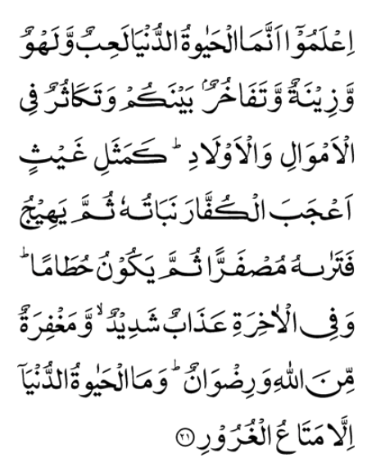
Recitation of the Holy Quran
Know that the life of this world is only a sport and a pastime, and an adornment, and a source of boasting among yourselves, and of rivalry in multiplying riches and children. This life is like the rain, the vegetation produced whereby rejoices the tillers. Then it dries up and thou seest it turn yellow; then it becomes broken pieces of straw. And in the Hereafter, there is severe punishment, and also forgiveness from Allah, and His pleasure. And the life of this world is nothing but temporary enjoyment of deceitful things.
(57:21)

Slide 4
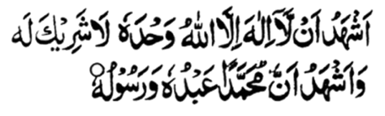
Ansar Pledge
Say this part three times:
Ash-hadu • alla ilaha • illallahu • wahdahu • la sharika lahu •
wa ash-hadu • anna Muhammadan • ‘abduhu • wa rasuluh
Say this part once:
I bear witness • that there is none worthy of worship • except Allah. • He is One • (and) has no partner, • and I bear witness • that Muhammad (peace be upon him) • is His servant • and messenger.
Say this part once:
I solemnly pledge • that I shall endeavor • throughout my life • for the propagation • and consolidation • of Ahmadiyyat in Islam, • and shall stand guard • in defense of • the institution of Khilafat. • I shall not hesitate • to offer any sacrifice • in this regard. • Moreover, • I shall exhort my children • to always remain dedicated • and devoted • to Khilafat. • Insha’allah.

Slide 5

The Holy Quran Segment
Suggested Time = 10 mins
It contains verses, questions
about the verses, followed
by commentary and discussion

Slide 6
Verses Recited Earlier
Know that the life of this world is only a sport and a pastime, and an adornment, and a source of boasting among yourselves, and of rivalry in multiplying riches and children. This life is like the rain, the vegetation produced whereby rejoices the tillers. Then it dries up and thou seest it turn yellow; then it becomes broken pieces of straw. And in the Hereafter, there is severe punishment, and also forgiveness from Allah, and His pleasure. And the life of this world is nothing but temporary enjoyment of deceitful things.
(57:21)

Slide 7
Commentary
In 57:21 why is the life in this world called a sport and pastime?
In this verse what is the wasted life of this earth likened to and why?

Slide 8
Commentary
Life spent in forgetfulness of God and disregard of its higher values is described in this verse as sprot and pastime otherwise man’s life on this earth is a serious matter
Life devoted to obtaining materialistic pleasures has been likened to the end of a blooming and blossoming crop over which a scorching wind has blown turning into broken pieces of straw

Slide 9
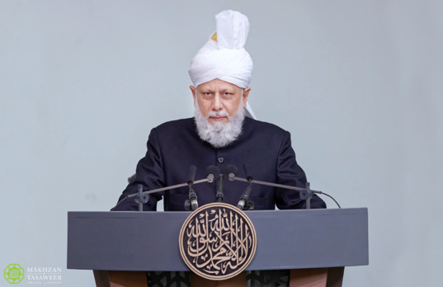
Khalifa’s guidance (aba)
Suggested Time = 20 mins
(All Ansar members need to participate in this discussion)
It contains the following items:
Scenario question and discussion (2 slides)
Guidance from the Khalifa (1 slide)
Take home message from the speech (1 slide)

Slide 10
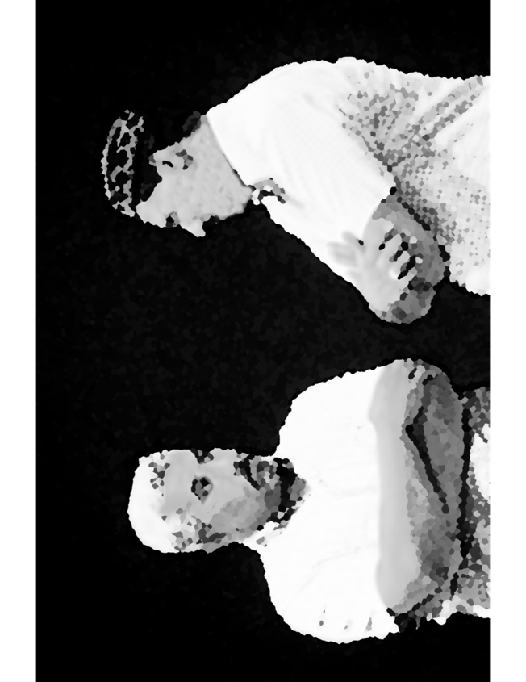
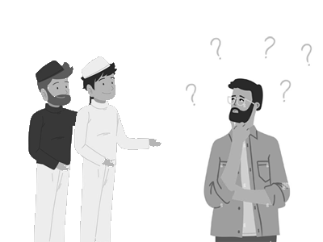
Discussion Scenario
One of the local Majalis held a tabligh meeting. Several non-Ahmadi guests participated. One individual expressed his disappointment that Ahmadis have been suffering for a while. Early on in India, and later in Pakistan. Several Ahmadis live a difficult life, and some are eventually killed in this cause. He was also surprised that most Ahmadis still stay connected with the Jama’at when they can easily have a life of ease and comfort outside the community.

Slide 11
Questions
Why do you think Ahmadi Muslims have been persecuted?
How would you explain the fact that Ahmadi Muslims do not leave the community to live the life of ease and comfort?

Slide 12
“World is a prison for the believer”
“On one occasion the Promised Messiah (peace be upon him) stated that people have now ventured far from the truth of Islam and that they have no idea what the truth of Islam is. True life in Islam requires a sort of death, in the form of hardship. But in the end, only he who attains this is truly alive. It is said in the sayings of the Holy Prophet (peace and blessings be upon him) that man considers the desires and luxuries of this world as heaven even though they are, in reality, hell, whilst the righteous person endures difficulties in the path of God, and this is heaven.”

Slide 13
Take "home" message?
Please review the following with children/family during casual discussion:
  Think about any unnecessary materialistic pursuits in your life and ways to overcome them?
Tips to engage youth in conversation: (1) Give them more talking time, and (2) use examples from Huzur’s (may Allah be his helper) sermon to make a point.

Slide 14
Domestic responsibility Segment
I have observed that children of such homes where parents do not have a loving relationship mostly find comfort outside of home. Therefore, I will say to the parents not to ruin the peace of the homes due to their personal egos and petty wishes and ultimately ruin their children. They should try to become leaders of the righteous and honor their trusts in the true sense. They should also fulfill their pledge and their promise that they took after taking the Bai’at of the Promised Messiah (on whom be peace). May Allah the exalted enable everyone to do so, Ameen. (Address to ladies Jalsa Salana Germany 8/15/2009)

Slide 15
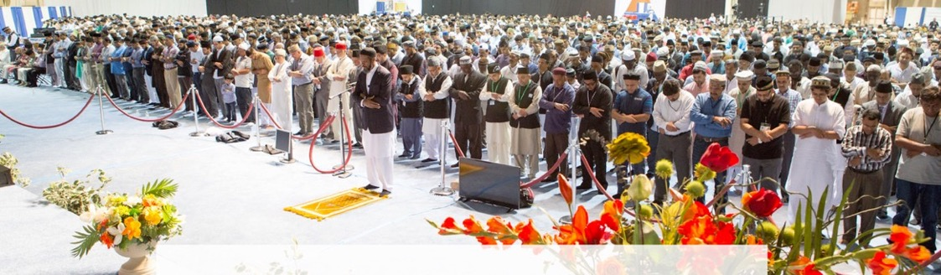
Salat Page
Salat is the best educator and the most excellent means of teaching perfect servitude. […] Be dutiful to Salat in such a way that, not only your body or tongue, but also all the intentions and passions of your soul entirely become Salat.
(Malfuzat Vol. 1 page 108)

Slide 16

Mental & Physical health Segment
Suggested Time = 15 mins
It contains
Questions of general knowledge and/or religious knowledge followed by their answers.
A thought-provoking video
A physical health segment

Slide 17


Mental Health
Which is the most broken bone in the body?
  Femur
  2. Collar bone
  3. Skull
What is incubation period?
  Diseases in babies
  Someone with infection with no symptoms
  Period of recovery after sickness
When did Alexander Dowie pass away?
  March 1907,
  March 1908,
  March 1909

Slide 18

Answers
Collar bone (Clavicle)
Period of illness when someone is infected by an organism but not yet showing symptoms. One may be infectious at this time (infect those around them)
March 1907

Slide 19


Technology Video
Answers
Link embedded within the above thumbnail,
it can be played by clicking on it in presentation mode
https://www.youtube.com/watch?v=Xenr8Vhi0-g

Slide 20
Social Media
Answers
The Good
The Bad/Ugly
Online Social Networks -> Social Media
Collaborative learning
Strengthen relationships
Support Groups
Campaigning for Social Good
Sharing experiences/expertise
Connect anytime
Exploration of different topics
Cyberbullying: posting, or sharing negative, harmful, false, or mean content about someone else
Echo Chamber: beliefs are amplified or reinforced by communication and repetition inside a closed system and insulated from rebuttal
Trolling: intentionally antagonizes others online by posting inflammatory, irrelevant, or offensive comments (“Troll Farms”)
Witch Hunts: campaign targeting a person or group who holds an unorthodox or unpopular view
Privacy Abuse: Companies sell or allow third parties to access data
Doomscrolling: Constant barrage of bad news creates anxiety/depression
Addictive: Activation of reward centers in the brain similar to cocaine

Slide 21
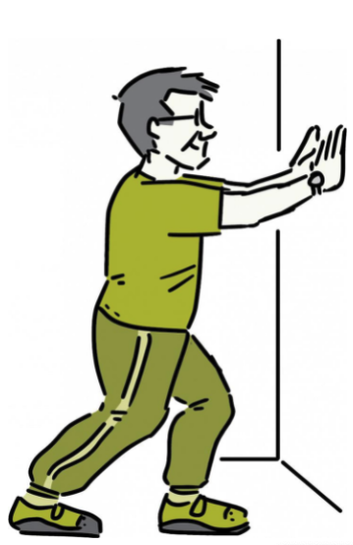
You’re Never too Old
Keep Active as you age
Health talk
Answers
Exercise for Life
https://newsinhealth.nih.gov/2011/12/youre-never-too-old
It is absolutely never too late to start to exercise
Exercise is Medicine - You will start to feel and look good, no matter when you start to exercise
Exercise is crucial to maintain your physical and mental well being. You will look and feel better

Slide 22
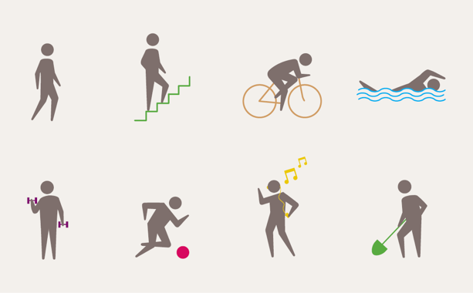
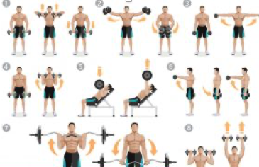
Aerobic Exercises
Strengthening Exercises
Aerobic, low-impact endurance exercises improve heart health, stamina, energy and promote healthy weight loss
The best exercises are walking, bicycling water aerobics-swimming at any age
Exercise regularly, most day of the week and at least 150 minutes per week.
Weight Training builds muscles, improves joint stability and mobility
Start low and go slow and exercise different muscle groups each day
Exercise different group of muscles every day

Slide 23
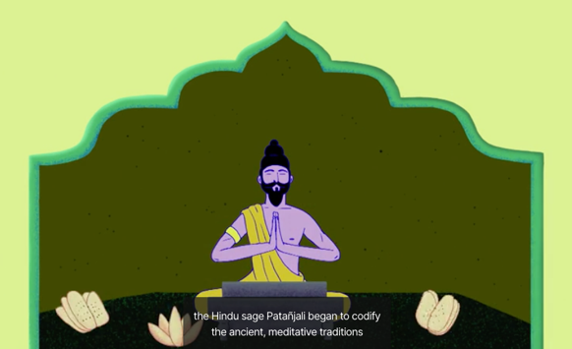
You can start a Yoga program at any age, needs no special equipment or gym
Check out the video https://www.ted.com/talks/krishna_sudhir_what_yoga_does_to_your_body_and_brain/transcript?language=en#t-1026
Yoga
Yoga is a mind-body workout that combines strengthening and stretching poses with deep breathing and meditation or relaxation
There are over a hundred types of yoga, some fast-paced, others gentle and relaxing

Slide 24
LOCAL TOPICS

Slide 25
That’s all folks
Reminders/Announcements
Dua
Jazakumullah for Participating!
If you enjoyed it, please convey to those brothers who are not here today!

