Slide 1

Majlis Ansārullāh
Monthly Meeting
June 2022
This slide deck contains images licensed for the purpose of this presentation only.
No one is permitted to use the images for any other use, without prior permission.

Slide 2

Agenda
Recitation of the Holy Quran (5 mins)
Pledge
The Holy Quran segment (10 min)
Khalifa’s guidance segment: Based on Huzoor’s address in the final
  session of UK Ansarullah Ijtema, 9/12/21 (20 min)
Domestic responsibility segment (10 mins)
Salat (Daily Prayers) Segment (5 mins)
Health segment (10 min)
Technology segment (5 mins)
Open slot for local topics (10-20 mins)
Reminders/announcements (5 mins)
Dua’
Suggested Total Time (75 – 90 mins)

Slide 3
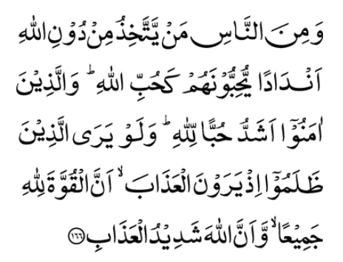
Recitation of the Holy Quran
And there are some among men who take for themselves objects of worship other than Allah, loving them as they should love Allah. But believers are stronger in their love for Allah. And if those who transgress could now see the time when they shall see the punishment, they would realize that all power belongs to Allah and that Allah is severe in punishing.
(2:166)

Slide 4
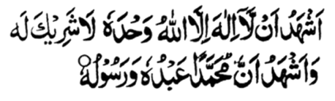
Ansar Pledge
Say this part three times:
Ash-hadu • alla ilaha • illallahu • wahdahu • la sharika lahu •
wa ash-hadu • anna Muhammadan • ‘abduhu • wa rasuluh
Say this part once:
I bear witness • that there is none worthy of worship • except Allah. • He is One • (and) has no partner, • and I bear witness • that Muhammad (peace be upon him) • is His servant • and messenger.
Say this part once:
I solemnly pledge • that I shall endeavor • throughout my life • for the propagation • and consolidation • of Ahmadiyyat in Islam, • and shall stand guard • in defense of • the institution of Khilafat. • I shall not hesitate • to offer any sacrifice • in this regard. • Moreover, • I shall exhort my children • to always remain dedicated • and devoted • to Khilafat. • Insha’allah.

Slide 5

The Holy Quran Segment
Suggested Time = 10 mins
It contains verses, questions
about the verses, followed
by commentary and discussion

Slide 6
Verse Recited Earlier
And there are some among men who take for themselves objects of worship other than Allah, loving them as they should love Allah. But believers are stronger in their love for Allah. And if those who transgress could now see the time when they shall see the punishment, they would realize that all power belongs to Allah and that Allah is severe in punishing.
(2:166)

Slide 7
Understanding the Verse
Based on verse 2:166 what is one of the qualities of believers?
Why should one love Allah the Almighty?

Slide 8
Commentary
The verse says that “believers are stronger in their love of Allah”. In other words, their love of Allah the Almighty is stronger than all other attractions and desires. We must reach high standards of love and relationship with Allah the Almighty.
No other subject has been so completely and so repeatedly dealt with in the Quran as God’s beauty and beneficence and such of His attributes as create an irresistible love and longing in the human soul for the Supreme being.

Slide 9
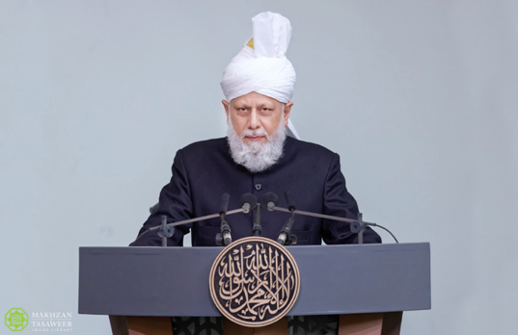
Khalifa’s guidance (aba)
Suggested Time = 20 mins
(All Ansar members need to participate in this discussion)
It contains the following items:
Scenario, question and discussion (2 slides)
Guidance from the Khalifa (1 slide)
Take home message from the speech (1 slide)

Slide 10
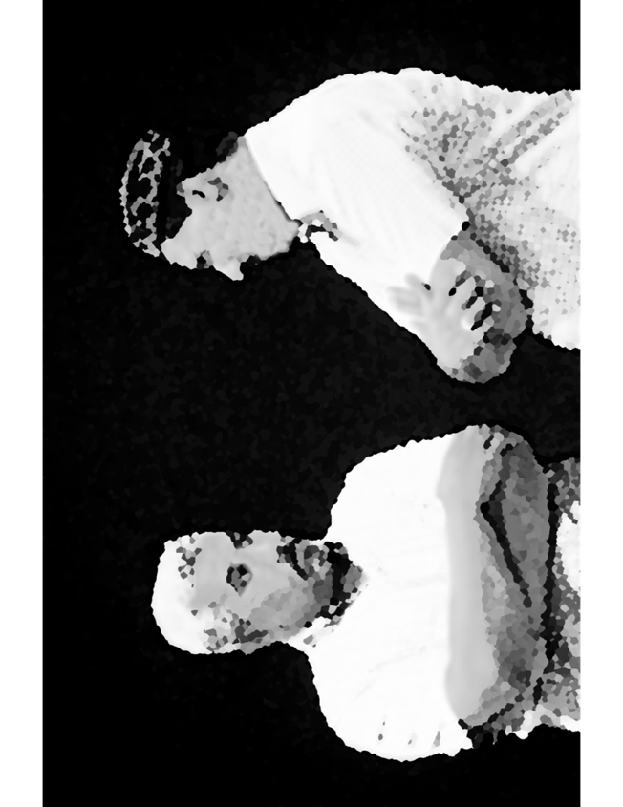


Discussion Scenario
A young Khadim approached his dad after having a discussion with his atheist friend. The two were discussing the concept of God. The atheist friend asked the Khadim as to why does he love God? The Khadim explained that if we do not follow God’s commandments and do not worship Him, we will go to hell. The atheist friend exclaimed that you worship a “policeman” up in the heaven?

Slide 11
Questions
Was Khadim’s response, correct?
How would you have responded to the atheist?
What are some of the ways to earn love of Allah the Almighty?

Slide 12
True love of Allah the Almighty
“I believe in heaven and hell and that they are a reality and that their punishments, blessings and pleasures are all true. But I say that man should not perform the worship of God on the basis of heaven or hell. Rather, he should do so because of his personal connection and love with Allah…”
“Does a mother care for her child in the hope that when the child grows older, he will feed her? No! Rather her love is pure. To such an extent that if a king was to instruct her, that if you neglect this child and it dies you shall not be punished in any way, rather will be given a reward, would she be happy with this command or would she rebuke the king? This is pure love, and it is in this spirit that one should worship Allah the Almighty, not out of a desire of any reward or fear of punishment.”
Based on Huzoor’s address in the final session of UK Ansarullah Ijtema, 9/12/21

Slide 13
Take "home" message?
Please review the following with children/family during casual discussion:
  What practical steps we can take as a family to develop relationship with Allah the Almighty
Tips to engage youth in conversation: (1) Give them more talking time, and (2) use examples from Huzur’s (may Allah be his helper) sermon to make a point.

Slide 14
Domestic responsibility Segment
‘Men who eye their wives’ property should take heed from this that it is their responsibility to provide, and they have no right over the property of their wives. They are indeed responsible to meet the full expenses of wives and children. No matter what the situation is, even if they have to take on manual work, it is their obligation to meet the expenses of the household. If prayer is made along with hard work, Allah the Exalted blesses and grants increase [in income].’
(Friday sermon delivered on 2 July 2004 at International Centre, Mississauga, Canada. Published in Al Fazl International 16 July 2004)

Slide 15
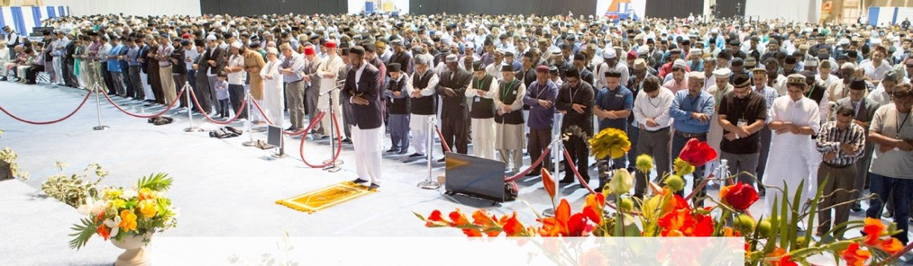
Salat Page
Salat is an instrument for security against sins. It is a characteristic feature of Salat that it drives one away from sin and evil deeds. Therefore, seek that sort of Salat and try to mold your Salats accordingly. Salat is the essence of blessings. Favors of Allah are attained through the Salat. Therefore, perform it decently that you may inherit Allah’s blessings. (Malfuzat Vol. 3 p 103)

Slide 16

Mental & Physical health Segment
Suggested Time = 15 mins
It contains
Questions of general knowledge and/or religious knowledge followed by their answers.
A thought-provoking video
A physical health segment

Slide 17


Mental Health
What is greenhouse effect?
  Green color makes house look spacious
  2. Vegetables grow faster in a greenhouse
  3. Gases in earth’s atmosphere prevent heat from escaping into the space
Based on scientific experiments, inhaling steam works for COVID patients?
  1. True 2. False
What was the duration mentioned in the prophecy regarding Lekh Ram during which he was going to suffer Divine wrath?
  Six years
  2. No time mentioned
  3. Six months

Slide 18

Answers
  Gases in earth’s atmosphere prevent heat from escaping into the space. This is called greenhouse effect and leads to global warming
  False. Steam inhalation has no benefit in treating COVID
  Within a span of six years, this person will be grievously punished by God Almighty for his disrespectfulness and profanities he uttered against the Holy Prophet of Islam. (Aeena Kamalate Islam)?

Slide 19
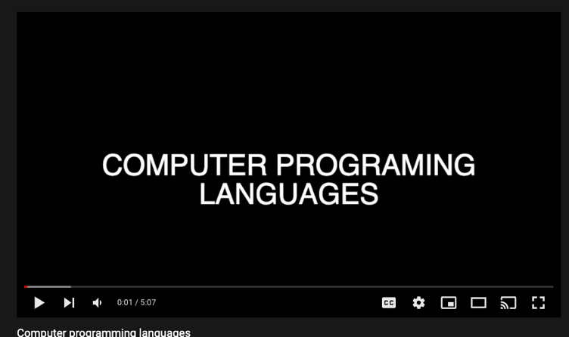

Technology Video
Answers
Link embedded within the above thumbnail,
it can be played by clicking on it in presentation mode
https://www.youtube.com/watch?v=B7MSwtRY5Z8

Slide 20

The life of Programmer
What do programmers do?
Essentially programmers solve problems (requirements) by writing code in small steps known as functions
Programmers write code that logically solves problems
Programmers need to know the syntax of a language as well the ecosystem of the language (database, filesystem, networking, etc.)
The more code you write and review, the better you become
Anyone can start coding and improve their skills with patience and practice

Slide 21
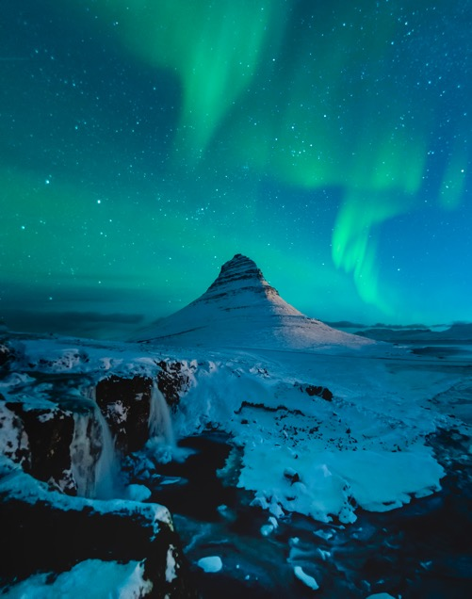
Mental Well Being
Health talk
What is Mental Health
Mental health includes our emotional, psychological, and social well-being. It affects how we think, feel, and act
Mental well being helps determine how we handle stress, relate to others, and make choices
Mental health is important at every stage of life, from childhood and adolescence through adulthood
It is a health problem like other health issues, and one should not be ashamed of or feel guilty of diagnosis

Slide 22

Health talk
Mental Health and Wellness
Positive mental health allows people to
  Realize their full potential, cope with the stresses of life, work productively, make meaningful contributions to their communities
Many factors contribute to mental health problems
  Biological factors such as genes and brain chemistry
  Life experiences such as trauma or abuse

Slide 23
Early Warning Signs
Experiencing one or more of the following feelings or behaviors can be an early warning sign of a problem:
  Eating or sleeping too much or too little, feeling helpless or hopeless
  Pulling away from people and usual activities, having low energy
  Inability to perform daily tasks like taking care of your kids or getting to work or school
  Smoking, drinking, or using drugs ( new or more than usual)
  Feeling unusually confused, forgetful, on edge, angry, upset, worried, or scared
  Yelling or fighting with family and friends, experiencing severe mood swings that cause problems in relationships
  Having persistent thoughts and memories you can't get out of your head, hearing voices or believing things that are not true
  Thinking of harming yourself or others

Slide 24

Mental Health and Wellness
Ways to maintain positive mental health include
  Getting professional help if you need it
  Connecting with others
  Staying positive
  Getting physically active
  Helping others
  Getting enough sleep
  Developing coping skills
  Prayers

Slide 25
LOCAL TOPICS

Slide 26
That’s all folks
Reminders/Announcements
Dua
Jazakumullah for Participating!
If you enjoyed it, please convey to those brothers who are not here today!

