Slide 1

Majlis Ansārullāh
Monthly Meeting
August 2022
This slide deck contains images licensed for the purpose of this presentation only.
No one is permitted to use the images for any other use, without prior permission.

Slide 2

Agenda
Recitation of the Holy Quran (5 mins)
Pledge
The Holy Quran segment (10 min)
Khalifa’s guidance segment: Based on Huzoor’s address in the final
  session of UK Ansarullah Ijtema, 9/12/21 (20 min)
Domestic responsibility segment (10 mins)
Salat (Daily Prayers) Segment (5 mins)
Health segment (10 min)
Technology segment (5 mins)
Open slot for local topics (10-20 mins)
Reminders/announcements (5 mins)
Dua’
Suggested Total Time (75 – 90 mins)

Slide 3

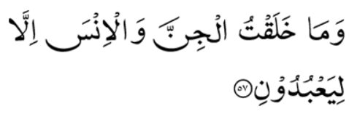
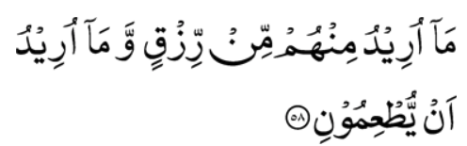

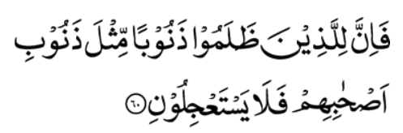
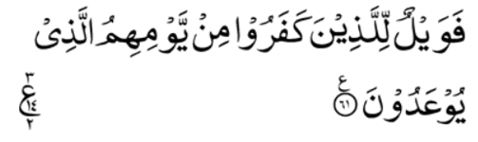
Recitation of the Holy Quran
And keep on exhorting; for verily, exhortation benefits those who would believe.
And I have not created the Jinn and the men but that they may worship Me.
I desire no sustenance from them, nor do I desire that they should feed Me
Surely, it is Allah Himself Who is the Great Sustainer, the Lord of Power, the Strong
So, the fate of those who do wrong shall surely be like the fate of their fellows of old; so, let them not ask Me to hasten on the punishment.
Woe, then, to those who disbelieve, because of that day of theirs which they have been promised (51:56-61)

Slide 4
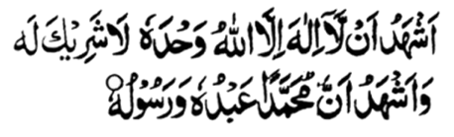
Ansar Pledge
Say this part three times:
Ash-hadu • alla ilaha • illallahu • wahdahu • la sharika lahu •
wa ash-hadu • anna Muhammadan • ‘abduhu • wa rasuluh
Say this part once:
I bear witness • that there is none worthy of worship • except Allah. • He is One • (and) has no partner, • and I bear witness • that Muhammad (peace be upon him) • is His servant • and messenger.
Say this part once:
I solemnly pledge • that I shall endeavor • throughout my life • for the propagation • and consolidation • of Ahmadiyyat in Islam, • and shall stand guard • in defense of • the institution of Khilafat. • I shall not hesitate • to offer any sacrifice • in this regard. • Moreover, • I shall exhort my children • to always remain dedicated • and devoted • to Khilafat. • Insha’allah.

Slide 5

The Holy Quran Segment
Suggested Time = 10 mins
It contains verses, questions
about the verses, followed
by commentary and discussion

Slide 6
Verses Recited Earlier
And keep on exhorting; for verily, exhortation benefits those who would believe.
And I have not created the Jinn and the men but that they may worship Me.
I desire no sustenance from them, nor do I desire that they should feed Me
Surely, it is Allah Himself Who is the Great Sustainer, the Lord of Power, the Strong
So, the fate of those who do wrong shall surely be like the fate of their fellows of old; so, let them not ask Me to hasten on the punishment.
Woe, then, to those who disbelieve, because of that day of theirs which they have been promised (51:56-61)

Slide 7
Understanding the Verse
According to the verse 51:57 the purpose of our creation is worship of God. What is the meaning of “Ibadah” and how can we achieve the purpose of our creation? Please discuss

Slide 8
Commentary
The primary significance of the word “Ibadah” is to subject oneself to a rigorous spiritual discipline, working with all one’s inherent powers and capacities to their fullest scope, in perfect harmony with and in obedience to Divine commandments, so as to receive God’s impress and thus to be able to assimilate and manifest in oneself His attributes. This is, as stated in the verse, the great and noble aim and object of man’s creation and this is exactly what worship of God means.

Slide 9
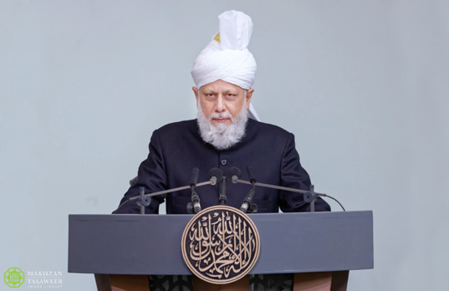
Khalifa’s guidance (aba)
Suggested Time = 20 mins
(All Ansar members need to participate in this discussion)
It contains the following items:
Scenario, question and discussion (2 slides)
Guidance from the Khalifa (1 slide)

Slide 10
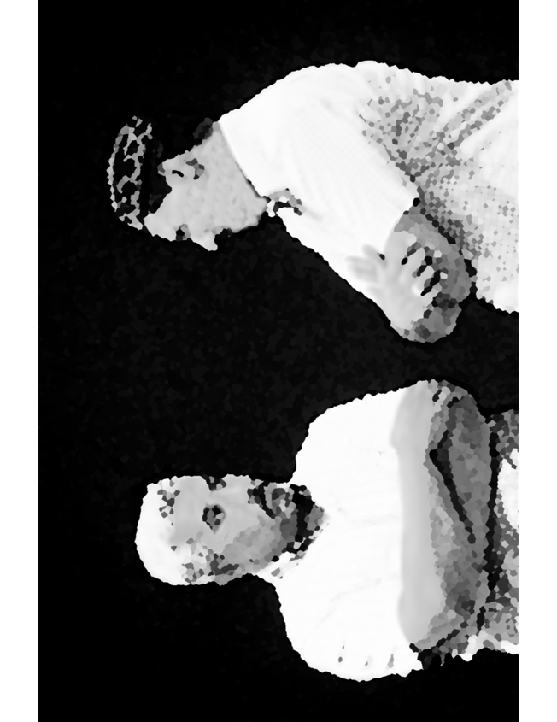


Discussion Scenario
After a local “Humanity first” event a Nasir was having dinner with some of his non-Muslim co workers. They appreciated the work “Humanity First” organization has been doing. One of them remarked that service of fellow mankind should be the main purpose of our life. The more we get “entangled” in religions the further away we move from social service and humanity. He gave examples of some extremist Muslim organizations?

Slide 11
Questions
Does practice of religion take us away from service of mankind?
If worship of Allah the Almighty is the purpose of our existence, why should we bother with other activities in life?

Slide 12
Purpose of life
The Promised Messiah^{as} said the pleasures of the world – such as children, wives and sustenance – were just a means of temporary rest for mankind, as a support in this life. They were only meant to assist mankind in fulfilling the rights of Allah the Almighty and the rights of mankind. They were not the sole purpose of life.
The Promised Messiah^{as} said there were scores of Muslims who thought building large houses and preparing lavish meals were the sole purposes of life. However, Allah the Almighty in the Holy Quran said that Allah would not care of any person if they did not worship and pray to Him.
Permissible worldly pleasures are just to assist humans in their worship of Allah the Almighty.
“If we understand this purpose of life, then we will be part of the true Ansar.” It is these people who can be true “helpers” of a prophet.
Based on Huzoor’s address in the final session of UK Ansarullah Ijtema, 9/12/21

Slide 13
Take "home" message?
Please review the following with children/family during casual discussion:
How can we improve the standards of worship in our household?
Tips to engage youth in conversation: (1) Give them more talking time, and (2) use examples from Huzur’s (may Allah be his helper) sermon to make a point.

Slide 14
Domestic responsibility Segment
‘Many disagreements between husband and wife stem from lack of confidence in each other. Wives complain that husbands do not tell the truth and husbands also complain that wives do not tell the truth habitually! In most of the cases they blame each other that the other had not been honest or is routinely dishonest. This affects the children, and they too start telling lies.’
‘It is also instructed that if you always speak the truth and try to continue to fulfil your responsibilities, in light of your efforts God Almighty will continue to reform you and will enable you to follow virtues. God will overlook your sins and your mistakes and make your home resemblance of paradise.’
‘It is also mentioned that they should stay firm on speaking the truth because this is the only way to establish mutual confidence, and this alone helps in honoring mutual relationship. Speaking the truth alone also enables the proper upbringing of children so that they become productive members of society.’
(Address delivered to ladies on 21 August 2004 at Jalsa Salana Germany. Published in Al Fazl International 1 May 2015)

Slide 15
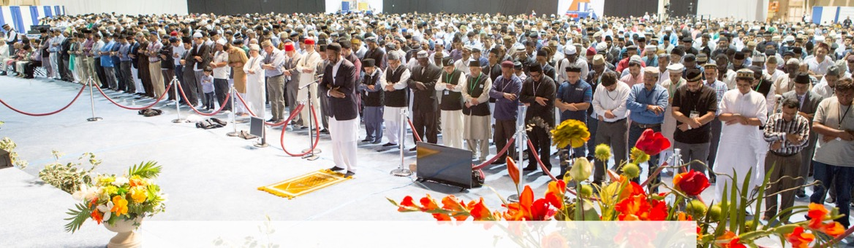
Salat Page
My experience is that nothing takes one so near to God as Salat. The various postures of the Salat demonstrate respect, humility and meekness. In Qiyam (standing posture) the worshipper stands with his arms folded as a slave stands respectfully before his master and king. In Ruku‘ (bowing) the worshipper bends down in humility. The climax of humility is reached in Sajdah (prostration), which indicates extreme helplessness.
[Speeches to Jalsa Salana, 1906, pp. 6-8 ]

Slide 16

Mental & Physical health Segment
Suggested Time = 15 mins
It contains
Questions of general knowledge and/or religious knowledge followed by their answers.
A thought-provoking video
A physical health segment

Slide 17


Mental Health
Which country emits the most greenhouse gases?
  USA
  2. China
  3. India
How long is home isolation recommended for an individual with COVID who has been afebrile for 24 hrs?
  5 days
  14 days
  21 days
Who lead the funeral prayer of the Promised Messiah (as)?
1. Mirza Bashiruddin Mahmood Ahmad (ra) 2. Hakim Maulvi Nooruddin (ra)
3. Mufti Mohammad Sadiq (ra)

Slide 18

Answers
  China emit 27% of greenhouse gases as opposed to 11% for USA
  5 days
  Hadhrat Hakim Maulvi Nooruddin Khalifatul Masih I (ra)

Slide 19


Technology Video
Answers
NO VIDEO
Link embedded within the above thumbnail,
it can be played by clicking on it in presentation mode
https://youtu.be/iyKRZm3xFI8

Slide 20
What is the cloud
On-Demand delivery of computing resources over the internet (“the cloud”)
All “content” is served through the cloud
Google Docs, Microsoft 365 are programs that run in the cloud
Dropbox, Google Drive, etc. are services that provide cloud storage
Windows Desktop (OS) running in the cloud accessible from a phone
Creating production-ready databases in seconds
Accessing compute-intensive services (machine learning, chatbots, voice-to-text, AI Services, etc.)
Requires Internet access!

Slide 21
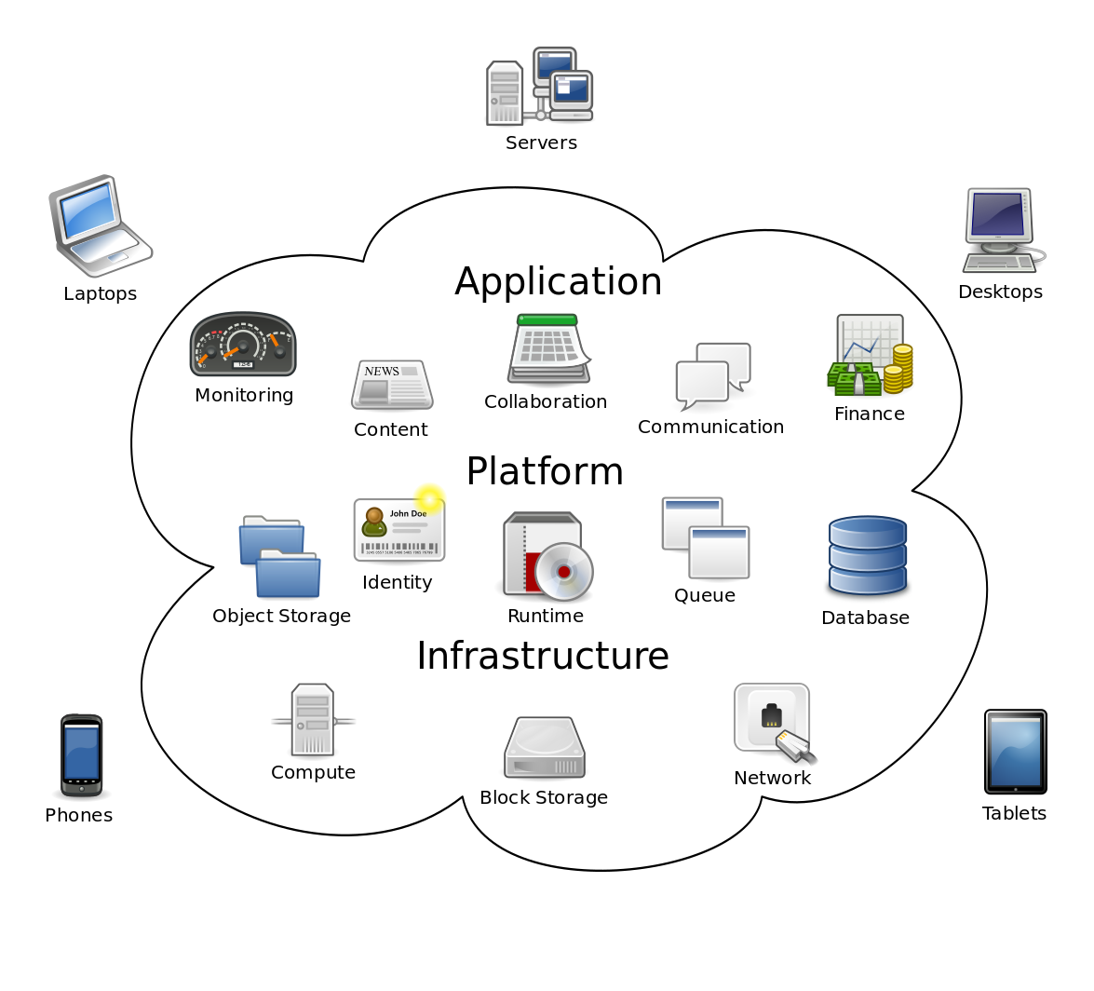
What is the cloud
THE CLOUD
Consists of three major types of services:
Applications: Google Docs, WhatsApp, Salesforce, etc.
Platform: Databases, Security, Queuing services, etc.
Infrastructure: servers/desktops, storage, etc.

Slide 22
For Businesses
Very little upfront investment; no physical infrastructure needed
Up and running within minutes
Compete with big businesses
Cost effective (on-demand, elastic)
Economies of Scale (savings passed on to the end user)
“Free” services: Databases, storage, image recognition, etc.)
You can build the next great service with cloud technologies

Slide 23
Cancer – It is getting Common
Health talk
Cancer Diagnosis Prevention & Treatment
Cancer is a large group of diseases that can start in almost any organ or tissue of the body. A neoplasm and malignant tumor are other names for cancer
Cancer is the second leading cause of death globally, accounting for an estimated 9.6 million deaths, or one in six deaths, in 2018
Lung, prostate, colorectal, stomach and liver cancer are the most common cancers in men
The cancer burden continues to grow globally, exerting tremendous physical, emotional and financial strain on individuals, families, communities and health systems

Slide 24
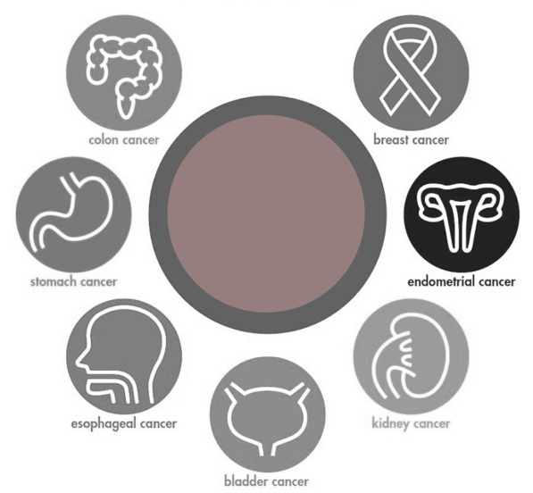
Cancer Prevention
Health talk
Some 30% to 50% of cancer deaths could be prevented by modifying or avoiding key risk factors and proven prevention methods
Prevention offers the most cost-effective long-term strategy for the control of cancer
The cancer burden can also be reduced through early detection of cancer and management of patients who develop cancer

Slide 25
Cancer Prevention Strategies
Health talk
No Alcohol and tobacco (no smokeless tobacco, Vape, pipe, Huka etc)
Eat a healthy diet with plenty of fruit and vegetables
Exercise regularly and maintain a healthy weight
Sexual promiscuity is a risk factor for some cancers
Vaccination against hepatitis B etc
Reduce exposure to ultraviolet radiation (Sun Protection against Skin Cancer)
Avoid urban air pollution

Slide 26
Health talk
Early Diagnosis and Treatment
Screening aims to detect early or at precancerous stage. Colonoscopy, self examination
Early diagnosis identifies symptomatic cancer cases at the earliest possible stage
Cancer is more likely to respond to effective treatment when identified early, resulting in a greater chance of survival and reduced suffering.
It is also less costly to treat at early stages when the disease is not metastatic (widespread)
Treatment options include surgery, cancer medicines and/or radiotherapy, administered alone or in combination.
Palliative care, which focuses on improving the quality of life of patients and their families, is an essential component of cancer care

Slide 27
That’s all folks
Reminders/Announcements
Dua
Jazakumullah for Participating!
If you enjoyed it, please convey to those brothers who are not here today!

