Slide 1

Majlis Ansārullāh
Monthly Meeting
February 2023
This slide deck contains images licensed for the purpose of this presentation only.
No one is permitted to use the images for any other use, without prior permission.

Slide 2

Agenda
Recitation of the Holy Quran (5 mins)
Pledge
The Holy Quran segment (10 min)
Hadith (5 min)
Khalifa’s (aba) guidance segment: (20 min)
Al-Wasiyyat (5 mins)
Salat (Daily Prayers) Segment (5 mins)
Health segment (10 min)
Open slot for local topics and/or interactive discussion with Murabbi sahib (10-20 mins)
Reminders/announcements (5 mins)
Dua'
Suggested Total Time (75 – 90 mins)

Slide 3
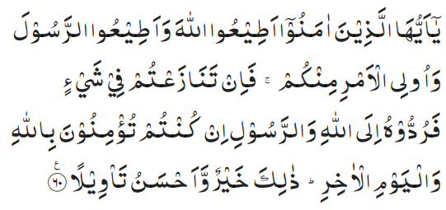
Recitation of the Holy Quran
O ye who believe! obey Allah and obey His Messenger and those who are in authority among you. And if you differ in anything among yourselves, refer it to Allah and His Messenger if you are believers in Allah and the Last Day. That is best and most commendable in the end. (4:60)

Slide 4
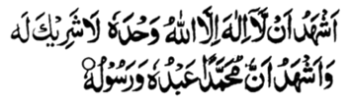
Ansar Pledge
Say this part three times:
Ash-hadu • alla ilaha • illallahu • wahdahu • la sharika lahu • wa ash-hadu • anna Muhammadan • ‘abduhu • wa rasuluh
Say this part once:
I bear witness • that there is none worthy of worship • except Allah. • He is One • (and) has no partner, • and I bear witness • that Muhammad (peace be upon him) • is His servant • and messenger.
Say this part once:
I solemnly pledge • that I shall endeavor • throughout my life • for the propagation • and consolidation • of Ahmadiyyat in Islam, • and shall stand guard • in defense of • the institution of Khilafat. • I shall not hesitate • to offer any sacrifice • in this regard. • Moreover, • I shall exhort my children • to always remain dedicated • and devoted • to Khilafat. • Insha’allah.

Slide 5
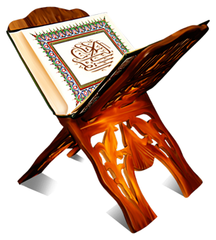
The Holy Quran Segment
Suggested Time = 10 mins
It contains verses, questions
about the verses, followed
by commentary and discussion

Slide 6
The Holy Quran Segment
O ye who believe! obey Allah and obey His Messenger and those who are in authority among you. And if you differ in anything among yourselves, refer it to Allah and His Messenger if you are believers in Allah and the Last Day. That is best and most commendable in the end. (4:60)

Slide 7
Understanding the Verse
Why is the word “obey” not used before “those in authority among you”?
Muslims are being asked to obey those in authority. What if they are under non-Muslim rulers?
What lessons can be learned by the office holders and Jama’at members from this verse?

Slide 8
Commentary
The word "obey" which has been repeated before the words "Allah" and "Messenger" has been omitted before the words, ”those who are in authority”, in order to point out that obedience to the authority properly constituted by Law is in fact obedience to God and His Messenger.
The words, those in authority, in their wider significance include even such non-Muslims as may happen to be in authority over Muslims. In this case the additional words منکم would not mean "from among you" but simply "among you", i.e., "over you". The practice of the Holy Prophet (peace and blessings of Allah be on him) as well as his sayings make it clear that in secular matters Muslims should obey even such of their rulers as are not Muslims.
The office holders are supposed to discharge their duties according to the commandment of Allah the Almighty and the Prophet (peace and blessings of Allah be on him). The Jama’at members are supposed to show unity and obedience
Five volume commentary

Slide 9
Hadith
“O Allah, bless Muhammad and prosper him and grant him peace; Thou art Praiseworthy and Glorious”
"The height of excellence is that you should strengthen the ties of relationship with the one who severs them and be generous to the one who is miserly to you and be forgiving to the one who abuses you." (Musnad Ahmad)

Slide 10
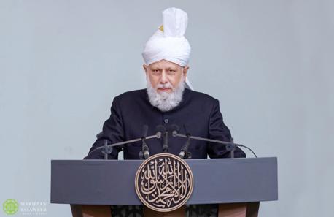
Khalifa’s guidance (may Allah be his helper)
Suggested Time = 20 mins
(All Ansar members need to participate in this discussion)
It contains the following items:
Scenario, question and discussion(2 slides)
Guidance from the Khalifa (1 slide)

Slide 11
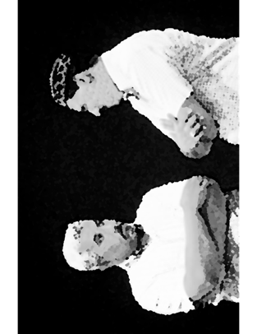
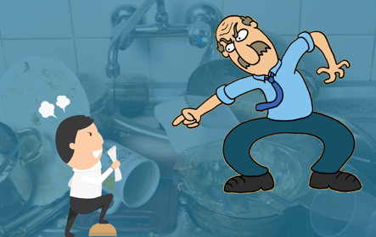
Discussion Scenario
Discussion Scenario
As the Iftar dinner was ending, the Jama’at Ziafat secretary requested Qaid Khuddam-ul-Ahmadiyya to have few Khuddam help with the cleanup. Qaid sahib complained that the Ansar never help with the cleanup and suggested that Za’im sahib Ansarullah be asked for help. Za’im sahib was standing nearby and remarked that Qaid sahib has no authority over Ansarullah matters and shouldn’t be making such suggestions. As this argument was going on in the dining area, few Jama’at members decided to step forward and help.

Slide 12
Discussion
How many undesirables can you identify in this scenario?
What do you think caused this argument?
How can we improve harmony in our Jama’at?

Slide 13
Khalifa’s (aba) guidance 1 of 2
“Office holders should be watchful of the self-esteem of the general membership and the general membership should respect the office holders and protect their dignity. Besides, the office holders should respect and revere each other. The office holders of one auxiliary should develop the respect of the office holders of another auxiliary in themselves and the auxiliary at large. Besides, the office holders of auxiliaries should instill the respect for Jama’at office holders in their hearts. All office holders must foster mutual respect. I say to the office holders that if this is established at the level of the office holders at the highest standards, spiritual change will automatically continue to happen in the Jama’at members”. (contd. Next slide)

Slide 14
Khalifa’s (aba) guidance 2 of 2
“As you will be respecting each other while treading on the path of righteousness, so will the Jama’at members be respecting each other, fulfilling each other’s needs and a desire to sacrifice will develop. Do not consider this an ordinary matter. These actions will take you to the high moral standards and by adapting these habits, imposing them on yourselves and by making them a part of your lives we will be taking part in the progress of the Jama’at” (8/26/2005 Jalsa Germay)

Slide 15
Al-Wasiyyat (The Will)
“Don’t fall in love with the pleasures of the world, for they take you away from God. Choose a life of austerity for the sake of God. The pain which pleases God is better than the pleasure which makes Him angry. And the defeat which pleases God is better than the victory which invites the wrath of Allah” (The Promised Messiah, peace be on him)
Questions for self reflection
Have you joined the system of Wasiyyat? If not, are you comfortable with your reasoning?
If you are a Moosi, are you satisfied with the spiritual purification expected of you?

Slide 16
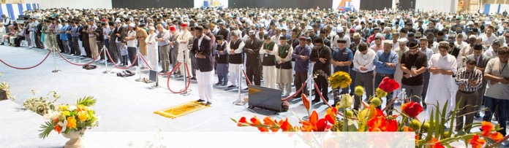
Salat Page
Allah the Almighty has emphasized on regularity in salat, timely observance of all the prayers in congregation. The commandment is of qiyam-us salat [observing the prayer] and 'qiyam-us salat literally means to observe salat on time and in congregation. (Friday Sermon 9/29/2017)

Slide 17

Mental and Physical health Segment
Suggested Time = 15 mins
It contains questions of
general knowledge and/or
religious knowledge
followed by their answers.
A thought-provoking video and a physical health segment

Slide 18

Mental Health

Slide 19

Quiz
Which of the following is not a good source of protein?
  Chicken, beef and fish
  Beans, peas and lentils
  Butter, cream cheese and sour cream
  Milk, yogurt, and cheese
What’s the smallest country in the world?
What is the purpose of the scheme of Tehrike Jadid?

Slide 20

Answers
c. Butter, cream cheese, and sour cream are not good sources of protein. Foods that are good sources of protein include chicken, lean meats, fish, and eggs, beans, peas, and lentils, and nuts, seeds, and soy products. Dairy products including milk, yogurt, cheese, and fortified soy beverages are also good sources of protein
At 0.19 square miles, Vatican City is the smallest nation in the world. This city-state has a population of 825 people, and is surrounded by Rome, Italy. Home to the headquarters of the Roman Catholic Church, learn more about the world's tiniest country.
The purpose of launching Tahrik-e-Jadid is to acquire such a fund with which Allah’s message can be delivered as far as the corners of the earth with ease and facility

Slide 21
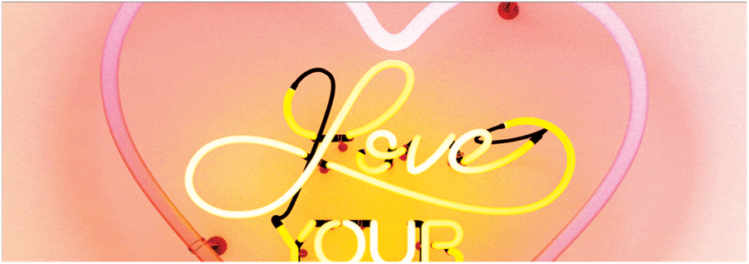
STRENGTH TRAINING @ 40 - LOVE YOUR AGE
TANVIR AHMED

Slide 22

MANY BENEFITS OF STRENGTH TRAINING
Age well. After the age of 40, those who are sedentary will lose on average 10% of their strength and 17% of their power every decade
Regular strength training and physical activity are vital to staying healthy as we age.

Slide 23
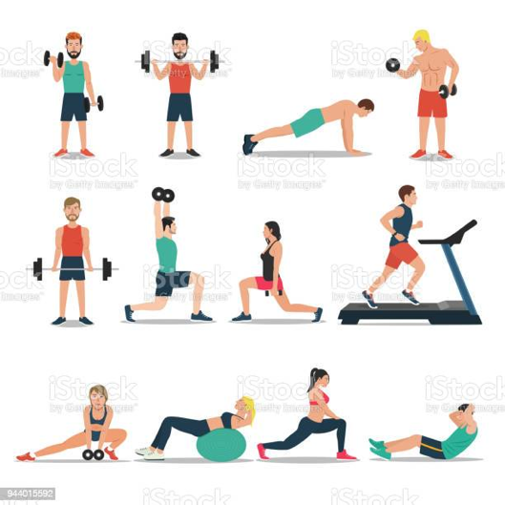
STRENGTH TRAINING
CDC recommends at least 2 days a week of muscle strengthening activity / exercise
According to the CDC, to gain health benefits, your strength training needs to be at the point where it's hard for you to do another repetition in that set

Slide 24
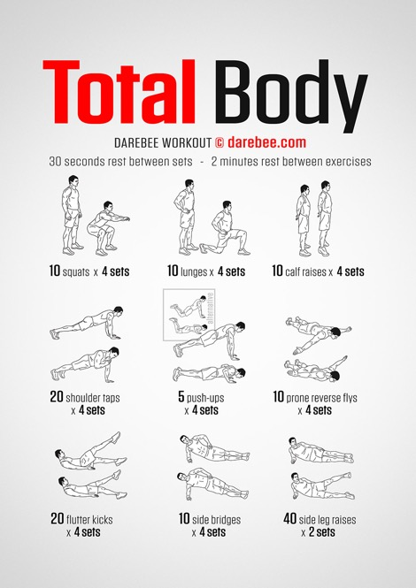
STRENGTH TRAINING
Burn more calories at rest. Your muscles burn calories throughout the day, even when you’re at rest.
The leaner muscle mass you have, the more calories you’ll burn without even trying
You do not need gym memberships, expensive equipment or hours to stay fit

Slide 25

MANY BENEFITS OF STRENGTH TRAINING
EAT HEALTHY
Increase bone density - Increased bone strength, decreased falls and fractures
Prevention of Injuries. The stronger you are the less chances of injury

Slide 26

Get started with a program that you can do safely at your age and fitness level
Increase gradually
Alternate with Aerobic exercises
Email Qaid Health qaid.health@answarusa.org
We will help you with anything you need

Slide 27
LOCAL TOPICS

Slide 28
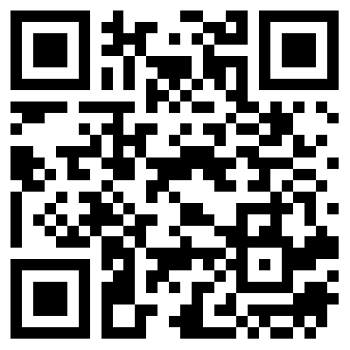
That’s all folks
Reminders/Announcements
Dua'
Jazakumullah for Participating!
If you enjoyed it, please convey to those brothers who are not here today!
Please provide feedback so we can do better
https://forms.gle/B17grkrjVNq5zCJR8

