Slide 1

Majlis Ansārullāh
Monthly Meeting
May 2023
This slide deck contains images licensed for the purpose of this presentation only.
No one is permitted to use the images for any other use, without prior permission.

Slide 2

Agenda
Recitation of the Holy Quran (5 mins)
Pledge
The Holy Quran segment (10 min)
Hadith (5 min)
Khalifa’s guidance segment: (20 min)
Al-Wasiyyat (5 min)
Salat (Daily Prayers) Segment (5 mins)
Health segment (10 min)
Open slot for local topics and/or interactive session with Murabbi sahib (10-20 mins)
Reminders/announcements (5 mins)
Du'a
Suggested Total Time (75 – 90 mins)

Slide 3
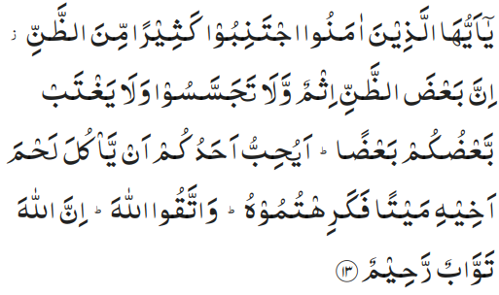
Recitation of the Holy Quran
O ye who believe! avoid most of suspicions; for suspicion in some cases is a sin. And spy not, nor back-bite one another. Would any of you like to eat the flesh of his brother who is dead? Certainly, you would loathe it. And fear Allah, surely, Allah is Oft-Returning with compassion and is Merciful. (49:13)

Slide 4
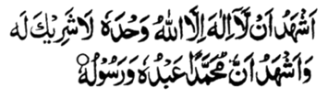
Ansar Pledge
Say this part three times:
Ash-hadu • alla ilaha • illallahu • wahdahu • la sharika lahu • wa ash-hadu • anna Muhammadan • ‘abduhu • wa rasuluh
Say this part once:
I bear witness • that there is none worthy of worship • except Allah. • He is One • (and) has no partner, • and I bear witness • that Muhammad (peace be upon him) • is His servant • and messenger.
Say this part once:
I solemnly pledge • that I shall endeavor • throughout my life • for the propagation • and consolidation • of Ahmadiyyat in Islam, • and shall stand guard • in defense of • the institution of Khilafat. • I shall not hesitate • to offer any sacrifice • in this regard. • Moreover, • I shall exhort my children • to always remain dedicated • and devoted • to Khilafat. • Insha’allah.

Slide 5

The Holy Quran Segment
Suggested Time = 10 mins
It contains verses, questions
about the verses, followed
by commentary and discussion

Slide 6
Recitation of the Holy Quran
O ye who believe! avoid most of suspicions; for suspicion in some cases is a sin. And spy not, nor back-bite one another. Would any of you like to eat the flesh of his brother who is dead? Certainly, you would loathe it. And fear Allah, surely, Allah is Oft-Returning with compassion and is Merciful. (49:13)

Slide 7
Understanding the Verse
What are some of the social evils mentioned in this verse?
What is one of the main problems which results from these social evils?
Why has thinking ill of other so strongly discouraged?

Slide 8
Commentary
Spying on one another, suspicion and backbiting.
The principal theme of the Surah is the establishment of concord, amity and goodwill between Muslim individuals and groups and therefore it has mentioned some of those social evils which cause discord, dissensions and differences, and corrode, corrupt and contaminate a society, eating into its vitals, and enjoins Muslims to be on their guard against them. .
Thinking ill of others is strongly discouraged and called a sin in some cases as it is the root cause of many evils. According to the Promised Messiah (peace be on him), it is such and evil that it blinds one and pushes them in a dark ditch of destruction.
Five volume commentary

Slide 9
Hadith
“O Allah, bless Muhammad and prosper him and grant him peace; Thou art Praiseworthy and Glorious”
"Beware of the fire of jealousy, because it consumes good deeds just as fire consumes wood and straw." (Abu Dawood)

Slide 10
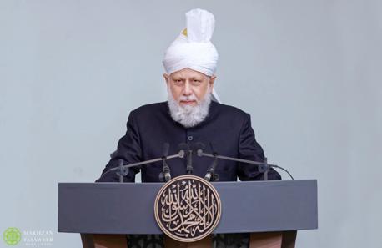
Khalifa’s guidance (may Allah be his helper)
Suggested Time = 20 mins
(All Ansar members need to participate in this discussion)
It contains the following items:
Scenario, question and discussion(2 slides)
Guidance from the Khalifa (1 slide)

Slide 11
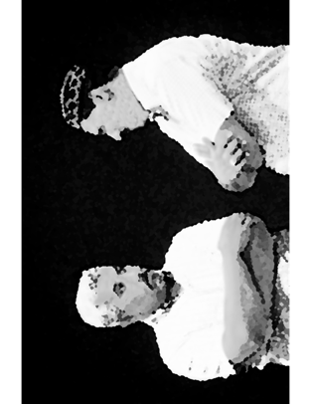

Discussion Scenario
Discussion Scenario
Local Ansar Amila meeting was going on. Muntazim Tabligh was not present. Zaim sahib expressed his frustration that he is late again! One of the other office holders chimed in stating that Muntazim sahib has not been performing his tasks properly and he does not come for salat despite living nearby. Another office holder suggested Zaim sahib to replace Muntazim sahib as he is disrupting the progress of the Majlis. This could also result in reformation of his ways. Before turning the conference call line off, Zaim sahib checked if there is anyone on the line. Muntazim sahib Tabligh responded with Assalamo Alaikum.

Slide 12
Discussion
What do you think has gone wrong?
Were the comments justified if Muntazim Tabligh is indeed not regular for Salat?
How could this whole scenario have played out differently?

Slide 13
Khalifa’s (aba) guidacne
Backbiting is a sin which leads to unrest in the society instead of reformation. Allah the Almighty while alluding to this evil act with disgust says that you backbite with ease thinking it is not a big deal. Had to say something and did so, wanted to enjoy some words so enjoyed it, wanted to utter some bitterness and did so. But remember, it is such an evil act as eating dead brother’s meat. Who would not abhor eating dead brother’s meat. Backbiting is mentioning someone’s weakness behind their back. Thus, if you want betterment of someone whom you have some concern about, explain in seclusion so they can reform themselves. If they do not understand than there are concerned office holders for reformation, there is system of the Jama’at, there is Ameer of the Jama’at. If for any reason, some opportune compromise, or due to lack of satisfaction, message can be sent to me (Khalifatul Masih aba). (Khutabate Masroor Vol 8 page 74-75. Friday sermon 2/5/2010)

Slide 14
Al-Wasiyyat (The Will)
“Look, I say to you truly and sincerely that ruined is he whose faith is tainted by even a hint of worldliness. Hell is very close to that soul all of whose intentions are not for God—rather some of them are for God and others are for the world. Thus, if you have an iota of worldly adulteration in your intentions, all your worship is in vain. In such a case you do not follow God. Rather you follow Satan. Never ever expect that when you are in such a condition God will help you ” (The Promised Messiah, peace be on him)
Questions for self reflection
Have you joined the system of Wasiyyat? If not, are you comfortable with your reasoning?
If you are a Moosi, are you satisfied with the spiritual purification expected of you?

Slide 15
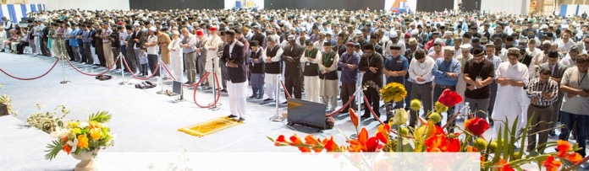
Salat Page
“Every Nasir should himself analyze his state and endeavor to become regular in congregational prayers. One should undertake the utmost effort to observe prayers in congregation mainly in the mosque, salat center or if this is not possible, then with the members of the household”. (Friday Sermon 9/29/2017)

Slide 16

Mental and Physical health Segment
Suggested Time = 15 mins
It contains questions of
general knowledge and/or
religious knowledge
followed by their answers.
A thought-provoking video and a physical health segment

Slide 17

Mental Health

Slide 18

Quiz
Which country consumes the most carbonated drinks?
  United Kingdom
  United States
  Russia
Which of the following gases does not trap heat?
  Carbon dioxide
  Oxygen
  Nitrogen
What is the required rate for Chanda Jalsa Salana?

Slide 19

Answers
b. The U.S. leads the pack in carbonated soft drink consumption, downing some 529, 12-ounce servings per person in 2008. Mexico, Malta, the Czech Republic, and Chile round out the top five. Unfortunately, sugary drinks provide calories with no nutrients. They can lead to obesity and related problems
c. Heat-trapping greenhouse gases absorb and emit radiation within the thermal infrared range. Water vapor, carbon dioxide and methane are Earth's most abundant greenhouse gases. Nitrogen, which makes up 80 percent of Earth's atmosphere, is not a greenhouse gas. This is because its molecules, which contain two atoms of the same element (nitrogen), are unaffected by infrared light.
1/10 of monthly income once a year or 1/120 of annual income

Slide 20
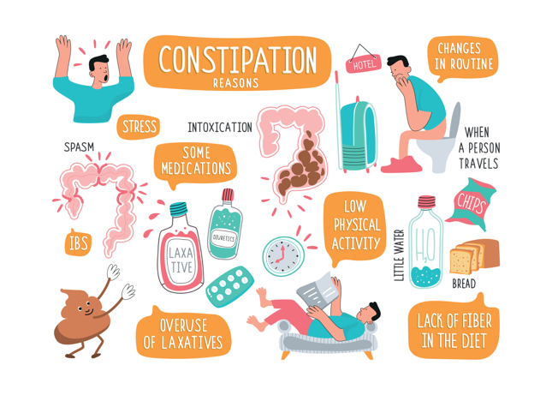
Constipation
Tanvir Ahmed
Qaid Health

Slide 21

Constipation
The most Common Digestive Complaint in the general population
Defined as having stool frequency of less than three bowel motion per week. Stools may be too hard or two small
It may also mean straining, incomplete evacuation sensation
More common in older age - over 65 yrs
More common with low physical activity, low income and poor education

Slide 22
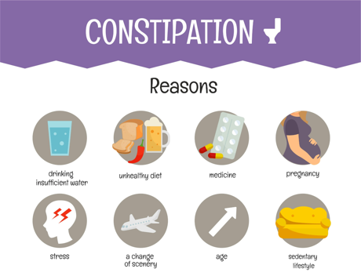
Causes of Constipation
Chronic Constipation can be associated with diseases like, Diabetes, COLORECTAL CANCER Anorexia Nervosa, Parkinson’s disease, MS etc.
Constipation can be a side effect of many medicines, e.g. narcotics
Not enough fibers in food
Not drinking enough water
Lack of physical activity
Processed and fatty food

Slide 23
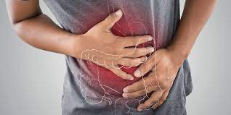
Talk to your Doctor
New onset constipation in older adults requires a visit to the doctor
You do not always need lab tests or endoscopy. Simple treatments are safe and effective to treat constipation
Red Flags and Alarm Symptoms include, blood in the stool, weight loss of >10 lbs, Family History of Colon Cancer, history of Cohn's disease etc.

Slide 24

Constipation Relief
Behavior Change - Follow your body's signals, practice regularity
Increase Fiber 20-35 gm /daily, such as fruits and vegetables. EXCESSIVE FIBER may cause bloating and gas too
Change what you eat and drink. Changing what you eat and drink may make your stools softer and easier to pass
Get regular physical activity

Slide 25

Constipation Relief
Talk to your doctor about medicine side effects
Laxatives e.g. Lactulose, Milk of Magnesia other Drugs - Amitiza, Linzness etc.
Enemas etc.
Biofeedback may help some patients
Floor toilets may help in some cases

Slide 26
LOCAL TOPICS

Slide 27
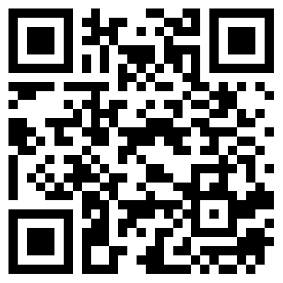
That’s all folks
Reminders/Announcements
Dua'
Jazakumullah for Participating!
If you enjoyed it, please convey to those brothers who are not here today!
Please provide feedback so we can do better
https://forms.gle/B17grkrjVNq5zCJR8

