Slide 1

Majlis Ansārullāh
Monthly Meeting
August 2023
This slide deck contains images licensed for the purpose of this presentation only.
No one is permitted to use the images for any other use, without prior permission.

Slide 2
Agenda
Recitation of the Holy Quran (5 mins)
Pledge
The Holy Quran segment (10 min)
Khalifa’s guidance segment: (20 min)
Al-Wasiyyat (5 mins)
Salat (Daily Prayers) Segment (5 mins)
Health segment (10 min)
Murabbi sahib’s comments and local topics (10-20 mins)
Reminders/announcements (5 mins)
Du'a
Suggested Total Time (75 – 90 mins)

Slide 3
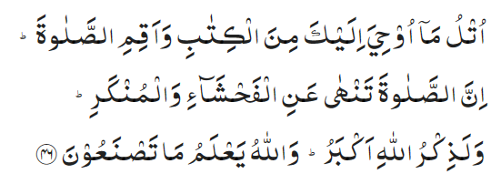
Recitation of the Holy Quran
Recite that which has been revealed to thee of the Book and observe Prayer. Surely, Prayer restrains one from indecency and manifest evil, and remembrance of Allah indeed is the greatest virtue. And Allah knows what you do. (29:46)

Slide 4
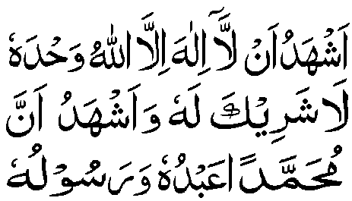
Ansar Pledge
Say this part three times:
Ash-hadu • alla ilaha • illallahu • wahdahu • la sharika lahu • wa ash-hadu • anna Muhammadan • ‘abduhu • wa rasuluh
Say this part once:
I bear witness • that there is none worthy of worship • except Allah. • He is One • (and) has no partner, • and I bear witness • that Muhammad (peace be upon him) • is His servant • and messenger.
Say this part once:
I solemnly promise that • I shall endeavor • till the end of my life • for the consolidation • and propagation of • Islām Ahmadiyyat • and for upholding • the institution of Khilafat. • I shall also be prepared • to offer the greatest sacrifice • for this cause. • Moreover, • I shall urge all my children • to remain true to • Khilafat Ahmadiyya. • Insha’Allah.

Slide 5
The Holy Quran Segment
Suggested Time = 10 mins
It contains verses, questions
about the verses, followed
by commentary and discussion

Slide 6
Recitation of the Holy Quran
Recite that which has been revealed to thee of the Book and observe Prayer. Surely, Prayer restrains one from indecency and manifest evil, and remembrance of Allah indeed is the greatest virtue. And Allah knows what you do. (29:46)

Slide 7
Understanding the Verse
What commandments have been given in this verse?
How can Salat keep one from indecency and evil?
What is your understanding of “remembrance of Allah”?

Slide 8
Understanding the Verse
Three things have been mentioned in this verse, viz. preaching and reading of the Quran, observance of Prayer and the remembrance of Allah. The purpose of all three is to deliver man from the bondage of sin and to help him to rise morally and spiritually which is the supreme object of all Divine Books.
Salat in congregation helps man to achieve a connection with his Creator along with staying away from indecencies and evil. Physical cleanliness and postures of Salat bring about spiritual cleanliness. Prayers of Salat also keep one from evil. Learning the attributes and qualities of the Almighty and standing before Him helps one from committing evil.
ذکر الله may mean, (1) man’s glorification of God, or (2) God’s remembrance of man, i.e. His raising him to a place of honor and eminence and spreading his good reputation. The verse purports to say that if you remember God and glorify Him, He will bestow honor and renown upon you and will make you eminent and respected in the world.

Slide 9
Khalifa’s guidance (may Allah be his helper)
Suggested Time = 20 mins
(All Ansar members need to participate in this discussion)
It contains the following items:
Scenario, question and discussion(2 slides)
Guidance from the Khalifa (1 slide)

Slide 10
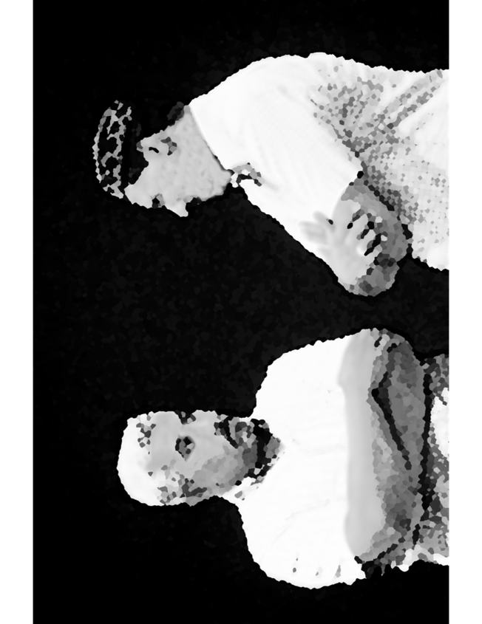
Discussion Scenario
Discussion Scenario
One Nasir was leading Salat at home. Afterwards, he asked his children if they had any questions. His son wanted to know why was it necessary to offer Salat. One can recite prayers without offering Salat. One can be a good person, pay charity, say the truth, and take care of the needy. Why are the gestures so important?

Slide 11
Discussion
In your opinion what is the most important responsibility of Ansarullah?
How would you have responded to the question posed by Nasir’s son?
How can one improve their level of Salat?

Slide 12
Huzur’s words (unofficial translation) Page 1 of 2
I want to turn your attention to the responsibilities of Ansarullah. The most important responsibility of Ansarullah is the establishment of five daily prayers. The Holy Quran has mentioned the first characteristic of the believers as یقیمون الصلوة, that is they establish prayers. They don’t ignore them. The Holy Prophet (peace and blessings of Allah be upon him) has laid tremendous emphasis on offering Salat. He has said that Salat distinguishes between a believer and a disbeliever. In a Hadith, it has been mentioned that a new group approached the Holy Prophet (peace and blessings of Allah be upon him) and requested that they be excused from Salat. He responded that the religion which is devoid of action is no religion at all. The Promised Messiah (peace be on him) has also repeatedly advised his Jama’at for establishment of Salat. (contd.)

Slide 13
Huzur’s words (unofficial translation) Page 2 of 2
He has unambiguously stated that Salat is not a useless tax, but it is the key to all virtue and man cannot attain nearness to Allah the Almighty unless they perform اقام الصلوة … Ansarullah has to fulfill their responsibilities for establishment of Salat. They should stay firm on five daily prayers and make their spouses and children accustomed to it. Offer all five prayers on appointed times and never miss them. Offer Salat repeatedly with this belief that you are standing in front of such an authority who can accept prayers instantly. It is an assurance of the spiritual purification of your generations, a way to shield from the filth and waste of the world. (Majlis Ansarullah Germany annual Ijtema 2007)

Slide 14
Al-Wasiyyat (The Will)
“And I pray that God may bless it and that He may make this very piece of land the Bahishti Maqbarah; and make it the resting place of such members of the Jama‘at as are pure of heart and who have in reality given precedence to Faith over the world and who have renounced the love of the world and have submitted themselves to God and have brought about in themselves a holy change and, like the companions of the Holy Prophet (peace and blessings of Allah be upon him), have set the example of Faithfulness and Truthfulness, Amin, O Lord of the world. ” (The Promised Messiah, peace be on him)
Questions for self reflection only (no answer needed in the meeting)
Have you joined the system of Wasiyyat? If not, are you comfortable with your reasoning?
If you are a Moosi, are you satisfied with the spiritual purification expected of you?

Slide 15
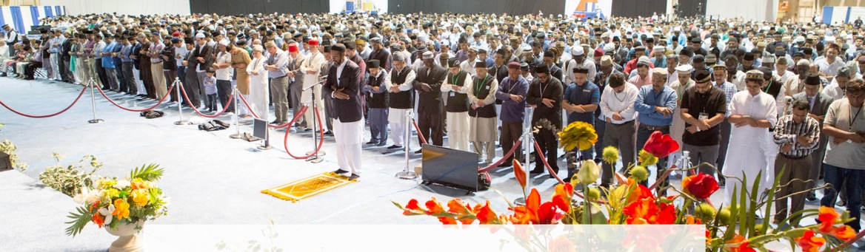
Salat Page
Promised Messiah (peace be on him) says: 'Remember that prayer is something that adorns and improves one's worldly life as well as faith. .. Also, a person must pray and supplicate constantly and committedly and only then can he or she develop a state of humility and pray with intense devotion and weep in their prayers. (Friday Sermon 9/29/2017)

Slide 16
Mental and Physical health Segment
Suggested Time = 15 mins
It contains questions of
general knowledge and/or
religious knowledge
followed by their answers.
A thought-provoking video and a physical health segment

Slide 17
Mental Health

Slide 18
Quiz
Who has the most followers on Twitter?
How much dietary fiber should an adult human being intake in a day?
  25-30 grams
  10-15 grams
  5-10 Kilograms
If a Musi’s property accrues income (for example rent on a house). How much Chanda will be payable on that?
  None
  1/10 (If Wasiyyat is for 1/10)
  1/16

Slide 19
Answers
Former President Barak Obama at 133 million followed by Elon Musk 119 millions, Canadian singer Justin Bieber 113 million. We must use social media for the propagation of Islam Ahmadiyyat.
a. A new analysis confirmed on a large scale that eating lots of fiber from vegetables, fruits, and whole grains can decrease your risk of dying from heart disease and cancer. Those who ate the most fiber reduced their risk of dying from cardiac disease, stroke, type 2 diabetes, and/or colon cancer by 16% to 24%, compared to people who ate very little fiber. The study also concluded that more fiber is better. For every additional 8 grams of dietary fiber a person consumed, the risk for each of the diseases fell by another 5% to 27%. Risk reductions were greatest when daily intake of dietary fiber was between 25 and 29 grams.
c. If income accrues from the property of the Musi then Hissa Amad shall be payable on such income at the rate of Chanda Am i.e., 1/16

Slide 20

Heart Disease in South Asians
Tanvir Ahmed
Qaid Health

Slide 21
South Asians
A Uniquely High Risk Group
for Heart Disease
South Asians men ( Pakistan India, Bangladesh etc.) are identified as a uniquely high-risk group for heart disease. However, cardiovascular disease is number one cause of morbidity and mortality on all men
South Asians have a four times greater risk of heart disease than the general population and a much greater chance of a heart attack before age 50 years
Heart attack strike south asians (men and women) at a younger age and is deadlier than the general population
Almost one in three in this group will die from heart disease before age 65.

Slide 22
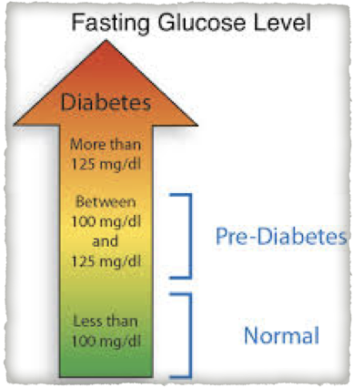
Pre-Diabetes, Borderline Diabetes and Insulin Resistance
Pre-Diabetes (Borderline Diabetes) Insulin Resistance
There is increased incidence of “pre-diabetes or borderline diabetes”.
Pre-Diabetics or borderline diabetics and those with diabetes are EQUALLY HIGH RISK for heart disease

Slide 23
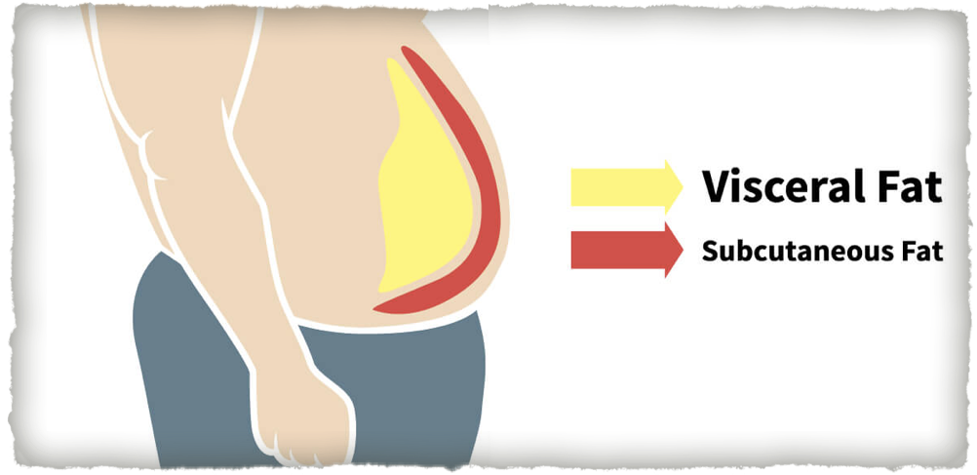
Thin Fat Syndrome
Body mass index (BMI) in South Asians often falls into a Thin-fat syndrome
People have a normal BMI (25 or less), but carry more weight in their abdomen and that fat is more likely to lead to a Heart Attack

Slide 24
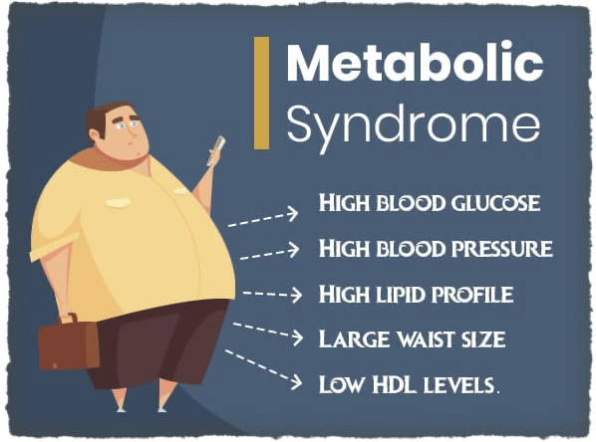


The Metabolic Syndrome
More than 1/3rd of South Asian men and 17% of South Asian women have metabolic syndrome which predisposes to heart disease
If more than one of these
conditions occur in combination, the risk is even greater for heart disease

Slide 25

Can I decrease my risk for Herat Disease
Immediate cessation of all forms of tobacco (cigarettes, Hukah, VAPE chewing tobacco)
Single most important risk for heart disease
No form of Tobacco is safe

Slide 26

Exercise
The best medicine
The second most important factor under your control
Lack of physical activity is a risk factor for heart disease
Exercise at least 30 minutes a day 4-5 times / week
Form a walking or Bike Club

Slide 27

Exercise and Stress Reduction
Reduce your stress with exercise, sleep, nutrition and do not waste time on your phone and tablets
Sleep 6-8 hours nightly

Slide 28
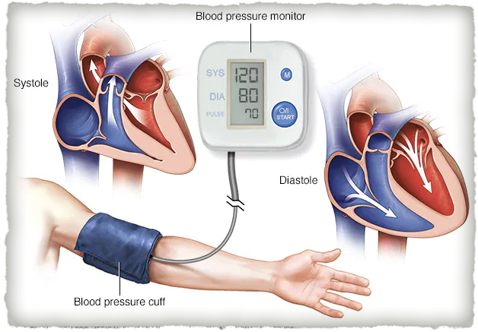
High Blood Pressure
High Blood Pressure
  Cut back on salt
  Regular exercise
  lose weight
  Eat healthy
  Take your medicines

Slide 29

Manage your Cholesterol
Lower your cholesterol
  Cut back on fat and sugars
  lose weight
  Take your medicines

Slide 30

Take control of your Diabetes
Eat well
Exercise
Maintain weight
Take your medicines
Follow your doctor’s advice closely

Slide 31
Email Qaid Health
Please email qaid.health@ansarusa.org for any questions or need any help

Slide 32
LOCAL TOPICS

Slide 33
That’s all folks
Reminders/Announcements
Dua
Jazakumullah for Participating!
If you enjoyed it, please convey to those brothers who are not here today!

