Slide 1

Majlis Ansārullāh
Monthly Meeting
December 2023
This slide deck contains images licensed for the purpose of this presentation only.
No one is permitted to use the images for any other use, without prior permission.

Slide 2
Agenda
Recitation of the Holy Quran (5 mins)
Pledge
The Holy Quran segment (10 min)
Khalifa’s guidance segment: (20 min)
Al-Wasiyyat (5 mins)
Salat (Daily Prayers) Segment (5 mins)
Health segment (10 min)
Murabbi sahib’s comments and local topics (10-20 mins)
Reminders/announcements (5 mins)
Du'a
Suggested Total Time (75 – 90 mins)

Slide 3
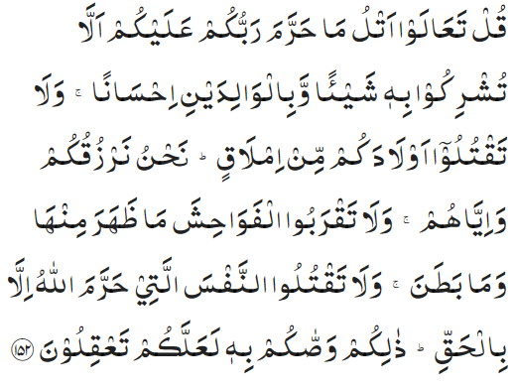
Recitation of the Holy Quran
Say, ‘Come, I will rehearse to you what your Lord has forbidden: that you associate not anything as partner with Him and that you do good to parents, and that you kill not your children for fear of poverty — it is We Who provide for you and for them — and that you approach not foul deeds, whether open or secret; and that you kill not the life which Allah has made sacred, save by right. That is what He has enjoined upon you, that you may understand. (6:152)

Slide 4
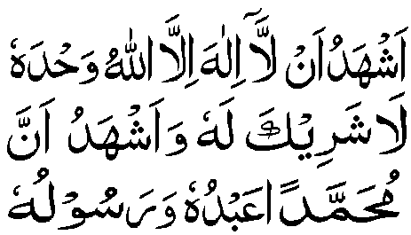
Ansar Pledge
Say this part three times:
Ash-hadu • alla ilaha • illallahu • wahdahu • la sharika lahu • wa ash-hadu • anna Muhammadan • ‘abduhu • wa rasuluh
Say this part once:
I bear witness • that there is none worthy of worship • except Allah. • He is One • (and) has no partner, • and I bear witness • that Muhammad (peace be upon him) • is His servant • and messenger.
Say this part once:
I solemnly promise that • I shall endeavor • till the end of my life • for the consolidation • and propagation of • Islām Ahmadiyyat • and for upholding • the institution of Khilafat. • I shall also be prepared • to offer the greatest sacrifice • for this cause. • Moreover, • I shall urge all my children • to remain true to • Khilafat Ahmadiyya. • Insha’Allah.

Slide 5
The Holy Quran Segment
Suggested Time = 10 mins
It contains verses, questions
about the verses, followed
by commentary and discussion

Slide 6
Recitation of the Holy Quran
Say, ‘Come, I will rehearse to you what your Lord has forbidden: that you associate not anything as partner with Him and that you do good to parents, and that you kill not your children for fear of poverty — it is We Who provide for you and for them — and that you approach not foul deeds, whether open or secret; and that you kill not the life which Allah has made sacred, save by right. That is what He has enjoined upon you, that you may understand. (6:152)

Slide 7
Understanding the Verse
Why is “doing good to parents” is under “what your Lord has forbidden”?
What is the true meaning of doing احسان (doing good) to the parents?
What could be the meaning of “kill not your children”?

Slide 8
Understanding the Verse
It should be noted that the injunctions which follow the word "forbidden" are what God requires us to do, and not what He forbids us to do. Thus, it is the contrary of the injunctions given in the verse that is forbidden. The injunctions have been expressly mentioned and the converse of them which is forbidden is implied. Thus, on the one hand, by using the word "forbidden" and, on the other, by following it up with positive commandments, the verse combines both the direct injunctions and their converse, and the attention of the reader has been drawn to both.
The word احسان (doing good) expresses the idea that the service of the parents enjoined in the words, do good to parents, is to be performed in the best way possible, for احسان literally signifies "doing a thing very well.".
Parents are bidden to nourish and bring up their children well, as implied in the words, kill not your children for fear of poverty. Indeed, he who neglects to bring up his children properly for fear of poverty virtually "kills" them. If it is the duty of the children to serve their parents well, it is equally the duty of the parents to bring up their children well.

Slide 9
Khalifa’s guidance (aba)
Suggested Time = 20 mins
(All Ansar members need to participate in this discussion)
It contains the following items:
Scenario, question and discussion(2 slides)
Guidance from the Khalifa (1 slide)

Slide 10
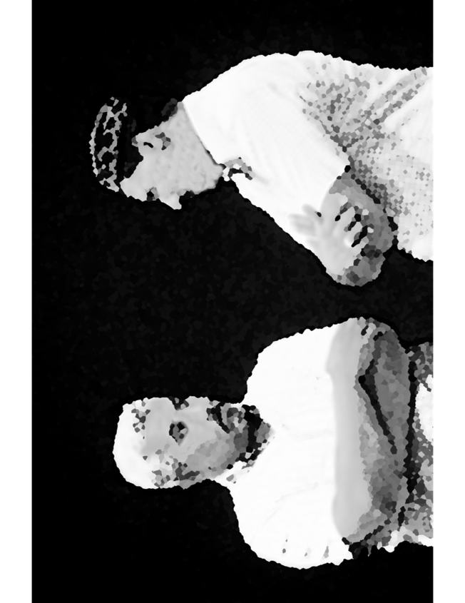
Discussion Scenario
Discussion Scenario
A Nasir was flying to attend national Ansar Ijtima. The weather was very rough, and the flight was bumpy. As the plane started it’s decent, the pilot announced that everybody put their seat belts on. The Nasir could see the storm and lightening from the window. He was very worried, and his mind started thinking about the worst-case scenarios. “If I can’t make it, what am I leaving behind for my children”. He thought about his property and bank balance and felt somewhat satisfied. With the grace of God, he reached his destination safely

Slide 11
Discussion
Was it natural for the Nasir to worry about the future of his children?
  No, as it is Allah’s responsibility to provide
  Yes, as he is the head of the household and father of the children
What should be our most important priority for the future of our children?
  Sufficient funds
  Good education
  Moral training
  Any other option
What will be considered a successful life for your children?

Slide 12
Huzur’s words (unofficial translation) Page 1 of 2
On this occasion, I would like to draw your attention to the moral training of your children. The best way to do that is to present before them your own virtuous model and pray for them. The Promised Messiah (peace be on him) says: “Some people are of the opinion that one should leave some funds for their children. I am surprised that they think of leaving funds. However, such people think of collecting funds for their children but do not worry and care for the competency of the children. They suffer at the hands of their children in their own lives and face problems due to their bad habits, and the assets they amassed, by God knows which trickery and ways, is eventually spent in drinking and evil deeds. Such progeny become heirs of evil and mischief for such parents. Trial of the off springs is a huge trial. If the offspring are virtuous, there are no worries (contd. Next page)

Slide 13
Huzur’s words (unofficial translation) Page 2 of 2
Allah the Almighty says in 7:197 وھو یتولی الصالحین (wa howa yata wallassaliheen) meaning Allah the Almighty becomes the custodial and protector of the righteous. If offspring are hopeless, even if hundreds of thousands of rupees are left, will be broke after losing it in evil deeds. They will be embroiled in such difficulties and troubles as are indispensable for them. Whoever aligns their judgement with the judgement and decree of Allah the Almighty, is at ease with their children. This happens if they strive for and pray for the abilities. If there is desire to have children, it should be that they become true servants of religion (Malfoozat vol. 4, 443-445) (Message to Ansarullah Germany, Ijtima 2011)

Slide 14
Al-Wasiyyat (The Will)
The third condition is that each one who is buried here should have led a righteous life and abstained from all that is prohibited and should have not been guilty of Shirk and Bid‘at. He should be a true and sincere Muslim.
(The Promised Messiah, peace be on him)
Questions for self reflection only (no answer needed in the meeting)
Have you joined the system of Wasiyyat? If not, are you comfortable with your reasoning?
If you are a Moosi, are you satisfied with the spiritual purification expected of you?

Slide 15
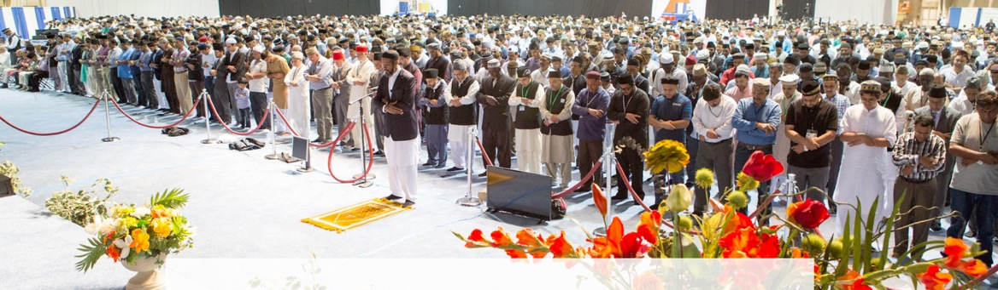
Salat Page
The Promised Messiah (peace be on him) states: God Almighty does not benefit but it is man himself who benefits from it as he has the opportunity to present himself in the presence/Divine court of God. … I impart a very important piece of advice to you, and I wish that it enters the hearts of people. Life is quickly passing by therefore do away with indolence and occupy yourself in earnest supplication. Supplicate to God in seclusion so that God Almighty protects your faith and becomes pleased with you.’ (Friday Sermon 9/29/2017)

Slide 16
Mental and Physical health Segment
Suggested Time = 15 mins
It contains questions of
general knowledge and/or
religious knowledge
followed by their answers.
A thought-provoking video and a physical health segment

Slide 17
Mental Health

Slide 18
Quiz
According to dietary guidelines, how much sodium can be consumed each day?
  More than10 grams
  Less than 2.3 grams
  About 100 grams
How many people are killed due to distracted driving in USA each year?
  100
  1000
  3000
At the time of filing for Wasiyyat if he doesn’t have a steady income what would an applicant write as his monthly income?

Slide 19
Answers
b. According to 2020-2025 guidelines Americans should consume less than 2300 mg of sodium each day. Currently over 90% Americans are consuming too much sodium. Top sources of sodium include breads, pizza, sandwich, cold cut meats, soups, burritos, savory snacks and cheese
c. About 3000 people are killed each year due to distracted driving. At 55 miles per hour, sending or reading a text is like driving the length of a football field with your eyes closed. (cdc.gov)
If some one has not any steady income, he/she could write the estimated monthly Income or the average income of 6 months or a year.

Slide 20
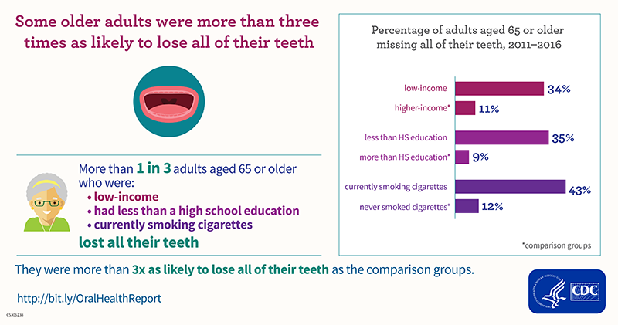
ADULT ORAL HEALTH
Oral health problems in adults:
  Untreated cavities (1 in 4 adults have untreated tooth decay)
  Gum disease (nearly half of adults have signs of gum disease)
  Tooth loss: Nearly 1 in 5 adults over 65 have lost all their teeth
  Oral Cancer
  Chronic diseases: People with chronic diseases such as arthritis, diabetes, heart diseases, and chronic obstructive pulmonary disease (COPD) may be more likely to develop gum (periodontal) disease, but they are less likely to get dental care than adults without these chronic conditions

Slide 21
Oral health and Cardiovascular disease
People with gum disease are at higher than usual risk of heart disease
Periodontal inflammation can increase the risk of heart attack and stroke

Slide 22
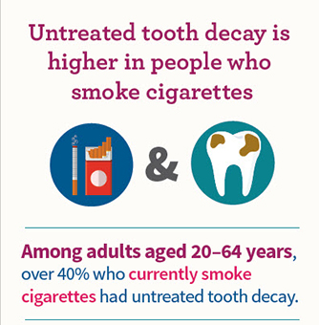
How to maintain good oral health
Brush teeth twice daily
Floss in between teeth daily
Brush with fluoride toothpaste
Visit your dentist regularly
Avoid tobacco products
Avoid alcoholic drinks

Slide 23
LOCAL TOPICS

Slide 24
That’s all folks
Reminders/Announcements
Dua
Jazakumullah for Participating!
If you enjoyed it, please convey to those brothers who are not here today!

