Slide 1
Majlis Ansārullāh
Monthly Meeting
February 2024
“This is a perfect book, there is no doubt in it”
This slide deck contains images licensed for the purpose of this presentation only.
No one is permitted to use the images for any other use, without prior permission.

Slide 2
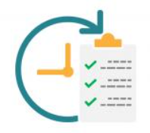
Agenda
Recitation and translation of the Holy Quran (10 min)
Pledge
Hadith
Discussion segment
Salat (Daily Prayers)
Al–Wasiyyat
Zahanat (Intelligence)
Reading The Holy Quran
Health segment
Local Time – Missionary Comments/Reminders/Announcements
Du’a

Slide 3
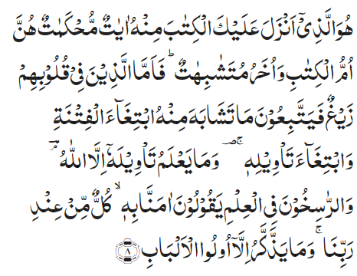
Recitation of the Holy Quran
He it is Who has sent down to thee the Book; in it there are verses that are decisive in meaning — they are the basis of the Book — and there are others that are susceptible of different interpretations. But those in whose hearts is perversity pursue such thereof as are susceptible of different interpretations, seeking discord and seeking wrong interpretation of it. And none knows its right interpretation except Allah and those who are firmly grounded in knowledge; they say, ‘We believe in it; the whole is from our Lord.’ — And none heed except those gifted with understanding. (3:8)

Slide 4
Pledge
Say this part three times:
Ash-hadu • alla ilaha • illallahu • wahdahu • la sharika lahu • wa ash-hadu • anna Muhammadan • ‘abduhu • wa rasuluh
Say this part once:
I bear witness • that there is none worthy of worship • except Allah. • He is One • (and) has no partner, • and I bear witness • that Muhammad (peace be upon him) • is His servant • and messenger.
Say this part once:
I solemnly promise that • I shall endeavor • till the end of my life • for the consolidation • and propagation of Islām Ahmadiyyat • and for upholding • the institution of Khilafat. • I shall also be prepared • to offer the greatest sacrifice • for this cause. • Moreover, • I shall urge all my children • to remain true • to Khilafat Ahmadiyya. • Insha’Allah.

Slide 5

Hadith
O Allah, Bless Muhammad^{sa} and the people of Muhammad^{sa}, as Thou didst bless Abraham and the people of Abraham. Thou art indeed the Praiseworthy, the Glorious. Prosper, O Allah, Muhammad^{sa} and the people of Muhammad^{sa}, as Thou didst prosper Abraham and the people of Abraham. Thou are the Praiseworthy, the Glorious
Hadrat Uthman bin Affan^{ra} states that the Holy Prophet^{sa}, said:
"The best among you is the one who learns the Qur'an and teaches it to others."
(Bukhari)
Hadrat Ibn Abbas^{ra} states that the Holy Prophet^{sa} said:
"The case of one who does not learn any portion of the Qur'an is like that of an abandoned house."
(Tirmidhi)

Slide 6
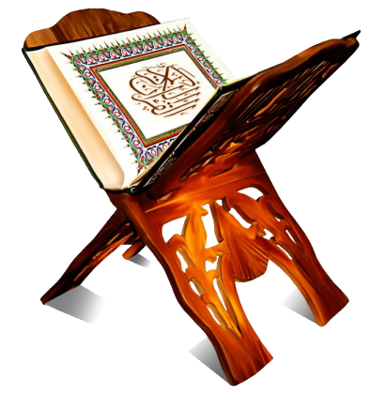
Discussion Segment
Suggested Time 15 mins

Slide 7
Recitation of the Holy Quran
He it is Who has sent down to thee the Book; in it there are verses that are decisive in meaning — they are the basis of the Book — and there are others that are susceptible of different interpretations. But those in whose hearts is perversity pursue such thereof as are susceptible of different interpretations, seeking discord and seeking wrong interpretation of it. And none knows its right interpretation except Allah and those who are firmly grounded in knowledge; they say, ‘We believe in it; the whole is from our Lord.’ — And none heed except those gifted with understanding. (3:8)
Notes:
Use this as a reference for discussion. Do not have to recite again.

Slide 8

Understanding the Verses
You made a nice presentation at an interfaith symposium about the message of Islam. You explained to the audience that Islam means peace and submission to the will of Allah. You quoted many verses including the verse, “There is no compulsion in religion”. During the question answer session, one participant questioned your explanation. She argued as to who should she believe? Your interpretation or that of the extremist organizations who present Quranic verses to justify murder and killing in the name of religion. She also commented the Muslims believe that many verses of the Holy Quran have been abrogated by other verses. She wondered what would be the use of such a book where verses are subject to interpretations, and they may have been cancelled by other verses?
  How would you respond to her questions?
  Please quote verses to support your explanation
Notes:
Please have a member read the scenario. Invite all members to try and answer the questions.

Slide 9

Understanding the verses
Discussion

Slide 10
Why different interpretations?
According to the verse, the Quran has two sets of verses. Some are “Muhkam” محکم decisive in meaning and others “Mutashabih” متشابه capable of different interpretations. The right way to interpret a Mutashabih متشابه verse is that only such interpretation of it should be accepted as agrees with the verses that are محکم and all other interpretations should be dismissed as incorrect.
It is on record that one day the Holy Prophet^{sa}, on hearing people disputing about the interpretation of certain verses of the Quran, angrily said: "Thus were ruined those who have gone before you. They interpreted certain parts of their scriptures in such a manner as to make them contradict other parts. But the Quran has been so revealed that different parts of it should corroborate one another. So do not reject any truth by making one part contradict the other. Act on what you understand thereof and refer that which you do not understand to those who know and understand it" (Musnad).
Hadrat Mirza Bashiruddin Mahmood Ahmad^{ra}, Five Volume Commentary

Slide 11
Understanding the verses
Muhkam means,
that which has been made secure from change or alteration;
that in which there is no ambiguity or possibility of doubt;
that which is clear in meaning and decisive in exposition and
a verse which embodies a teaching special to the Qur’an (Mufradat & Lane).
Mutashabih is used about
that phrase, sentence or verse which is susceptible of different, though concordant, interpretations;
that whose parts resemble or are concordant with one another;
that whose true significance bears a similarity to a sense which is not meant;
that of which the true meaning is known only by referring it to what is termed Muhkam;
that which cannot be rightly understood without repeated consideration;
a verse which contains teaching corresponding to or resembling those contained in the previous revealed Scriptures (Mufradat).
Short Commentary – Hadrat Mirza Bashiruddin Mahmood Ahmad^{ra}

Slide 12
So said the Promised Messiah^{as}
And we have complete confidence in the fact that Holy Qur’an is the last divine book, and that not an iota or dot can be added or detracted from its laws, limits, commandments and orders. Now there is no revelation or inspiration from Allah that can modify, change or abrogate any command of the Holy Qur’an.
(Ruhani Khazain, vol. 3 pg. 170, Izala Auham)
The truth is that the (text of the) Holy Qur’an cannot be truly abrogated or added to because this would falsify it.
(Ruhani Khazain, vol. 4 pg. 93, Mubahitha Ludhiana)

Slide 13
Abrogation?
Meaning of abrogation
Webster – to abolish by authoritative action
Oxford – the repeal or abolition of a law
منسوخی
“Whatever Sign We abrogate or cause to be forgotten, We bring one better than that or the like thereof. Dost thou not know that Allah has the power to do all that He wills?”
(2:107)
Commentary: There is nothing in this verse to indicate that the Ayah spoken of in this verse as being abrogated, refers to the previous Revelations. It is pointed out that the previous Scriptures contained two kinds of commandments: (a) Those which, owing to changed conditions and to the universality of the new Revelation, required abrogation. (b) Those containing eternal truths which needed resuscitation so that people might be reminded of the forgotten truth. It was, thereof, necessary to abrogate certain portion of those Scriptures and bring in their place new ones, and also to restore the lost ones. So, God abrogated some portions of the previous Revelations, substituting them with new and better ones, and at the same time re-introduced the missing general spirit of the Quranic teaching. The Qur’an has abrogated all previous Scriptures; for, better than all the old Laws, but is also meant for all men for all times.

Slide 14



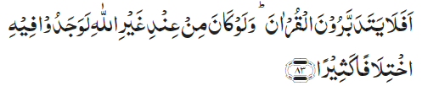

Verses against Abrogation
[5:4] This day have I perfected your religion for you and completed My favour upon you and have chosen for you Islam as religion
[11:2] Alif Lam Ra. This is a Book whose verses have been made unchangeable and then they have been expounded in detail. It is from One Wise, and All-Aware
[4:83] Will they not, then, meditate upon the Qur’an? Had it been from anyone other than Allah, they would surely have found therein much disagreement
[15:10] Verily, We Ourself have sent down this Exhortation, and most surely We will be its Guardian

Slide 15
Salat
Salat and Peace
The greatest criterion of man’s pious life is Salat. He, who keeps crying out to God in Salat, lives in peace.
(Malfuzat Vol. 1 page 402)
Offering Salat on time
By nature, I like that Salat be offered at its prescribed time and this question of Salat on time is very dear to me. Even when it is raining heavily, I wish to offer Salat on time.
(Malfuzat Vol. 2, p 45)

Slide 16
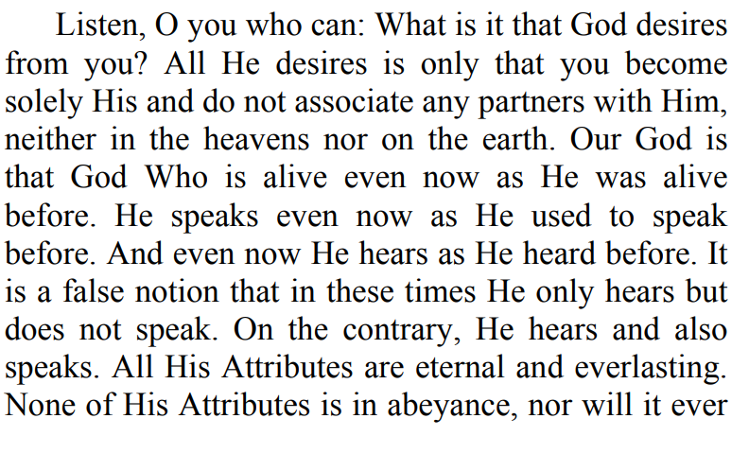
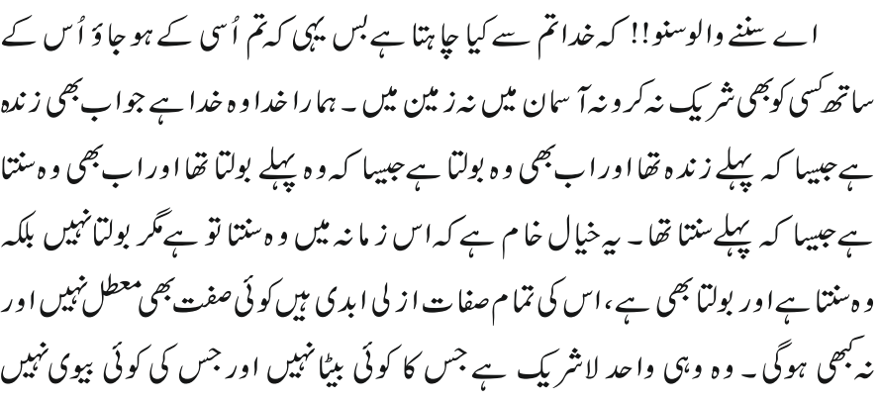

Al Wasiyyat

Slide 17
Zahanat (Intelligence)
Q. What is -6 + 13?
- 7
18
7
-78
Q. How many months have 28 days in them?
1
4
8
12
Q. Spinach is high in?
Vitamin C
Iron
Biotin
Nothing – its just green leaves

Slide 18
Zahanat (Intelligence)
Q. What is -6 + 13?
- 7
18
7
-78
Q. How many months have 28 days in them?
1
4
8
12
Q. Spinach is high in?
Vitamin C
Iron
Biotin
Nothing – its just green leaves

Slide 19

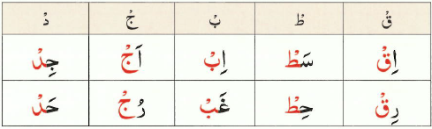

Reading the Holy Quran
Quran Tajweed Basics
Qalqalah
Qalqlah means to vibrate or echo. In Tajweed, it means to make an echoing sound when finding a sukoon sign on any of the five letters of Qalqalah(ق , ط , ب , ج , د).
The phrase to remember these letters:
Click here for a short video

Slide 20
Health

Slide 21
Artificial or non -nutritive sweeteners
Notes:
Please assign a health professional if one is available to cover this topic

Slide 22
Artificial sweeteners
Acesulfame potassium (Sweet One, Sunett).
Advantame.
Aspartame (NutraSweet, Equal).
Neotame (Newtame).
Saccharin (Sweet'N Low).
Sucralose (Splenda).
Luo han guo (Monk Fruit in the Raw).
Purified stevia leaf extracts (Truvia, PureVia, others).
Sugar alcohols

Slide 23
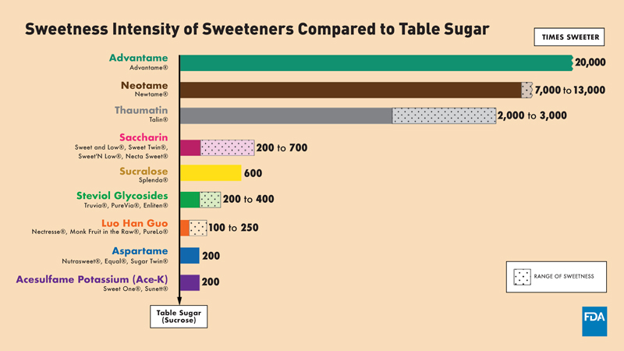
Blood clots, heart disease & stroke

Slide 24
World Health Organization
WHO recommends against using artificial sweeteners for weight control or trying to boost health
Recent study has raised the possibility that artificial sweeteners could increase risk of Diabetes, Heart Disease, stroke and even death
There is a correlation between artificial sweeteners and migraine, depression, developmental issues and dementia

Slide 25
Bottom line
Artificial sweeteners can be a short-term way to help some people lessen their use of sugar and lose or manage weight.
But be aware of how sugar substitutes affect your food and drink choices. These ingredients may get your tastebuds used to sweetness. And that can make drinking enough water a challenge.
Products made with sugar substitutes also may give you the wrong message about processed foods. A snack labeled low sugar, or no sugar may not be the most nutritious choice. Whole foods, such as fruits and vegetables, usually have the best mix of nutrients for the body.
But artificial sweeteners can help some people enjoy sweetness without excess calories. And if used in moderation, artificial sweeteners may be safe. However, many of these have shown to cause side effects in some people.
Future studies may be needed to get more information about their safety.

Slide 26
Known scientific facts about honey
Honey is essentially pure sugar, with no fat and only trace amounts of protein and fiber
One tablespoon of honey contains 61 calories
It is absorbed slower than table sugar
It has antioxidants and wound healing properties and has healthy influence on intestinal bacteria
It should be consumed in moderation as it still contains calories and raises blood sugar levels
Its health benefits are being actively studied
(This information is not presented to challenge any facts mentioned in the Holy Quran and Ahadith)

Slide 27
Local Majlis Time
Sign-up for TAQWA Quran classes via the following link
https://www.altaqwa.us/registration/
Murabbi Sahib’s Comments
Reminders/announcements
Du’a
Adjourn
Jazakumullah for Participating!
If you enjoyed it, please convey to those brothers who are not here today!

