Slide 1
Majlis Ansārullāh
Monthly Meeting
November 2024
The Holy Quran and Our Moral Development
This slide deck contains images licensed for the purpose of this presentation only.
No one is permitted to use the images for any other use, without prior permission.

Slide 2

Agenda
Recitation and translation of the Holy Quran
Pledge
Hadith
Discussion segment
Salat (Daily Prayers)
Al–Wasiyyat
Zahanat
Reading The Holy Quran
Health segment
Local Time – Missionary Comments/Reminders/Announcements
Du’a

Slide 3

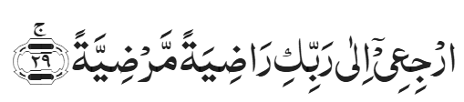

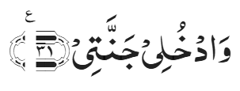
Recitation of the Holy Quran
And thou, O soul at peace!
Return to thy Lord well pleased with Him and He well pleased with thee.
So enter thou among My chosen servants,
And enter thou My Garden.
Chapter 89 Al-Fajr, Verses 28-31

Slide 4
Pledge
Say this part three times:
Ash-hadu • alla ilaha • illallahu • wahdahu • la sharika lahu • wa ash-hadu • anna Muhammadan • ‘abduhu • wa rasuluh
Say this part once:
I bear witness • that there is none worthy of worship • except Allah. • He is One • (and) has no partner, • and I bear witness • that Muhammad (peace be upon him) • is His servant • and messenger.
Say this part once:
I solemnly promise that • I shall endeavor • till the end of my life • for the consolidation • and propagation of Islām Ahmadiyyat • and for upholding • the institution of Khilafat. • I shall also be prepared • to offer the greatest sacrifice • for this cause. • Moreover, • I shall urge all my children • to remain true • to Khilafat Ahmadiyya. • Insha’Allah.

Slide 5
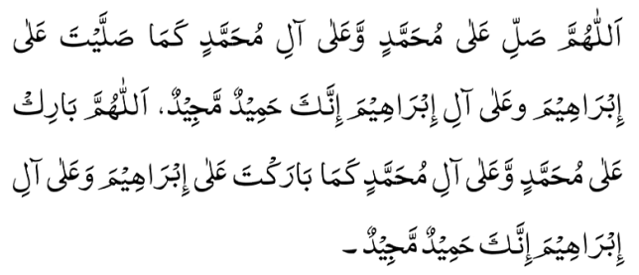
Hadith
O Allah, Bless Muhammad^{sa} and the people of Muhammad^{sa}, as Thou didst bless Abraham and the people of Abraham. Thou art indeed the Praiseworthy, the Glorious. Prosper, O Allah, Muhammad^{sa} and the people of Muhammad^{sa}, as Thou didst prosper Abraham and the people of Abraham. Thou are the Praiseworthy, the Glorious
Narrated by Hadrat Aisha^{ra} – The Prophet of Allah^{sa} said:
“The best of you is one who is best in his treatment of his family [wife], and I am the best of you in the treatment of my family.”
Sunan at-Tirmidhi, Book of Virtues,
Chapter: Virtues of wives of the Holy Prophet^{sa}

Slide 6
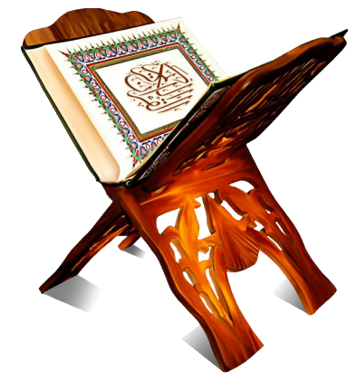
Discussion Segment
Suggested Time 15 mins

Slide 7
Recitation of the Holy Quran
And thou, O soul at peace!
Return to thy Lord well pleased with Him and He well pleased with thee.
So enter thou among My chosen servants,
And enter thou My Garden.
Chapter 89 Al-Fajr, Verses 28-31

Slide 8

Understanding the verses
A key purpose of religious teachings is to make one a better human being. Do you believe, if one follows the Holy Quran honestly, one will develop high morals?
Please provide prove your claim from the verses of the Holy Quran.
Wrong
Right

Slide 9
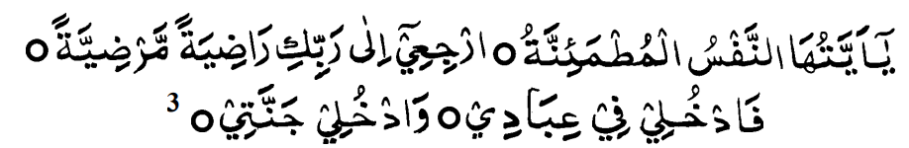
So Says The Promised Messiah^{as}
The Third Source: The Soul at Rest
Then there is a third source, which signifies the beginning of the spiritual state. The Holy Qur’an describes it as Nafs-e-Mutma’innah [the soul at rest]; it says:
(Part 30, Ruku‘ 14)
This means that: ‘O tranquil soul that has found peace in God, return to thy Lord well pleased with Him as He is well pleased with thee. Join My chosen servants and enter My Paradise.’
This is the stage at which the soul, having been delivered from all weakness, is filled with spiritual strength and has such a relationship with God Almighty that it cannot
live without Him. Just as water flows downwards and rushes forth because of its sheer volume, and removes all obstacles in its way, so does the soul flow towards God. It is to this state that the Divine injunction refers: ‘O soul that has found peace in God, return to Him.’ It brings about a great transformation, not only after death, but also in this very life, and is granted a paradise in this world even before the hereafter.
[The Philosophy of the Teachings of Islam, Ruhani Khaza’in, vol. 10, pp. 316-320]

Slide 10
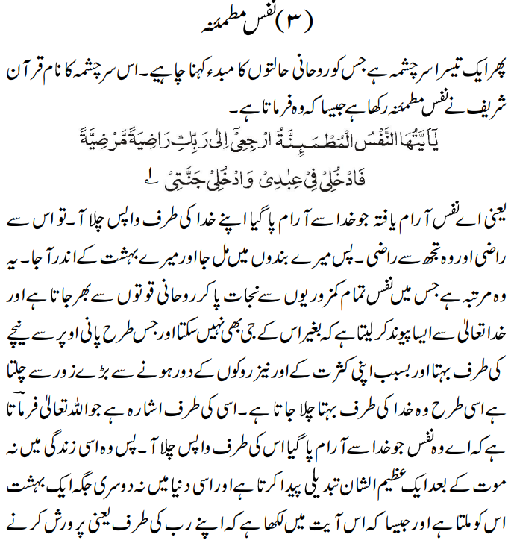
اسلامی اصول کی فلاسفی

Slide 11
Understanding the verses
Chapter 89 Verses 28 – 31
The last four verses of the Surah constitute a befitting climax. They purport to say that he who acquires the prerequisites for full moral development, mentioned in the foregoing verses, becomes immune to all possibility of faltering or falling. He attains the highest stage of spiritual development; "he is well pleased with his Lord and his Lord is well pleased with him." At this stage, called the heavenly stage, man is freed from all weakness and frailty and is braced with a peculiar spiritual strength. He becomes "united" with God and cannot exist without Him. As water flows with great force down a slope and, on account of its great mass and the total absence of all obstacles, dashes down with irresistible force, so the God-intoxicated man, at this stage, casting off all trammels, becomes attracted unrestrainedly towards his Maker. It is in this life and not after death that this great transformation takes place in him and it is in this world and not elsewhere that access to Paradise is granted to him. He finds his support only in God; He drinks deep at this fountain of spiritual life and is delivered from death.
Five Volume Commentary – Reference 4722

Slide 12
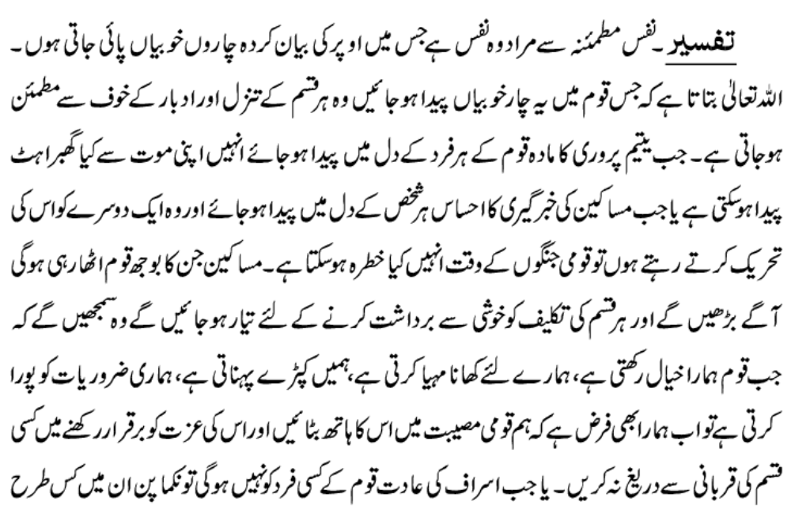
تفسیر کبیر جلد ١٢ صفحہ ٢٨٤

Slide 13
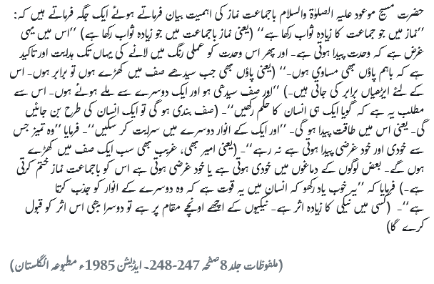
Salat
The Promised Messiah^{as} while explaining the importance of congregational prayers to the Jama'at says:
"The rationale behind putting more reward in congregational prayers is that it creates unity. The instructions to practically implement unity are so particular that even the feet are required to be aligned." This means that while offering prayers in rows, feet should also be brought into line, for which heels must be aligned. He further says, "and the rows must be straight, and (worshippers) should be standing connected to each other. It means that they must act like one being." By standing in rows, they will turn into one being, meaning there will be a dynamism in them. "So that one's illuminations can permeate into others. The disparity that gives birth to ego and selfishness, does not last (in such setting).“
Friday sermon, delivered by Hadrat Khalifatul-Masih V^{aba} January 20th ,2017

Slide 14
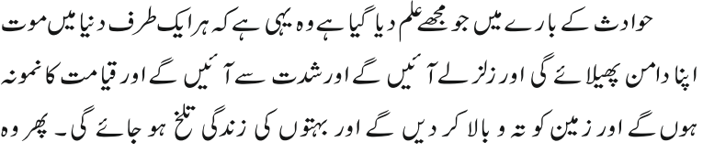
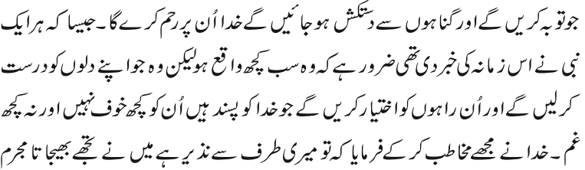
Al Wasiyyat
The knowledge that I have been granted about the calamities is none other than that death will run rampant on all sides, that earthquakes of such severity will occur as will provide a foretaste
of the Day of Judgment. The earth will be turned upside down and the lives of many will become agonizingly distressing. Then, those who repent and forsake sin, to them Allah will show mercy.
As all the Prophetsas had prophesied about this age, it was inevitable that all this should have come to pass. But those who set their hearts aright and follow the ways favored by God shall have no fear or grief.

Slide 15
Zahanat
Who discovered that the earth revolves around the sun?
Nicolaus Copernicus
Galileo Galilei
Johannes Kepler
Donald Trump
How many bones are there in an ear?
  8
  4
  1
  3
Where would you be if you were standing on the Spanish Steps?
Los Angeles
Rome
Madrid
New York City

Slide 16
Zahanat
Who discovered that the earth revolves around the sun?
Nicolaus Copernicus
Galileo Galilei
Johannes Kepler
Donald Trump
In 1543, Nicolaus Copernicus detailed his radical theory of the Universe in which the Earth, along with the other planets, rotated around the Sun. His theory took more than a century to become widely accepted.
How many bones are there in an ear?
  8
  4
  1
  3
Each human ear has three bones known as ossicles; the malleus, incus, and stapes (also known by their shape as the hammer, anvil, and stirrup, respectively). All of the ear bones are in the middle of the ear. The outer ear and inner ear are boneless.
Where would you be if you were standing on the Spanish Steps?
Los Angeles
Rome
Madrid
New York City
The Spanish Steps (Italian: Scalinata di Trinità dei Monti) in Rome, Italy, climb a steep slope between the Spanish Plaza known as the Piazza di Spagna at the base and Piazza Trinità dei Monti, dominated by the Trinità dei Monti church, at the top.

Slide 17

Reading The Holy Quran
Quran Tajweed Basics
Marks/Signs of Pausing during Tilawat
 |  | Compulsory to stop here.
 |  | Do not stop and start from here. (if a pause is made, it is essential to recite from the Prev meaningful word(s))
 |  | Better to stop but not compulsory.
 |  | Permissible to stop or continue.
 |  | Proposed stop. Permitted to stop here.
 |  | Permitted to stop here if needed
 |  | Stop only at the one of the two 3 dots.

Slide 18
Health

Slide 19
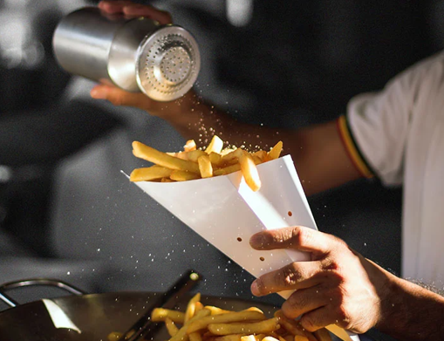
SALT

Slide 20
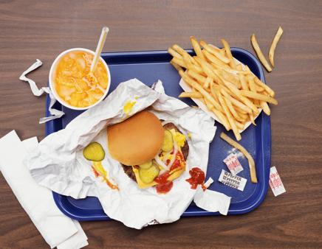
Salt and Health
The words “salt or table salt” and “sodium” are often used interchangeably but they are not the same
Table salt is sodium chloride and sodium chloride is 40% sodium and 60% chloride
One teaspoon of table salt contains about 2.4gm of sodium
Sodium is found in many foods, including monosodium glutamate (MSG), sodium bicarbonate (baking soda) and sodium nitrate (a preservative)

Slide 21
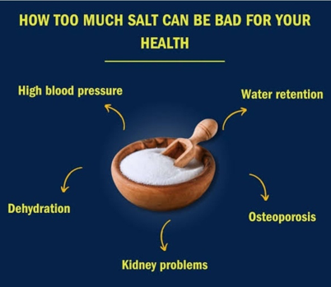
Salt and Health
The body needs a small amount of sodium to function, but most Americans consume too much of it
Most sodium we consume is from table salt. High sodium consumption can raise blood pressure which is a major risk factor for heart disease and stroke
Together, heart disease and stroke kill more Americans each year than any other cause
Reducing sodium intake will improve health, prevent disease and disability

Slide 22
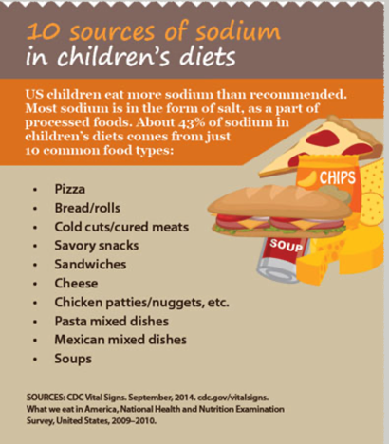
We consume too much Salt
Average Americans consume more than 3.4 grams of sodium each day
This is above the Dietary Guidelines of 2.3 gm daily salt intake for healthy lifestyle
More than 40% of the sodium we eat each day comes from just 10 types of foods, with breads and rolls at the top
Eggs and omelets are the tenth leading source of sodium

Slide 23
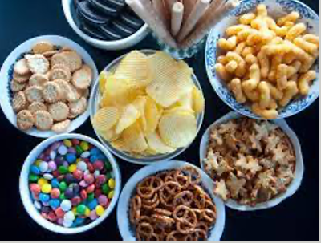
Why Is Sodium Added to Packaged Food?
About 70% sodium we eat is added to packaged and restaurant food
Sodium enhances flavor, preserves freshness, and improves texture and appearance. These effects can be accomplished with much lower levels of sodium
Many US food products contain lower amounts of sodium when they are sold in other countries
Salt is an acquired taste and individuals can easily adapt with gradual reductions in salt intake

Slide 24

How to Reduce Sodium Intake
When buying prepared meals, look for those with less than 600 milligrams (mg) of sodium per meal, which is the upper limit set by the FDA for a healthy meal
Choose “low sodium,” “reduced sodium,” or “no salt added” foods
Buy fresh, frozen, or canned vegetables with no salt or sauce added. Read food labels

Slide 25
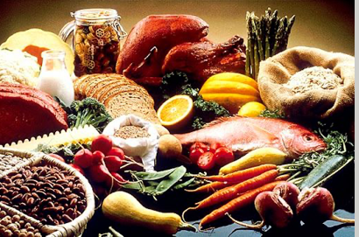
Reduce Sodium Intake
When possible, purchase fresh poultry, fish, and lean meat, rather than cured, salted, smoked, and other processed meats
Check your fresh foods to see whether salt or saline solution has been added - avoid if fresh foods have added salt
Registered dietitian and your doctor can help. Follow their advice and take action

Slide 26
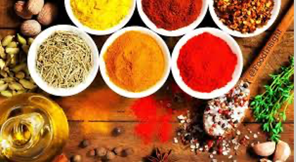
Reduce Salt Intake
Use salt alternatives when cooking such as garlic, citrus juice, salt-free seasonings, spices to reduce salt in food
Prepare rice, pasta, beans, and meats from their most basic forms (dry and fresh). Eat more fruits and vegetable and limit ready made foods, pasta sauce
Dining out? select a lower sodium meal ask that no salt be added to your foods
Keep takeout and fast food to an occasional treat

Slide 27
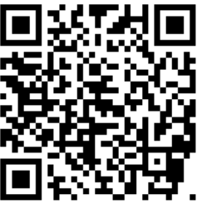

Local Majlis Time
Sign-up for TAQWA Quran classes via the following link
https://www.altaqwa.us/registration/
Sign-up for Waqf e Ardhi via the following link
https://tinyurl.com/WaqfeArdhiSignup
Murabbi Sahib’s Comments
Reminders/announcements
Du’a
Adjourn
Waqf e Ardhi Sign-up
Jazakumullah for Participating!
If you enjoyed it, please convey to those brothers who are not here today!
Please take a moment to provide your feedback
https://tinyurl.com/TalimDeckFeedback
Feedback

