Slide 1

Majlis Ansārullāh
Monthly Meeting
March 2025
Living up to the title, “Father”
Kindness in dealing with our children

Slide 2
AGENDA
Recitation and translation of the Holy Quran
Pledge
Hadith
Discussion Segment
Salat (Daily Prayers)
Al–Wasiyyat
Zahanat
Reading The Holy Quran
Health segment
Local Time – Missionary Comments/Reminders/Announcements
Du’a

Slide 3
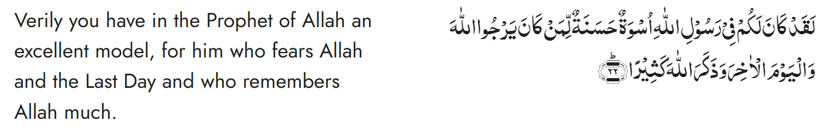
Recitation of the Holy Quran
Chapter 33, Al Ahzab, Verse 22

Slide 4
Pledge
Say this part three times:
Ash-hadu • alla ilaha • illallahu • wahdahu • la sharika lahu • wa ash-hadu • anna Muhammadan • ‘abduhu • wa rasuluh
Say this part once:
I bear witness • that there is none worthy of worship • except Allah. • He is One • (and) has no partner, • and I bear witness • that Muhammad (peace be upon him) • is His servant • and messenger.
Say this part once:
I solemnly promise that • I shall endeavor • till the end of my life • for the consolidation • and propagation of Islām Ahmadiyyat • and for upholding • the institution of Khilafat. • I shall also be prepared • to offer the greatest sacrifice • for this cause. • Moreover, • I shall urge all my children • to remain true • to Khilafat Ahmadiyya. • Insha’Allah.

Slide 5
Hadith

Slide 6

Hadith
O Allah, Bless Muhammad^{sa} and the people of Muhammad^{sa}, as Thou didst bless Abraham and the people of Abraham. Thou art indeed the Praiseworthy, the Glorious. Prosper, O Allah, Muhammad^{sa} and the people of Muhammad^{sa}, as Thou didst prosper Abraham and the people of Abraham. Thou are the Praiseworthy, the Glorious
Hadrat A'isha^{ra} reported that there came a few desert Arabs to Allah's Messenger^{sa} and said: Do you kiss your children? He said: Yes. Thereupon they said: By Allah but we do not kiss our children. Thereupon Allah's Messenger^{sa} Then what can I do if Allah has deprived you of mercy?
Sahih Muslim

Slide 7
The Holy Quran Discussion

Slide 8
Recitation of the Holy Quran
Chapter 33, Al Ahzab, Verse 22

Slide 9
Discussion
A Nasir brought his 15 yr. old son to the Masjid after a while. The son used to be a regular but over last several months had not been attending any programs. As soon as Salat was over, the father noticed that the son did not join the congregational prayers. The father found his son outside the prayer area and scolded him in front of everyone for missing Salat. He said, “you have really disappointed me today”. Few days later, Zaim sahib approached this Nasir and told him not be harsh with his son. The Nasir got upset and said he was allowed to punish children for missing Salat.
What happened here?
Do you agree with the Nasir or Zaim sahib?
How would you have reacted if your son acted this way?

Slide 10
The Promised Messiah^{as}
An individual with self‐respect and self‐control, who is also forbearing and dignified, has the right to correct a child to a certain extent or guide the child. But a wrathful and hot‐headed person who is easily provoked is not fit to be a guardian of children.
(Malfuzat, vol. 2, p. 4)
Beating of children is an act which can be termed as a sort of polytheism (shirk). It actually means that the ill‐tempered person makes himself a partner of God in giving guidance and sustaining the creatures…I wish that, instead of punishing children, parents would resort to prayer and would make it a habit to supplicate earnestly for their children as the supplications of the parents for their children are particularly accepted by God.
(Malfuzat, vol. 2, p. 4)
I pray for my children and require them to follow a broad set of rules of behavior and no more. Beyond this I put my full trust in Allah Almighty with the confidence that the seed of good fortune inherent in each of them will flourish at its proper time.
(Malfuzat, vol. 2, p. 5)

Slide 11
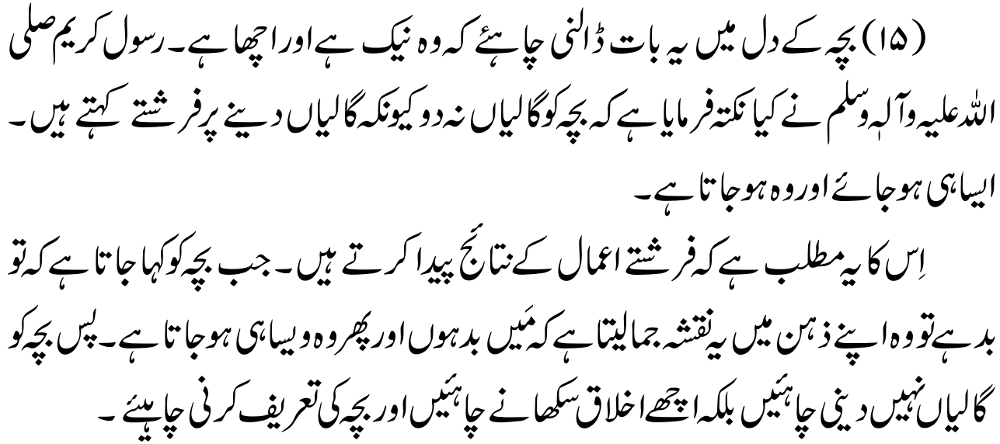
Way of the seekers (HKMII^{ra})
Tell the child that it is nice and good. The Holy Prophet^{sa} said, “Do not curse a child for when you curse, angels add: Let it be like that; and like that he becomes”. Incidentally, this also means that angels are responsible for the consequences of actions. When you tell a child it is bad, it draws an imaginary picture in which it figures itself out as bad and does in fact become bad. Therefore, do not abuse a child. Praise it and teach it to be good.
Address a child politely and courteously, for a child is a great mimic. If you address it rudely, it will return the compliment in kind

Slide 12
Friday Sermon delivered by HKMV^{aba}, May 19, 2017
Further, husbands need to understand their responsibilities as fathers. Fathers should also play their role in the child’s training and upbringing. When boys reach seven or eight years old, they become needful of their father’s attention. Men and fathers must establish their good examples. Where fathers should show respect and regard to their children, they develop good morals. A father’s good relationship with his children gives them a sense of protection. Thus, to instill in children a sense of security, it is imperative that fathers spend some time in leisure activities with their children and pray for them.

Slide 13
خطبہ جمعہ ١٩ مئی ٢٠١٧ ءفرمودہ حضرت مرزا مسرور احمد، خلیفۃ المسیح الخامس ایدہ اللہ تعالیٰ بنصرہ العزیز
مَردوں کو نہایت اہم زرّیں نصائح
پھر مردوں کی بحیثیت باپ جو ذمہ داری ہے اسے بھی سمجھنے کی ضرورت ہے۔ صرف یہ نہ سمجھ لیں کہ یہ صرف ماں کی ذمہ داری ہے کہ بچے کی تربیت کرے۔ بیشک ایک عمر تک بچے کا وقت ماں کے ساتھ گزرتا ہے اور انتہائی بچپن کی ماؤں کی تربیت بچے کی تربیت کرنے میں بہت اہم کردار ادا کرتی ہے لیکن اس سے مرد اپنے فرائض سے بری الذّمہ نہیں ہو جاتے۔ باپوں کو بھی بچوں کی تربیت میں اپنا کردار ادا کرنا چاہئے۔ خاص طور پر لڑکے جب سات آٹھ سال کی عمر کو پہنچتے ہیں تو اس کے بعد پھر وہ باپوں کی توجہ اور نظر کے محتاج ہوتے ہیں، ورنہ خاص طور پر اس مغربی ماحول میں بچوں کے بگڑنے کے زیادہ امکان ہو جاتے ہیں۔ یہاں بھی وہی اصول لاگو ہو گا جس کا عورتوں کے ضمن میں پہلے ذکر ہو چکا ہے کہ مَردوں کو، باپوں کو اپنے نمونے دکھانے اور قائم کرنے کی ضرورت ہے۔ باپوں کو جہاں بچوں کی عزت و احترام کرنے کی ضرورت ہے تا کہ ان کے اخلاق اچھے ہوں وہاں ان پر گہری نظر رکھنے کی بھی ضرورت ہے تا کہ وہ ماحول کے بداثرات سے بچ کر رہیں۔ پھر باپوں کا بچوں سے تعلق بچوں کو ایک تحفّظ کا بھی احساس دلاتا ہے۔
اپنے بارے میں فرمایا کہ ’’ہم تو اپنے بچوں کے لئے دعا کرتے ہیں اور سرسری طور پر قواعد اور آدابِ تعلیم کی پابندی کراتے ہیں۔‘‘ (تعلیم ہماری کیا ہے؟ اس کے آداب کیا ہیں؟ کیا قواعد ہیں؟ اس کی پابندی کی طرف توجہ دلاتے رہیں۔) ’’بس اس سے زیادہ نہیں اور پھر اپنا پورا بھروسہ اللہ تعالیٰ پر رکھتے ہیں۔ جیسا کسی میں سعادت کا تخم ہو گا وقت پر سرسبز ہو جائے گا۔‘‘
(ملفوظات جلد 2 صفحہ 5۔ ایڈیشن 1985ء مطبوعہ انگلستان)

Slide 14
Speech by Hazrat Khalifatul Masih V^{aba}
Majlis Ansarullah UK Annual Ijtima 2024
Fathers, therefore, must be patient, kind, and forgiving, offering their children a positive, nurturing environment.
Fathers, Huzoor^{aba} explained, bear a great responsibility in the upbringing of their children. He stressed that their conduct and behavior, particularly towards their wives and relatives, would leave a lasting impression on their children. If children witness conflict or harshness in the home, it could drive them away from the values of faith, leading them to seek comfort elsewhere, which might expose them to negative influences. A father’s role is not just as a disciplinarian but also as a spiritual guide who instils love for Allah and faith in the hearts of his children

Slide 15
Salat

Slide 16
Salat
By the sheer grace and mercy of Allah Almighty, there is a motivation in USA towards construction of mosques, but the benefit can only be derived when the mosques are utilized in their full right Islam, to populate them with those obedient servants of God who offer prayers in congregation. Many people are occupied at work during the daytime, however Fajr, Maghrib and Isha prayers can be offered at Masjid. Many Ahmadis living in the Western countries live 15-20 miles from Masjid but still make the effort to go to Masjid to offer salat in congregation. If everyone who possesses a car utilizes it for worldly matters, uses it for gaining God’s pleasure, then the purpose of these vehicles will become the service of Islam, and the individual will gain both worldly and religious rewards. Wherever it is not possible to go to Masjid, a few Ahmadis living close by should organize to get together in one home to offer prayers in congregation. And those Ahmadis living in isolated areas should make arrangements within the household to offer prayers in congregation with family members. The children will also learn the importance of salat in this manner. such arrangements will also safeguard the children from getting involved in other activities outside the home.
Friday Sermon delivered by Hazrat Khalifatul Masih V^{aba}, June 22nd , 2012

Slide 17
Salat
نماز کی اہمیت
اللہ تعالیٰ کے فضل سے امریکہ میں مساجد بنانے کی طرف بہت توجہ پیدا ہوئی ہے، لیکن مساجد بنانے کا فائدہ تو تبھی ہے جب اُن کے حق بھی ادا ہوں۔ اور مساجد کے حق اُن کو آباد کرنا ہے۔ اور آبادی کے لئے خدا تعالیٰ نے جو معیار رکھا ہے وہ پانچ وقت مسجد میں آ کر نماز ادا کرنا ہے۔ بہت سے لوگ بیشک ایسے ہیں جن کو کام کے اوقات کی وجہ سے پانچ وقت مسجد میں آنا مشکل ہے۔ لیکن فجر، مغرب اور عشاء میں تو یہ عذر نہیں چلتا، اُس پر تو حاضر ہو سکتے ہیں۔ میں جانتا ہوں دنیائے احمدیت میں بہت سے ایسے لوگ ہیں جو اِن مغربی ممالک میں رہتے ہیں اور مسجد سے پندرہ بیس میل کے فاصلے پر رہتے ہیں۔ لیکن نمازوں کے لئے مسجد میں آتے ہیں۔ اگر ظہر، عصر کی نمازیں نہ پڑھ سکیں، تو جیسا کہ میں نے کہا، یہ لوگ فجر، مغرب اور عشاء پر ضرور شامل ہونے کی کوشش کرتے ہیں۔ یہاں تو تقریباً ہر ایک کے پاس سواری ہے، اپنے دنیاوی کاموں کے لئے سواریاں استعمال کرتے ہیں، اگر اللہ تعالیٰ کی رضا کے حصول کے لئے اور اُس کی عبادت کے لئے یہ سواریاں استعمال کریں گے تو ان سواریوں کا مقصد دین کی خدمت بھی بن جائے گا اور آپ کے بھی دین و دنیا دونوں سنور جائیں گے۔ جہاں بہت زیادہ مجبوری ہے وہاں اگر قریب احمدی گھر ہیں تو کسی گھر میں جمع ہو کے گھروں میں باجماعت نماز کی ادائیگی ہو سکتی ہے۔ جہاں اکیلے گھر ہیں وہاں اپنے گھر میں اپنے بیوی بچوں کے ساتھ باجماعت نماز کی ادائیگی کی کوشش ہونی چاہئے تا کہ بچوں کو بھی نماز باجماعت کی اہمیت کا پتہ چلے۔ بچوں کو ماں باپ اگر فجر کی نماز کے لئے اُٹھائیں گے تواُن کو جہاں نماز کی اہمیت کا اندازہ ہو گا وہاں بہت سی لغویات سے بھی وہ بچ جائیں گے۔
خطبہ جمعہ ٢٢ جون ٢٠١٢ ءفرمودہ حضرت مرزا مسرور احمد، خلیفۃ المسیح الخامس ایدہ اللہ تعالیٰ بنصرہ العزیز

Slide 18
Al-Wasiyyat

Slide 19
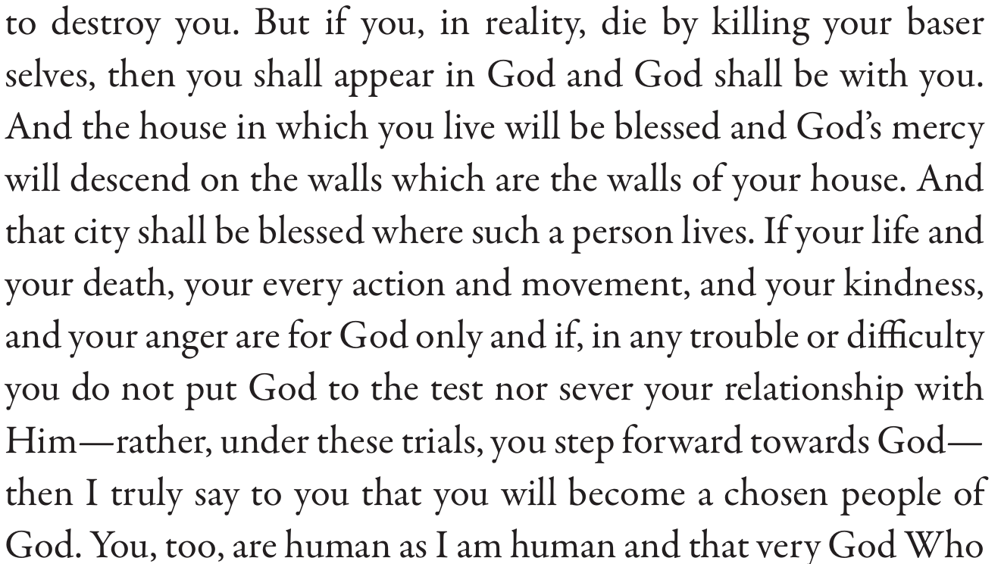
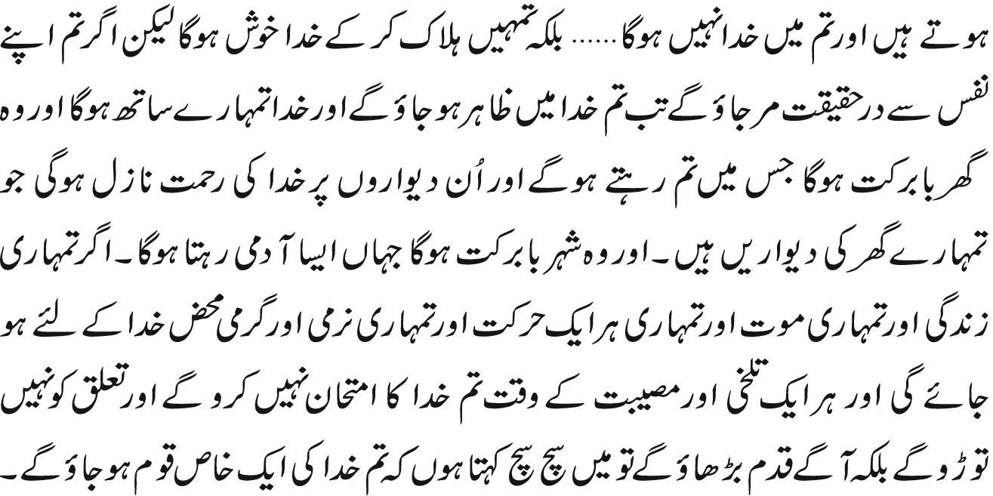
Al Wasiyyat
Al Wasiyyat

Slide 20
Zahanat
(Mental ability)

Slide 21
Zahanat
Q 1. What is the chemical symbol for oxygen?
O
O₂
Oz
Oy
Q 2. What do you call a baby goat?
Calf
Goatee
Kid
Mini
Q 3. In what year did Christopher Columbus first reach the Americas?
1542
1492
2023
He never arrived

Slide 22
Zahanat
Q 1. What is the chemical symbol for oxygen?
O
O₂
Oz
Oy
O – Oxygen is a chemical element with the symbol O and atomic number 8.
Q 2. What do you call a baby goat?
Kid
For the first six months of its life, a baby goat is called a kid. From six months to a year old, a female goat is known as a doeling. A male is a buckling. At a year old, a female goat is a doe or nanny. An adult male goat is referred to as a Billy or Buck. The formal name for a group of goats is a herd, although some people use the term tribe.
Calf
Goatee
Kid
Mini
Q 3. In what year did Christopher Columbus first reach the Americas?
1542
1492
2023
He never arrived
1492
October 12, 1492, is of enormous significance in Western history: It is the day when explorer Christopher Columbus completed his journey across the Atlantic Ocean and landed in the “New World.”

Slide 23
Reading of the Holy Quran

Slide 24


Reading of the Holy Quran
Quran Tajweed Basics
Letter Rā (ر)Thick/Thin sounds(conti.)
Rā Sākin(ڒ) can be pronounced thick(Tafkhīm) or thin(Tarqīq) based on certain conditions:
Rā Sākin will also be pronounced with thick sound if previous Mutaharrik letter bears Fat’hah or Dammah, or it precedes by blank alif(Hamzatul-Wasl) or a bold letter appears after Rā .
Rā Sākin will be pronounced with thin sound if previous Mutaharrik letter bears Kasrah or happens to be a Yā Sākin. This equally applies to Rā Sākin observing a pause.
Play Audio
Or Click Here

Slide 25
Health

Slide 26

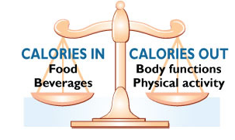
Men’s Health
Tanvir Ahmed
tahmedmd@me.com
(601) 209-3546

Slide 27
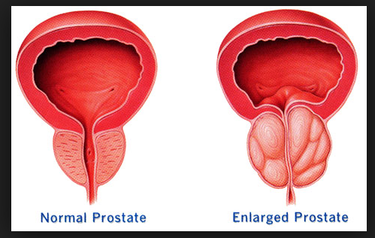

The Prostate
The prostate gland is about the size of a walnut. It is part of the male reproductive system and wraps around the tube that carries urine out of the bladder
It grows larger as you get older. If your prostate gets too large, it can cause health issues
Having prostate problems does not always mean you have cancer

Slide 28
The Prostate Problems
Benign prostatic hyperplasia (BPH) means that the prostate is enlarged but it is not a cancer. It is very common in older men
Prostate Cancer is common among American men. Risk Factors include
Age. Men age 50 and older
Race Most common among African-American men.
Family history. Increased risk If your father or brother has had prostate cancer
Diet Eating high-fat food with few fruits and vegetables may raise your risk
Watch for these symptoms and seek care with your doctor
Frequent urge to urinate
Need to get up many times during the night to urinate
Blood in urine or semen
Painful or burning urination
Not being able to urinate
Painful ejaculation
Frequent pain or stiffness in lower back, hips, pelvic or rectal area, or upper thighs
Dribbling of urine

Slide 29
How to Manage
Treatment of Benign prostatic hyperplasia (BPH)
Watchful waiting, also called active surveillance. If your symptoms are not too bad, your doctor may tell you to wait before starting any treatment
Medications. There are medicines that can help shrink the prostate or help relax muscles near your prostate to ease your symptoms
Surgery. If nothing else has worked, your doctor may suggest surgery to help urine flow. There are many types of BPH surgery
Other treatments. Sometimes radio waves, microwaves, or lasers are used to treat urinary problems caused by BPH. These methods use different kinds of heat to reduce extra prostate tissue.

Slide 30
Prostate Cancer
Treatment for prostate cancer depends on whether cancer is in part or all of the prostate or if it has spread to other parts of the body
It also depends on your age and overall health
Watchful Waiting or Active Surveillance. If the cancer is growing slowly and not causing problems, you may decide not to treat it right away
Surgery. There are different types of Surgical options
Radiation Therapy
Hormone Therapy can also be used for prostate cancer that has spread beyond the prostate (Metastatic Cancer)

Slide 31


Local Majlis Time
Sign-up for TAQWA Quran classes via the following link
https://www.altaqwa.us/registration/
Sign-up for Waqf e Ardhi via the following link
https://tinyurl.com/WaqfeArdhiSignup
Murabbi Sahib’s Comments
Reminders/announcements
Du’a
Adjourn
Waqf e Ardhi Sign-up
Jazakumullah for Participating!
If you enjoyed it, please convey to those brothers who are not here today!
Please take a moment to provide your feedback
https://tinyurl.com/TalimDeckFeedback
Feedback

