Slide 1

Majlis Ansārullāh
Monthly Meeting
June 2025
Two Basic Principles
Huqooqullah and Huqooqul Ibad

Slide 2
AGENDA
Recitation and translation of the Holy Quran
Pledge
Hadith
Discussion Segment
Salat (Daily Prayers)
Al–Wasiyyat
Zahanat
Reading The Holy Quran
Health segment
Local Time – Missionary Comments/Reminders/Announcements
Du’a

Slide 3
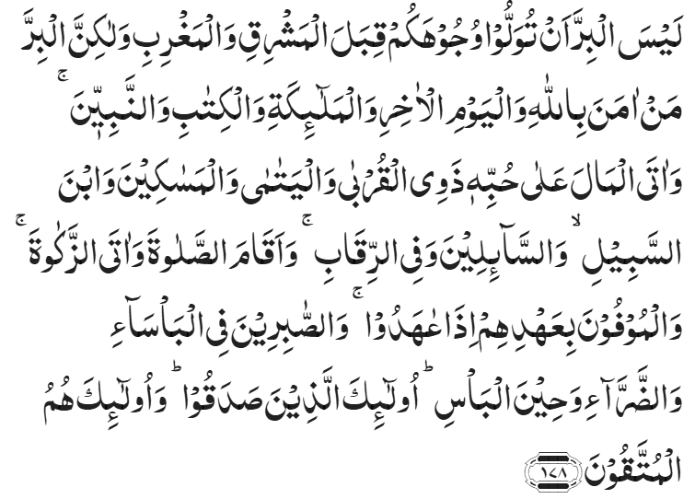
Recitation of the Holy Quran
It is not righteousness that you turn your faces to the East or the West, but truly righteous is he who believes in Allah and the Last Day and the angels and the Book and the Prophets, and spends his money for love of Him, on the kindred and the orphans and the needy and the wayfarer and those who ask for charity, and for ransoming the captives; and who observes Prayer and pays the Zakat; and those who fulfil their promise when they have made one, and the patient in poverty and afflictions and the steadfast in time of war; it is these who have proved truthful and it is these who are the God-fearing.
Chapter 2, Al Baqarah, Verse 178

Slide 4
Pledge
Say this part three times:
Ash-hadu • alla ilaha • illallahu • wahdahu • la sharika lahu • wa ash-hadu • anna Muhammadan • ‘abduhu • wa rasuluh
Say this part once:
I bear witness • that there is none worthy of worship • except Allah. • He is One • (and) has no partner, • and I bear witness • that Muhammad (peace be upon him) • is His servant • and messenger.
Say this part once:
I solemnly promise that • I shall endeavor • till the end of my life • for the consolidation • and propagation of Islām Ahmadiyyat • and for upholding • the institution of Khilafat. • I shall also be prepared • to offer the greatest sacrifice • for this cause. • Moreover, • I shall urge all my children • to remain true • to Khilafat Ahmadiyya. • Insha’Allah.

Slide 5
Hadith

Slide 6

Hadith
O Allah, Bless Muhammad^{sa} and the people of Muhammad^{sa}, as Thou didst bless Abraham and the people of Abraham. Thou art indeed the Praiseworthy, the Glorious. Prosper, O Allah, Muhammad^{sa} and the people of Muhammad^{sa}, as Thou didst prosper Abraham and the people of Abraham. Thou are the Praiseworthy, the Glorious
Narrated by Hadrat Abu Hurairah^{ra} that the Messenger of Allah^{sa},"The Muslim is the one from whose tongue and hand (other) Muslims are safe, and the believer is the one with whom the people trust their blood and their wealth."
Jami al Tirmidhi
Hadrat Mu’adh bin Jabal^{ra} said: “The Messenger of Allah^{sa} passed by me when I was riding a donkey, and said: ‘O Mu’adh, do you know what Allah’s right over His slaves is and what His slaves’ right over Allah is?’ I said: ‘Allah and His Messenger know best.’ He said: ‘The right of Allah over His slaves is that they should worship Him and not associate anything with Him. And the right of the slaves over Allah, if they do that, is that He should not punish them.’”
Sunan Ibn Majah

Slide 7
The Holy Quran Discussion

Slide 8
Recitation of the Holy Quran
It is not righteousness that you turn your faces to the East or the West, but truly righteous is he who believes in Allah and the Last Day and the angels and the Book and the Prophets, and spends his money for love of Him, on the kindred and the orphans and the needy and the wayfarer and those who ask for charity, and for ransoming the captives; and who observes Prayer and pays the Zakat; and those who fulfil their promise when they have made one, and the patient in poverty and afflictions and the steadfast in time of war; it is these who have proved truthful and it is these who are the God-fearing.
Chapter 2, Al Baqarah, Verse 178

Slide 9
Discussion
A shelter home was built by local church for homeless people in the society. This was near a mosque in one of our Majalis. In one of the Ansar meeting, a discussion ensued about supporting this shelter home. Some Ansar were in favor of doing so while others felt there are other useful avenues to spend our manpower and funds.
What would be your approach and why?
Should we be spending on charities outside Jama’at?
Should we support someone who does not believe in God?

Slide 10
Five Volume Commentary
Chapter 2, Al Baqarah, Verse 178
……..this verse gives a gist of the teachings of Islam. It begins with the fundamental Islamic beliefs and doctrines which are the source and basis of all actions…..
After stating the fundamental objects of faith, the verse proceeds to mention some of the more important ordinances relating to man’s actions. Pride of place is given to charity which a man gives not as a duty imposed on him, but as prompted by love, solicitude and sympathy for his kinsmen and fellow beings or out of love for common humanity. Next come the commandments regarding Prayer and Zakah which help to establish a true connection between God and man on the one hand and regulate relations between man and man on the other. Finally, are laid down the two bulwarks of character and morality, i.e. (1) the redemption of promises and pledges; and (2) the displaying of fortitude, patience and steadfastness in time of distress, the first-mentioned forming one of the bases of international morality and the latter the means of its perfection.

Slide 11
Speech by Hazrat Khalifatul Masih V^{aba}
Majlis Ansarullah UK Annual Ijtima 2024
Two basic principles, Huqooqullah and Huqooqul Ibad
The Promised Messiah^{as}’s mission, Huzoor^{aba} reminded the ansar, was based on two overarching principles: the Oneness of Allah and living with kindness and sympathy for others. If members of the Jama’at adhered to these values, they would set an example for the wider world, showcasing the true teachings of Islam.

Slide 12
Hazrat Khalifatul Masih V^{aba}
“Ever since its foundation, the Ahmadiyya Muslim Community has always sought to be on the very front lines of serving humanity, whether it be directly through our own Community’s schemes, or through Humanity First or through the support of other charities and good causes. For example, over the past few decades, the Ahmadiyya Muslim Community has opened many hospitals and schools across Africa, in which the local people are provided access to healthcare and excellent education, irrespective of their ethnicity, religion or social background”.
Inauguration of Nasir Hospital Guatemala, October 23rd, 2018

Slide 13
Hazrat Khalifatul Masih V^{aba}
“That is why our schools, colleges and hospitals are established in various parts of the world – and in some of the poorest countries of Africa and Asia – so that we can serve humanity. Moreover, we serve others without discrimination. Ninety percent of the patients in our hospitals are Christians, and similarly ninety percent of the students that study in our schools are either Christians, people of no faith or belonging to other faiths. We also award scholarships to those students among them who are very talented and again this is done without any sort of discrimination or bias. We do this because people have basic human rights and, if because of their situation or circumstances, some people have been deprived of certain necessities, then we must provide for them and alleviate their state of deprivation to the greatest extent possible – and this in fact is service to mankind’.
Inauguration of Baitul Afiyat Mosque Waldshut-Tiengen, Germany, April 10th, 2017

Slide 14
Hazrat Khalifatul Masih V^{aba}
The Promised Messiah^{as} said: ‘Every person should fear God. Fear of God would make him do many virtues.’ He also said: ‘In realty only that person is good and pious who proves to be good when scrutinized by Allah the Exalted. Many people deceive themselves and consider themselves pious, however only he is righteous in the real sense who is deemed righteous in the office of Allah the Exalted.’
This is an important advice and if it is kept in view we would rightfully pay our dues to Allah the Exalted as well as our dues to mankind. However, if we presume that our worship of God is good and we pay the dues of God but there is some sort of pretense or ostentation in these matters or although we worship God but do not pay the dues of mankind, then this will not gain acceptance in God’s sight and cannot attain His pleasure.
Friday Sermon, September 20th, 2013

Slide 15
Hazrat Khalifatul Masih V^{aba}
Hazrat Khalifatul Masih narrated a lengthy Hadith in which the Holy Prophet^{sa} counselled Hazrat Mu’adh^{ra}. He said: ‘O Mu’adh I shall tell you something which will benefit you if you remember it and if you forget it, you will not attain God’s grace and you will have no reasoning as assurance for salvation. Allah the Exalted created seven attendant angels before He created seven heavens and the Earth and placed one angel as attendant of each heaven. They were told to remain in position and only permit those actions to go through which were allowed by God. Angels who safeguard man’s actions and write them down daily, took the actions of a man which he had done from morning till evening and rose to heaven. The angels thought very highly of the actions and considered them pure. However, when they reached the first heaven, they said to the attendant angel that they had brought a man’s actions to present before God. They said the actions were very pure. The attendant angel said: ‘Stop here, you are not allowed to go further, return and throw back these actions in the face of the person whose actions they are. God has instructed me not to let the actions of one who back-bites go through, and this person is always back-biting.’
Friday Sermon, September 20th, 2013

Slide 16
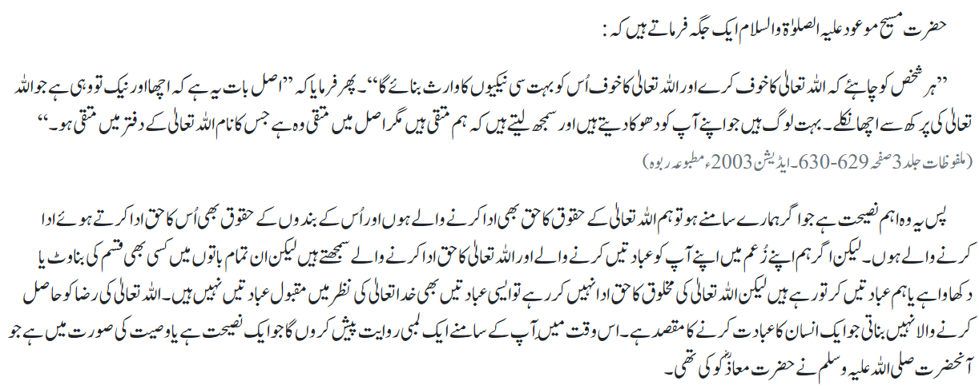

Slide 17
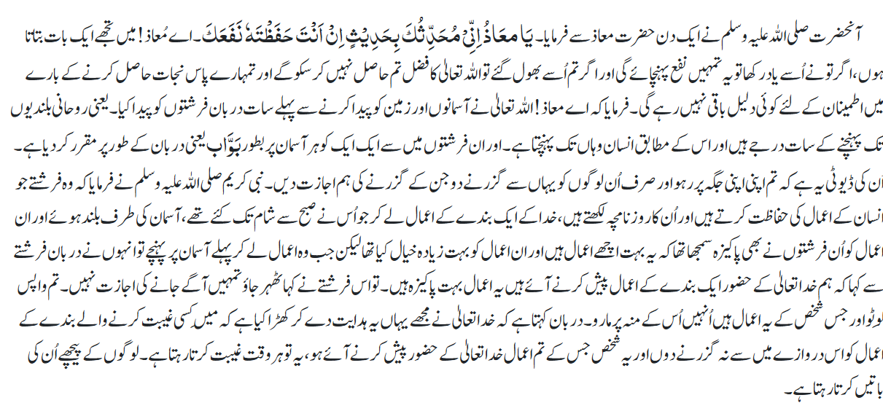

Slide 18
Salat

Slide 19
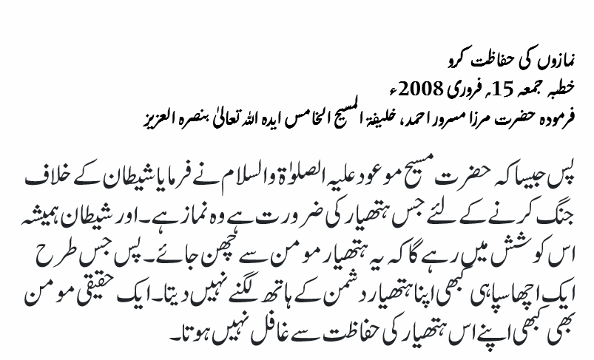
Salat
Salat (Prayers)
Friday Sermon February 15th, 2008
Delivered by Hazrat Khalifatul Masih V^{aba}
The Promised Messiah (on whom be peace) said that Salat alone is the virtue that dispels satanic weaknesses, and that Satan wishes man to stay away from Salat because he knows it is Salat that would purify man. ….. Just as a soldier would never surrender his best weapon in a battlefield Salat is the most excellent weapon for a believer and a believer should safeguard it at all costs.

Slide 20
Al-Wasiyyat

Slide 21
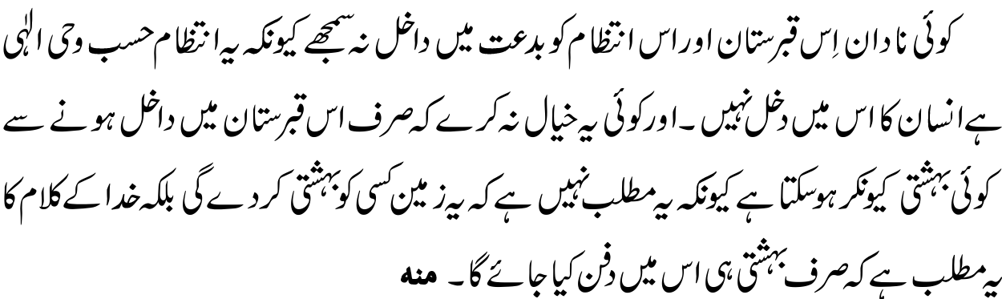
Al Wasiyyat
Al Wasiyyat
Let no ignorant person think that this graveyard and the arrangements for it fall into the category of Bid‘at [an unwarranted religious innovation]. For this arrangement is in accordance with Divine revelation and there is no element of human involvement in it. And let no one wonder how, by just being buried in this graveyard, one can enter Paradise. The idea behind it all is not that this piece of land will make anyone worthy of Heaven; rather the Word of God means that only those will be buried here who are worthy of Heaven.

Slide 22
Zahanat
(Mental ability)

Slide 23
Zahanat
Q 1. In which city/town was William Shakespeare born?
Barton-upon-Humber
Stratford-upon-Avon
Ross-on-Wye
Norton-on-Derwent
Q 2. What was the name of the first cloned animal?
Golly
Jolly
Molly
Dolly
Q 3. How many amendments make up the Bill of Rights?
4
8
10
15

Slide 24
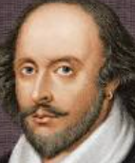
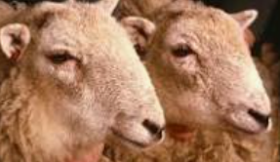
Zahanat
Q 1. In which city/town was William Shakespeare born?
Barton-upon-Humber
Stratford-upon-Avon
Ross-on-Wye
Norton-on-Derwent
Stratford-upon-Avon, a medieval market town in England’s West Midlands, is the 16th-century birthplace of William Shakespeare.
Q 2. What was the name of the first cloned animal?
Golly
Jolly
Molly
Dolly
The first successfully cloned mammal was Dolly the sheep, cloned from an adult somatic cell in 1996. She was the product of research by Ian Wilmut and Keith Campbell at the Roslin Institute.
Q 3. How many amendments make up the Bill of Rights?
4
8
10
15
On September 25, 1789, the First Congress of the United States proposed 12 amendments to the Constitution. Ten of the proposed 12 amendments were ratified by three-fourths of the state legislatures on December 15, 1791. The ratified Articles (Articles 3–12) constitute the first 10 amendments of the Constitution, or the U.S. Bill of Rights.

Slide 25
Reading of the Holy Quran

Slide 26
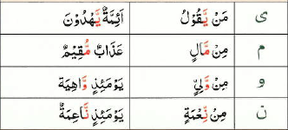

Quran Tajweed Basics
Rules of Nūn Sākin(ݩ) – Idghām(assimilation) with Gunnah
In Tajweed, Idghām means to merge one letter into another. If Nūn Sākin(ݩ) or Tanwīn is followed by Mashaddad Yā/Mīm/Nūn/Wau then Idgham will take place with a 2-second Gunnah Sound.
See Ch:88 V3,4,9
Play Audio
Or Click Here

Slide 27
Health

Slide 28
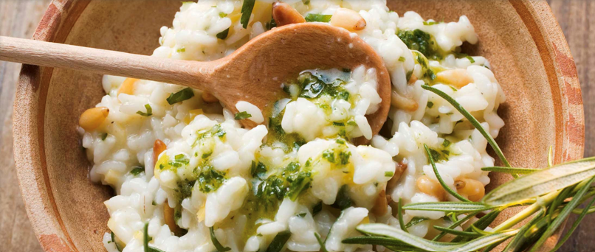
How to Prevent Diabetes
REF: Mayo clinic and Harvard Health
Tanvir Ahmed

Slide 29
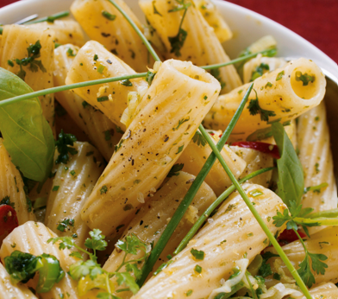

Diabetes Prevention Naturally
Lifestyle changes can help prevent the onset of type 2 Diabetes. It is never too late to start
Prevention is especially important if you are a pre-diabetic (borderline diabetes)

Slide 30

Lose Extra weight
If you lose 7-10% of weight with exercise and nutrition, the risk of developing diabetes will go down by unto 60%. More weight loss will confer greater benefits.
Strive to lose 1-2 lbs. a week and set a goal weight
Remember there are no magical pills or diet fads that work for long term

Slide 31
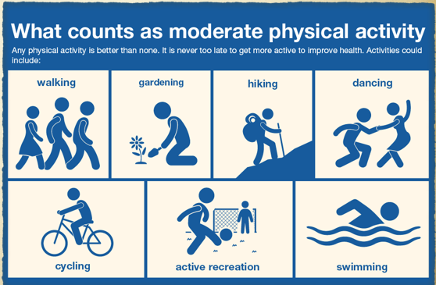
Be More Active
Exercise can help you lose weight, lower your blood sugar and increase your strength, balance and mood
Aerobic Exercise such as brisk walking, cycling, swimming etc. for 30 minutes daily
Resistance exercise such as weight training etc. 3 times a week
Breaks from sitting for long periods with walking stretching etc.

Slide 32

Choose healthy plant foods
Plants provide vitamins, minerals and carbohydrates in your diet
Eat a variety of healthy, fiber-rich foods
Non-starchy vegetables, such as leafy greens, broccoli and cauliflower
Legumes, such as beans, chickpeas and lentils
Whole grains, such as whole-wheat pasta and bread, whole-grain rice etc.

Slide 33

Choose Healthy Fats
Fats should be limited and consumed in moderation - high in calories
Unsaturated fats promote healthy blood cholesterol levels and good heart and vascular health e.g., Olive oil, avocado oil
Nuts and seeds, such as almonds, peanuts and fish such as salmon, mackerel, sardines, tuna and cod
Eat less of saturated fats (coconut oil, palm oil, butter and high fat red meat)
Eat more protein such as lean meat, fish, nuts, egg white, legumes, and lentils

Slide 34
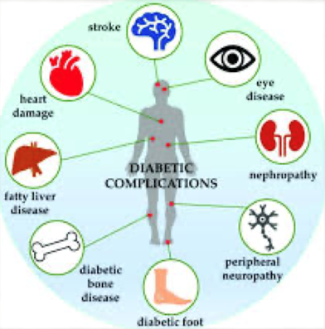
Diabetes Prevention-Naturally
Preventing diabetes will help you avoid serious health complications of diabetes in the future, such as nerve, kidney, eye and heart diseases

Slide 35
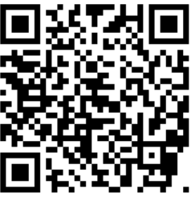
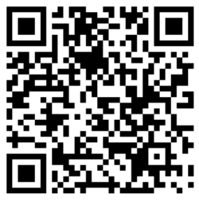
Local Majlis Time
Sign-up for TAQWA Quran classes via the following link
https://www.altaqwa.us/registration/
Sign-up for Waqf e Ardhi via the following link
https://tinyurl.com/WaqfeArdhiSignup
Murabbi Sahib’s Comments
Reminders/announcements
Du’a
Adjourn
Waqf e Ardhi Sign-up
Jazakumullah for Participating!
If you enjoyed it, please convey to those brothers who are not here today!
Please take a moment to provide your feedback
https://tinyurl.com/TalimDeckFeedback
Feedback

