Slide 1

Majlis Ansārullāh
Monthly Meeting
July 2025
Mirage
Worldly pursuits in lieu of prioritizing Allah can lead to ruin
I shall give preference to my faith over all worldly matters
میں دین کو دنیا پر مقدّم رکھوں گا

Slide 2
AGENDA
Recitation and translation of the Holy Quran
Pledge
Hadith
Discussion Segment
Salat (Daily Prayers)
Al–Wasiyyat
Zahanat
Reading The Holy Quran
Health segment
Local Time – Missionary Comments/Reminders/Announcements
Du’a

Slide 3
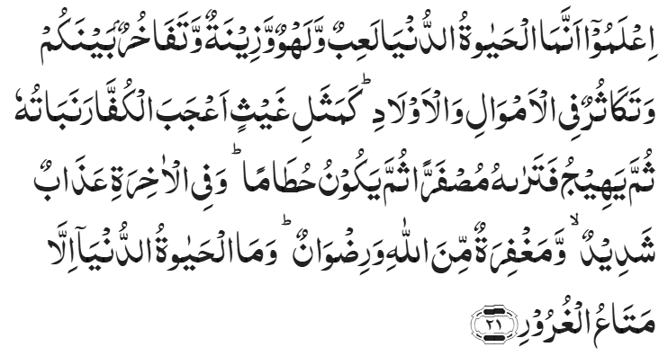
Recitation of the Holy Quran
Know that the life of this world is only a sport and a pastime, and an adornment, and a source of boasting among yourselves, and of rivalry in multiplying riches and children. This life is like the rain the vegetation produced whereby rejoices the tillers. Then it dries up and thou seest it turn yellow; then it becomes broken pieces of straw. And in the Hereafter, there is severe punishment, and also forgiveness from Allah, and His pleasure. And the life of this world is nothing but temporary enjoyment of deceitful things.
Chapter 57, Al Hadid, Verse 21

Slide 4
Pledge
Say this part three times:
Ash-hadu • alla ilaha • illallahu • wahdahu • la sharika lahu • wa ash-hadu • anna Muhammadan • ‘abduhu • wa rasuluh
Say this part once:
I bear witness • that there is none worthy of worship • except Allah. • He is One • (and) has no partner, • and I bear witness • that Muhammad (peace be upon him) • is His servant • and messenger.
Say this part once:
I solemnly promise that • I shall endeavor • till the end of my life • for the consolidation • and propagation of Islām Ahmadiyyat • and for upholding • the institution of Khilafat. • I shall also be prepared • to offer the greatest sacrifice • for this cause. • Moreover, • I shall urge all my children • to remain true • to Khilafat Ahmadiyya. • Insha’Allah.

Slide 5
Hadith

Slide 6

Hadith
O Allah, Bless Muhammad^{sa} and the people of Muhammad^{sa}, as Thou didst bless Abraham and the people of Abraham. Thou art indeed the Praiseworthy, the Glorious. Prosper, O Allah, Muhammad^{sa} and the people of Muhammad^{sa}, as Thou didst prosper Abraham and the people of Abraham. Thou are the Praiseworthy, the Glorious
Abdullah^{ra} narrated, "The Messenger of Allah^{sa} was sleeping upon a mat, then he stood, and the mat had left marks on his side. We said: 'O Messenger of Allah! We could get a bed for you.' He said: 'What do I have to do with the world! I am not in the world but as a rider seeking shade under a tree, then he catches his breath and leaves it."
Sunan Al Tirmidi, 2377

Slide 7
The Holy Quran Discussion

Slide 8
Recitation of the Holy Quran
Know that the life of this world is only a sport and a pastime, and an adornment, and a source of boasting among yourselves, and of rivalry in multiplying riches and children. This life is like the rain the vegetation produced whereby rejoices the tillers. Then it dries up and thou seest it turn yellow; then it becomes broken pieces of straw. And in the Hereafter there is severe punishment, and also forgiveness from Allah, and His pleasure. And the life of this world is nothing but temporary enjoyment of deceitful things.
Chapter 57, Al Hadid, Verse 21

Slide 9
Discussion
A new family moved in your Jama’at. They decided to reside near the Masjid to stay connected. They started participating in most activities. Over time, you noticed that the family was not coming to the mosque much and their children hardly attended any programs or classes. You approached the father about it. He mentioned that school and extracurricular activities were overwhelming. Fortunately, his children are good at sports, and they are busy with many games and training sessions. He said that they will take care of the religious knowledge of their children. There needs to be no concern.
Are you concerned? If so, why?
How do we handle conflicting priorities?

Slide 10
Five Volume Commentary
Life spent in forgetfulness of God and disregard of its higher values is, as described in the verse under comment, but a sport and a pastime, otherwise man’s life on earth is a most serious fact. It has a great mission and a noble object to fulfil. The verse implies that at the time when the great Promised Reformer to whom reference is impliedly made in the preceding verse would make his appearance, men would neglect the grim and noble purpose of their lives and would give themselves up, body and soul, to the pursuit of petty and paltry pleasures of life and there would be a mad craze and unhealthy competition among them, and vying with one another, for amassing wealth and material resources. But the end of all this competition and rivalry, says the verse, would be like the end of a blooming and blossoming crop over which a scorching wind has blown turning it into broken pieces of straw.
And those who believe in Allah and His Messengers and they are the Truthful and the Witnesses in the sight of their Lord, they will have their reward and their light. But as for those who disbelieve and reject Our Signs, these are the inmates of Hell.
Chapter 57, Al Hadid, Verse 20
Chapter 57, Al Hadid, Verse 21

Slide 11
Speech by Hazrat Khalifatul Masih V^{aba}
Majlis Ansarullah UK Annual Ijtima 2024
Huzoor^{aba} shared Promised Messiah^{as}’s teachings on how greed and worldly desires can create a metaphorical hell in this life. Huzoor^{aba} cautioned that the pursuit of wealth often leaves a person dissatisfied, as materialism can never truly bring inner peace or fulfilment. Instead, it creates an unquenchable thirst for more, which ultimately leads to spiritual ruin.
Huzoor^{aba} reminded the Ansar that while striving for worldly success is permissible, it must always remain subservient to the goals of faith and service to Allah. Wealth, family, and status are all trials that must be navigated carefully to avoid becoming veils between man and God. True peace, he explained, can only be achieved by living for the sake of Allah and prioritizing the spiritual over the material.

Slide 12
Hazrat Khalifatul Masih V^{aba}
Every man, woman, young and old of the Jama’at knows a phrase very well, which is ‘I shall give precedence to faith over worldly matters.’ This is because the Promised Messiah^{as} drew great attention to this. Speeches of our orators cite this phrase as well as addresses of Khulafa. Indeed, this phrase is a synopsis of the conditions of Bai’at as it is a summary of the pledges of our various auxiliary organizations. And these words are also mentioned in the conditions of Bai’at. In short, this phrase is a promise an Ahmadi makes on which his Bai’at is dependent. As does his connection with Khilafat and Nizam e Jama’at (administration) rely on this phrase. If he does not practice this phrase then his claim to Bai’at, connection with Khilafat and Nizam of Jama’at is erroneous. And assertions about Bai’at and attainment of God’s pleasure are reduced to mere verbosity!
In this regard the Promised Messiah^{as} said: ‘If someone asserts during Bai’at that he will give precedence to faith over worldly matters but does not practice it and does not honor his pledge, then what care has God for him?
Giving precedence to faith over worldly matters
Friday Sermon delivered by Hazrat Khalifatul Masih V^{aba}, October 17, 2014

Slide 13
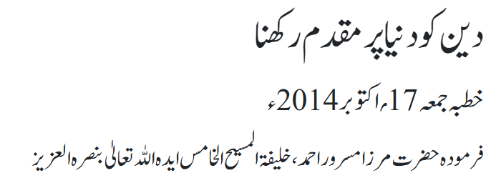
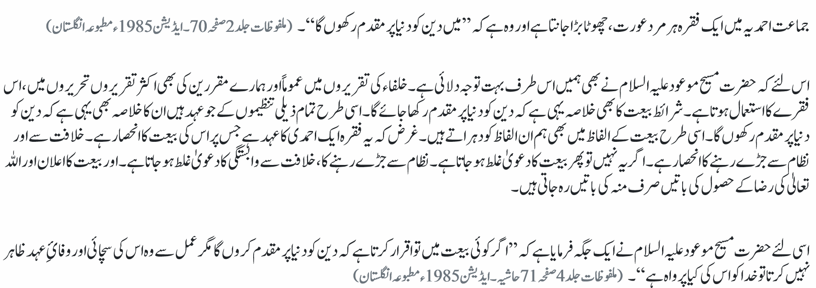
Hazrat Khalifatul Masih V^{aba}

Slide 14
Salat

Slide 15
Salat
Salat (Prayers)
Friday Sermon January 20, 2017
Delivered by Hazrat Khalifatul Masih V^{aba}
For a real believer, offering Salat is the only way to remove spiritual corrosion. As Prophet Muhammad (peace be upon him) explained with an example, "if there was a river at a person's door and he took a bath in it five times a day, can you believe that any dirt would be left on his body." His companions replied, "O Prophet of God, not a trace of dirt would be left." At this, the Holy Prophet (peace be upon him) said, "That is the parable of the five prayers by which Allah removes sins and eliminates weaknesses." It means that not a trace of dirt is left on the soul of a person who offers five daily prayers.
Sahih Al Bukhari Hadith 528
Thus, the Holy Prophet (peace be upon him) explained the importance of prayers with such a beautiful parable. But as I already said, that the commandment is not merely about offering Salat. The Prophet Muhammad (peace be upon him) further stated that a person who performed ablution at home, and then he set off heading to the mosque so that he could offer obligatory prayers he would be rewarded according to the number of steps he has to take to reach the mosque. One step will remove one of his sins, the next will elevate his (spiritual) status. This means that every step will gain him rewards.
Sahih Muslim Hadith 1406

Slide 16
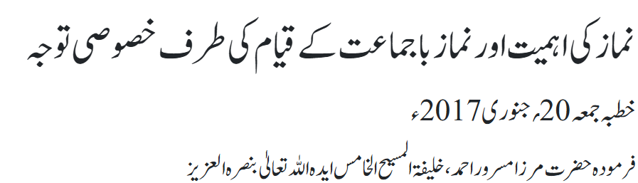
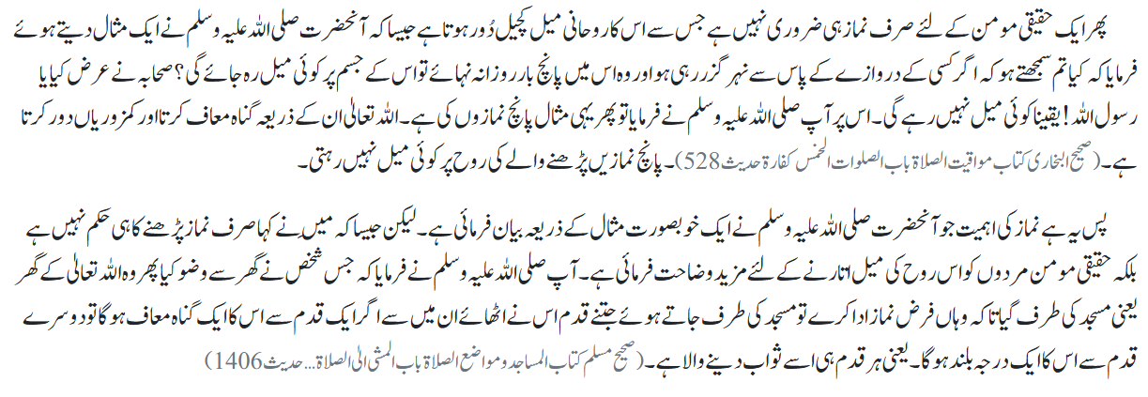
Salat

Slide 17
Al-Wasiyyat

Slide 18
Al Wasiyyat
Al Wasiyyat
Again, for the third time do I pray: O my Mighty and Benevolent [God!] O Forgiving and Merciful God, do grant them alone a place for graves here who have true faith in this messenger of Yours and who have no trace of hypocrisy, of selfish and obedience deserve to be followed and observed, they follow and observe it for Your sake; and in their heart of hearts they have already sacrificed their lives for you and in your path and You are pleased with them; and those whom You know to be totally lost in love for You; and those who have with your Messenger a relationship of love and devotion based on loyalty, total respect and enlightened faith, Amin, O Lord of the world.

Slide 19
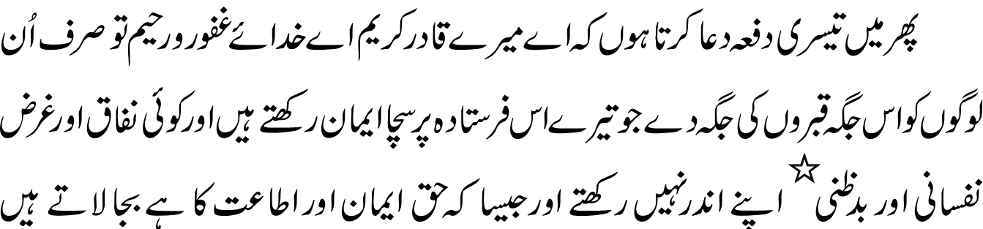
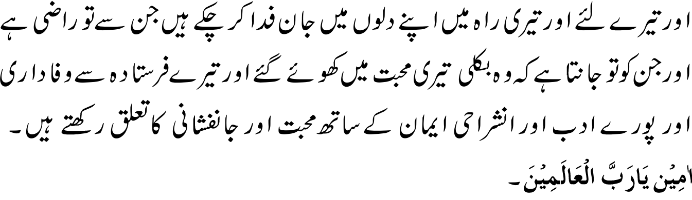
Al Wasiyyat
الوصیت

Slide 20
Zahanat
(Mental ability)

Slide 21
Zahanat
Q 1. Where is Mount Kilimanjaro located?
Australia
Tanzania
Madagascar
Sri Lanka
Q 2. What is the process by which plants convert sunlight to energy?
Photosynthesis
Metamorphosis
Osmosis
Symbiosis
Q 3. Which country features a shipwreck on its national flag?
Brazil
Portugal
Bermuda
Greenland

Slide 22
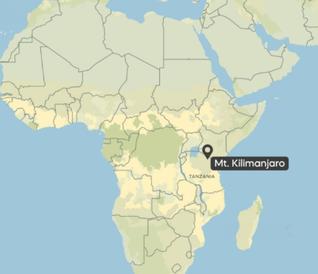


Zahanat
Q 1. Where is Mount Kilimanjaro located?
Australia
Tanzania
Madagascar
Sri Lanka
Mount Kilimanjaro is located in northeastern Tanzania, near the border with Kenya.
Q 2. What is the process by which plants convert sunlight to energy?
Photosynthesis
Metamorphosis
Osmosis
Symbiosis
Photosynthesis is the process by which plants, algae, and some bacteria convert light energy, usually from the sun, into chemical energy in the form of glucose (a type of sugar), while also producing oxygen as a byproduct.
Q 3. Which country features a shipwreck on its national flag?
Brazil
Portugal
Bermuda
Greenland

Slide 23
Reading of the Holy Quran

Slide 24
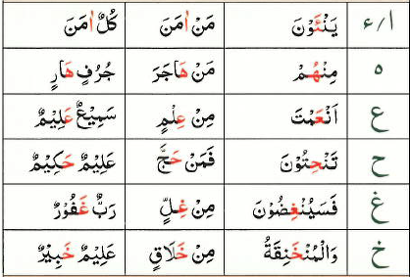

Quran Tajweed Basics
Rules of Nūn Sākin(ݩ) – Izhār
Izhār means manifestation or express clearly. If Nūn Sākin(ݩ) or Tanwīn is followed by following six letters, it is pronounced clearly without any elongated nasal sound (Ghunnah sound). In Tajweed, these six letters are called throat or Izhār letters.
Play Audio
Or Click Here

Slide 25
Health

Slide 26

HEALTH CONSEQUENCEs OF BOTTLED WATER
https://pubs.acs.org/doi/epdf/10.1021/envhealth.3c00052?ref=article_openPDF

Slide 27
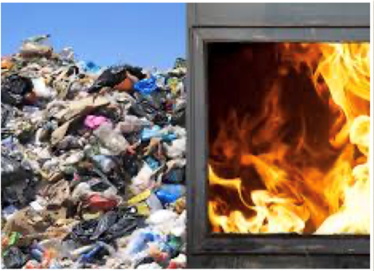
environment pollution
A million water bottles are bought every minute around the globe
Tap water in the US is tightly regulated unlike bottled water
Some estimate suggest that up to two-thirds of bottled water in the US is repackaged tap water
Plastic bottles are the second most common ocean pollutant behind plastic bags
Most bottles end up in landfills or incinerators

Slide 28

BOTTLED WATER
Bottled water can carry harmful chemicals from the bottle itself besides risk of contamination
Micro or Nano-plastics can be carried to your liver, kidney and the brain
Researchers have found plastic chemicals in the brain, heart, liver, kidney and lungs of the developing baby (pregnant mice)
The long-term effects of these contaminants remain largely unknown

Slide 29

TAP or Bottled water
Microplastic contamination is associated with oxidative stress, immune system dysregulation, and changes in fat levels
Bottled water can be on average 1,000 times more expensive than tap water.

Slide 30

The Solution
The solution is to switch to reusable, refillable water bottles and drink filtered tap water
Install Water cooler and fountains in your Mosques, gyms and community Centers
Your Qaid Health is ready to help. Please contact qaid.health@ansarusa.org

Slide 31
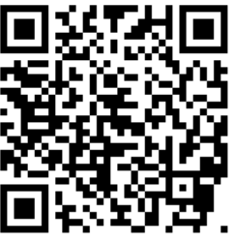
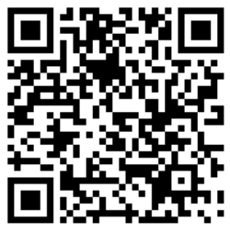
Local Majlis Time
Sign-up for TAQWA Quran classes via the following link
https://www.altaqwa.us/registration/
Sign-up for Waqf e Ardhi via the following link
https://tinyurl.com/WaqfeArdhiSignup
Murabbi Sahib’s Comments
Reminders/announcements
Du’a
Adjourn
Waqf e Ardhi Sign-up
Jazakumullah for Participating!
If you enjoyed it, please convey to those brothers who are not here today!
Please take a moment to provide your feedback
https://tinyurl.com/TalimDeckFeedback
Feedback

