Slide 1

Majlis Ansārullāh
Monthly Meeting
August 2025
Are Muslims the “Best People”?
The causes of decline of Muslims

Slide 2
AGENDA
Recitation and translation of the Holy Quran
Pledge
Hadith
Discussion Segment
Salat (Daily Prayers)
Al–Wasiyyat
Zahanat
Reading The Holy Quran
Health segment
Local Time – Missionary Comments/Reminders/Announcements
Du’a

Slide 3
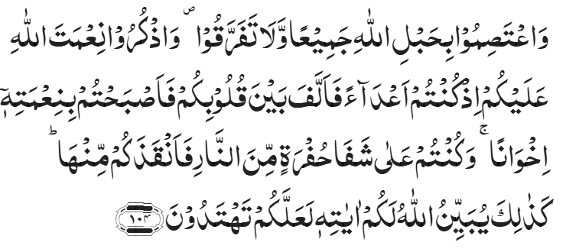
Recitation of the Holy Quran
And hold fast, all together, by the rope of Allah and be not divided; and remember the favour of Allah which He bestowed upon you when you were enemies and He united your hearts in love, so that by His grace you became as brothers; and you were on the brink of a pit of fire and He saved you from it. Thus does Allah explain to you His commandments that you may be guided.
Chapter 3, Aal-e-’Imran, Verse 104

Slide 4
Pledge
Say this part three times:
Ash-hadu • alla ilaha • illallahu • wahdahu • la sharika lahu • wa ash-hadu • anna Muhammadan • ‘abduhu • wa rasuluh
Say this part once:
I bear witness • that there is none worthy of worship • except Allah. • He is One • (and) has no partner, • and I bear witness • that Muhammad (peace be upon him) • is His servant • and messenger.
Say this part once:
I solemnly promise that • I shall endeavor • till the end of my life • for the consolidation • and propagation of Islām Ahmadiyyat • and for upholding • the institution of Khilafat. • I shall also be prepared • to offer the greatest sacrifice • for this cause. • Moreover, • I shall urge all my children • to remain true • to Khilafat Ahmadiyya. • Insha’Allah.

Slide 5
Hadith

Slide 6

Hadith
O Allah, Bless Muhammad^{sa} and the people of Muhammad^{sa}, as Thou didst bless Abraham and the people of Abraham. Thou art indeed the Praiseworthy, the Glorious. Prosper, O Allah, Muhammad^{sa} and the people of Muhammad^{sa}, as Thou didst prosper Abraham and the people of Abraham. Thou are the Praiseworthy, the Glorious
Narrated by An-Nu`man bin Bashir: Allah's Messenger^{sa} said, "You see the believers as regards their being merciful among themselves and showing love among themselves and being kind, resembling one body, so that, if any part of the body is not well then the whole body shares the sleeplessness (insomnia) and fever with it."
Sahih Al Bukhari 6011

Slide 7
The Holy Quran Discussion

Slide 8
Recitation of the Holy Quran
And hold fast, all together, by the rope of Allah and be not divided; and remember the favour of Allah which He bestowed upon you when you were enemies and He united your hearts in love, so that by His grace you became as brothers; and you were on the brink of a pit of fire and He saved you from it. Thus does Allah explain to you His commandments that you may be guided.
Chapter 3, Aal-e-’Imran, Verse 104

Slide 9
Discussion
A Nasir was reciting the Holy Quran one day. The following verse caught his attention:
“You are the best people raised for the good of mankind;”
(Chapter 3, Aal-e-’Imran, Verse 111)
He started thinking about the Muslims of the world. He could not help but notice the plight of Muslim countries. They are weak and are attacked from every which way. Instead of winning, they are helpless and loosing. What happened to the Ummah he thought? They have the best teaching, best role model and best Book.
Are his questions valid?
Why are the Muslim countries suffering?
Is there any solution to these problems?

Slide 10
Five Volume Commentary
Another cause of the spiritual degradation of the Israelites was that they did not remain united but split up into sections, finding fault with one another. The verse warns Muslims against that danger. The Holy Prophet is reported to have said: "The Book of God is the rope of Allah which has been extended from the heavens to the earth" (Jarir, iv. 30). Broadly speaking, there are three things which may be taken to have been here meant by the rope of God, by holding fast to which Muslims may remain united and be safe against disunion and disruption:
the Quran;
the Messenger of God;
the Successors to the Messenger of God.
The similitude may have reference to sea life. Ropes are thrown to save the life of a drowning man. When a man falls into the sea or when a boat is wrecked by a storm, people in the boat or those standing on the shore throw out ropes to those who are struggling for their lives in the sea. The similitude is thus incidentally a refutation of the objection that the Quran restricts its similitudes to such objects only as were known to the desert dwellers of Arabia.

Slide 11
Five Volume Commentary
It may be noted here that whenever the Quran speaks of the open or secret hostility of the enemies of Islam, it exhorts Muslims to be strong of faith; for it is at such times that one is likely to waver and show weakness in resolution. Thus, after referring to the hostility of the People of the Book (3:100, 101) the Quran exhorts Muslims:
to fear God as He should be feared (Chapter 3: Verse 103);
to be constant in obedience to God (Chapter 3: Verse 103);
to hold fast to the rope of God and preserve themselves from disunion (Chapter 3: Verse 104).

Slide 12
Speech by Hazrat Khalifatul Masih V^{aba}
Majlis Ansarullah UK Annual Ijtima 2024
It is the discord amongst one another that has led the Muslims towards their current state whereby they are being attacked by the enemy form all directions. Not only that, they seem to be winning against the Muslims. On the one hand, Allah the Almighty states that the believers are the ones who shall be victorious, but here we see the opposite. The reason is that the Muslims are disunited. Therefore, we must create that unity for which the Promised Messiah (peace be upon him) was sent and we must also pass on this teaching to the rest of the society

Slide 13
Hazrat Khalifatul Masih V^{aba}
Today, we see that Muslims from every sect, who have carefully pondered and felt the pain owing to the disputes between various sects within Islam, have used their knowledge, wisdom and prayer and joined the community of the Promised Messiah^{as}. Each year, hundreds of thousands continue to join the fold. The Ahmadiyya Muslim Community has not been established on the basis of differences that exist between various sects and groups, or owing to their differences of opinion, nor the difference in their interpretations and commentaries. Rather, this community has been established in the latter days by the true servant of the Holy Prophet^{sa} in accordance with the prophecy made by the Holy Prophet^{sa} and the promise of Allah Almighty. After pledging allegiance to the Promised Messiah^{as}, it is this community which will bring an end to the disputes between the Shi’as and the Sunnis, or between any other group or sect for that matter; and thus enable them to become united under one Ummah. We are to establish a single Ummah by informing the Muslim of the true teachings of Islam. The Promised Messiah^{as} was commissioned for this purpose and established this community, in accordance with the commandment of Allah the Almighty. In order to fulfil this task, Allah the Almighty revealed to the Promised Messiah (as) that he should, “gather to together all Muslims who are on the earth on one religion.”
Tadhkirah, p. 763 – English Edition (2009)
Friday Sermon delivered by Hazrat Khalifatul Masih V^{aba}, August 28, 2020

Slide 14
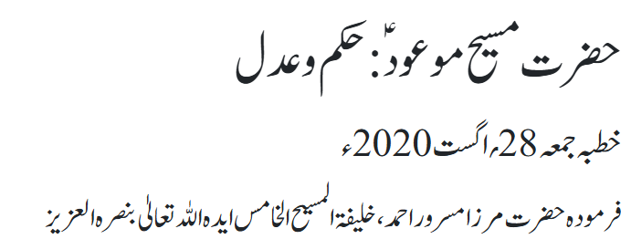
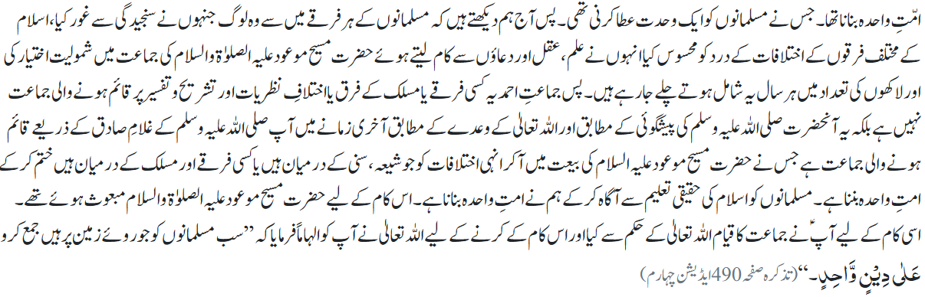
Hazrat Khalifatul Masih V^{aba}

Slide 15
Salat

Slide 16
Salat
Salat (Prayers)
Friday Sermon January 20, 2017
Delivered by Hazrat Khalifatul Masih V^{aba}
For a real believer, offering Salat is the only way to remove spiritual corrosion. As Prophet Muhammad (peace be upon him) explained with an example, "if there was a river at a person's door and he took a bath in it five times a day, can you believe that any dirt would be left on his body." His companions replied, "O Prophet of God, not a trace of dirt would be left." At this, the Holy Prophet (peace be upon him) said, "That is the parable of the five prayers by which Allah removes sins and eliminates weaknesses." It means that not a trace of dirt is left on the soul of a person who offers five daily prayers.
Sahih Al Bukhari Hadith 528
Thus, the Holy Prophet (peace be upon him) explained the importance of prayers with such a beautiful parable. But as I already said, that the commandment is not merely about offering Salat. The Prophet Muhammad (peace be upon him) further stated that a person who performed ablution at home, and then he set off heading to the mosque so that he could offer obligatory prayers he would be rewarded according to the number of steps he has to take to reach the mosque. One step will remove one of his sins, the next will elevate his (spiritual) status. This means that every step will gain him rewards.
Sahih Muslim Hadith 1406

Slide 17
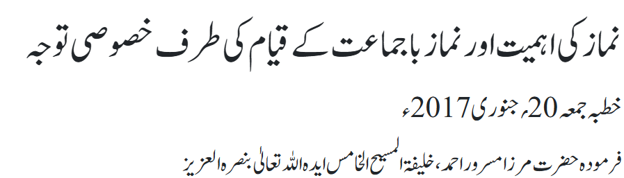
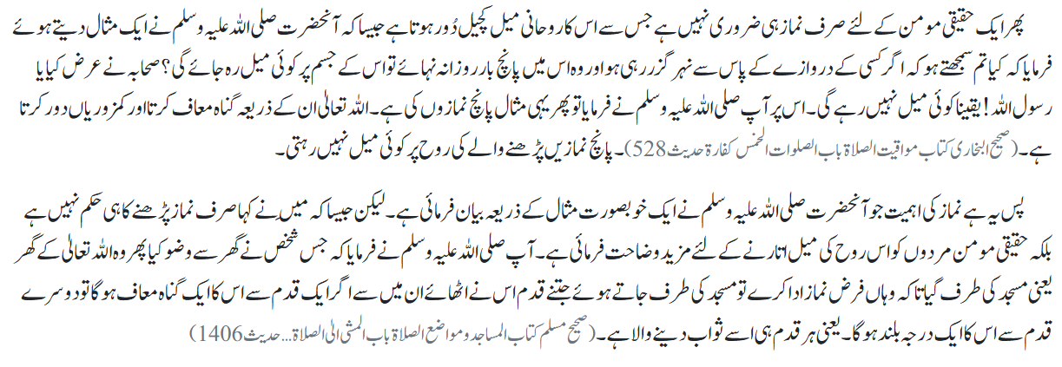
Salat

Slide 18
Al-Wasiyyat

Slide 19
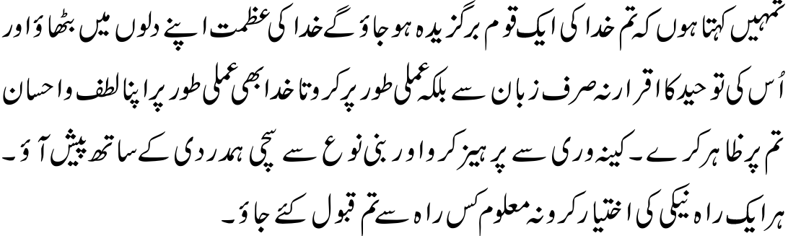
Al Wasiyyat
Al Wasiyyat
Let the Greatness of God take root in your hearts; and acknowledge His Unity not just with your tongues but also with your actions, so that God, too, practically shows His Mercy and Kindness to you. Refrain from malice and treat human beings with true compassion. Adopt each and every path of righteousness for who knows from which of these paths you will be accepted?

Slide 20
Zahanat
(Mental ability)

Slide 21
Zahanat
Q 1. Aureolin is a shade of what color?
Green
Purple
Yellow
Red
Q 2. Name the scientists who shared the 1979 Nobel Prize for Physics with Dr. Abdus Salam
Michael Faraday and Sheldon Glashow
Niels Bohr, and Richard Feynman
James Chadwick and Steven Weinburg
Sheldon Glashow and Steven Weinburg
Q 3. What is the national sport of Japan??
Sumo Wrestling
Competitively eating sushi
Soccer
Curling

Slide 22
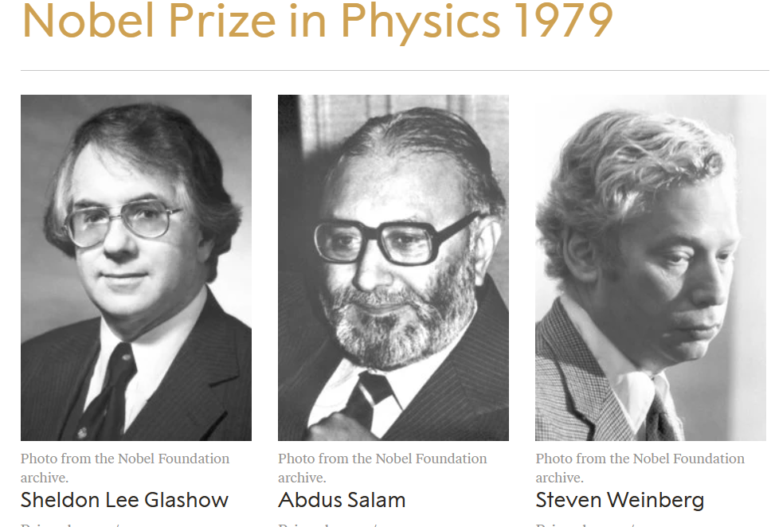
Zahanat
Q 1. Aureolin is a shade of what color?
Green
Purple
Yellow
Red
Aureolin, also known as Cobalt Yellow, is a brilliant, transparent, and lightfast yellow pigment primarily used in watercolor and occasionally in oil painting
Q 2. Name the scientists who shared the 1979 Nobel Prize for Physics with Dr. Abdus Salam
Michael Faraday and Sheldon Glashow
Niels Bohr, and Richard Feynman
James Chadwick and Steven Weinburg
Sheldon Glashow and Steven Weinburg
Q 3. What is the national sport of Japan??
Sumo Wrestling
Competitively eating sushi
Soccer
Curling

Slide 23
Reading of the Holy Quran

Slide 24
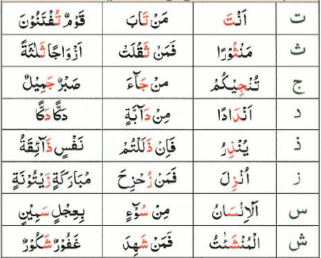
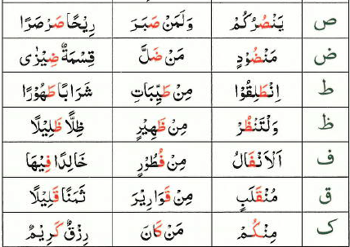

Quran Tajweed Basics
Rules of Nūn Sākin(ݩ) – Ikhfā (hiding)
Ikhfā means concealment or hiding. If Nūn Sākin(ݩ) or Tanwīn is followed by following 15 letters, the sound of Nūn Sākin or Tanwīn will be partially concealed(producing light Gunnah for 2 counts/sec). In Tajweed, these 15 letters are called Huruful-Ikhfā.
Play Audio
Or Click Here

Slide 25
Health

Slide 26

Walking before or after eating
Tanvir Ahmed

Slide 27


Walking before or after Eating
Walking is the single best exercise that you can start at any age and advance to higher levels at your own pace
No special equipment, terrain, gym or clothing needed and least likely to cause injury
Whether you walk before or after you eat depends on your goals and preferences
Both have benefits, including helping with weight loss and blood sugar control

Slide 28

Walk before you eat
Walking first thing in the morning or three to four hours after eating can boost your metabolism and help your body burn fat and help lose weight
Study found that people who exercised on an empty stomach burned about 70% more fat than those who did 2 hours after eating
Walking boosts your energy levels for the entire day
Waking increases your metabolism

Slide 29

Walk before you eat
Boosts your metabolism
Improves your blood circulation
Decreases Cholesterol
Improves blood sugar
Strengthens your bones and muscles
Walking improves mood
Walking in evening is also calming and refreshing

Slide 30

Walk after you eat - Lowers Sugar
People with a history of gas, bloating, and belching will benefit by walking for 10-15 minutes after every meal with decreased symptoms
Whether you want to prevent diabetes or or already have diabetes, walking after eating can help manage your blood sugar
Walking after eating burns glucose and lowers blood sugar levels.
Walking even for 2-5 minutes after eating can have the beneficial effects of improving your sugar

Slide 31
Walk after you eat - Weight Loss
If you plan to walk after eating, do so soon after you eat to burn the calories that you just consumed. You will lose more weight if you plan your walk within 30 minutes after eating.
Walking consistently can also promote sleep, boost heart health and improve your mood and increase longevity
Avoid high intensity or rigorous exercise after eating

Slide 32


Local Majlis Time
Sign-up for TAQWA Quran classes via the following link
https://www.altaqwa.us/registration/
Sign-up for Waqf e Ardhi via the following link
https://tinyurl.com/WaqfeArdhiSignup
Murabbi Sahib’s Comments
Reminders/announcements
Du’a
Adjourn
Waqf e Ardhi Sign-up
Jazakumullah for Participating!
If you enjoyed it, please convey to those brothers who are not here today!
Please take a moment to provide your feedback
https://tinyurl.com/TalimDeckFeedback
Feedback

