Slide 1

Majlis Ansārullāh
Monthly Meeting
September 2025
“And indeed, We have made the Qur’an easy to understand and to remember”
Chapter 54, Al-Qamar, Verse 33

Slide 2
AGENDA
Recitation and translation of the Holy Quran
Pledge
Hadith
Discussion Segment
Salat (Daily Prayers)
Al–Wasiyyat
Zahanat
Reading The Holy Quran
Health segment
Local Time – Missionary Comments/Reminders/Announcements
Du’a

Slide 3




Recitation of the Holy Quran
And when the Qur’an is recited, give ear to it and keep silence, that you may be shown mercy.
And when thou recitest the Qur’an, seek refuge with Allah from Satan the rejected.
And the Messenger will say, ‘O my Lord, my people indeed treated this Qur’an as a discarded thing.’
And indeed We have made the Qur’an easy to understand and to remember. But is there anyone who would receive admonition?
Chapter 7, Al-A`raf, Verse 205
Chapter 16, An-Nahl, Verse 99
Chapter 25, Al-Furqan, Verse 31
Chapter 54, Al-Qamar, Verse 33

Slide 4
Pledge
Say this part three times:
Ash-hadu • alla ilaha • illallahu • wahdahu • la sharika lahu • wa ash-hadu • anna Muhammadan • ‘abduhu • wa rasuluh
Say this part once:
I bear witness • that there is none worthy of worship • except Allah. • He is One • (and) has no partner, • and I bear witness • that Muhammad (Peace and blessings of Allah be upon him) • is His servant • and messenger.
Say this part once:
I solemnly promise that • I shall endeavor • till the end of my life • for the consolidation • and propagation of Islām Ahmadiyyat • and for upholding • the institution of Khilafat. • I shall also be prepared • to offer the greatest sacrifice • for this cause. • Moreover, • I shall urge all my children • to remain true • to Khilafat Ahmadiyya. • Insha’Allah.

Slide 5
Hadith

Slide 6

Hadith
O Allah, Bless Muhammad^{sa} and the people of Muhammad^{sa}, as Thou didst bless Abraham and the people of Abraham. Thou art indeed the Praiseworthy, the Glorious. Prosper, O Allah, Muhammad^{sa} and the people of Muhammad^{sa}, as Thou didst prosper Abraham and the people of Abraham. Thou are the Praiseworthy, the Glorious
Narrated Ali bin Abi Talib^{ra}: that the Messenger of Allah^{sa} said: "The best of you is he who learns the Qur'an and teaches it."
Sahih Al Bukhari 5027
Abu Umama^{RA} said he heard Allah's Messenger^{SA} say: “Recite the Qur'an, for on the Day of Resurrection it will come as an intercessor for those who recite It.”
Sahih Muslim 804a

Slide 7
The Holy Quran Discussion

Slide 8
Recitation of the Holy Quran
And when the Qur’an is recited, give ear to it and keep silence, that you may be shown mercy.
And when thou recitest the Qur’an, seek refuge with Allah from Satan the rejected.
And the Messenger will say, ‘O my Lord, my people indeed treated this Qur’an as a discarded thing.’
And indeed We have made the Qur’an easy to understand and to remember. But is there anyone who would receive admonition?
Chapter 7, Al-A`raf, Verse 205
Chapter 16, An-Nahl, Verse 99
Chapter 25, Al-Furqan, Verse 31
Chapter 54, Al-Qamar, Verse 33

Slide 9
Five-Volume Commentary
In answer to their demand for fresh signs disbelievers are here told to listen to the Quran carefully, because it contains signs and evidences enough and to spare. This will make them realize the error of their demand and they will see the truth and will as a result become deserving of the mercy of God
Chapter 7, Al-A`raf, Verse 205
The reason why Muslims are bidden to seek the protection of God against Satan while beginning to recite the Quran is that it is a most precious treasure from which Satan tries to keep men away. Hence the necessity of seeking God’s protection against Satan while beginning the recitation of the Quran lest worldly gains and material comforts should make men oblivious of their great spiritual objectives
Chapter 16, An-Nahl, Verse 99
Perhaps never during the last 14 centuries the Quran was so much neglected and ignored by the Muslims as it is today. There is a saying of the Holy Prophet to the effect: "A time will come upon my people when there will remain nothing of Islam but its name and of the Quran but its words (Baihaqi, Shu‘abul-Iman). The present indeed is that time.
The emphasis on the word "this" in the expression "this Quran" is full of pathos. The Holy Prophet is represented here as saying that his people have discarded such a blessed book as this Quran in which there is light and guidance for them and which is God’s greatest boon for mankind and which has been revealed to raise them to the highest pinnacles of moral and spiritual eminence.
Chapter 25, Al-Furqan, Verse 31

Slide 10
The Promised Messiah^{AS}
“I call Allah to witness that the Holy Qur’an is a rare pearl. Its outside is light, and its inside is light and its above is light and its below is light and there is light in every word of it. It is a spiritual garden whose clustered fruits are within easy reach and through which streams flow. Every fruit of good fortune is found in it and every torch is lit from it. Its light has penetrated to my heart and I could not have acquired it by any other means. And Allah is my Witness that if there had been no Qur’an I would have found no delight in life.”
A’ina-e-Kamalat-e-Islam, Ruhani Khaza’in, Vol.5

Slide 11
Discussion
In 2023 an individual ripped out the pages of the Holy Quran and set them on fire. There was a lot of outcry. Your non-Ahmadi friends were discussing this incidence one day. They had many questions.
  Why does this happen?
  How should Muslims respond? Should thy burn a copy of the bible?
  Why are Muslims so concerned about burning of the Holy Quran?

Slide 12
Press Release August 29, 2020
Hazrat Mirza Masroor Ahmad condemns the “hateful act” during a meeting with the National Majlis Amila (Executive) of the Ahmadiyya Muslim Community in Sweden, whilst calling for a peaceful response.
His Holiness also made it clear that it was wrong for Muslims to respond to such horrific and provocative acts through violence or disorder. Rather, it was up to Muslims to educate people about the Quran’s true teachings so that anti-Muslim extremists could not seek to defame Islam by taking individual Quranic verses completely out of context to further their own hateful aims and objectives.
“The truth is that most people in Sweden and other Western countries remain unaware of the true teachings of Islam and this enables extremists to take individual verses of the Holy Quran completely out of context for the sake of their false propaganda. People who conduct such hateful acts have no knowledge of Islam or what the actual conditions laid down in the Holy Quran are for Jihad. They ignore the fact that the Bible has many more verses that can be taken out of context and used to justify the use of force. Regardless, it is the duty of Ahmadi Muslims to introduce and exemplify the true and peaceful teachings of Islam in each and every city and town so that people understand the reality of our religion.”

Slide 13
Speech by Hazrat Khalifatul Masih V^{aba}
Majlis Ansarullah UK Annual Ijtima 2024
Huzoor^{ABA} placed great emphasis on the importance of adhering to the Holy Quran, advising members of Majlis Ansarullah to make it their constant source of guidance. He echoed the Promised Messiah^{AS}’s teaching that the Holy Quran is the ultimate tool for spiritual success and that other religious texts, while important, should not overshadow it. The Holy Quran, Huzoor^{ABA} said, contains within it all the knowledge and guidance required for living a righteous life, and it is only through acting upon its teachings that one can attain true success.
He encouraged members to dedicate themselves to studying the Quran and to ensure that their children also form a strong connection with it. Ansarullah, as mature members of the Jamaat, have a special responsibility to lead by example in their commitment to the Quran, ensuring that future generations uphold its teachings.

Slide 14
Guidance from Huzoor^{ABA}
The Holy Qur’an is the Only Lasting Law
His Holiness^{ABA} quoted the Promised Messiah^{AS} who said that the Holy Qur’an is continuous and lasting Shari’ah (law). God’s teachings are of two types; those that are applicable throughout all times, and others that are specific to certain times or instances albeit those too are everlasting teachings, such as the teachings of fasting or shortening prayers whilst travelling. Or there is the teaching of the veil, which applies when women leave the home, however in their own home women do not have to adopt the veil. In this way, the Holy Qur’an is a complete and everlasting teaching, contrary to other scriptures which do not possess within them the same everlasting and universal nature in their teachings.
His Holiness^{ABA} said that the teachings of the Qur’an encompass all conditions. For instance, with regards to the example given regarding the veil, there are some who raise objections that the veil is no longer necessary in accordance with the current times. Yet even women’s organizations and others have begun to realize and express that the mixing between men and women creates issues and that there should be some form of separation.
Friday Sermon delivered by, Hazrat Khalifatul Masih V^{ABA}, March 31, 2023

Slide 15
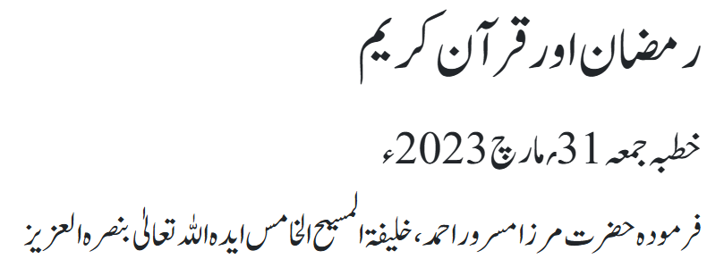
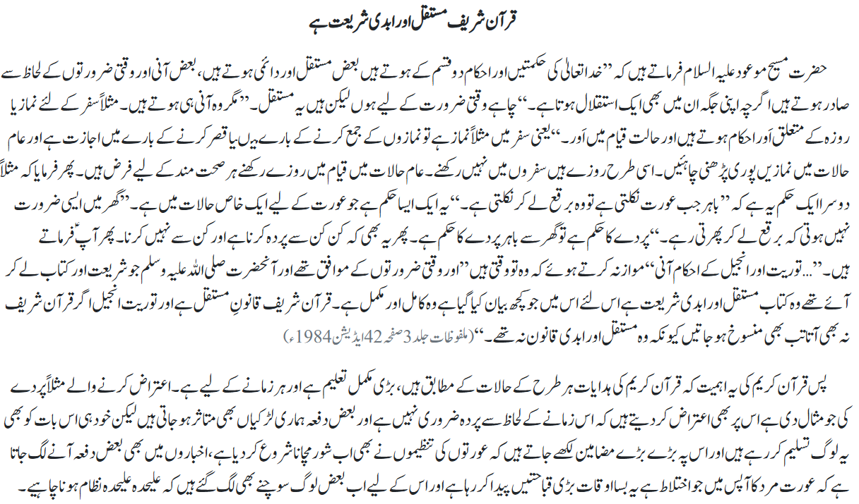
Hazrat Khalifatul Masih V^{aba}

Slide 16
Salat

Slide 17
Salat
Salat Is It
Friday Sermon, April 15, 2016
Delivered by Hazrat Khalifatul Masih V^{ABA}
The Holy Qur'an draws attention to observance of Salat in many places. At times it gives commandment to safeguard Salat, other times it gives commandment to be regular in Salat, and it also gives commandment to offer Salat on time. In short, God has instructed true believers repeatedly towards observance of Salat and its excellence and above all has stated: 'And I have not created the Jinn and the men but that they may worship Me.' (51:57) But man does not recognize this and is distant.
The Promised Messiah (on whom be peace) said that God has created you for the purpose of worshipping Him. Those who do not follow this simply eat and drink and sleep like animals and lose out on God's grace. Whereas a person who claims to have faith should try their utmost to become recipient of God's grace.

Slide 18
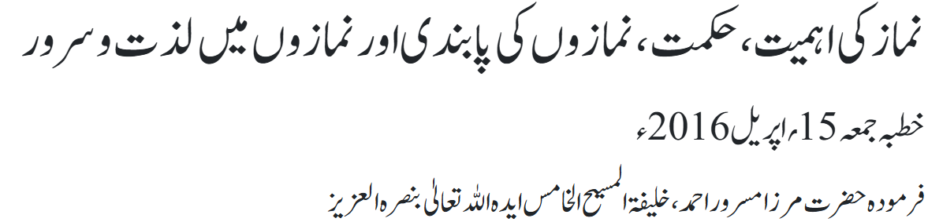
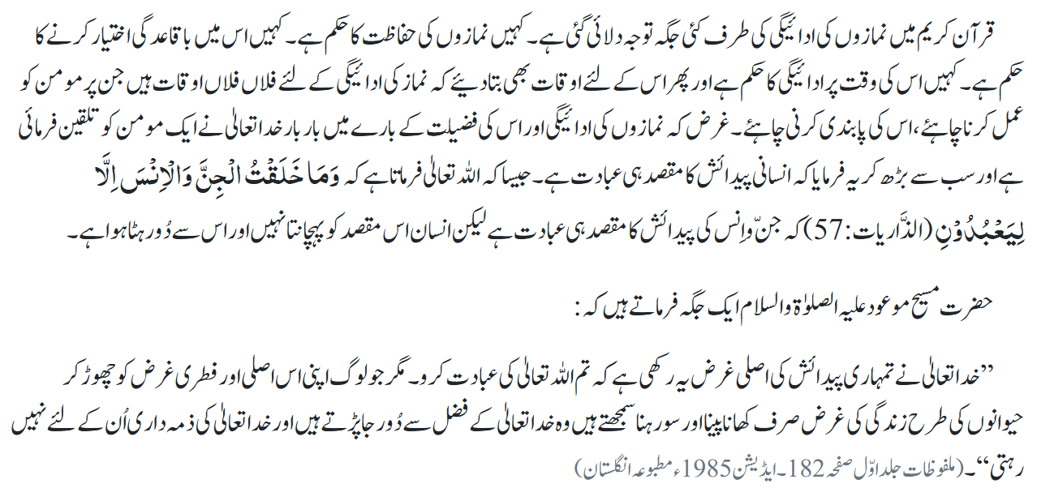
Salat

Slide 19
Al-Wasiyyat

Slide 20
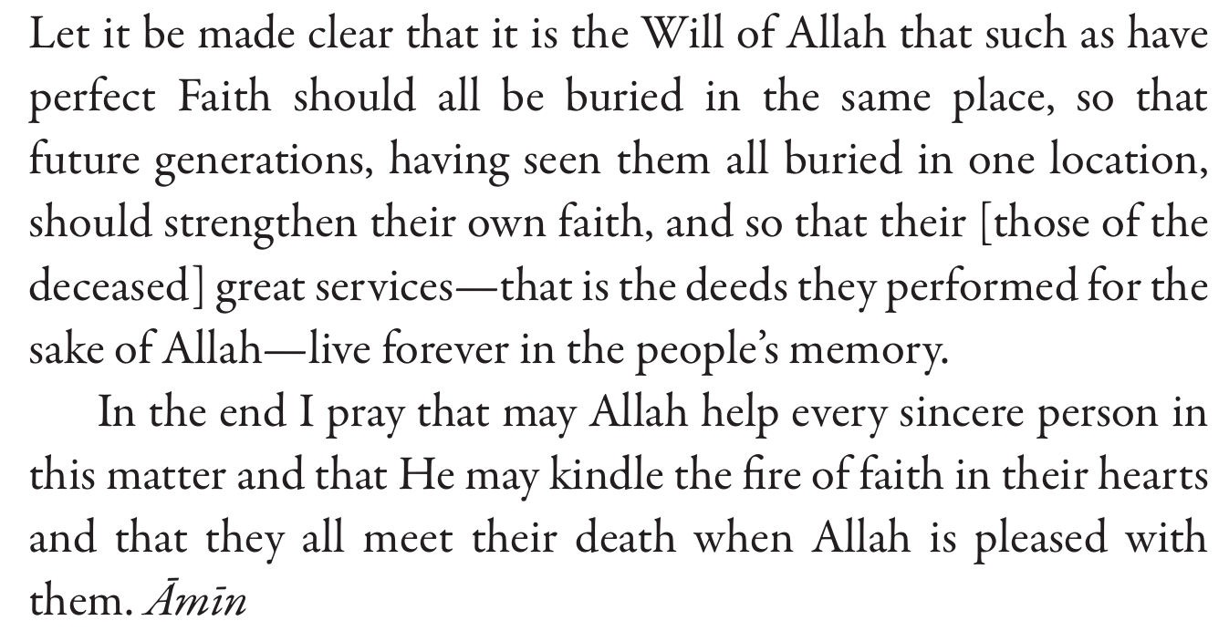
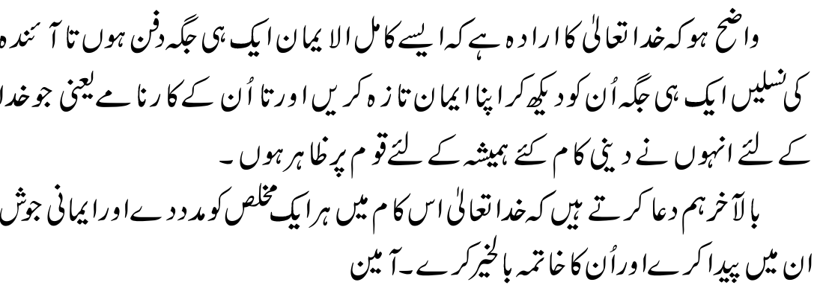
Al Wasiyyat
Al Wasiyyat

Slide 21
Zahanat
(Mental Ability)

Slide 22
Zahanat
Q 1. Which African country is known as the “Pearl of Africa”?
Uganda
Nigeria
Egypt
Libya
Q 2. What is the collective noun for a group of penguins?
Hood or Mohalla
School or Pod
Waddle or Colony
Parliament or Murder
Q 3. What sport features a “spike” and a “dig”?
Baseball
Volleyball
Pickleball
Cricket

Slide 23
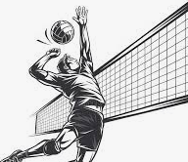

Zahanat
The African country known as the "Pearl of Africa" is Uganda. This nickname was popularized by Winston Churchill in his 1908 book, My African Journey, where he described the country's remarkable natural beauty, diverse landscapes, abundant wildlife, and welcoming people.
Q 1. Which African country is known as the “Pearl of Africa”?
Uganda
Nigeria
Egypt
Libya
On land, a group of penguins is often called a colony or rookery (a breeding group) or a waddle. In the water, they are known as a raft. Other terms include huddle (when penguins gather to share body heat) and creche (a group of chicks)
Q 2. What is the collective noun for a group of penguins?
Hood or Mohalla
School or Pod
Waddle or Colony
Parliament or Murder
Q 3. What sport features a “spike” and a “dig”?
Baseball
Volleyball
Pickleball
Cricket
Spike is an offensive action of jumping and forcefully hitting the ball with an overhead motion into the opponent's court.
Dig is a defensive maneuver used to prevent an opponent's spike from hitting the ground.

Slide 24
Reading of the Holy Quran

Slide 25




Quran Tajweed Basics
Rules of Mīm Sākin
1) The sound of Mīm Sākin is completely merged into following Mīm Mushadad with two counts/Sec of Gunnah. It is called Idghām Shafawi.
See CH:2 V11
2) The sound of Mīm Sākin will be prolonged for 2 counts of light Gunnah if letter Bā(ب) appears after Mīm Sākin. It is called Ikhfa Shafawi.
See CH:105 V5
3) The sound of Mīm Sākin will be pronounced clearly(without elongation) for one count if any letter other than Bā or Mīm appears after Mīm Sākin.
Play Audio
Or Click Here

Slide 26
Health

Slide 27
GUM DISEASE

Slide 28
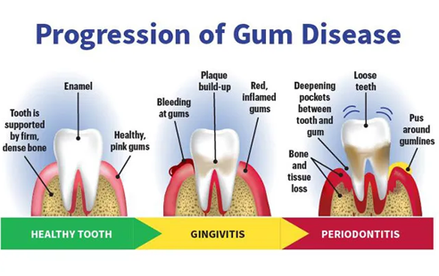
Gum disease
Periodontal (gum) disease is a broad term for conditions involving inflammation and infection of the tissues (gum and bone) that surround and support the teeth
  Gingivitis is a type of gum disease that involves inflammation of the gums. It is largely preventable and treatable with a combination of routine oral hygiene and professional cleanings.
  Periodontitis, which also involves bone loss around teeth, is an irreversible condition that can be slowed down and managed with professional treatment.
The chronic presence of bacteria from plaque and tartar causes gum inflammation and destroys gum tissue, ligaments, and bone around teeth
Untreated, it leads to partial or complete loss of teeth.

Slide 29
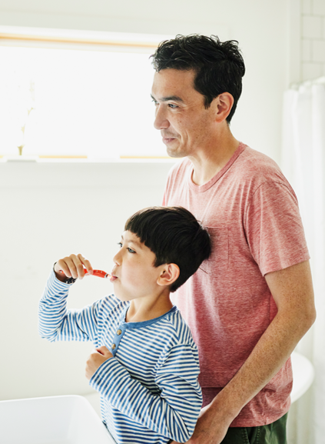
Who does Periodontitis Impact?
About 4 in 10 U.S. adults 30 years or older had a mild, moderate, or severe level of periodontitis in 2009–2014.
About 1 in 2 men and 1 in 3 women 30 years or older had some level of periodontitis.
Periodontitis is more common as people age. About 60% of adults 65 years or older had periodontitis in 2009–2014.

Slide 30
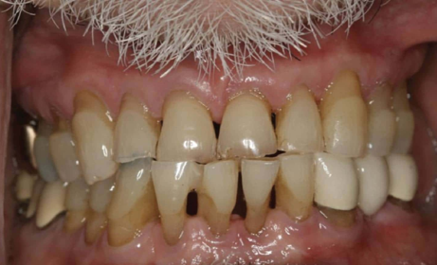
Risk factors
Lack of regular dental cleanings
Poor oral hygiene
Genetics
Smoking
Poor nutrition and obesity
Clenching or grinding the teeth
Hormonal changes (pregnancy or menopause
Notes:
Smile Gallery | Before and After Periodontal Therapy

Slide 31
Signs and symptoms
Red, swollen, or tender gums.
Bleeding gums.
Gums that have moved away or downward from your teeth.
Loose or sensitive teeth.
Painful chewing.
Any change in the way your teeth fit together when biting.
Any change in how well your partial denture fits.
Notes:
Smile Gallery | Before and After Periodontal Therapy

Slide 32

Periodontitis can be associated with…
  Dementia and Alzheimer's disease
  Cancer
  Worsened diabetes outcomes (harder to control blood sugar and greater risk of complications)
  Heart disease
  Increased risk of rheumatoid arthritis
  Increased risk of chronic respiratory diseases
  Losing some or all of your teeth greatly reduces your quality of life. Many adults have difficulty tolerating and chewing with dentures.

Slide 33
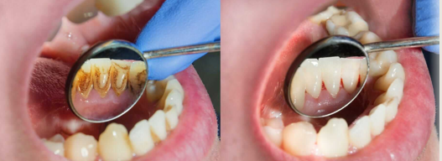
Prevention
Brush your teeth. Brushing after meals helps remove food debris and plaque trapped between your teeth and gums.
Floss. Flossing at least once a day
Swish with mouthwash. Using a mouthwash can help reduce plaque
Know your risk. Age, smoking, diet, and genetics can all increase your risk for periodontal disease.
See your dentist. Get regular professional cleaning

Slide 34
Treatment
A non-surgical procedure commonly known as "scaling and root planning” or “deep cleaning” of the affected tooth and root surfaces.
Prescribed medication, such as an oral rinse or medicine placed directly under the affected gums.
Surgical procedures

Slide 35


Resources
Center for Disease Control

Slide 36


Local Majlis Time
Sign-up for TAQWA Quran classes via the following link
https://www.altaqwa.us/registration/
Sign-up for Waqf e Ardhi via the following link
https://tinyurl.com/WaqfeArdhiSignup
Murabbi Sahib’s Comments
Reminders/announcements
Du’a
Adjourn
Waqf e Ardhi Sign-up
Jazakumullah for Participating!
If you enjoyed it, please convey to those brothers who are not here today!
Please take a moment to provide your feedback
https://tinyurl.com/TalimDeckFeedback
Feedback

