Slide 1

Majlis Ansārullāh
Monthly Meeting
November 2025
“Helpers of Allah”
What it means to be Ansarullah

Slide 2
AGENDA
Recitation and translation of the Holy Quran
Pledge
Hadith
Discussion Segment
Salat (Daily Prayers)
Al–Wasiyyat
Zahanat
Reading The Holy Quran
Health segment
Local Time – Missionary Comments/Reminders/Announcements
Du’a

Slide 3
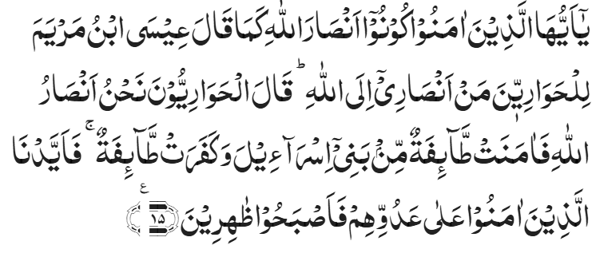
Recitation of the Holy Quran
O ye who believe! be helpers of Allah, as said Jesus, son of Mary, to his disciples, ‘Who are my helpers in the cause of Allah.’ The disciples said, ‘We are helpers of Allah.’ So a party of the children of Israel believed, while a party disbelieved. Then We gave power to those who believed against their enemy, and they became victorious.
Chapter 61, As-Saff, Verse 15

Slide 4
Pledge
Say this part three times:
Ash-hadu • alla ilaha • illallahu • wahdahu • la sharika lahu • wa ash-hadu • anna Muhammadan • ‘abduhu • wa rasuluh
Say this part once:
I bear witness • that there is none worthy of worship • except Allah. • He is One • (and) has no partner, • and I bear witness • that Muhammad (Peace and blessings of Allah be upon him) • is His servant • and messenger.
Say this part once:
I solemnly promise that • I shall endeavor • till the end of my life • for the consolidation • and propagation of Islām Ahmadiyyat • and for upholding • the institution of Khilafat. • I shall also be prepared • to offer the greatest sacrifice • for this cause. • Moreover, • I shall urge all my children • to remain true • to Khilafat Ahmadiyya. • Insha’Allah.

Slide 5
Hadith

Slide 6

Hadith
O Allah, Bless Muhammad^{sa} and the people of Muhammad^{sa}, as Thou didst bless Abraham and the people of Abraham. Thou art indeed the Praiseworthy, the Glorious. Prosper, O Allah, Muhammad^{sa} and the people of Muhammad^{sa}, as Thou didst prosper Abraham and the people of Abraham. Thou are the Praiseworthy, the Glorious
Abu Huraira^{RA} reported Allah's Messenger^{SA} as saying: He who alleviates the suffering of a brother out of the sufferings of the world, Allah would alleviate his suffering from the sufferings of the Day of Resurrection, and he who finds relief for one who is hard-pressed, Allah would make things easy for him in the Hereafter, and he who conceals (the faults) of a Muslim, Allah would conceal his faults in the world and in the Hereafter. Allah is at the back of a servant so long as the servant is at the back of his brother, and he who treads the path in search of knowledge, Allah would make that path easy, leading to Paradise for him and those persons who assemble in the house among the houses of Allah (mosques) and recite the Book of Allah and they learn and teach the Qur'an (among themselves) there would descend upon them tranquility and mercy would cover them and the angels would surround them and Allah mentions them in the presence of those near Him, and he who is slow-paced in doing good deeds, his (high) lineage does not make him go ahead.
Sahih Muslim 804

Slide 7
The Holy Quran Discussion

Slide 8
Recitation of the Holy Quran
O ye who believe! be helpers of Allah, as said Jesus, son of Mary, to his disciples, ‘Who are my helpers in the cause of Allah.’ The disciples said, ‘We are helpers of Allah.’ So a party of the children of Israel believed, while a party disbelieved. Then We gave power to those who believed against their enemy, and they became victorious.
Chapter 61, As-Saff, Verse 15

Slide 9
Five-Volume Commentary
Of the three religious groups among the Jews to whom Jesus preached his Message – the Pharisees, the Sadducees and the Essenes – Jesus belonged to the last, while he had not yet been commissioned as a Divine Preacher. The Essenes were a highly religious and righteous people who lived away from the world’s hustle and bustle, passing their time in meditation and prayer and in the service of humanity. It was from these people that most of Jesus’s early followers came ("The Dead Sea Community" by Kurt Schubert and "The Crucifixion by an Eye-Witness"). They have been called "Helpers" by Eusephus.
The concluding words of the Surah are indeed very prophetic. Throughout the ages the followers of Jesus have enjoyed power and precedence over their enemies—the Jews. They have founded and ruled over vast and powerful empires while the Jews have been a dispersed people so much so that "The Wandering Jew" has become a byword.
Chapter 61, As-Saff, Verse 15

Slide 10
Hazrat Khalifatul Masih IV^{RH}
If one needs help and support from Allah, one has to offer everything they have for support of Allah, in other words support God with all your potential. That is when Allah will support and help you.
Ansarullah is a lifelong state meaning becoming helper for the entire life not just offering one for temporary support but always included in amongst the helpers.
Being helper of Allah and being helper of the Messiah and Mahdi aren’t two separate states. Jama’at Ahmadiyya has to understand this point fully and try to adopt this strategy. Otherwise, we will not be deserving of the glad tidings mentioned in the next chapter (Surah Jumuah). That glad tidings are when the Messiah of Muhammad^{SA} will solicit people to be his helpers, companions will offer themselves with such glory that Allah will unite them with the companions of the Holy Prophet^{SA}
Hazrat Khalifatul Masih IV^{RH} Friday Sermon February 7, 1992
(unofficial translation)

Slide 11
Discussion
At the first Ansar meeting of the year, Zaim sahib introduced new Ansar who had graduated from Khuddamul Ahmadiyya. One of the new Nasir asked a question about the name Ansarullah. Khuddamul Ahmadiyya is obvious, we were servants of the Jama’at. What would be my role now, how can I help Allah? Most Ansar looked at each other for answers.
  How would you respond to that question?
  Do you truly believe, you have been a true helper of Allah?

Slide 12
Guidance from Huzoor^{ABA}
Huzoor^{ABA} then shed light on the slogan of “Nahno Ansarullah” i.e. We are the helpers of Allah, and he elaborated upon the two Quranic verses where this slogan appears. The first is the following verse: “And when Jesus perceived their disbelief, he said, ‘Who will be my helpers in the cause of Allah?’ The disciples answered, ‘We are the helpers of Allah. We have believed in Allah. And bear thou witness that we are obedient.” (3:53) When the disciples accepted the message, they also recited a prayer which is preserved in the following Quranic verse: ‘Our Lord, we believe in that which Thou hast sent down and we follow this Messenger. So write us down among those who bear witness.’ (3:54) Huzoor^{ABA} said that the obedience to a Prophet means that one must fulfil the pledge taken at his hand, to practice upon his teachings and to have firm faith in the truthfulness of his teachings.
Friday Sermon delivered by Hazrat Khalifatul Masih V^{ABA} October 1, 2010

Slide 13
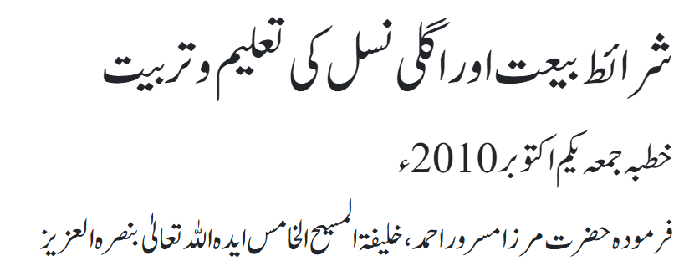
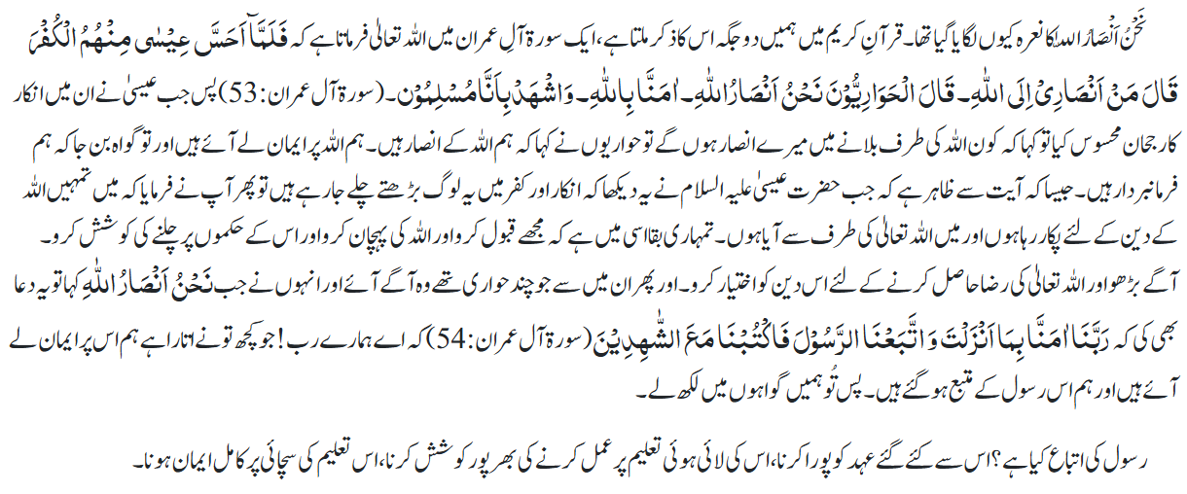
Guidance from Huzoor^{ABA}

Slide 14
Speech by Hazrat Khalifatul Masih V^{ABA}
Majlis Ansarullah UK Annual Ijtima 2024
Huzoor^{ABA} reminded the ansar that the success of the Jama’at’s mission depends on the collective effort of its members. Only through mutual cooperation, teamwork, and shared commitment to the cause can the Jama’at achieve its goals. Huzoor^{ABA} urged ansar to live up to their title of (نَحْنُ أَنْصَارُ اللّٰهِ ) -We are the helpers of Allah by working together with dedication and a spirit of service.
Huzoor^{ABA} said: “When we have called ourselves Ansarullah and have raised the slogan (نَحْنُ أَنْصَارُ اللّٰهِ ) - We are the helpers of Allah, then we must make every possible effort to fulfil the rights of being part of the Community of the Promised Messiah^{AS} and being the Ansarullah [i.e., Helpers of Allah].”

Slide 15
Guidance from Huzoor^{ABA}
“The very meaning of Ansarullah is ‘Helpers of Allah’ and so it is the duty of Majlis Ansarullah to spread the true and peaceful teachings of Islam to all parts of the world. It is your duty to teach the Holy Quran with its true meaning and to act as a positive moral example for all others to follow and learn from. It is your duty to guide the world towards peace and prosperity. And so all members of Majlis Ansarullah must ask themselves to what extent they are each playing their respective roles in this effort.”
“In this era, Allah the Almighty sent the Promised Messiah^{AS} to guide the world and so the Ahmadiyya Muslim Community can only be successful if it stays true to his teachings. Let it be clear that our ambitions and goals are not kingdoms or material power, rather we are those who give precedence to our faith over all worldly matters.”
Huzoor^{ABA}’s Concluding address at the 33rd Majlis Ansarullah Ijtima UK, 2015

Slide 16
Salat

Slide 17
Salat
Essence of Worship of Allah
Friday Sermon, April 10, 2015
Delivered by Hazrat Khalifatul Masih V^{ABA}
The Promised Messiah^{AS} writes: The first stage of a believer's spiritual state is that humility, weeping and tender-heartedness which a believer experiences during Salat and remembrance of Allah. That is, to generate in oneself a spirit of supplication, poignancy, humility, extreme humbleness, meekness of soul, ardor and warmth. To assume a state of fear while turning to the Glorious God as this verse states: 'Surely, success comes to the believers, Who are humble in their Prayers.’ (Chapter 23, Al-Mu’minun, Verses 2-3). That is, successful are the believers who are humble in their Salat and during remembrance of Allah and who are engaged in remembrance of their Lord with poignancy, tender-heartedness, ardor and heart-felt passion.'
Appendix of Barahin e Ahmadiyya, Volume 5 Roohani Khazain

Slide 18
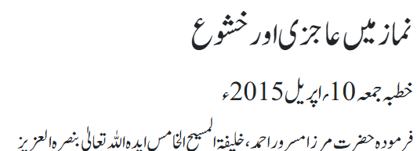
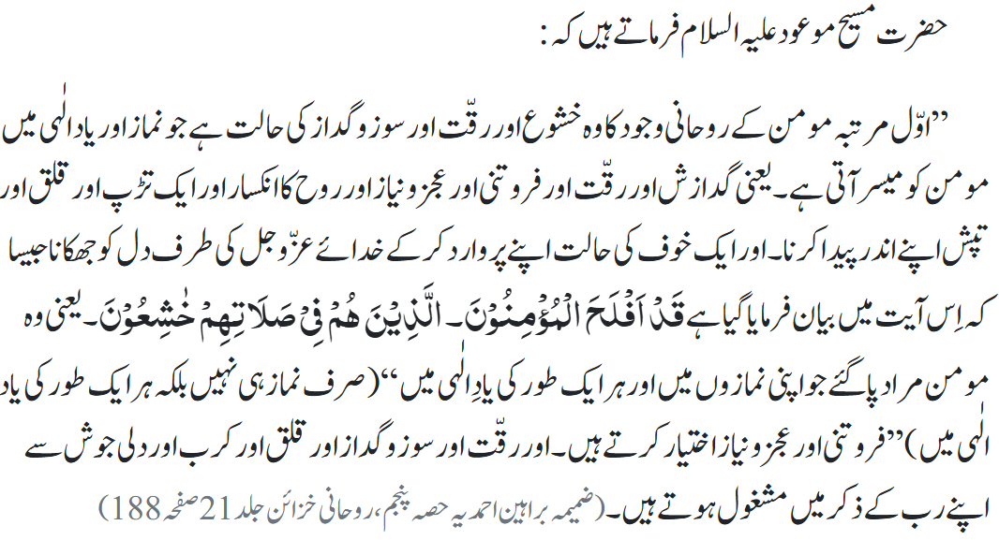
Salat

Slide 19
Al-Wasiyyat

Slide 20
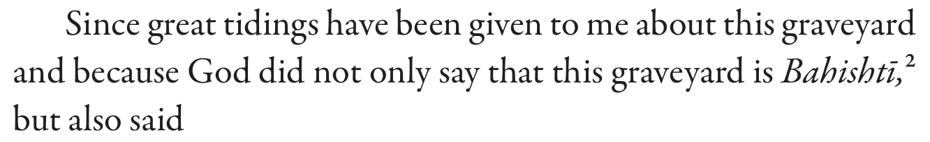
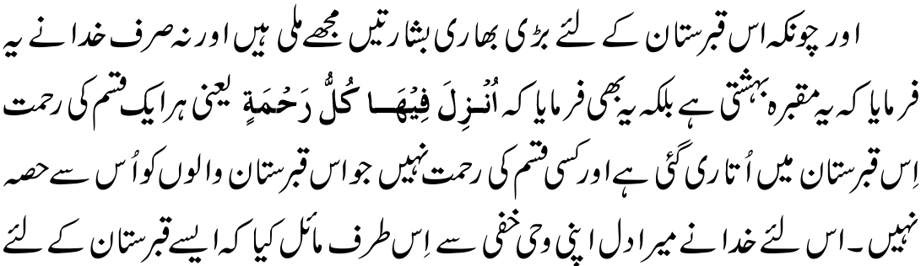
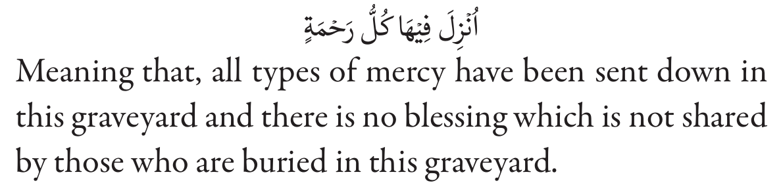
Al Wasiyyat
Al Wasiyyat

Slide 21
Zahanat
(Mental Ability)

Slide 22
Zahanat
Q 1. Where is Angel Falls, the world’s largest waterfall, located?
Argentina
Ecuador
Brazil
Venezuela
Q 2. What is the northernmost capital city in the world?
Oslo, Norway
Dublin, Ireland
Reykjavik, Iceland
Nuuk, Greenland
Q 3. Which company developed the first commercially available computer mouse?
Xerox
Smith and Wesson
Microsoft
Sony

Slide 23
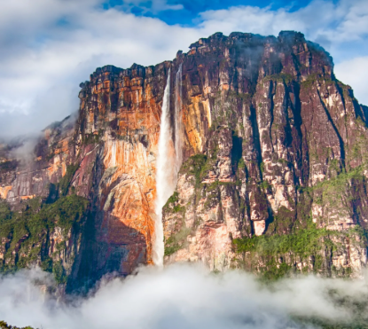
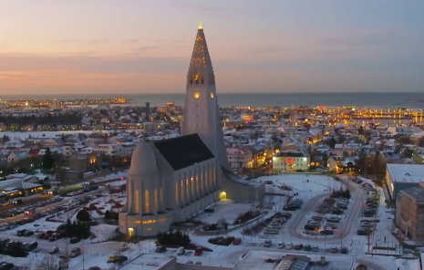
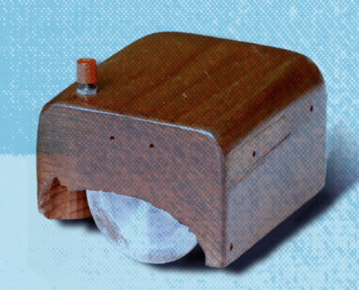
Zahanat
Q 1. Where is Angel Falls, the world’s tallest waterfall, located?
Argentina
Ecuador
Brazil
Venezuela
Angel Falls is the world's tallest uninterrupted waterfall, located in Canaima National Park, Venezuela, with a total drop of 3,212 feet (979 meters).
Q 2. What is the northernmost capital city in the world?
Oslo, Norway
Dublin, Ireland
Reykjavik, Iceland
Nuuk, Greenland
Reykjavík is known for being the world's northernmost capital of a sovereign state. It holds this title due to its location in the southwest of Iceland, at a latitude of approximately 64°08′ N.
Q 3. Which company developed the first commercially available computer mouse?
Xerox
Smith and Wesson
Microsoft
Sony
While Douglas Engelbart is credited with inventing the first mouse prototype in 1964, it was Xerox that introduced the device to the commercial market as part of its innovative desktop system.

Slide 24
Reading of the Holy Quran

Slide 25




Quran Tajweed Basics
Hamzatul-Wasl(Joining Hamza)
In Holy Quran some words start with a blank alif. It is called Hamzatul-Wasl. It has following rules:
1) Fat’hah: The blank alif always take Fat’hah if the next letter is Lam Sakin/Mushaddad.
See CH:59 V24
2) Kasrah: If the very first Mutaharrik(vowelled) letter of such word bears a Fat’hah or Kasrah, the blank alif always take a Kasrah.
See CH:2 V213
3) Dammah: If the very first Mutaharrik (vowelled) letter of such word bears a Dammah, the blank alif always take a Dammah.
See CH:4 V90
Play Audio Or Click Here

Slide 26
Health

Slide 27

The Power Of Walking
Tanvir Ahmed

Slide 28
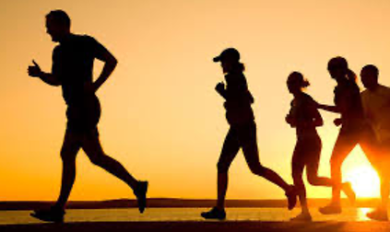
Power of Walking
Walking can be a go-to solution for many of life’s challenges
Whether you’re stressed, depressed or simply need a low-impact way to get in shape, walking is the way.
Most accessible exercise options and suitable for a variety of people

Slide 29
Japanese or Interval Walking Training
Interval walking training (IWT) is a fitness activity that alternates between faster, higher-intensity walking intervals and slower, lower-intensity walking intervals
Warm up, stretch walk fast for three minutes followed by three minutes of slower walking, for 30 minutes per day at least four days per week
Start slow @ 15 minutes a day. Increase to150 minutes per week

Slide 30
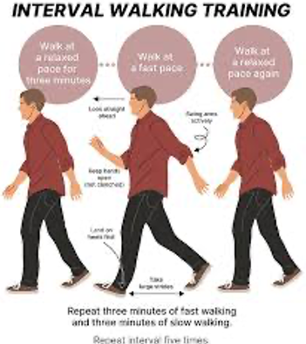
Japanese walking
Middle-aged and older people who practice Japanese walking had
  Lower blood pressure
  Improved cholesterol, Improved cardio-respiratory endurance
  Stronger thigh muscles
  Better aerobic capacity
  Improves fitness levels more efficiently
  Decreased BMI and improved flexibility

Slide 31

Nordic Walking
Nordic walking is of Finnish origin and a total-body version of walking
Nordic walking requires Nordic Poles, mimicking the motion of cross-country skiing by using poles to push yourself as you walk along a trail or sidewalk
Nordic walking combines cardiovascular exercise with a vigorous muscle workout for your shoulders, arms, core, and legs
Almost everyone can do it
Poles cost 20$ and up
Technique
https://youtu.be/zAmsHhc2zCw

Slide 32
Nordic Walking Benefits
With Nordic walking you are engaging 80% to 90% of your muscles
Nordic walking decreases fat mass, "bad" LDL cholesterol and triglycerides and increases "good" HDL
Also helps with depression, anxiety, chronic pain, and waist circumference
Lots of evidence confirms that Nordic walking burns more calories than regular walking – estimates range from an 18% to 67% increase

Slide 33
Start a Walking Club
Qaid Health will reach out to your Zaim to start a Walking Club.
You can also email Qaid Health, Tanvir Ahmed at qaid.health@ansarusa.org

Slide 34
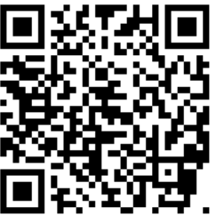
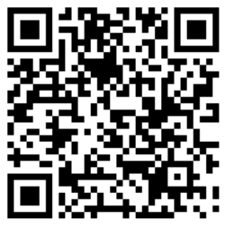
Local Majlis Time
Sign-up for TAQWA Quran classes via the following link
https://www.altaqwa.us/registration/
Sign-up for Waqf e Ardhi via the following link
https://tinyurl.com/WaqfeArdhiSignup
Murabbi Sahib’s Comments
Reminders/announcements
Du’a
Adjourn
Waqf e Ardhi Sign-up
Jazakumullah for Participating!
If you enjoyed it, please convey to those brothers who are not here today!
Please take a moment to provide your feedback
https://tinyurl.com/TalimDeckFeedback
Feedback

