Slide 1

Majlis Ansārullāh
Monthly Meeting
December 2025
“From the tongue to the heart”
How do we make sure that our pledge is not merely lip service

Slide 2
AGENDA
Recitation and translation of the Holy Quran
Pledge
Hadith
Discussion Segment
Salat (Daily Prayers)
Al–Wasiyyat
Zahanat
Reading The Holy Quran
Health segment
Local Time – Missionary Comments/Reminders/Announcements
Du’a

Slide 3
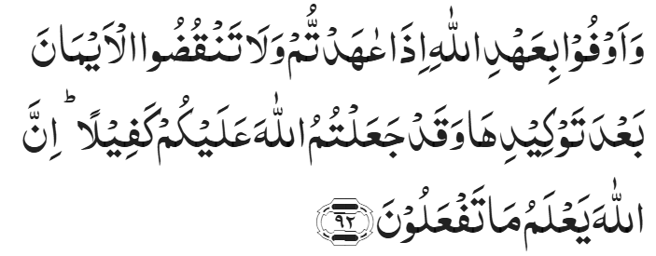
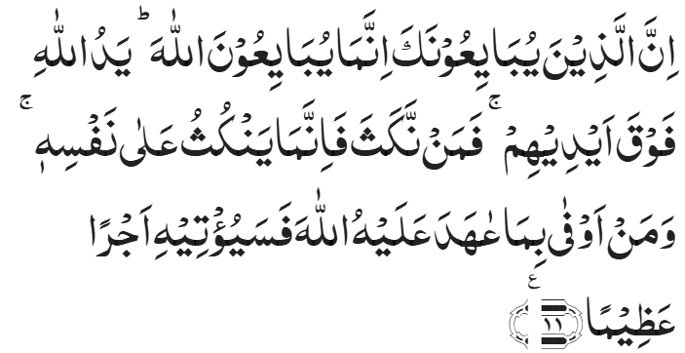
Recitation of the Holy Quran
And fulfil the covenant of Allah when you have made; and break not the oaths after making them firm, while you have made Allah your surety. Certainly, Allah knows what you do.
Chapter 16, An-Nahl, Verse 92
Verily, those who swear allegiance to thee indeed swear allegiance to Allah. The hand of Allah is over their hands. So whoever breaks his oath, breaks it to his own loss; and whoever fulfils the covenant that he has made with Allah, He will surely give him a great reward.
Chapter 48, Al-Fath, Verse 11

Slide 4
Pledge
Say this part three times:
Ash-hadu • alla ilaha • illallahu • wahdahu • la sharika lahu • wa ash-hadu • anna Muhammadan • ‘abduhu • wa rasuluh
Say this part once:
I bear witness • that there is none worthy of worship • except Allah. • He is One • (and) has no partner, • and I bear witness • that Muhammad (Peace and blessings of Allah be upon him) • is His servant • and messenger.
Say this part once:
I solemnly promise that • I shall endeavor • till the end of my life • for the consolidation • and propagation of Islām Ahmadiyyat • and for upholding • the institution of Khilafat. • I shall also be prepared • to offer the greatest sacrifice • for this cause. • Moreover, • I shall urge all my children • to remain true • to Khilafat Ahmadiyya. • Insha’Allah.

Slide 5
Hadith

Slide 6
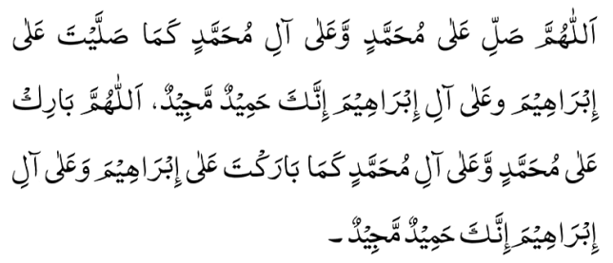
Hadith
O Allah, Bless Muhammad^{sa} and the people of Muhammad^{sa}, as Thou didst bless Abraham and the people of Abraham. Thou art indeed the Praiseworthy, the Glorious. Prosper, O Allah, Muhammad^{sa} and the people of Muhammad^{sa}, as Thou didst prosper Abraham and the people of Abraham. Thou are the Praiseworthy, the Glorious
Narrated by Abu Huraira^{RA}: The Prophet^{SA} said, "The signs of a hypocrite are three”
Whenever he speaks, he tells a lie
Whenever he promises, he always breaks it (his promise)
If you trust him, he proves to be dishonest. (If you keep something as a trust with him, he will not return it.)"
Sahih Bukhari 33

Slide 7
The Holy Quran Discussion

Slide 8
Recitation of the Holy Quran
And fulfil the covenant of Allah when you have made; and break not the oaths after making them firm, while you have made Allah your surety. Certainly, Allah knows what you do.
Chapter 16, An-Nahl, Verse 92
Verily, those who swear allegiance to thee indeed swear allegiance to Allah. The hand of Allah is over their hands. So whoever breaks his oath, breaks it to his own loss; and whoever fulfils the covenant that he has made with Allah, He will surely give him a great reward.
Chapter 48, Al-Fath, Verse 11

Slide 9
Five-Volume Commentary
This verse further explains and repeats the theme of the previous verse, viz. believers are enjoined faithfully to discharge the obligations they owe to God which are covered by the words "covenant of Allah" and the duties they owe to their fellow-men which are implied in the words, "the oaths". It must be remembered that oaths taken in defiance of God’s commandment are not binding.
Chapter 16, An-Nahl, Verse 92
The reference in the verse is to the oath taken by the believers at the hands of the Holy Prophet under a tree at Hudaibiyyah when a rumour reached him that ‘Uthman, his special envoy, had been killed by the Meccans. The believers were asked to declare on solemn oath that they would stand by the Holy Prophet (pbuh) at all costs and would fight under his banner to the bitter end.
Chapter 48, Al-Fath, Verse 11

Slide 10
Discussion
As the year is coming to an end and a Nasir was going home after attending the Ansar meeting. He was alone in his car and was thinking about the meeting. He recalled the pledge he had taken standing up with rest of the Ansar. The words started echoing in his mind. He started thinking about his role as the head of the household. He thought about the start of the new year and famous new year’s resolutions.
  Why do we repeat the pledge in every meeting?
  As a Nasir what change do you plan to bring in your life which would be helpful to you and your family?

Slide 11
Speech by Hazrat Khalifatul Masih V^{ABA}
Majlis Ansarullah UK Annual Ijtima 2024
In his address, Huzoor^{aba} stressed that the pledge of allegiance (bai‘at) is not merely an outward declaration but a commitment to undergo a profound inner transformation. He warned that without this internal change, the bai‘at would be nothing more than a hollow shell. The essence of the pledge lies in developing a deep love for Allah and showing kindness and sympathy to His creation. Without these qualities, a person cannot truly claim to follow the Promised Messiah^{AS}.
He concluded by praying for the success of the Jamaat, for their ability to fulfil the pledge of allegiance, and for the spread of peace and harmony within society. “May Allah the Almighty grant us the ability to transform our own conditions, to strive to bring about a change in the conditions of our children, to keep the environment of our homes peaceful, and to maintain peace in our society. We should be the bearers of peace and security for the world. We should strive to turn this world towards recognizing God, to raise the banner of the Holy Prophet^{sa} in this world, and to bring the world under the shade of his flag. May Allah enable us to always remain such ansar. Amin.”

Slide 12
Speech by Hazrat Khalifatul Masih V^{ABA}
Majlis Ansarullah UK 38th Annual Ijtima 2021
Huzoor^{aba} said,
“On one occasion the Promised Messiah^{as} said that when the prophets (peace be upon them) asked ‘Who is it that will help me in taking people towards Allah the Almighty?’ it was because it is the law of nature that to complete grand and important tasks there is the need of helpers. Such great tasks cannot be completed by just one person. Moreover, even though the Prophets manifested the highest standards of reliance and trust upon God, according to this law of nature they still also called upon helpers.”
Huzoor^{aba} continued,
“Therefore, you who call yourselves ‘Ansarullah’ (The helpers of God) must always keep this at the forefront of your mind that you can only truly be called ‘Ansarullah’ when you answer the call of the Imam of this Age, the appointed one of God, the Promised Messiah and Mahdi, and are not just Ansarullah by name. Rather, be those who sincerely raise slogans that ‘we are the helpers of Allah’, whilst understanding this spirit as well.”
His Holiness explained that living up to the pledge of Ansarullah and being true helpers of the Promised Messiah^{as} requires self-assessment and a great reformation of one’s individual state.

Slide 13
Guidance from Huzoor^{aba}
Huzoor^{aba} said,
Then another pledge Ansarullah members perform is to form a bond of loyalty with Khilafat-e-Ahmadiyya which can only be achieved when the members strive to spread the words and programs of Khilafat and try their best to help in this work. This can only be made possible when Ansar members will pay great heed to the Khalifa of the time. For this, Allah has blessed us with the MTA through which we can hear the Khalifa despite the long distances. You should also connect your children to the institution of Khilafat along with other spiritual teachings so that the connections of faithfulness to Khilafat are transferred from generation to generation. Also, this would help in the propagation of Islam as after the Promised Messiah it has to be taken forward through the institution of Khilafat. Thus, for this, keep a look out on every pledge that demands sacrifice. May Allah help you all to achieve these goals.
Friday Sermon, September 30th, 2016, delivered by Hazrat Khalifatul Masih V^{ABA}

Slide 14
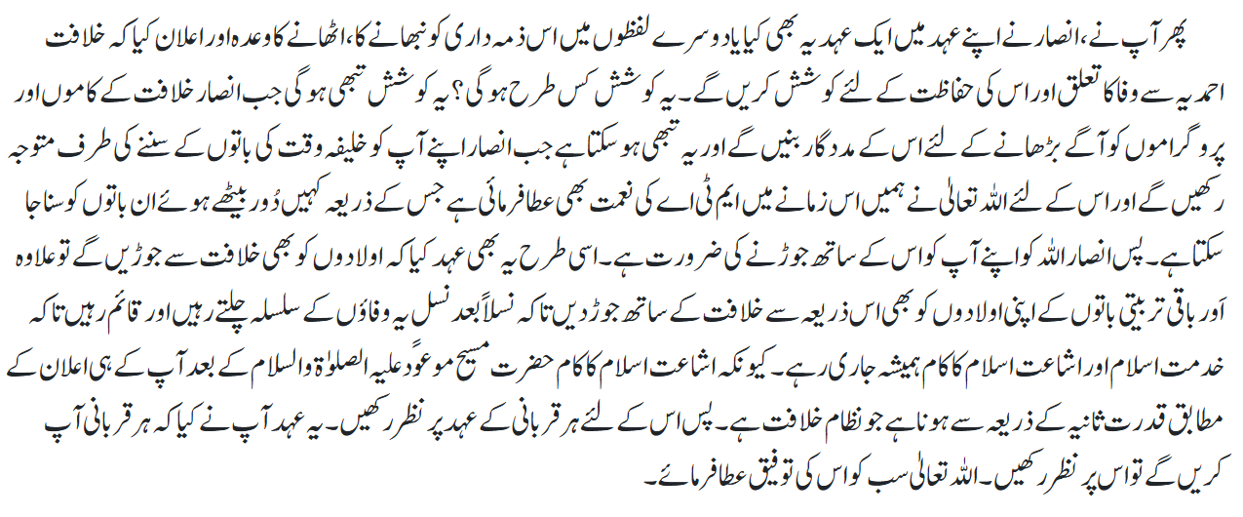
Guidance from Huzoor^{aba}
اللہ تعالیٰ سے تعلق اور آپس میں محبت و اخوت
خطبہ جمعہ 30؍ ستمبر 2016ء
فرمودہ حضرت مرزا مسرور احمد، خلیفۃ المسیح الخامس ایدہ اللہ تعالیٰ بنصرہ العزیز

Slide 15
Salat

Slide 16
Salat
….it is of concern that men who are named Qawwam (guardian) are indolent about Salat. They are the head of household, and it is their responsibility to be a model for the family, if they are not making an effort in this regard what sort of model will the children become. When boys reach adolescence and the father does not offer Salat, they too do not offer it in spite of the mother’s efforts. The custom is that if the mosque or Salat center is at a distance then congregational Salat should be offered at homes. This fills homes with blessings. Men are particularly enjoined to observe Salat and ‘observance of Salat’ means, except in exceptional situation, to offer it in congregation. Congregational Salat is offered during Jalsa. In order to attain the objective of attending Jalsa this should be made a regular feature of life.
Friday Sermon delivered by Hazrat Khalifatul Masih V^{ABA} May18, 2012

Slide 17
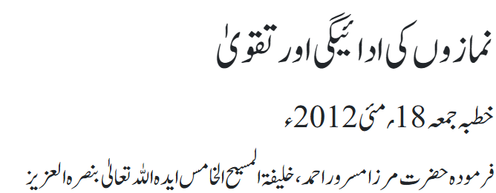
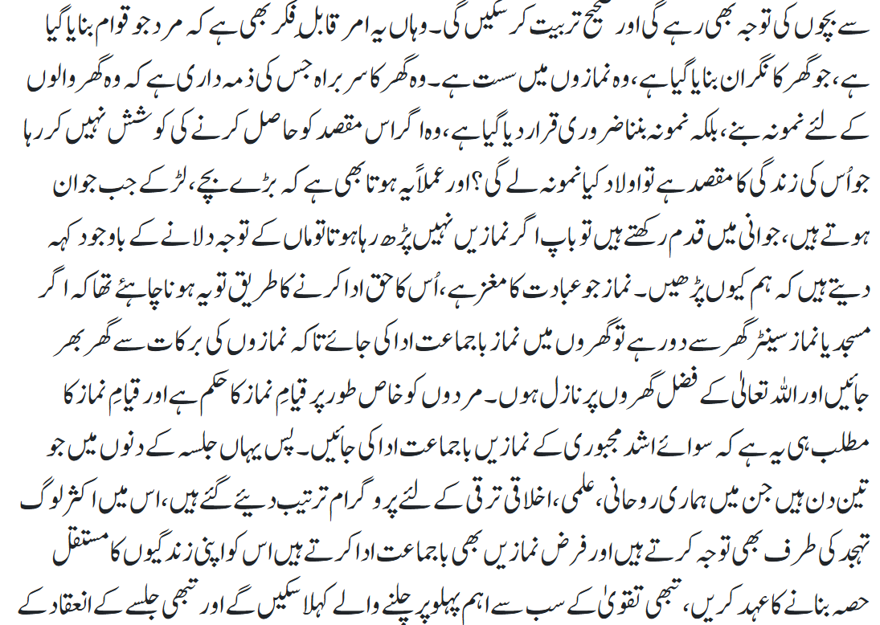
Salat

Slide 18
Al-Wasiyyat

Slide 19
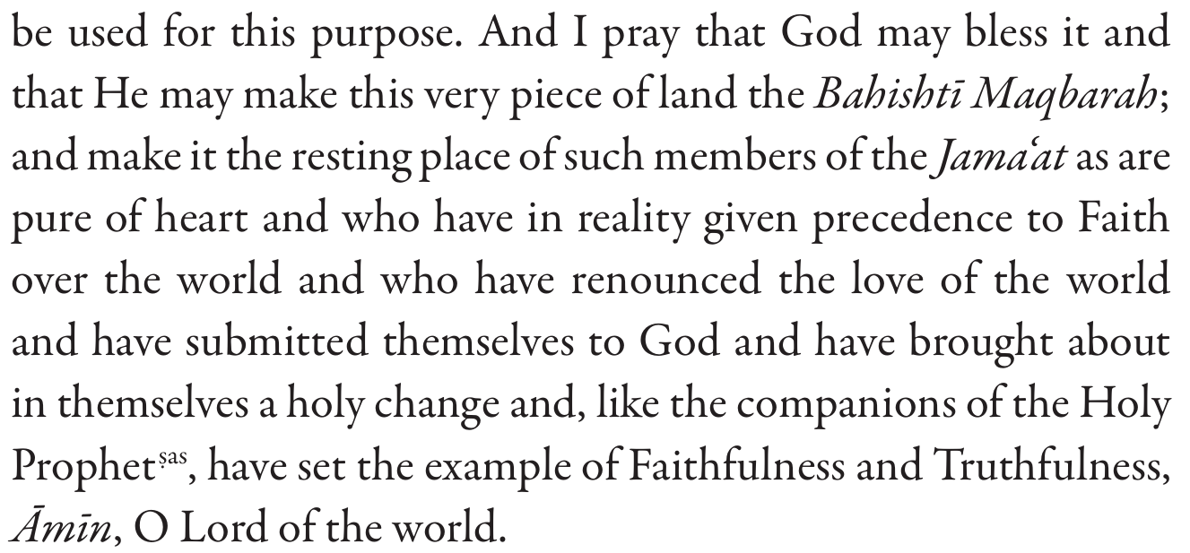
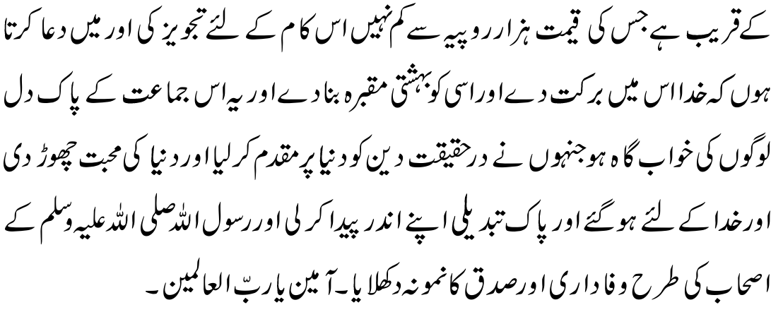
Al Wasiyyat
Al Wasiyyat

Slide 20
Zahanat
(Mental Ability)

Slide 21
Zahanat
Q 1. What is a group of pandas known as?
Coalition
Senate
Pandemonium
Embarrassment
Q 2. Which search engine was originally called “Backrub”?
Yahoo
Jeeves
Google
Bing
Q 3. How many minutes are there in a full week?
15,760
10,080
12,180
14,460

Slide 22
Zahanat
A group of pandas is most commonly called an embarrassment, but other collective nouns include cupboard, bamboo, or bunch. It is worth noting that pandas are naturally solitary animals and are rarely seen in groups.
Q 1. What is a group of pandas known as?
Coalition
Senate
Pandemonium
Embarrassment
Q 2. Which search engine was originally called “Backrub”?
Yahoo
Jeeves
Google
Bing
According to Stanford’s David Koller, and Google’s own website, Page and Brin’s 1996 foray into the world of search engines was initially called “BackRub.”
Q 3. How many minutes are there in a full week?
15,760
10,080
12,180
14,460
60 X 24 X 7 = 10,080

Slide 23
Reading of the Holy Quran

Slide 24




Quran Tajweed Basics
Hamzatul-Wasl(Joining Hamza)
In Holy Quran some words start with a blank alif. It is called Hamzatul-Wasl. It has following rules:
1) Fat’hah: The blank alif always take Fat’hah if the next letter is Lam Sakin/Mushaddad.
See CH:59 V24
2) Kasrah: If the very first Mutaharrik(vowelled) letter of such word bears a Fat’hah or Kasrah, the blank alif always take a Kasrah.
See CH:2 V213
3) Dammah: If the very first Mutaharrik (vowelled) letter of such word bears a Dammah, the blank alif always take a Dammah.
See CH:4 V90
Play Audio Or Click Here

Slide 25
Health

Slide 26

Health Myths & Misconceptions
Tanvir Ahmed
Qaid Health

Slide 27
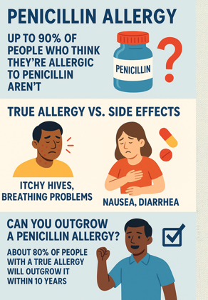

Penicillin Allergy
PENICILLIN ALLERGY - A penicillin allergy is rare (less than 1% of the population has it), but 10% of people THINK they have it.
YOU CAN GET TESTED to see if you have a true allergy because being labelled allergic may deprive you from using a number of antibiotics for your potentially serious infection

Slide 28
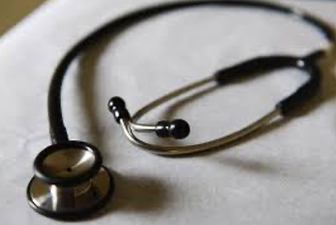
Skipping your Annual Exam
People skip their annual checkup because they 'feel fine.’
Serious conditions like diabetes, high blood pressure, and early-stage cancer don't always cause symptoms and you may feel fine
Annual physical allows you to detect disease in early stages that may be life saving and prevent needless suffering

Slide 29

I need a Liver and Kidney Detox
The purported liver, kidney and colon detox or 'cleansing' process is not necessary — it's just what some people say to make money.”
"If your kidneys and liver are functioning properly, they detox themselves. You do not need any detox.

Slide 30
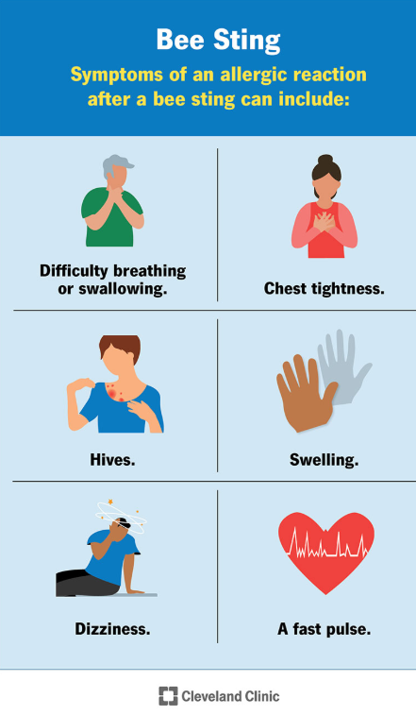
Bee Sting Allergy ?
When stung by a bee, swelling of the affected area does not mean you are allergic.
However, seek care if your throat closes or have shortness of breath and yes you are probably allergic.
In other cases, an antihistamine like Benadryl may be used
See care if it is getting worse or have new symptoms

Slide 31

Vaccines cause autism
Vaccines do not cause Autism
Vaccinate your kids (and yourself) against measles, mumps, RSV, flu, COVID, polio, or any of the other horrible diseases that we have been able to prevent years of vaccine research & development

Slide 32
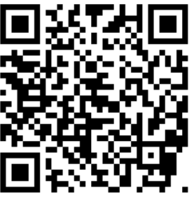
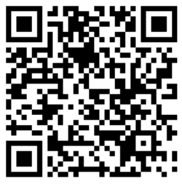
Local Majlis Time
Sign-up for TAQWA Quran classes via the following link
https://www.altaqwa.us/registration/
Sign-up for Waqf e Ardhi via the following link
https://tinyurl.com/WaqfeArdhiSignup
Murabbi Sahib’s Comments
Reminders/announcements
Du’a
Adjourn
Waqf e Ardhi Sign-up
Jazakumullah for Participating!
If you enjoyed it, please convey to those brothers who are not here today!
Please take a moment to provide your feedback
https://tinyurl.com/TalimDeckFeedback
Feedback

