Slide 1

Majlis Ansārullāh
Monthly Meeting
January 2026
Staying Away from Shirk
Have we rid ourselves of ALL kinds of shirk?

Slide 2
agenda
Recitation and translation of the Holy Quran
Pledge
Hadith
Discussion Segment
Salat (Daily Prayers)
Al–Wasiyyat
Brotherhood
Zahanat
Reading The Holy Quran
Health segment
Local Time – Missionary Comments/Reminders/Announcements
Du’a

Slide 3
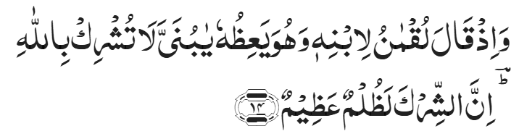
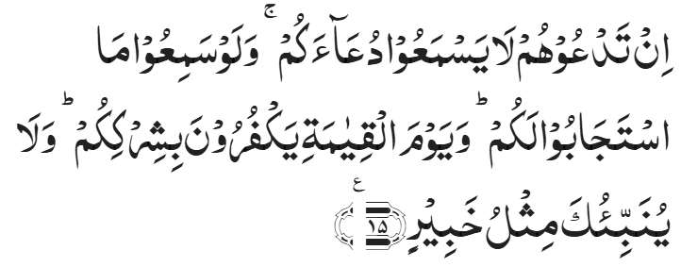
Recitation of the Holy Quran
And remember when Luqman said to his son while exhorting him, ‘O my dear son! associate not partners with Allah. Surely, associating partners with God is a grievous wrong.’
Chapter 31, Surah Luqman, Verse 14
If you call on them, they will not hear your call; and even if they heard it, they could not answer you. And on the Day of Resurrection, they will deny your having associated them with God. And none can inform thee like the One Who is All-Aware.
Chapter 35, Surah Fatir, Verse 15

Slide 4
Pledge
Say this part three times:
Ash-hadu • alla ilaha • illallahu • wahdahu • la sharika lahu • wa ash-hadu • anna Muhammadan • ‘abduhu • wa rasuluh
Say this part once:
I bear witness • that there is none worthy of worship • except Allah. • He is One • (and) has no partner, • and I bear witness • that Muhammad (Peace and blessings of Allah be upon him) • is His servant • and messenger.
Say this part once:
I solemnly promise that • I shall endeavor • till the end of my life • for the consolidation • and propagation of Islām Ahmadiyyat • and for upholding • the institution of Khilafat. • I shall also be prepared • to offer the greatest sacrifice • for this cause. • Moreover, • I shall urge all my children • to remain true • to Khilafat Ahmadiyya. • Insha’Allah.

Slide 5
Hadith

Slide 6

Hadith
O Allah, Bless Muhammad^{sa} and the people of Muhammad^{sa}, as Thou didst bless Abraham and the people of Abraham. Thou art indeed the Praiseworthy, the Glorious. Prosper, O Allah, Muhammad^{sa} and the people of Muhammad^{sa}, as Thou didst prosper Abraham and the people of Abraham. Thou are the Praiseworthy, the Glorious
Narrated Muʿādh ibn Jabal^{ra}
I was a companion rider of the Prophet^{sa} on a donkey called 'Ufair. The Prophet^{sa} asked, "O Mu`adh! Do you know what Allah's right on His slaves is, and what the right of His slaves on Him is?” I replied, "Allah and His Apostle know better.” He said, "Allah's right on His slaves is that they should worship Him (Alone) and should not worship any besides Him. And slave's right on Allah is that He should not punish him who worships none besides Him.”….
Sahih Al Bukhari Hadith 2856

Slide 7
The Holy Quran Discussion

Slide 8
Recitation of the Holy Quran
And remember when Luqman said to his son while exhorting him, ‘O my dear son! associate not partners with Allah. Surely, associating partners with God is a grievous wrong.’
Chapter 31, Surah Luqman, Verse 14
If you call on them, they will not hear your call; and even if they heard it, they could not answer you. And on the Day of Resurrection, they will deny your having associated them with God. And none can inform thee like the One Who is All-Aware.
Chapter 35, Surah Fatir, Verse 15

Slide 9
Discussion
Which of the following is a form of Shirk and why?
  A person bows down in front of an idol and prays to it for his difficulties
  Child comes home from school with stomachache. The father says, I am sure it was the fast food you had last night. How many times have a I told not to have this type of food
  A doctor was giving a lecture. He claimed, I have several remedies and can cure of many illnesses
  A father lied about her daughter’s age to find a good match
Please share ideas on how one can stay away from all forms of Shirk

Slide 10
Five Volume Commentary
The first and basic principle of all religious teaching is that God is One. All other noble ideals flow from this principle. By worshipping any other thing or being beside God Who is the Creator, Lord and Sustainer, man degrades himself and stunts, stifles and stultifies his personality. So, Luqman began his moral sermon by laying stress on this most supreme of all religious beliefs.
Chapter 31, Surah Luqman, Verse 14
The verse further dwells upon the complete failure of the forces of evil to arrest the progress of Islam. It says that the idols of idol worshippers will prove entirely powerless and useless against the onward march of Islam.
The reference in the words, "the One Who is All-Aware," as the translation of the text shows, is to God. It may also be to the Holy Prophet when the word would mean, well-aware.
Chapter 35, Surah Fatir, Verse 15

Slide 11
Guidance from the Promised Messiah^{AS}
But there is another type of shirk, which is spreading secretly like poison, and it is greatly on the increase in this age and that is that there is no trust in and dependence upon God Almighty. We do not say, nor is it part of our faith, that means should be discarded altogether. For God Almighty has Himself urged the use of means and if means are not used to the extent to which they are necessary, this would be to dishonor human faculties and to defame the grand action of God Almighty in bestowing them…..
All this is right up to the proper limit and is not forbidden; but when, transcending that limit, a person places all his trust in the means, that becomes shirk which casts a person far away from his true purpose. For instance, if a person says that had it not been for a certain factor, he would have died of hunger, or that if had it not been for a certain property or an occupation, he would have been in bad shape, or if it had not been for a certain friend, he would have been in trouble, this would be displeasing to God. He would not approve that a person should rely so much upon property, or other means or friends that he should stray far away from God Almighty. (Essence of Islam vol 1 p:173)

Slide 12
Guidance from Huzoor^{ABA}
The Holy Qur'an states, “And those who bear not false witness and when they pass by anything vain, they pass by with dignity”
Chapter 25, Surah Al Furqan, Verse 73
Shirk (associating partners with God) and falsehood have also been mentioned together in the Holy Qur'an as if falsehood is as big a sin as shirk is! The Arabic word الزور‘zoor' is used in the aforementioned verse to denote falsehood. It means lying, associating partners with God, assemblies or places where falsehood is rampant, gatherings of song and idle, frivolous pursuits etc. People of God do not tell lies and do not attend places where falsehood and frivolity is common, nor do they go to places where idolatrous practices are pursued, and they do not give false testimonies. Those who avoid all these situations are true believers.
Friday Sermon delivered by Hazrat Khalifatul Masih V^{aba}
February 5, 2016

Slide 13
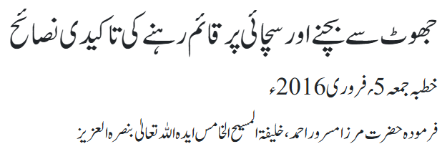
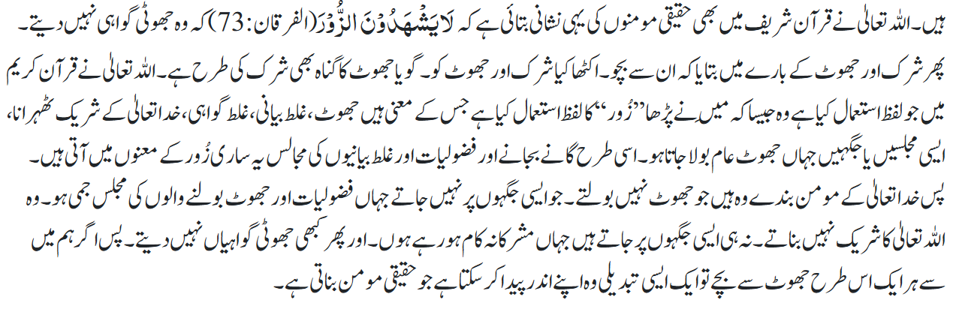
Guidance from Huzoor^{ABA}

Slide 14
Guidance from Huzoor^{ABA}
The Ansar have a great responsibility in the sense that the coming generations look up to them as role models. The fundamental basis to fulfil this responsibility is taqwa.
The Promised Messiah^{as} instructed his followers to adopt taqwa, which he described as not committing any acts which have even an ounce of doubt of being a vice.
By keeping this standard in our sights, we will be able to fulfil our oaths of allegiance.
The bai’at (oath of allegiance) that the Promised Messiah^{as} took from us includes many aspects, one of which is shirk (associating partners with Allah). We should remain observant of ourselves to ensure that we do not become complicit in any form of shirk. As the Promised Messiah^{as} elucidated, shirk does not only include worshipping physical idols, rather it encompasses any type of priority given to anything aside from Allah.
Huzoor^{ABA}’s concluding address at Majlis Ansarullah UK Ijtema 2025

Slide 15
Salat

Slide 16
Salat
Citing verse 239 of Surah Al Baqarah (2:239)
"Watch over prayers, and the middle Prayer, and stand before Allah submissively."
Huzur said various commentators have interpreted the term 'middle prayer' differently; it is an instruction in principle, and 'middle prayer' can be applied to different people in accordance to their leanings towards worldly matters or their laziness that may make them negligent towards observing Salat. It can be the specific time for different people during a day when their attention diverts elsewhere by satanic enticements. If we can overcome this then consider that we safeguard our Salat and in turn Salat will indeed safeguard us.
Friday Sermon delivered by Hazrat Khalifatul Masih V^{aba}, February 15, 2008

Slide 17
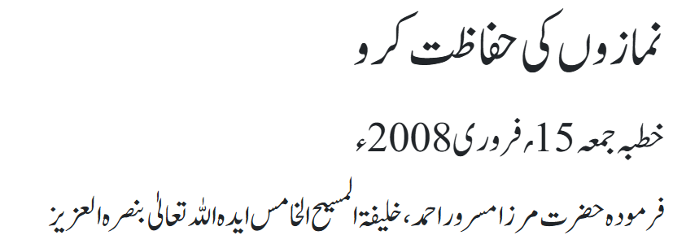
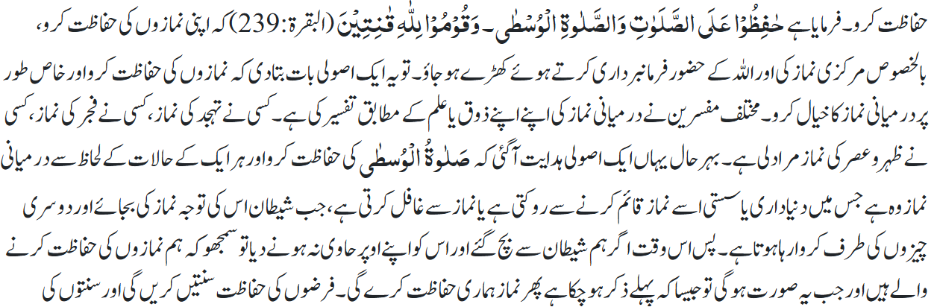
Salat

Slide 18
Al-Wasiyyat

Slide 19
Al Wasiyyat
Al Wasiyyat
The Promised Messiah (on whom be peace) wrote:
‘I came from God as a Manifestation of Divine Providence, and I am a personification of His Power. And after I am gone there will be some other persons who will be the manifestation of the second Power [of God]. So, while waiting for the second Manifestation of His Power, you all together keep yourselves busy praying. And let a Jama‘at of righteous people, one and all, in every country keep themselves busy in prayers so that the second Manifestation may descend from the Heaven and show you that your God is such Mighty God. Consider your death to be close at hand for you never know when that hour will strike. Let the righteous persons of the Jama‘at who have pure souls accept Bai‘at in my name. God Almighty desires to draw all those who live in various habitations of the world, be it Europe or Asia, and who have virtuous nature, to the Unity of God and unite His servants under one Faith. This indeed is the purpose of God for which I have been sent to the world. You, too, therefore should pursue this end, but with kindness, moral probity and fervent prayers. And till that time when someone inspired by God with the Holy Spirit is raised by Him, all of you should work in harmony with one another.’ [The Will, pp. 8 – 9]

Slide 20
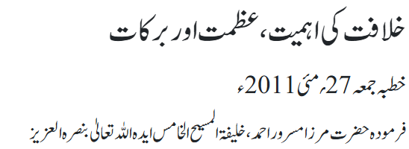
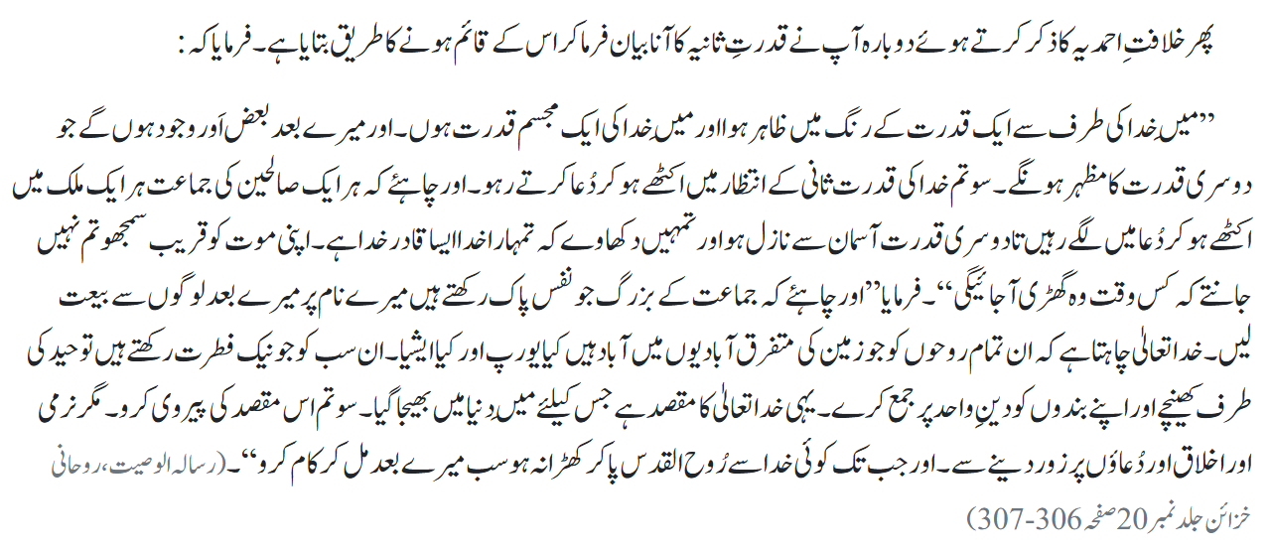
Al Wasiyyat

Slide 21
Brotherhood

Slide 22
Brotherhood
اِنَّ اَکۡرَمَکُمۡ عِنۡدَ اللّٰہِ اَتۡقٰکُمۡ ؕ
Verily, the most honorable among you, in the sight of Allah, is he who is the most righteous among you.
Action item: Members commit to actively seeking out and appreciating the contributions of individuals they might not typically engage with, especially newer or less outwardly prominent members.
Please share ideas how this can be accomplished

Slide 23
Zahanat
(Mental ability)

Slide 24
Zahanat
Q. What country has the most islands in the world?
Sweden
United States
Indonesia
Finland
Q. What is the smallest bone in the human body?
Humerus
Tibia
Femur
Stapes
Q. In tennis, what fruit is found at the top of the men’s Wimbledon trophy?
Orange
Pineapple
Peach
Dragon Fruit

Slide 25
Zahanat
Q. What country has the most islands in the world?
Sweden
United States
Indonesia
Finland
Sweden has the most islands in the world, with over 267,000, followed by Norway and Finland, thanks to their intricate coastlines and archipelagos, though most of these islands are small, uninhabited islets.
Q. What is the smallest bone in the human body?
Humerus
Tibia
Femur
Stapes
The smallest bone in the human body is the stapes (or stirrup bone), located in the middle ear, measuring just a few millimeters and crucial for transmitting sound vibrations from the eardrum to the inner ear.
Q. In tennis, what fruit is found at the top of the men’s Wimbledon trophy?
Orange
Pineapple
Peach
Dragon Fruit
There's a pineapple on the Wimbledon men's trophy because it was a rare luxury and symbol of wealth, status, and hospitality in
19th-century Europe, reflecting the elite nature of the prestigious tournament.

Slide 26
Reading of the Holy Quran

Slide 27




Quran Tajweed Basics
Al-Hurufush-Shamsiyya/Al-Huruful-Qamariyyah
In Arabic the “Al” prefix comes before nouns to make them definite. The “Laam” in this prefix is pronounced:
Silent, merged into next letter(with Tashdeed) if any of the following 14 letters appear after Laam. These letters are called “Al-Hurufush-Shamsiyya” (Sun Letters).
      Examples:
2) Clearly with Sukun if any of the following 14 letters appear after Laam. These letters are called “Al-Huruful-Qamariyyah” (Moon Letters).
Examples:

Slide 28
Health

Slide 29


Slide 30
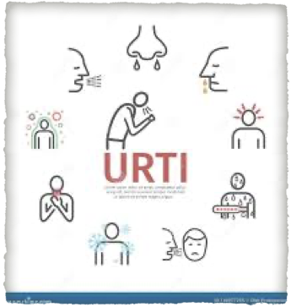

An upper respiratory tract infection (URTI) is a viral or bacterial illness in the upper part of your respiratory system. This includes your nose, sinuses and throat
Vast majority is caused by viruses but some by bacteria and rarely fungus
Viruses responsible for the flu, COVID-19 and RSV, can cause both upper and lower respiratory infections

Slide 31
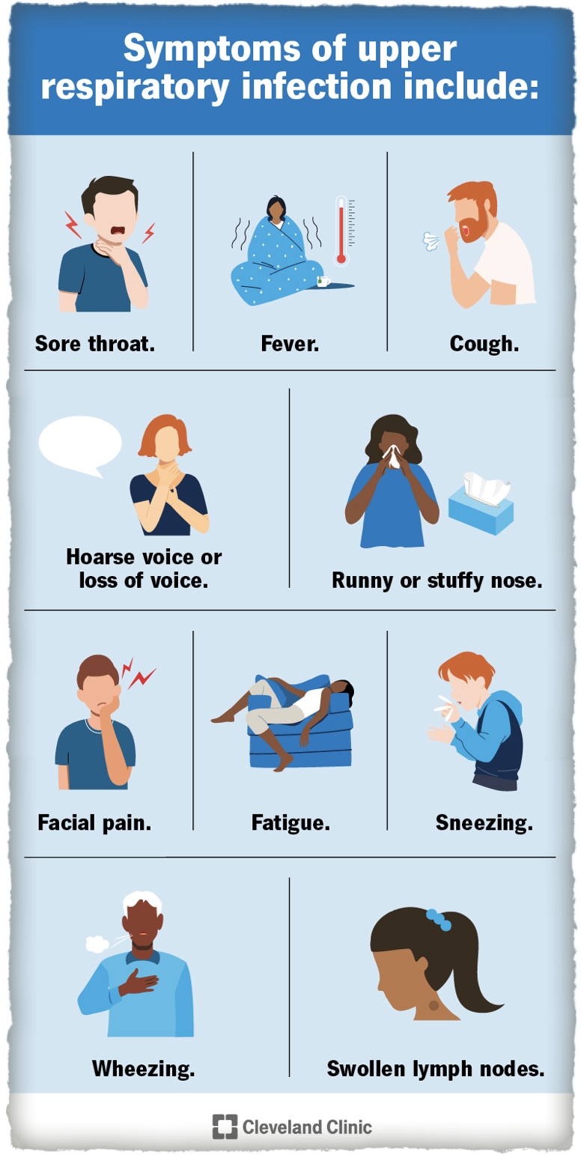
Symptom of URTIs may include
Fever
Sore throat
Runny or stuffy nose
Congestion
Sneezing
Fatigue
Hoarseness
Swollen lymph node
Facial Pain
Wheezing

Slide 32
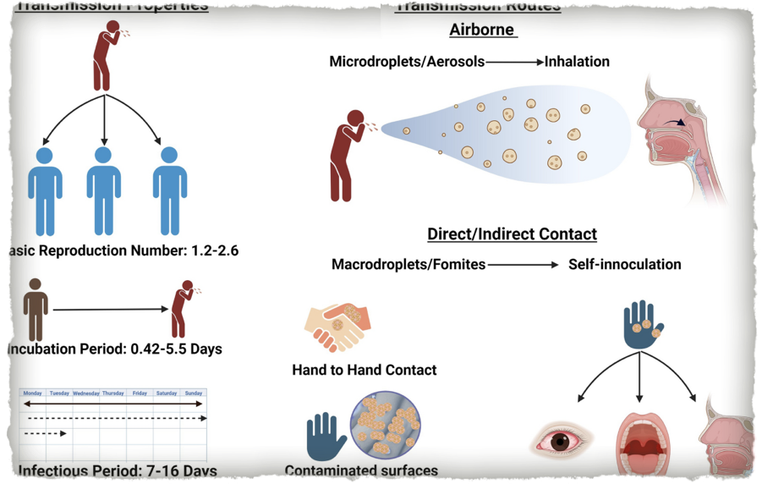
How it spreads
The viruses and bacteria that cause upper respiratory infections can spread from person to person (contagious)
The germs spread by respiratory droplets when someone coughs, sneezes or talks
It may spread by sharing utensils
Contact with objects or surfaces with germs such as doorknob switches
Fungus that cause upper respiratory infections are not contagious

Slide 33
Rare Complications of URTIs
Most upper respiratory infections are self limiting illnesses. They rarely can cause complications like
  Meningitis
  Rheumatic fever
  Scarlet fever
  Sepsis

Slide 34
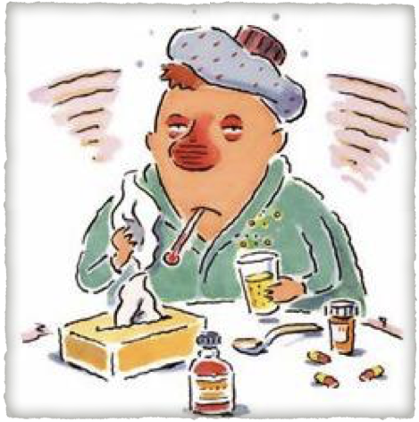
Treatment of Upper Respiratory Tract Infections
Most viral infections have no specific treatment. The disease runs its course for 1-2 weeks
Drink plenty of healthy fluids
Tylenol and Advil for pain fever
No aspirin for children under 18
Treatment is available for influenza COVID-19 in specific cases.
Antibiotics if you have a bacterial infection such as strep throat.
Seek care if your symptoms are severe or last longer than two weeks

Slide 35
Prevent Flu and Colds
Get your flu shot as soon as possible. It takes 2-3 weeks for immunity to kick in
Cover your sneeze & cough with a tissue or cough into your elbow
Wash your hands often and practice social distancing
Eat-healthy and stay well hydrated

Slide 36
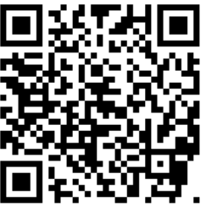
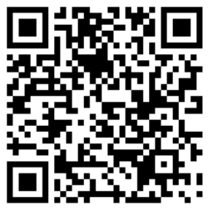
Local Majlis Time
Sign-up for TAQWA Quran classes via the following link
https://www.altaqwa.us/registration/
Sign-up for Waqf e Ardhi via the following link
https://tinyurl.com/WaqfeArdhiSignup
Murabbi Sahib’s Comments
Reminders/announcements
Du’a
Adjourn
Waqf e Ardhi Sign-up
Jazakumullah for Participating!
If you enjoyed it, please convey to those brothers who are not here today!
Please take a moment to provide your feedback
https://tinyurl.com/TalimDeckFeedback
Feedback

