Slide 1

Majlis Ansārullāh
Monthly Meeting
February 2026
Staying Away from Lying
Have we rid ourselves of ALL kinds of lies?

Slide 2
agenda
Recitation and translation of the Holy Quran
Pledge
Hadith
Discussion Segment
Salat (Daily Prayers)
Al–Wasiyyat
Brotherhood
Zahanat
Reading The Holy Quran
Health segment
Local Time – Missionary Comments/Reminders/Announcements
Du’a

Slide 3
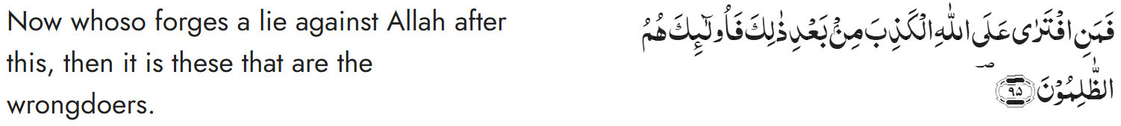
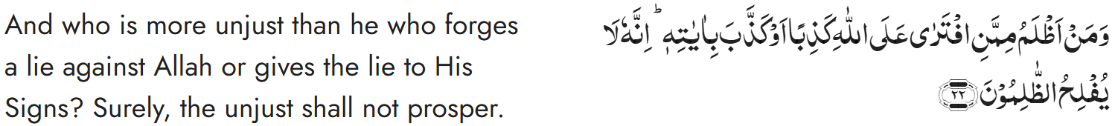
Recitation of the Holy Quran
Chapter 3, Aal-e-’Imran, Verse 95
Chapter 6, Surah Al-An’am, Verse 22

Slide 4
Pledge
Say this part three times:
Ash-hadu • alla ilaha • illallahu • wahdahu • la sharika lahu • wa ash-hadu • anna Muhammadan • ‘abduhu • wa rasuluh
Say this part once:
I bear witness • that there is none worthy of worship • except Allah. • He is One • (and) has no partner, • and I bear witness • that Muhammad (Peace and blessings of Allah be upon him) • is His servant • and messenger.
Say this part once:
I solemnly promise that • I shall endeavor • till the end of my life • for the consolidation • and propagation of Islām Ahmadiyyat • and for upholding • the institution of Khilafat. • I shall also be prepared • to offer the greatest sacrifice • for this cause. • Moreover, • I shall urge all my children • to remain true • to Khilafat Ahmadiyya. • Insha’Allah.

Slide 5
Hadith

Slide 6
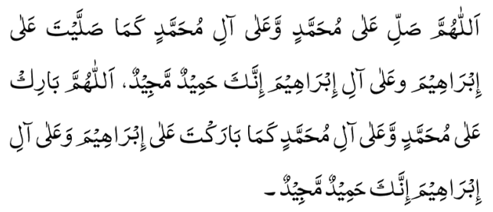
Hadith
O Allah, Bless Muhammad^{sa} and the people of Muhammad^{sa}, as Thou didst bless Abraham and the people of Abraham. Thou art indeed the Praiseworthy, the Glorious. Prosper, O Allah, Muhammad^{sa} and the people of Muhammad^{sa}, as Thou didst prosper Abraham and the people of Abraham. Thou are the Praiseworthy, the Glorious
Narrated by Abu Huraira^{ra}:
The Prophet^{SA} said, "Whoever does not give up false statements (i.e. telling lies), and evil deeds, and speaking bad words to others, Allah is not in need of his (fasting) leaving his food and drink.
Sahih Al Bukhari Hadith 6057

Slide 7
The Holy Quran Discussion

Slide 8
Recitation of the Holy Quran
Chapter 3, Aal-e-’Imran, Verse 95
Chapter 6, Surah Al-An’am, Verse 22

Slide 9
Discussion
A Nasir stayed up late at night due to Jama’at work. He had difficulty waking up in the morning and was late to his job. When he was asked about the delay, he blamed the traffic.
How would you have dealt with this situation?
Did Jama’at work made him make a false statement?
Should we make a big deal of these minor lies?

Slide 10
Five Volume Commentary
The word ذالك (this) refers to the statement made in the preceding verse. To say that such and such parts of food were disallowed by God whereas He had not forbidden them, or even without directly attributing any commandant to God persistently to abstain from partaking of a lawful food without just reason virtually amounted to forging a lie against God which only wrongdoers could resort to.
Chapter 3, Aal-e-’Imran, Verse 95
Every sane man will testify that if a person claims to speak in the name of God while God has not spoken to him, and he forges lies against Him, such a person is one of the greatest culprits and God must bring him to naught…..
Chapter 6, Surah Al-An’am, Verse 22

Slide 11
Guidance from Huzoor^{ABA}
The Promised Messiah^{as} continues: ‘… a true believer carefully controls what he or she says (he or she refrains from uttering anything that is unrighteous). Thus, govern your tongues rather than allowing your tongues to govern you leading you to speaking excessively and beyond measure.’ One should keep their tongues in check, is what is meant by ‘governing’ them and not allowing yourself to blurting out whatever comes to mind, because this would only lead to exclaiming anything and everything, whether truthful or false. In turn, this creates disorder and strife. May Allah the Almighty enable every one of us to understand this fact
Friday Sermon delivered by Hazrat Khalifatul Masih V^{aba}
June 16, 2017

Slide 12
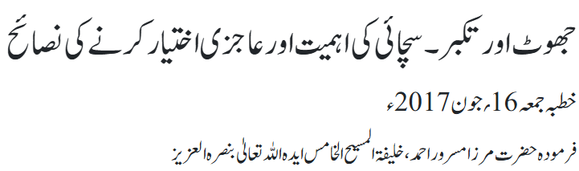
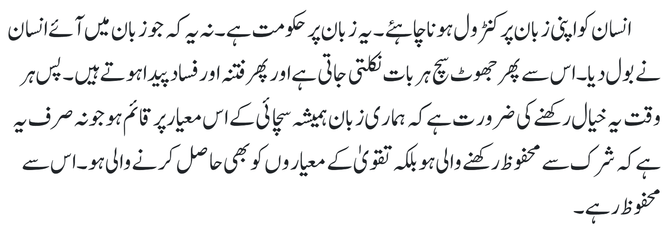
Guidance from Huzoor^{ABA}

Slide 13
Guidance from Huzoor^{ABA}
Another vice that the Promised Messiah^{as} warned us against is lying. As the Holy Prophet^{sa} is reported to have said that amongst the four traits which lead a person to hypocrisy are various forms of lying, such as not fulfilling oaths, making false promises and using foul language during an argument. In reality, these are all forms of lying.
The gravity of lying is such that the Holy Quran even compares it to worshipping idols. Lying can become a habit, so much so that when a liar speaks the truth, he is scrutinized harshly due to his habit of lying.
Huzoor^{ABA}’s concluding address at Majlis Ansarullah UK Ijtema 2025

Slide 14
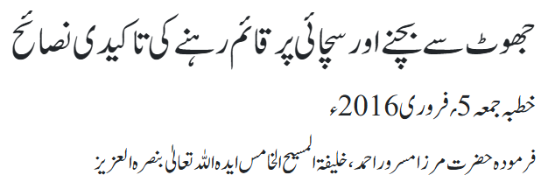
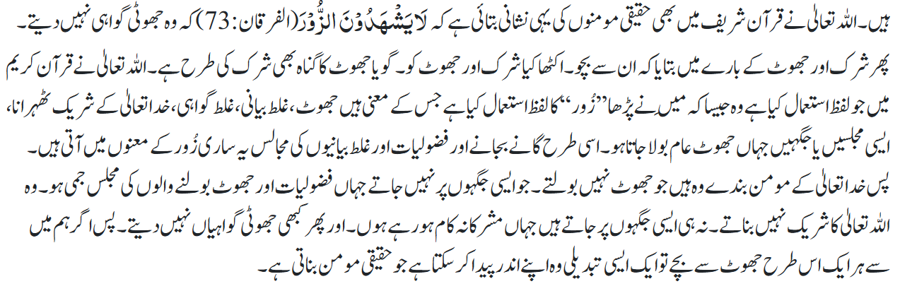
Guidance from Huzoor^{ABA}

Slide 15
Salat

Slide 16
Salat
The Promised Messiah^{as} said people are negligent about Salat because they are not aware of the pleasure and delight that God has placed in it. He said question arises why are people not aware of this and why have they not experienced this delight! He said people are occupied in their tasks when the call for Prayer is made and people do not want to know. There are shopkeepers with shops adjacent to mosques, but they do not attend. Thus, one should pray most soulfully to God that just as He has given us the delights and pleasures of foods and other things, may He also grant us the delight in His worship. Those who do not offer Salat consider it as a burden which entails getting up in the morning and doing ablutions in the cold, leaving blissful sleep and other comforts. Such people are weary and do not know of the delight and pleasure that is found in Salat.
Friday Sermon delivered by Hazrat Khalifatul Masih V^{aba}, April 15, 2016

Slide 17
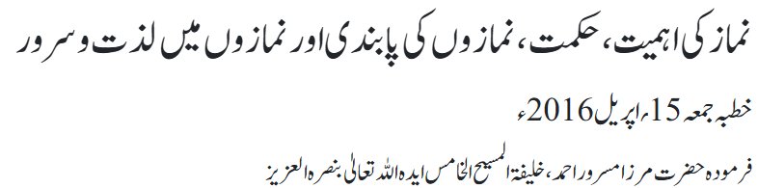
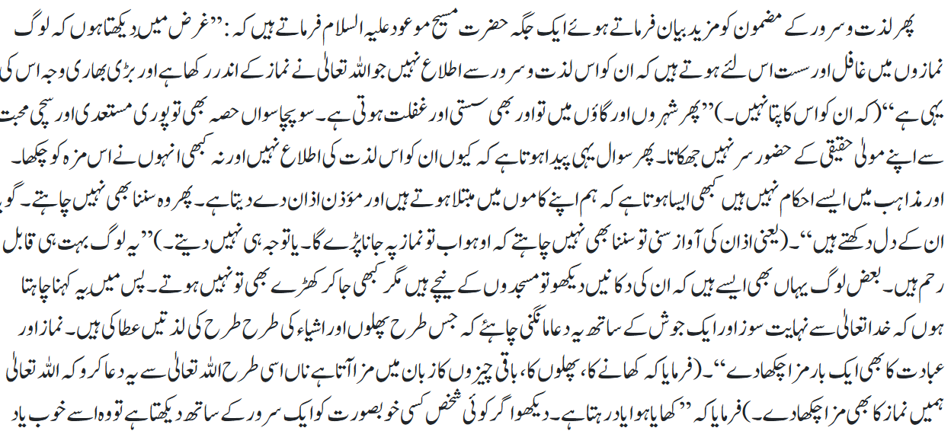
Salat

Slide 18
Al-Wasiyyat

Slide 19
Al Wasiyyat
Al Wasiyyat
Taqwa is a tree that should be planted in the heart. The very water which nourishes Taqwa irrigates the whole garden. Taqwa is a root without which everything is meaningless; and if it remains intact then nothing is lost. What benefit is there for a man in indulging himself in the useless activity of claiming with his tongue that he seeks God while he has no sure footing with his Lord. Look, I say to you truly and sincerely that ruined is he whose faith is tainted by even a hint of worldliness. Hell is very close to that soul all of whose intentions are not for God—rather some of them are for God and others are for the world.
The Will, Page 10

Slide 20
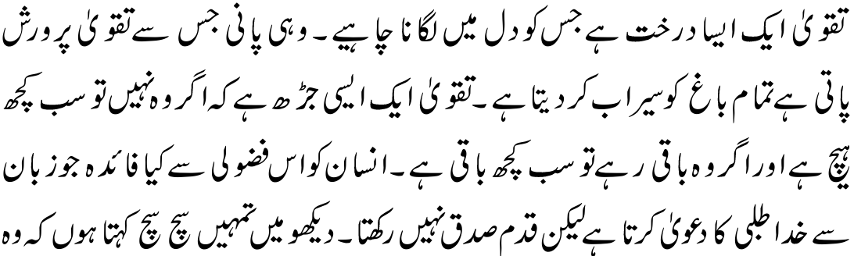
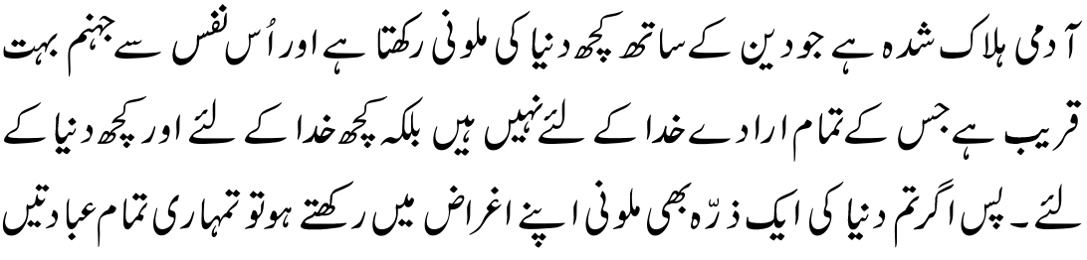

Al Wasiyyat

Slide 21
Brotherhood

Slide 22

Verily, the most honorable among you, in the sight of Allah, is he who is the most righteous among you.
Action item: Try "Brotherhood Mixing” in Jama’at gatherings, with interaction and conversation with members from different ethnic and racial backgrounds.
Please share ideas how this can be accomplished

Slide 23
Zahanat
(Mental ability)

Slide 24
Zahanat
Which of the following fruit has its seeds on the outside?
Dragon Fruit
Blackberry
Strawberry
Mango
What’s the fastest-growing plant on Earth?
Hibiscus
Bamboo
Fern
Money-Plant
In what country is it common to find cube shaped watermelons?
Germany
USA
France
Japan

Slide 25
Zahanat
Which of the following fruit has its seeds on the outside?
Dragon Fruit
Blackberry
Strawberry
Mango
The most famous fruit with "seeds" on the outside is the strawberry, but those specks are actually tiny, dry fruits called achenes, each containing a seed, while the red fleshy part is the swollen receptacle.
What’s the fastest-growing plant on Earth?
Hibiscus
Bamboo
Fern
Money-Plant
The fastest-growing plant is bamboo, with some species reaching up to 35 inches (91 cm) in just 24 hours,
In what country is it common to find cube shaped watermelons?
Germany
USA
France
Japan
Cube watermelons were intended to fit more compactly in fridges, and their shape makes them easier to cut as they do not roll.

Slide 26
Reading of the Holy Quran

Slide 27



Quran Tajweed Basics
Rules/Signs of Waqf(Pause)
1) The sign of “Sili” means to connect. It is better and more desirable not to stop here.
2) “Qaf” means “pause is made here”. It is better to stop here.

Slide 28
Health

Slide 29
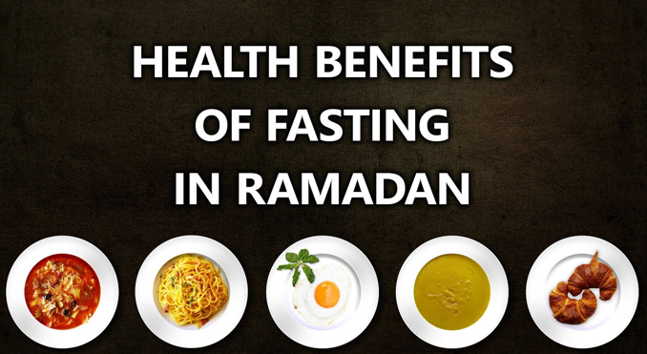
The Many Health Benefits of Fasting

Slide 30
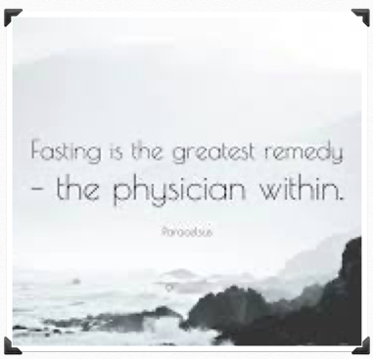
Fasting Quotes
Fasting is the greatest remedy - The physician within
Philippus Paracelsus - Swiss Physician
Humans live on one-quarter of what they eat; on the other three-quarters lives their doctors
(Egyptian Pyramid Inscription 3800 BC)

Slide 31
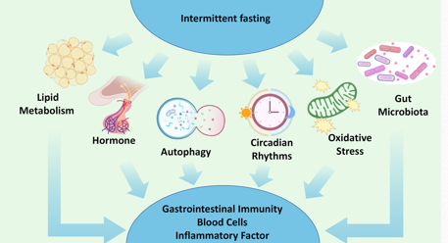
Fights Inflammation
Chronic Inflammation negatively affects your health leading to heart disease, cancer, arthritis etc.
Some studies have found that fasting can help decrease levels of inflammation and promote better health
The net advantage is reduced risk of cancers, heart disease, diabetes, arthritis etc.

Slide 32
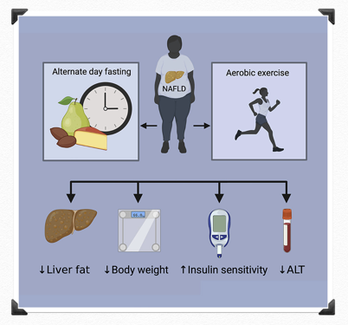
Blood Sugar and Diabetes
Diabetes Mellitus Fasting can decrease insulin resistance which can reduce the risk of developing diabetes
Fasting can improve blood sugar management.
Some diabetics may be able to reverse the need for insulin. Talk to your doctor

Slide 33
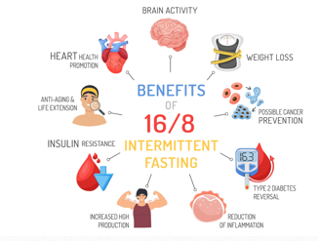

High Blood Pressure, Heart Disease and Cholesterol
Fasting can particularly improve your heart health
Fasting has been associated with a lower risk of coronary heart disease
Fasting may help lower blood pressure, triglycerides, and cholesterol levels

Slide 34
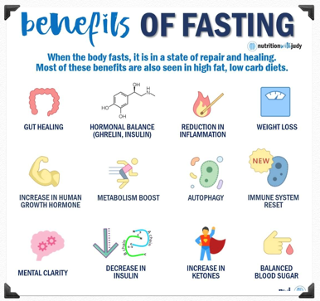
Improves Physical and mental Performance
Physical performance. Young men who fasted for 16 hours showed fat loss while maintaining muscle mass
Tissue health. Intermittent fasting reduced tissue damage in surgery and improved results (Animal Model)
Studies discovered that intermittent fasting boosts memory

Slide 35
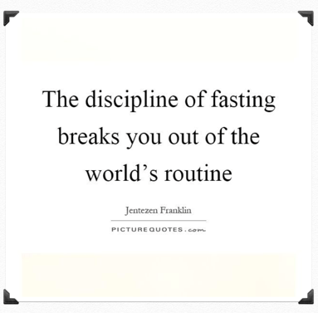
Who Should Not Fast
Children
Women who are pregnant or breastfeeding
People are sick with diseases like Type 1 Diabetes
People with eating disorders

Slide 36


Local Majlis Time
Sign-up for TAQWA Quran classes via the following link
https://www.altaqwa.us/registration/
Sign-up for Waqf e Ardhi via the following link
https://tinyurl.com/WaqfeArdhiSignup
Murabbi Sahib’s Comments
Reminders/announcements
Du’a
Adjourn
Waqf e Ardhi Sign-up
Jazakumullah for Participating!
If you enjoyed it, please convey to those brothers who are not here today!
Please take a moment to provide your feedback
https://tinyurl.com/TalimDeckFeedback
Feedback

