Slide 1

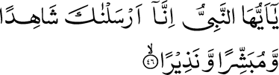

O Prophet, truly We have sent thee as a Witness, and Bearer of glad tidings, and a Warner,
And as a Summoner unto Allah by His command, and as a Lamp that gives bright light. [33:46-47]

Slide 2
Propagate!
333,000,000 Americans
need to know about Islam
It is our responsibility and we have to do it.
One Nasir has to reach more than 100,000!
One Nasir to 2,000 Muslims!
Under the banner of Khilafat, we can achieve a lot!
In Sha Allah.

Slide 3
Many Campaigns
Muslims for Peace
Muslims for Life
Muslims for Loyalty
Peace through Messiah
Great effort and participation all over the country

Slide 4
First Tabligh Question in the Monthly Report
How many Ansar participated in all the propagation activity arranged by Ansar, Jama‘at or any other auxiliary? _____ (Please count a Nasir only once)
If you enter zero...

Slide 5
What Else Can You Do?

Slide 6
Types of Tabligh
Indirect Tabligh
  television, books in library, newspaper article, radio, Review, Sunrise, posting on internet, CD, DVD, billboard
Im-personal contact
Direct Tabligh
  interfaith, seminar, exhibition, leaflet distribution, bookstall, book fair, open house, bus, trailer, lectures in schools
Personal contact
One-on-One Tabligh
  repeat visits to small towns, retirement homes, ethnic groups, meetings with missionary
Personal inter-action
Partici-pation
  Jum‘ah, Jalsa, events, Salat
Partici-pation

Slide 7
Types of Tabligh
Indirect Tabligh
  television, books in library, newspaper article, radio, Review, Sunrise, posting on internet, CD, DVD, billboard
Im-personal contact
Direct Tabligh
  interfaith, seminar, exhibition, leaflet distribution, bookstall, book fair, open house, bus, trailer, lectures in schools
Personal contact
One-on-One Tabligh
  repeat visits to small towns, retirement homes, ethnic groups, meetings with missionary
Personal inter-action
Partici-pation
  Jum‘ah, Jalsa, events, Salat
Partici-pation

Slide 8
Next Questions
How many nonmembers were brought to the mosque/center or an event by Ansar (Jum‘ah, Salat, open house, meeting with missionary, interfaith meeting, Jalsa Salana, Jama‘at events, mosque/center visit)? _____ (Please count a nonmember only once)

Slide 9
Types of Tabligh
Indirect Tabligh
  television, books in library, newspaper article, radio, Review, Sunrise, posting on internet, CD, DVD, billboard
Im-personal contact
Direct Tabligh
  interfaith, seminar, exhibition, leaflet distribution, bookstall, book fair, open house, bus, trailer, lectures in schools
Personal contact
One-on-One Tabligh
  repeat visits to small towns, retirement homes, ethnic groups, meetings with missionary
Personal inter-action
Partici-pation
  Jum‘ah, Jalsa, events, Salat
Partici-pation

Slide 10
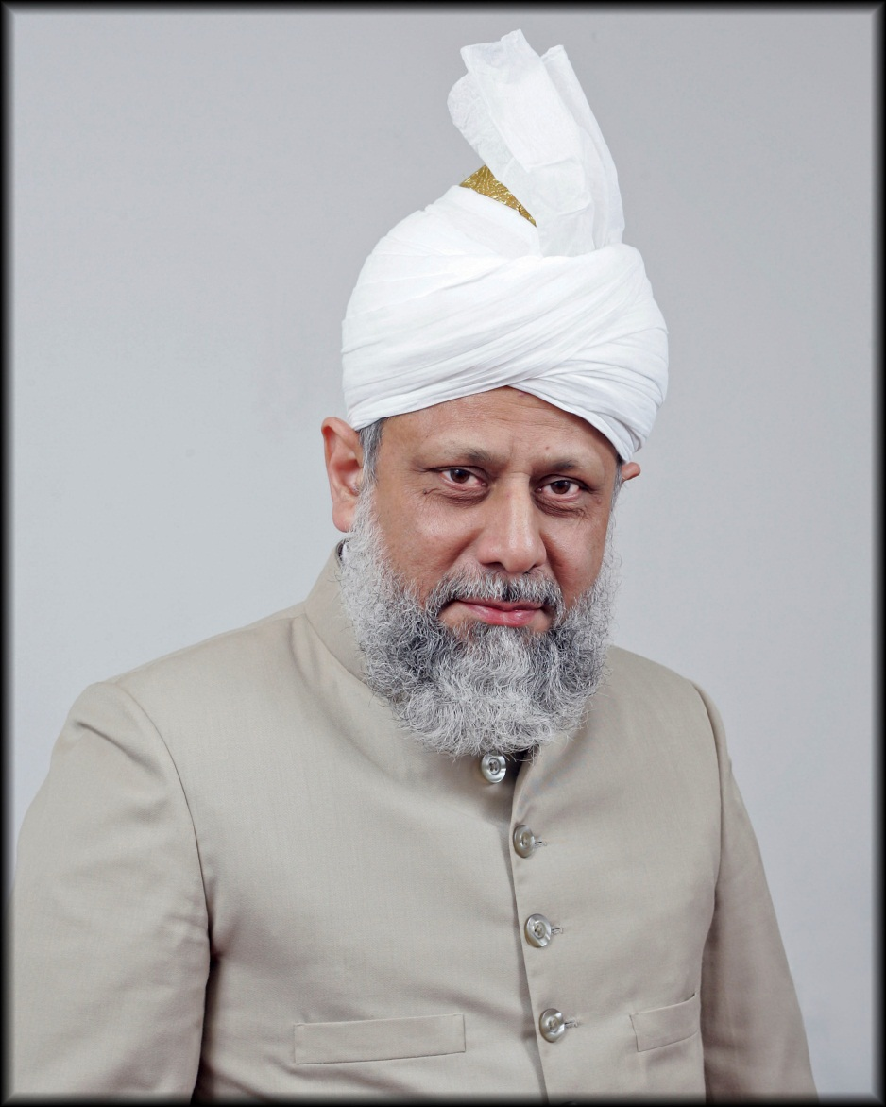
Visit small towns and make contacts
Visit retirement homes and make contacts
Make contacts with immigrant communities

Slide 11
Next Questions
How many nonmembers were contacted by Ansar in visits to small towns, retirement homes, ethnic groups, etc. _____ (Please count a nonmember only once)

Slide 12
261 visits to small towns
last year
282 nonmembers
brought to mosques to meet the missionaries

Slide 13
Types of Tabligh
Indirect Tabligh
  television, books in library, newspaper article, radio, Review, Sunrise, posting on internet, CD, DVD, billboard
Im-personal contact
Direct Tabligh
  interfaith, seminar, exhibition, leaflet distribution, bookstall, book fair, open house, bus, trailer, lectures in schools
Personal contact
One-on-One Tabligh
  repeat visits to small towns, retirement homes, ethnic groups, meetings with missionary
Personal inter-action
Partici-pation
  Jum‘ah, Jalsa, events, Salat
Partici-pation

Slide 14
Next Questions
How many events were held specifically for nonmembers organized by Jama‘at, Ansar or Khuddam? _____
How many total nonmembers came to the events held specifically for nonmembers? _____

Slide 15
Interfaith events held last year
184
Nonmember participants
7,466

Slide 16
Types of Tabligh
Indirect Tabligh
  television, books in library, newspaper article, radio, Review, Sunrise, posting on internet, CD, DVD, billboard
Im-personal contact
Direct Tabligh
  interfaith, seminar, exhibition, leaflet distribution, bookstall, book fair, open house, bus, trailer, lectures in schools
Personal contact
One-on-One Tabligh
  repeat visits to small towns, retirement homes, ethnic groups, meetings with missionary
Personal inter-action
Partici-pation
  Jum‘ah, Jalsa, events, Salat
Partici-pation

Slide 17
Next Questions
How many flyers, leaflets, CDs, DVDs and books were distributed or placed in reading rooms or libraries by Ansar? _____
Number of Bai’ats realized through the efforts of Ansar: _____

Slide 18
605 publications
19 Bai‘ats

Slide 19
The Last Question
What Tabligh activity was initiated, managed, supported or conducted by local Majlis or Ansar such as propagation days, open houses, bookstalls, book fairs, mobile or stationary exhibitions, interfaith meetings, seminars, lectures, TV/Radio programs, billboards, publications in newspapers, postings on internet, subscription to the Review of Religions for libraries or nonmembers, contact by mail, email or phone, etc? Please list each by date and name and give details of the activity preferably in numbers. (Examples: 5 Ansar went to 2 small towns Littleton and Miniton and had discussions with 10 nonmembers. 3 Ansar helped man bookstall and distributed 30 leaflets. One Nasir gave a talk on Islam in the US at Middleton College to a class of 45 students.)

Slide 20
How?

Slide 21
Tabligh Work Flow
Plan in Amilah
Take plan to general meeting
Review performance
Make teams
Measure performance

Slide 22
Visits to small towns, retirement homes, ethnic groups, correctional facilities, jails, etc.
Bookstall at farmers’ market or at flea market or at a fair or at book fair
Open houses, TV/Radio programs, billboards
Dā‘īn Teams
Flyers distribution to individual and books placement in libraries
Interfaith meeting, lecture or a seminar at a university or at a college or at a school
Exhibition at a library or at a fair or at a book fair

Slide 23
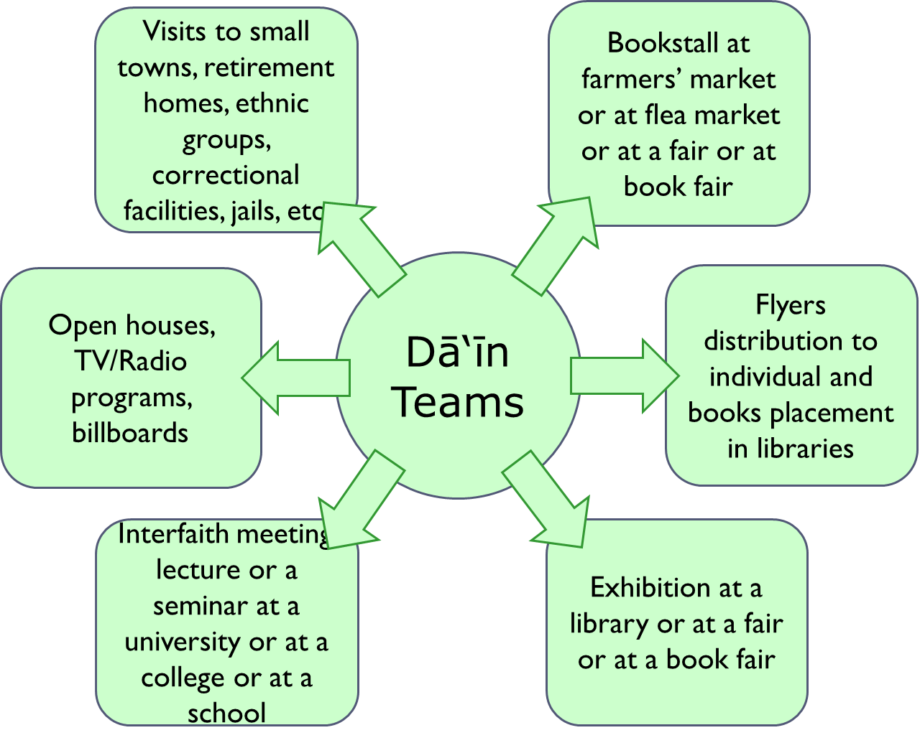
What Do You Need?
Flyers
Books: amibookstore.us
Space
Transportation

Slide 24
Tabligh Harmony
☺
Da’i Ilallah
Muntazim Tabligh
Local Secretary Tabligh
Missionary
*
$
Qa’id Tabligh
Za‘im
President
National Secretary Tabligh
Sadr Ansarullah
Local Ansar Amilah
Local Jama‘at Amilah
Amir

Slide 25
Types of Tabligh
Indirect Tabligh
  television, books in library, newspaper article, radio, Review, Sunrise, posting on internet, CD, DVD, billboard
Im-personal contact
Direct Tabligh
  interfaith, seminar, exhibition, leaflet distribution, bookstall, book fair, open house, bus, trailer, lectures in schools
Personal contact
One-on-One Tabligh
  repeat visits to small towns, retirement homes, ethnic groups, meetings with missionary
Personal inter-action
Partici-pation
  Jum‘ah, Jalsa, events, Salat
Partici-pation

Slide 26
Priorities
Video Programs on Public Access Community Channels
Bookstall at a busy venue
Visits to retirement homes, ethnic groups and
small towns
Bring guests to the mosque, events, missionary
Interfaith group

Slide 27

Ahmadiyya Muslim TV Programs on Local Cable Channels
Free or nominal cost
Pre-recorded DVDs available
Record your own
Drop off new DVDs and pick up old ones
Recycle when you run out

Slide 28


Islam in Focus
_________
QA Session 22 November 1998
Running Time
00:58:30

Slide 29
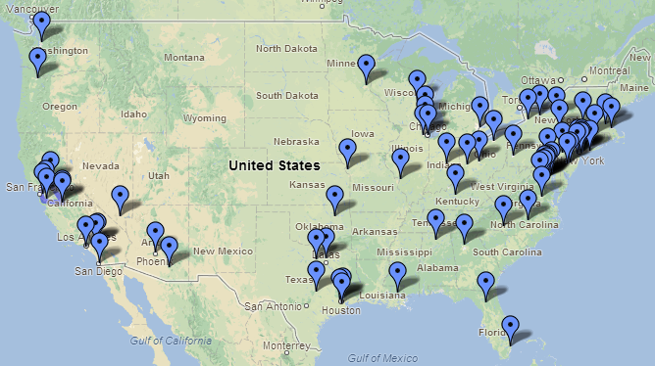
Ansar Majalis

Slide 30
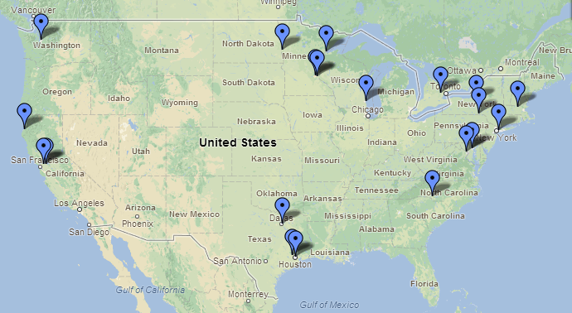
Weekly Ahmadiyya Muslim Programs
On Local Cable Channels
https://maps.google.com/maps/ms?msa=0&msid=207409470923916004785.0004d1a2a610c81e0f037

Slide 31
Ansar Majalis
PACT Majalis

Slide 32
Weekly Ahmadiyya Muslim Programs
On Local Cable Channels
10 States, 20 Cities
 | State | City 1 | City 2 | City 3 | City 4
1 | California | Arcata | Antioch | Concord
2 | Maryland | Baltimore | Potomac
3 | Massachusetts | Fitchburg
4 | Minnesota | Duluth | Mankato | Minneapolis | St Paul
5 | New York | Binghamton | Queens | Syracuse
6 | North Carolina | Charlotte
7 | North Dakota | Fargo
8 | Texas | Cypress | Dallas | Houston
9 | Washington | Seattle
10 | Wisconsin | Milwaukee

Slide 33
Where do Ansar live?
~ 2500 Ansar
2494 to be exact
942 Towns
Currently playing in 20 towns
45 States
Currently covering 10 states

Slide 34
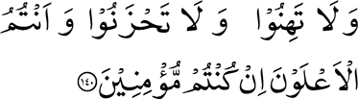
Slacken not, nor grieve; and
you shall certainly have the upper hand, if you are believers.
[3:140]

Slide 35
Majalis Ranking
Goal | Points
Fifty percent of Ansar Tajnid participation in propagation activity during a month. | 20
Nonmember attendance equal to Ansar Tajnid realized by Ansar in Jum‘ah and other events during a month. | 20
Five nonmembers per Ansar Tajnid contacted during the month by Ansar in visits to small towns, retirement homes, ethnic groups, etc. | 20
Ten flyers and books distributed per Nasir according to the number of Ansar in Tajnid. | 20
One Tabligh activity initiated, conducted or managed by local Majlis such as bookstalls, exhibitions, interfaith meetings, TV/Radio programs or seminars | 20

Slide 36



Da’in Cards

Slide 37
Contact Form
Name | Please provide at least one of the items below to receive info |  |  | Would you like to receive Review of Religions free for a year? | Would you like to receive Muslim Sunrise free for a year? | Would you like to be informed of upcoming events? | Would you like to receive link to Friday Sermon?
 | Address | Email | Phone

Slide 38
Online Contact Database
www.ansarusa.org/contact
Username: Zaim
Password: 40&overAdd

Slide 39
Let Us Know of Your Needs
Exhibition Posters
Quran Translations
Flyers
Welcome Center at the Mosque
Contact Form
Budget, Budget, Budget

Slide 40
Review of Religions
468
27 Libraries
20 Gifts

Slide 41
Tabligh Pipeline
Categories of contacts:
  Searching truth with good chance to become an Ahmadi.
  Conciliatory but wants to make sure and may get inclined towards Ahmadiyyat.
  Indifferent and will take a good effort to get him involved.
  Antagonistic and - even if defeated in argument - will take a lot to change.
Level of knowledge: (This is independent of category of contact or what stage he is in acceptance)
  Rudimentary or little (ilm-ul-yaqin).
  Some knowledge (‘ain-ul-yaqin).
  Well-read (haqq-ul-yaqin).
Stages of journey towards acceptance:
  Introduced (contacted only once or got some info only once or a couple of times).
  Interested (contacted more than a couple of times).
  Engaged (reading himself, listening, asking questions, resolving doubts and ambiguities, coming to events to listen)
  Participating (coming to mosque for Friday services or Prayer services, spending time with Ahmadis)

Slide 42
What Your Majlis Can Do?
A. Nonmember meeting with missionary
B. Visits to small towns, retirement homes, ethnic groups, correctional facilities, jails, etc.
C. Bookstall at farmers’ market or at flea market or at a fair or at book fair
D. Interfaith meeting, lecture or a seminar at a university or at a college or at a school
E. Exhibition at a library or at a fair or at a book fair
F. Flyers distribution to individual and books placement in libraries
G. Open houses, TV/Radio programs, billboards

Slide 43
Types of Interaction
Introduction (little or no interaction, anonymous, impersonal):
  alislam web site, Review of Religions, Muslim Sunrise, newspaper article, posting on internet, radio, television, books in library, CD, DVD, billboard

Slide 44
Types of Interaction
Introduction (little or no interaction, anonymous, impersonal):
  alislam web site, Review of Religions, Muslim Sunrise, newspaper article, posting on internet, radio, television, books in library, CD, DVD, billboard
Interaction (personal contact):
  interfaith meeting, seminar, exhibition, leaflet distribution, bookstall, book fair, open house, bus, trailer, lectures in schools, radio talk show

Slide 45
Types of Interaction
Introduction (little or no interaction, anonymous, impersonal):
  alislam web site, Review of Religions, Muslim Sunrise, newspaper article, posting on internet, radio, television, books in library, CD, DVD, billboard
Interaction (personal contact):
  interfaith meeting, seminar, exhibition, leaflet distribution, bookstall, book fair, open house, bus, trailer, lectures in schools, radio talk show
Engagement (interpersonal contact, interpersonal dialog):
  repeat visits to small towns, repeat retirement homes visits, repeat contacts with ethnic groups, meetings with missionary

Slide 46
Types of Interaction
Introduction (little or no interaction, anonymous, impersonal):
  alislam web site, Review of Religions, Muslim Sunrise, newspaper article, posting on internet, radio, television, books in library, CD, DVD, billboard
Interaction (personal contact):
  interfaith meeting, seminar, exhibition, leaflet distribution, bookstall, book fair, open house, bus, trailer, lectures in schools, radio talk show
Engagement (interpersonal contact, interpersonal dialog):
  repeat visits to small towns, repeat retirement homes visits, repeat contacts with ethnic groups, meetings with missionary
Participation (voluntary):
  Jum‘ah, Jalsa, events, Salat

Slide 47
Types of Interaction
Introduction (little or no interaction, anonymous, impersonal):
  alislam web site, Review of Religions, Muslim Sunrise, newspaper article, posting on internet, radio, television, books in library, CD, DVD, billboard
Interaction (personal contact):
  interfaith meeting, seminar, exhibition, leaflet distribution, bookstall, book fair, open house, bus, trailer, lectures in schools, radio talk show
Engagement (interpersonal contact, interpersonal dialog):
  repeat visits to small towns, repeat retirement homes visits, repeat contacts with ethnic groups, meetings with missionary
Participation (voluntary):
  Jum‘ah, Jalsa, events, Salat
Acceptance:
  Bai‘at (initiation)

Slide 48
Levels of Contact
Introduction (little or no interaction, anonymous, impersonal):
  alislam web site, Review of Religions, Muslim Sunrise, newspaper article, posting on internet, radio, television, books in library, CD, DVD, billboard
Interaction (personal contact):
  interfaith meeting, seminar, exhibition, leaflet distribution, bookstall, book fair, open house, bus, trailer, lectures in schools, radio talk show
Engagement (interpersonal contact, interpersonal dialog):
  repeat visits to small towns, repeat retirement homes visits, repeat contacts with ethnic groups, meetings with missionary
Participation (voluntary):
  Jum‘ah, Jalsa, events, Salat
Acceptance:
  Bai‘at (initiation)
Impersonal contact
Personal contact
Personal interaction
Participation

Slide 49
Tasks for Each Level
Impersonal contact
  Review of Religions, Muslim Sunrise, newspaper article, posting on internet, radio, television, books in library, CD, DVD, billboard
Personal contact
  interfaith meeting, seminar, exhibition, leaflet distribution, bookstall, book fair, open house, bus, trailer, lectures in schools
Personal interaction
  repeat visits to small towns, retirement homes, ethnic groups, meetings with missionary
Participation
  Invite to Jum‘ah, Jalsa, events, Salat

Slide 50
Tasks for Each Level
Impersonal contact
  Review, Sunrise, newspaper article, posting on internet, radio, television, books in library, CD, DVD, billboard
Indirect Tabligh
Personal contact
  interfaith, seminar, exhibition, leaflet distribution, bookstall, book fair, open house, bus, trailer, lectures in schools
Direct Tabligh
Personal interaction
  repeat visits to small towns, retirement homes, ethnic groups, meetings with missionary
One-on-One Tabligh
Participation
  Invite to Jum‘ah, Jalsa, events, Salat
Participation

Slide 51
What can we do?
Indirect Tabligh
  television, books in library, newspaper article, radio, Review, Sunrise, posting on internet, CD, DVD, billboard
Impersonal contact
Direct Tabligh
  interfaith, seminar, exhibition, leaflet distribution, bookstall, book fair, open house, bus, trailer, lectures in schools
Personal contact
One-on-One Tabligh
  repeat visits to small towns, retirement homes, ethnic groups, meetings with missionary
Personal interaction
Participation
  Invite to Jum‘ah, Jalsa, events, Salat
Participation

Slide 52
Qa’ids Goals
Expand PACT
Stalls in every Majlis
Visits to small towns
Introducing Islam by groups (teachers, clergy, etc.)
Personalities
Visits to regions and Majalis (Abu Bakr Ladd or ?)
Letters to Editors: Remind writers. Provide ideas.
Review subscriptions
Books in Libraries
Message to churches

Slide 53
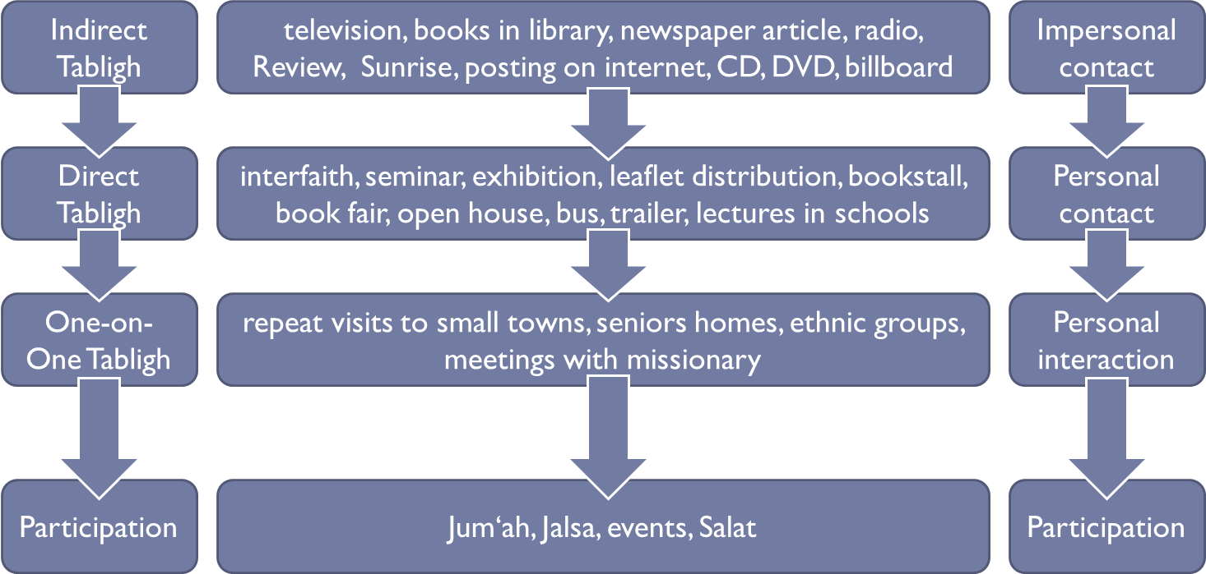
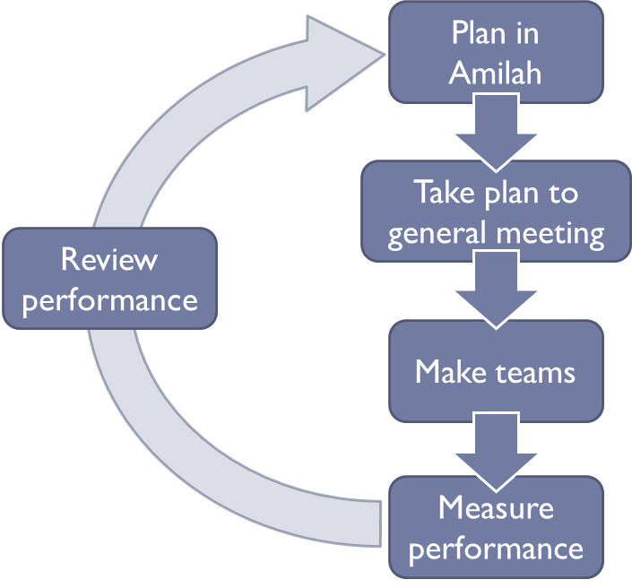
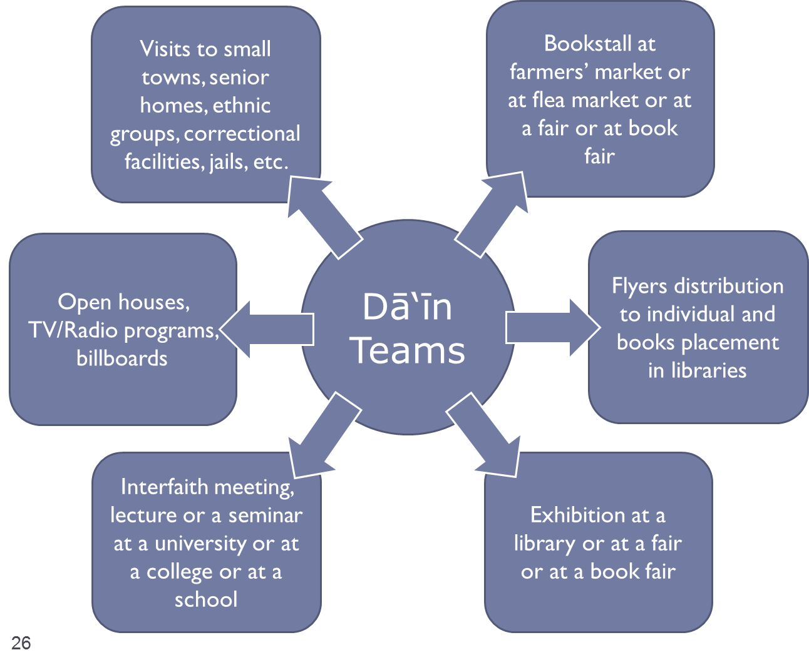
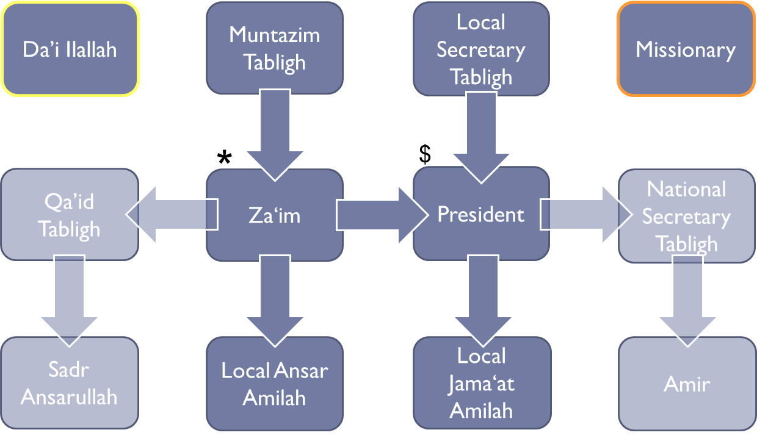
qaid.tabligh@ansarusa.org
701 200 1674

Slide 54
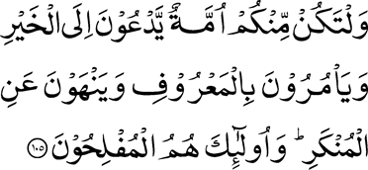
And let there be among you a body of men who should invite to goodness, and enjoin equity and forbid evil. And it is they who shall prosper. [3:105]

Slide 55
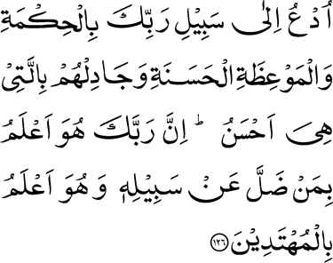
Call unto the way of thy Lord with wisdom and goodly exhortation, and argue with them in a way that is best. Surely, thy Lord knows best who has strayed from His way; and He knows those who are rightly guided. [16:126]

Slide 56
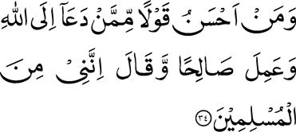
And who is better in speech than he who invites men to Allah and does good works and says, ‘I am surely of those who submit?’ [41:34]

Slide 57
Tabligh 2013
Qa‘id Tabligh:
Syed Sajid Ahmad
Na’ib Qa’id:
Chaudhry Mushtaq Ahmad

Slide 58

Da‘in Teams
Assign tasks according to personal interest
Activate retired members

Slide 59
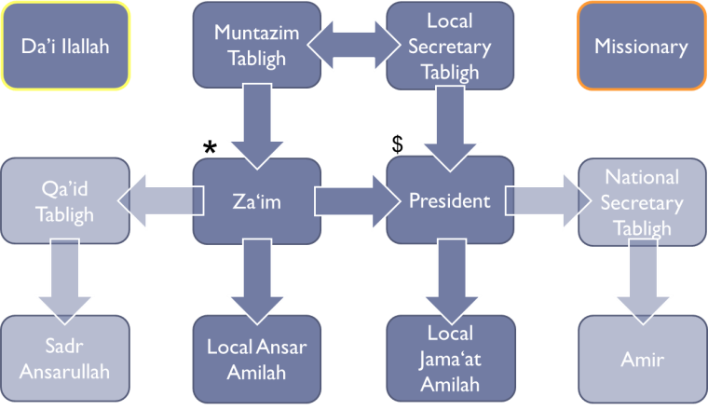
We will provide support
In Sha Allah
Literature:
  Leaflets, books, CDs, DVDs, subscriptions to the Review of Religions and the Muslim Sunrise
Propagation tools:
  Bookmarks, rulers
Appropriate and reasonable rental fees for bookstalls and booths
Please convey to us your needs and we will consider them, In Sha Allah, as long as they are reasonable and practical

Slide 60
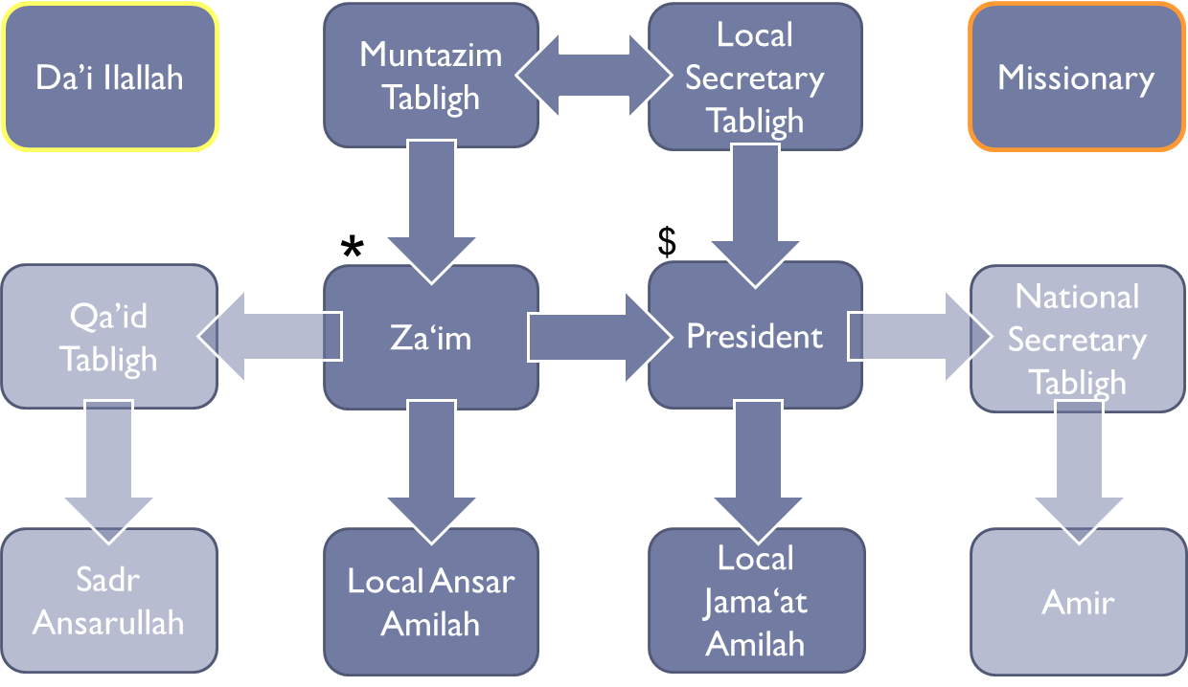
How To Guidelines and Help
Consult the Ansar Handbook
How to Use Mosques and Centers for Tablīgh
Public Access Cable TV (PACT) Tablīgh Project
Literature to Give
Contact Qa’id Tabligh

Slide 61
Tools to Monitor
Level of Activities and
Level of Progress
Tablīgh Activities Tracking Sheet
Event Sign-in Sheet

Slide 62
Where do Ansar live?
~ 2500 Ansar
2494 to be exact

Slide 63
Where do Ansar live?
~ 2500 Ansar
2494 to be exact
942 Towns
Currently playing in 20 towns

Slide 64
Types of Tabligh
Indirect Tabligh
  television, books in library, newspaper article, radio, Review, Sunrise, posting on internet, CD, DVD, billboard
Impersonal contact
Direct Tabligh
  interfaith, seminar, exhibition, leaflet distribution, bookstall, book fair, open house, bus, trailer, lectures in schools
Personal contact
One-on-One Tabligh
  repeat visits to small towns, retirement homes, ethnic groups, meetings with missionary
Personal interaction
Participation
  Jum‘ah, Jalsa, events, Salat
Participation

Slide 65
Types of Tabligh
Indirect Tabligh
  television, books in library, newspaper article, radio, Review, Sunrise, posting on internet, CD, DVD, billboard
Impersonal contact
Direct Tabligh
  interfaith, seminar, exhibition, leaflet distribution, bookstall, book fair, open house, bus, trailer, lectures in schools
Personal contact
One-on-One Tabligh
  repeat visits to small towns, retirement homes, ethnic groups, meetings with missionary
Personal interaction
Participation
  Jum‘ah, Jalsa, events, Salat
Participation

Slide 66
Types of Tabligh
Indirect Tabligh
  television, books in library, newspaper article, radio, Review, Sunrise, posting on internet, CD, DVD, billboard
Impersonal contact
Direct Tabligh
  interfaith, seminar, exhibition, leaflet distribution, bookstall, book fair, open house, bus, trailer, lectures in schools
Personal contact
One-on-One Tabligh
  repeat visits to small towns, retirement homes, ethnic groups, meetings with missionary
Personal interaction
Participation
  Jum‘ah, Jalsa, events, Salat
Participation

Slide 67
Types of Tabligh
Indirect Tabligh
  television, books in library, newspaper article, radio, Review, Sunrise, posting on internet, CD, DVD, billboard
Impersonal contact
Direct Tabligh
  interfaith, seminar, exhibition, leaflet distribution, bookstall, book fair, open house, bus, trailer, lectures in schools
Personal contact
One-on-One Tabligh
  repeat visits to small towns, retirement homes, ethnic groups, meetings with missionary
Personal interaction
Participation
  Jum‘ah, Jalsa, events, Salat
Participation

Slide 68
Types of Tabligh
Indirect Tabligh
  television, books in library, newspaper article, radio, Review, Sunrise, posting on internet, CD, DVD, billboard
Impersonal contact
Direct Tabligh
  bookstall, interfaith, seminar, exhibition, leaflet distribution, book fair, open house, bus, trailer, lectures in schools
Personal contact
One-on-One Tabligh
  repeat visits to small towns, retirement homes, ethnic groups, meetings with missionary
Personal interaction
Participation
  Jum‘ah, Jalsa, events, Salat
Participation

