Slide 1
Majlis Ansārullāh USA
ALC-2013
SYED FAZAL AHMED
Qaid Ta'līmul Qur'ān

Slide 2
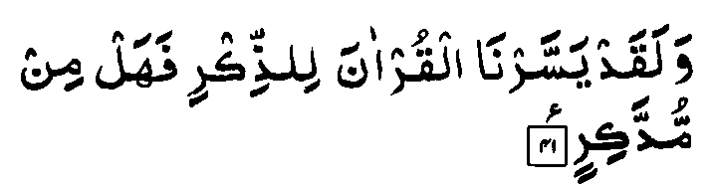
AL QURAN
And, indeed, We have made the Qur'an
easy to remember.
But is there anyone who will take heed?
(54: 41)

Slide 3

The best among you is the one who learns the Holy Qur'an and teaches it to others (Buhkari)
HADITH

Slide 4
The Promised Messiah writes:
A Persian poem translated
With the Divine word, the dawn of truth has broken;
The eye that has not seen those holy scriptures has seen nothing.
The eye which does not partake of the light of the Furqan;
I declare in the name of God, that it will never be redeemed of its blindness.
Unfortunate and benighted are the people;
Who turn their backs upon this light because of their self-conceit.
[Brahin-e-Ahmadiyya, Ruhani Khaza’in Vol. 1, p. 335]

Slide 5
THE HOLY QUR`AN SYLLABUS: 2013
January-June: Ch 24, Āl Nur Verses: 36-41
July-December : Ch 24, Āl Nur Verses: 52-58

Slide 6
MONTHLY REPORTING QUESTIONS
How many Ansar Learnt to Recite with correct pronunciation?
How many Ansar Learnt the translation and Commentary ?
How many Ansar Memorized the verses?
How many Ansar Registered in Waqf ‘Ārdi?
Did your Majlis Organized Quran Exhibition ?

Slide 7
ANNUAL TARGET
Waqf ‘Ārdi
Quran Exhibition
Small Majlis =1
Medium Majlis =2
Large Majlis =3

Slide 8
AVAILABLE RESOURCES
Ansar Hand book has the syllabus portion
Monthly Ansar news letter also contains the verses in syllabus of the month
Web sites:
www.ansarusa.org
www.alislam.org
www.alfurqan.us

Slide 9
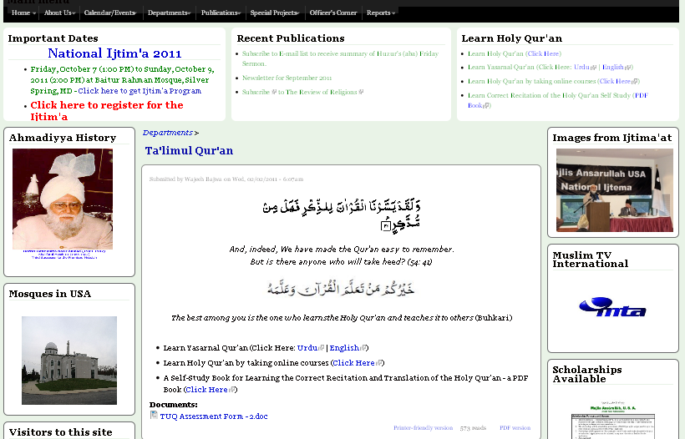
Visit Ansar web: www.ansarusa.org

Slide 10
At-Tarteel (الترتیل) course for members of Majlis Ansarullah, USA by Alfurqan
Class Name: AR09 At-Tarteel (Holy Qur'an Recitation with basic Tajweed rules)
Teacher: Respected Hafiz Burhan Muhammad Khan Sahib (Professor, Jamia Ahmadiyya)
Start Date: January 21, 2013
Time Commitment: Mon - Wed at 7:00 pm EST
For registration go through this step by step User's guide Class_Join_in_Guide_for_Students.pdf OR
Call us on (732) 734 4879

Slide 11
SPECIAL PROJECTS -2013
TELEPHONE CLASS FOR HOLY QUR`AN LEARNING
CLASS FOR NEW CONVERTS
TEACHER CERTIFICATION ONLINE CLASS FOR CORRECT TARTEEL & TAJWEED
REQUEST:URGE MEMBERS TO ENROLL

Slide 12
Our ultimate responsibilities towards the Holy Qur`an
Motivating ourselves to learn the reading of the Holy Qur’ān with correct pronunciation and teach it to others.
Teaching and helping others to recite the Holy Qur’ān
Inculcating love of the Holy Qur’ān by understanding it.
Leading by example -by practicing what we preach.
Exhorting our children for all the above
MAY ALLAH ENABLE ALL OF US TO FULFILL OUR RESPONSIBILITIES
JAZAKUMULLAH WA AHSANULJAZA

Slide 13
Q & A

