Slide 1
Tāblīgh Team:
Muzaffar Siddiqi Qā'id Tāblīgh
Moyenuddin Sirajee – Naib Qā'id
Imran Malik – Naib Qā'id

Slide 2
Focal point of 2015 plan:
To implement following approved 2014 Shura Proposal for Tabligh.
  “Hazard Khalifatul Masih's book, "World Crisis - Pathway to Peace" is not only an essential reading for policy makers but also an excellent way to introduce Jamaat to non-Muslim audiences. Majlis Ansārullāh should identify and implement novel - yet achievable - ways to distribute this book to members of government, academia, media and other organizations in the USA. “
Support and Supplement Jamat Tabligh plans at Majlis level.

Slide 3

Shura Subcommittee Recommendations:
Every member of Majlis should read the book himself first to familiarize with its contents to be able to explain to others.
Majlis Ansarullah USA should distribute at least 5000 copies of Huzoor’s above mentioned book during the year 2015 .
First Check with your local Jamat President/Sec Tabligh that to whom Jamat has already sent this book under Jamat program to avoid duplicate efforts
In you Majlis Geographical area…. Find Name and Mailing addresses of.
  County ,City officials. Media especially talk show hosts
  Judicial Judges.
  Universities, colleges or any educational institution.
  Faith based organizations and Neighbors.

Slide 4
SMART goals (Specific, Measurable, Achievable, Result oriented, Timely)
National Goal:
2500 copies of Book “World Crisis - Pathway to Peace”, will be distributed to government officials, academia, press and libraries. 50% of it by first due data and remaining 50% by second due date. | May,.30, 2015 Nov, 30,.2015 | Books will be supplied by National office.
Local Goals | Due Date | Resource(s) | Points
One book “World Crisis - Pathway to Peace” ) per member in local tajneed will be distribute to local Members of government, academia, media, neighbors and other organizations or on Tabligh fairs/stalls. Example: A Majlis with tajneed of 90 members will distribute total 90 books. 50% (45) before first due data and remaining 50% (45) before second due date. | May,.30, 2015 Nov, 30,.2015 | Books will be supplied to Majalis by National office. Members can read soft copy at http://www.alislam.org/library/books/World-Crisis-and-Pathway-to-Peace.pdf | 40 40
Participate in local Jamat Tabligh activities and report number of members, hours spent and brief detail of each activity. | Every month | Contact Local Jamat Secretary Tabligh for their event calendar and coordinate. | 20

Slide 5
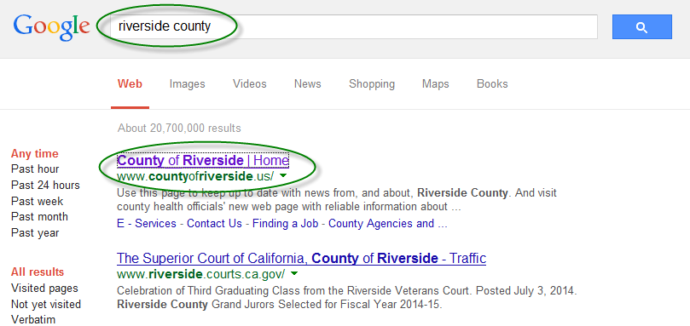
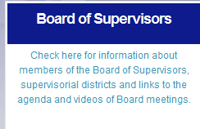


How to find County officials in your area?

Slide 6
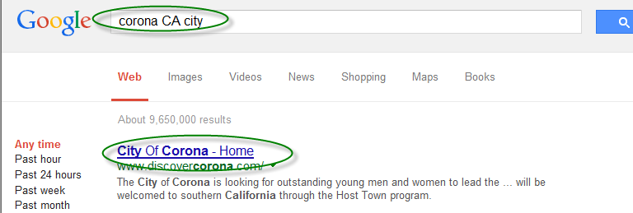
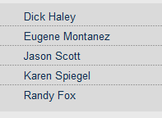

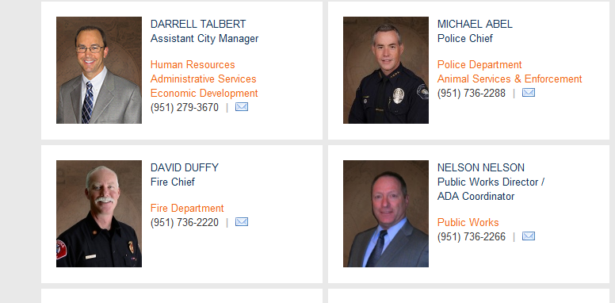
How to find City officials in your area?

Slide 7
How to proceed?
  Make a Group of 2-3 Ansar. Try to set up appointment and introduce yourself and our community. Present the book as gift with a proper cover letter addressed to the recipient with your signature and contact information.
  Send a copy through US mail with proper cover letter containing your contact information.
Sample Covering Letter and Label.
Councilman Dick Haley
City of Corona
400 S. Vicentia Ave.
Corona, CA 92882-2785

Slide 8
Recording and reporting.
  Zaim or Muntazim Tabligh should keep a spread sheet as record, with them containing names and contact information of recipients of these books.
  Zaim has to report number of books distributed in online monthly report for that specific month for progress evaluation.

